Slide 1
Current Events
Buffett Investing Advice

Slide 3
Chapter 10
The Cost of Capital

Slide 4
Cost of Capital
The firm’s cost of financing (use of investor funds)
The average return required by firm’s investors
What must be paid to attract funds
The base rate of return that a project must earn to increase firm value
WACC [Weighted Average Cost of Capital]
Weighted average cost of types of financing
Weights are capital structure percentages
Capital Structure
Most firms attempt to maintain an optimal mix of debt and equity financing – target capital structure

Slide 5
Table 10.1: The Balance Sheet

Slide 6
WACC – Capital components
Types of capital used by firms to raise money:
r_{d}= interest rate on new debt (before tax cost of debt)
r_{d(1-T)} = after tax cost of debt
r_{ps} = cost of preferred stock
r_{s} = cost of existing common stock
r_{e} = cost of issuing new stock
w_{d}, w_{ps}, w_{c} = target weights of debt, preferred stock, and common equity
WACC = weighted average (overall) cost of capital

Slide 7
Estimating the Cost of Debt
Current cost of debt for a publicly traded bond = yield to maturity
Account for float (issue) costs
Current cost of long-term bank or other private debt
Call the banker and ask what rate the bank would charge if they decided to refinance the debt today
Cost of debt is the weighted average cost of all debt combined
Consider bonds outstanding and all loans outstanding at market value
Cost of NEW borrowing!

Slide 8
Calculating Pre-Tax Cost of Bonds
Scenario:
Company wants to issue $1000 par value, 9% coupon, 20 year bonds with semi-annual interest payments
Similar risk bonds are being issued at > 9% coupon rates so the company has to sell bonds for $980 each
In addition, they must pay issuance costs of $30 each
Net proceeds to the company: $950 each
Calculate the pre-tax cost of debt (YTM)
What is the annual YTM?

Slide 9
After-tax Cost of Bonds
Interest payments are tax deductible
Interest expense reduces the firm’s taxable income
Smaller tax liability
After-tax cost of debt
r_{d} = pre-tax cost of debt
T is the firm’s tax rate
r_{d(1-T)}
If the firm’s tax rate is 40% and the pre-tax cost of debt is 9.57%, what is the after-tax cost?
This makes debt the cheapest form of financing!

Slide 10
Cost of Preferred Stock
Rate of return investors require on the firm’s preferred stock
r_{p} = D_{p}/P_{p}
D_{p} = Constant (fixed) dividend
P_{p} = per share net proceeds firm receives from the issue or sale; net of issue costs

Slide 11
Calculating Cost of Preferred Stock
Student Investment Co. wants to issue a preferred stock with the following features:
$77 par value (which is what it will sell for)
10% dividend ($7.70/share)
Issue (flotation) costs/share = $3
What are the net proceeds per share?
What is their cost of Preferred Stock?
r_{p} = D_{p}/P_{p}

Slide 12
The Cost of Common Equity
Return required from common equity investors
Based on market values of common stock
Method 1: Using the Capital Asset Pricing Model (CAPM)
Method 2: Using a Bond Yield Plus Risk Premium approach
Method 3: Using the Constant-Growth Dividend Model (DCF)
The most appropriate depends on what information is available and how reliable the analyst believes it is.

Slide 13
The CAPM Approach
r_{s} = r_{RF} + (Market risk premium × β)
r_{s} = cost of common equity
r_{RF} = risk-free rate of return
β = beta coefficient for common stock

Slide 14
Bond Yield Plus Risk Premium
Subjective approach when no good info exists to calculate CAPM
General rule:
Risk premium above r_{d} for company’s stock ranges from 3-5%
Add judgmental risk premium of 3-5% to interest rate on long-term debt
r_{s} = Bond yield + Company Risk Premium

Slide 15
The Discounted Cash Flow Approach (Expected Rate of Return)
r_{s} = (D₁/P₀) + g
r_{s} = cost of common stock P₀ = current stock price
g = expected constant growth rate
D₁ = next period’s expected dividend

Slide 16
Calculate the cost of existing common stock
Constant Growth
Dividend in year 1 = $3.50
Current market price = $33.63
Dividends are growing at 2%/yr
What is the cost of common stock?
Bond Yield Plus Risk Premium - what is cost of common stock?
Capital Asset Pricing Model (CAPM)
Current risk-free rate is 2%
Annual market return is 8%
Company’s beta is 1.8
What is the cost of common stock?
r_{s} = (D₁/P₀) + g
r_{s} = r_{RF} + (Market risk premium × β)

Slide 17
Costs of New Common Stock Issues
Calculated the same as existing common stock
Difference is in the market price
Price will be lower due to flotation costs
May have to underprice shares to sell
Cost is higher than existing common stock
Usually the most expensive type of financing for the company!
Last choice for financing

Slide 18
Capital Structure and WACC
Optimal Capital Structure
% of debt, preferred stock, and common equity in the capital structure to maximize stock price
Minimizes WACC
WACC
A weighted average of the component costs of debt, preferred stock, and common equity
Based on market values for each type of capital
Why use a weighted average?
The use of debt impacts the ability to use equity, and vice versa
The weighted average cost must be used to evaluate projects
Regardless of the specific financing used to fund a particular project.
Required return on investor provided capital

Slide 19
Weighted Average Cost of Capital, WACC
WACC = w_{d}r_{d}(1-T) + w_{p}r_{p} + w_{c}r_{s}
w_{d} = proportion of debt in firm’s capital structure
w_{p} = proportion of preferred stock in firm’s capital structure
w_{c} = proportion of common stock in firm’s capital structure

Slide 20
Calculating WACC
Two important points should be noted in the WACC calculation:
Best to convert the weights into decimal form and leave the individual costs in percentage terms.
The weights must be non-negative and sum to 1.0.

Slide 21
Calculating WACC
We found the costs of the types of capital for Student Investment Co. to be as follows:
Cost of debt, r_{d(1-T)}= 5.74%
Cost of preferred stock, r_{ps} = 10.41%
Cost of existing common stock, r_{s} = 12.59%
The company has the following market values for capital. Use these to determine the weights used in calculating its WACC
Long-term debt (amount owed) = $399,923
Preferred stock (based on market price)= 1,300 shares outstanding at $77/share
Common stock equity (market price) = 14,868 shares outstanding at $33.63/share
Calculate the WACC based on the above information
What is the WACC used for?
WACC = w_{d}r_{d}(1-T) + w_{ps}r_{ps} + w_{c}r_{s}

Slide 22
Factors That Affect WACC
Non-controllable factors:
Interest rates
General level of stock prices (markets)
Tax rates
Controllable factors:
Capital structure
Dividend payout ratio
Capital budgeting decision rules

Slide 23
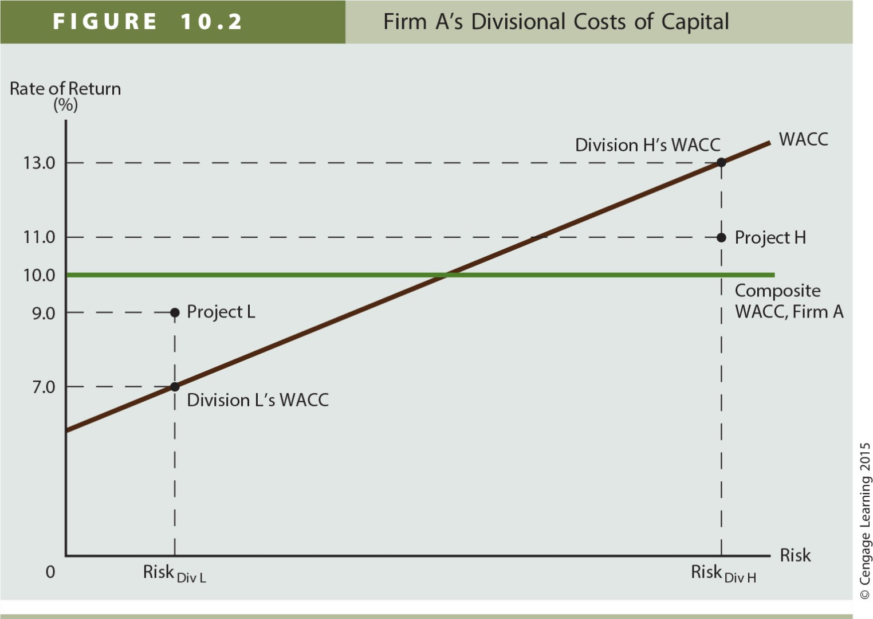
Adjusting the WACC for Project Risk

Slide 24
Assignment
Chapter 10 MindTap Homework
Due Friday, November 9th by 11:59 pm
Read Chapter 11 for Thursday

