Slide 1
Current Events
What’s left?
One chapter with homework, WSJ Retirement planning and assignment, exam review assignment, final exam

Slide 3
cash flow estimation and risk analysis
Chapter 12

Slide 4
Relevant cash flows
Ignore sunk costs
What are they?
Examples?
Include opportunity costs
What are they?
Examples?
Externalities (inside and outside company)
Incremental free cash flows
[EBIT*(1-T) + Depr] – [Investment in fixed assets and NOWC]
Initial investment (fixed assets and NOWC)
Terminal Value (sales of fixed assets and recovery of NOWC)

Slide 5
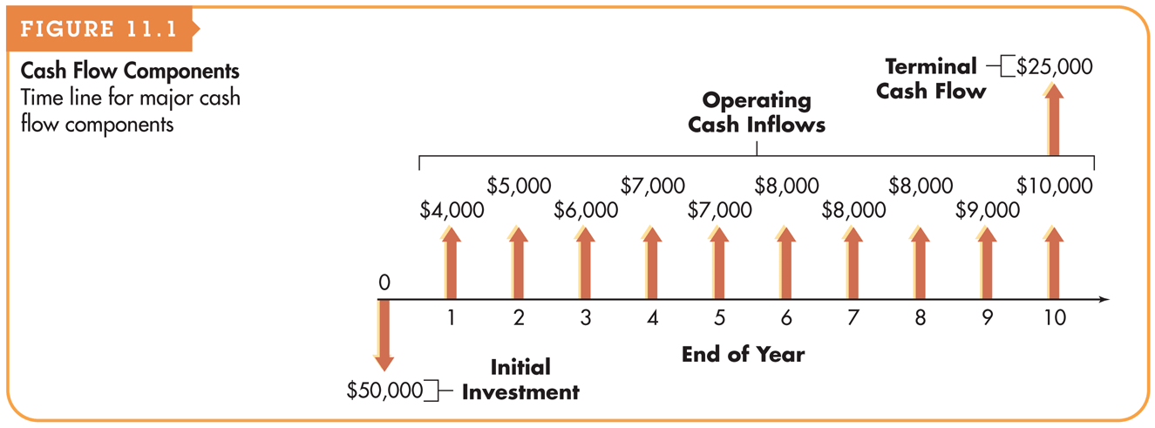
Cash Flow Components

Slide 6
Initial investment
Cost of new equipment, including installation
After-tax salvage value of old equipment (for replacement projects)
Changes in Net Operating Working Capital
Operating Current Assets – Operating Current Liabilities
Most of these increase
Need more cash to support operations
Increased A/R and Inventory to support increased sales
Increased A/P and Accruals to meet expanded product demand
Increases in NOWC are considered an outflow
Increases in assets are outflows
Increases in liabilities are inflows

Slide 7
After-tax operating cash flows
Projected after-tax operating cash flows
Determine revenues and expenses (including depreciation expense)
Find operating income
Find after-tax operating income
Add back depreciation, why?
Only consider incremental cash flows
Difference between cash flows with new project and without
Replacement project: consider what cash flows could have been without replacing the asset (opportunity cost)

Slide 8
Terminal cash flows
After-tax proceeds from the sale of the new asset
After-tax proceeds from sale of the old asset (for replacement projects)
Considered an opportunity cost
Shows the incremental cash flows from sale of assets
Deduct from proceeds of new asset
Change in Net Operating Working Capital
Typically recover NOWC at the end of a project
Sell inventories
A/R is collected and A/P gets paid
Ultimately ends in a decrease in NOWC
Considered an inflow
Add to proceeds of new asset

Slide 9
Capital budgeting cash flow example
Current machine was purchased 2 yrs ago for $40,000
Depreciated using MACRS – 5 year recovery period
Can be sold now for $42,000 (after clean-up & removal costs)
No market value after another 3 yrs of use
New machine can be purchased costing $140,000
3 year MACRS recovery period
Requires 10,000 to install
Can be sold for $35,000 (before taxes) at the end of three years
NWC will increase
A/R will increase by $10,000
Inventory will increase by $25,000
A/P will increase by $15,000
Pre-tax cash flows for 3 year project (not including depreciation)
Old machine: $70,000 per year
New machine: $120,000 1st year, $130,000 2nd and 3rd years
Firm has a 40% tax rate
WACC = 10.2%

Slide 10
MACRS Depreciation Schedules

Slide 11
Measuring Stand-alone risk in capital budgeting projects
Risk is the uncertainly of projected cash flows
Greater variability in cash flows = greater risk
Sensitivity Analysis – how sensitive is NPV to changes in inputs?
Scenario Analysis
Consider the probability of different cash flows from the project
Evaluate their NPV and their range of NPV’s
Monte Carlo Simulation
Use statistical modeling to develop a probability of NPV’s for the project
Can view a continuum of risk-return tradeoffs instead of a single project estimate

Slide 12
Additional important considerations for capital projects
Project vs. Firm risk
May accept a risky project if it’s negatively correlated with risk of other firm projects
Real Options
Methods to alter cash flows after investment made
Post Audit
Important feedback for improvement

Slide 13
Assignment
Chapter 12 MindTap homework due Sunday, November 18th on BbLearn at 11:59 pm
Read WSJ Guide for Tuesday, November 27th
Retirement: What is a 401(k)?, How to make the most of your 401(k) plan
Saving for College: How to start a 529 college savings plan

