Slide 1
One of the funny things about the stock market is that every time one person buys, another sells, and both think they are astute.
~William Feather

Slide 2
Multinational financial management
Chapter 17

Slide 3
International monetary system
Late 1800’s to early 1900’s
Tied to gold standard
Other less formal exchanges from WWI to WW2
1944-1971 Bretton Woods System
Tied to U.S. $ or gold (1 oz. equal to $35)
Most currencies pegged or fixed to these
What is the price of gold today?
Currently
Managed floating exchange rate
Currencies allowed to float against each other
Price depends on supply and demand for each currency in world markets
Some countries manipulate currencies for political or economic purposes

Slide 4
Balance of Payments
Record of all money transactions between a country and the rest of the world during a period of time
Current account
Merchandise trade deficit or surplus
Imports and exports
Most publicized

Slide 5
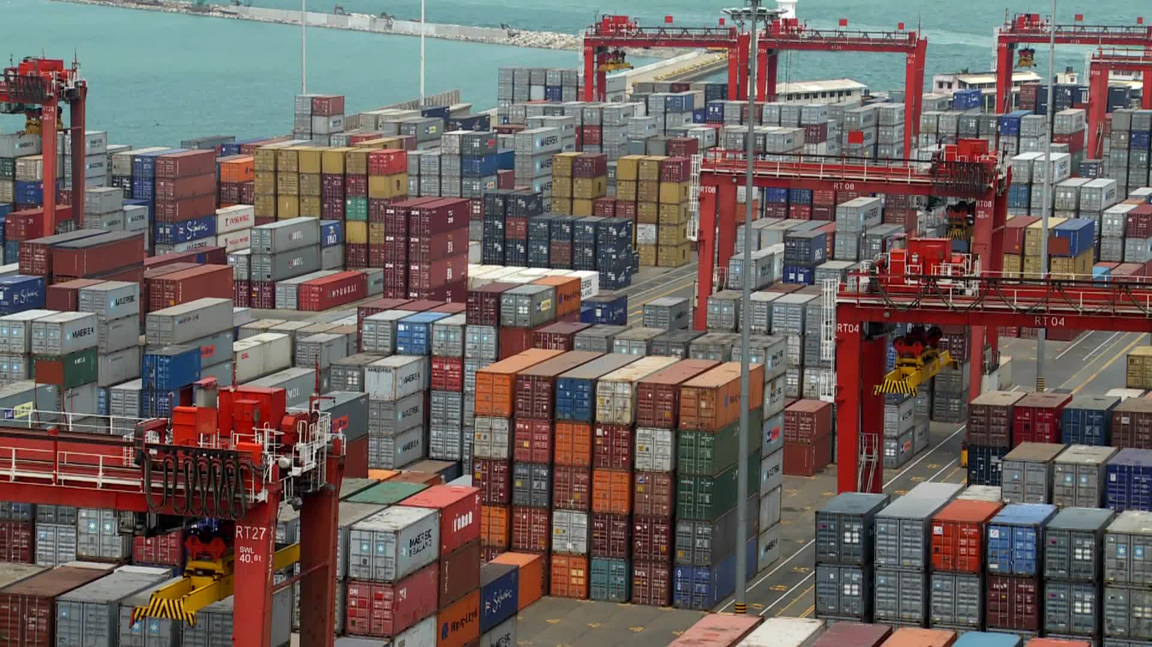
Current events
Is the trade deficit a problem??
NAFTA explained

Slide 6
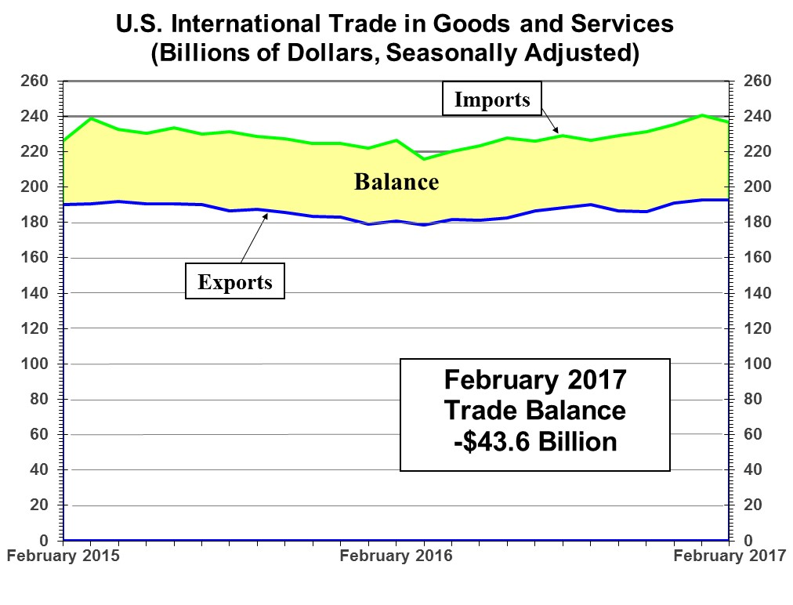
Balance of Trade
February 2015
TRADE BALANCE
-$36.0 Billion
(census.gov)

Slide 7
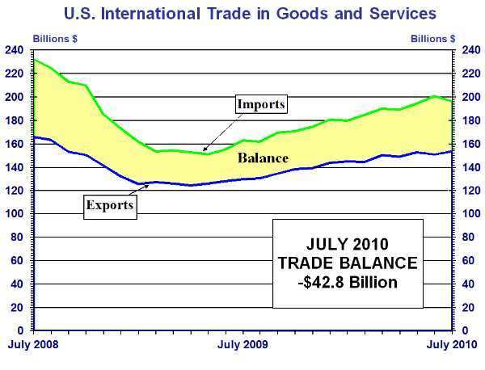
Historical balance of trade

Slide 8
What is a multinational corporation?
A corporation that operates in two or more countries.
Decision making within the corporation
may be centralized in the home country
may be decentralized across the countries in which the corporation does business.

Slide 9
Why do firms expand into other countries?
To seek production efficiency.
To avoid political and regulatory hurdles.
To seek new markets.
Coca-Cola: almost 60% of 2012 net sales were from business outside the U.S.!
To seek raw materials and new technology.
To protect processes and products.
To diversify.
To retain customers.

Slide 10
Risk in International Trade
Exchange Rate Risk
Changes in currency values between the time of purchase and payment
Example: Auto importer in Brazil wants to import Toyotas from Japan. Deal signed on March 1, but payment due on June 1. During this three months the Brazilian real loses 10% value against all other currencies. All other currencies maintain their value. Who wins or loses in the following payment situations?
The Brazilian importer must pay in Japanese yen
The Brazilian importer must pay in Brazilian real
The Brazilian importer must pay in a third currency

Slide 11
Orange Juice Project: Setting the Appropriate Price
A firm can produce a liter of orange juice and ship it to Japan for $1.75 per liter. If the firm wants a 50% markup on the project, what should the juice sell for in Japan?
Markup price = ($1.75)(1.50)= $2.625
Price in Japan = $2.625(111.11 ¥/$)
= 291.66 ¥

Slide 12
Risk in International Trade
Political/Country Risk
Changes in tax laws
Restrictive laws related to labor, wages and prices
Require local citizens to head firm or partner with local firm
Tariffs and quotas on imports
Limits on payments to parent company
Complete Nationalization of physical assets
Require a higher rate of return for this

Slide 13
Foreign Currencies
Each country can have their own currency
EU and Euro ratified in 2002
28 member countries
Not all countries use the Euro
European Central Bank
Monetary Policy for the EU
Some countries have transferred sovereignty (or lawmaking authority) to EU

Slide 14
Currency Quotations
Spot Rate
Cost to purchase a currency right now (market rate)
Direct Quote
The price in $ for one unit of a foreign currency (US $ Equivalent)
Indirect Quote
The amount of foreign currency for $1 U.S. (Currency per US$)

Slide 15
Currency Quotations (cont’d)
Forward Rate
Price of currency in the future
Contract for future purchase or sale of currency
You agree to buy or sell for this price in the future
Why might you want to buy British pounds in three months? Give an example.
Think about exchange rate risk
Cross Rates
Exchange rate between two foreign currencies
Useful to calculate when the only rates you have are quoted in terms of the local currency (i.e. US$).

Slide 16
Currency Valuation
Devaluation - depreciation of one currency relative to another currency
Canadian $ relative to US $
Revaluation - appreciation of one currency relative to another currency
US $ has revalued in the last several years relative to most major currencies
Can a currency devalue and revalue simultaneously?

Slide 17
Exchange Rates
Exchange rate
Value of one currency in terms of (relative to) another
How many U.S. $ would it take to buy a burger at McDonald’s in Germany that costs €2.25?
Country | US$ Equivalent | Currency per U.S. Dollar
Euro (€) | $1.23045 | €0.81271

Slide 18
Exchange Rates
Exchange Rates for $1 U.S. (indirect)
Chinese Yuan Renminbi (CNY) | 6.2771
Canadian Dollar (CAD) | 1.2936
Euro (EUR) | 0.81271
Mexican Peso (MXN) | 18.3299
Rates as of 04/2/2018
www.exchange-rates.org

Slide 19
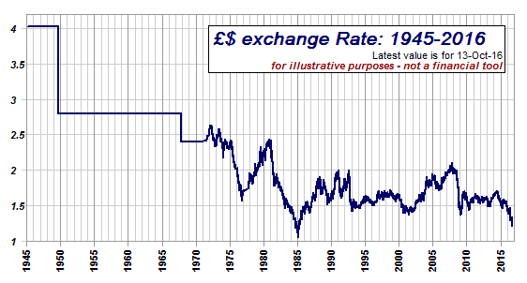
Fluctuations in the British Pound
Apr 2, 2018: Dollar Price of the British Pound is $1.4042

Slide 20
Hedging Foreign Exchange Risk
Burton Snowboards has just entered into a contract to sell boards to a company in France for €1,000,000. The sale was made in October with payment made to them six months later in April (they will get €1.0m in 6 months). This is a sizable contract and the firm is considering hedging to reduce the exchange rate risk. Determine what Burton gets paid in € & $ if they do nothing or if they hedge based on the following information.
Spot rate is $1.23/€
Six month forward rate is $1.20/ €
Spot rate in six months ends up being $1.18/ €

Slide 21
Assignment
Chapter 17 MindTap HW due Sunday, December 9th by 11:59 pm
Read about purchasing power parity in chapter to answer the homework question (and see slide #11)

