Slide 2
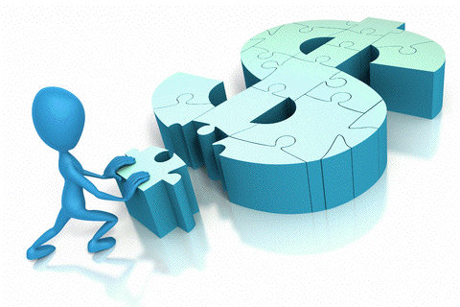
Review
What are the three main areas of finance?
Name one form of business organization and list the advantages and disadvantages of that type of organization
What is the main goal of management and the firm?
Does the stock market price always reflect the company’s true value?

Slide 3
Follow-up
Is being socially responsible inconsistent with maximizing shareholder wealth?
List a few examples of some recent unethical behavior in business news.
What role do ethics play in maximizing shareholder wealth?
Hint: consider how wealth is maximized; future cash flows!

Slide 4
Financial Markets and Institutions
Chapter 2
The Capital Allocation Process
Financial Institutions
Financial Markets
Stock Markets and Returns
Stock Market Efficiency

Slide 5
The Capital Allocation Process
Capital flows efficiently from suppliers to demanders of capital:
Suppliers of capital
Individuals and institutions with “excess funds.”
Saving money and looking for a return on their investment.
Demanders or users of capital
Individuals and institutions raising funds to finance investments.
Willing to pay a rate of return on the capital they borrow/use.

Slide 6
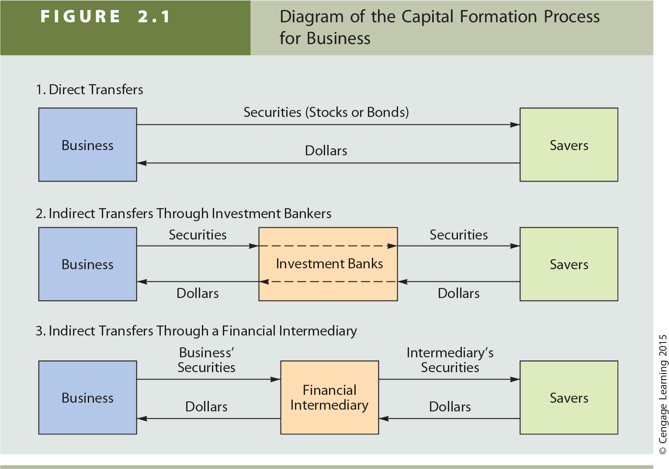
Transfer of Capital

Slide 7
Types of Financial Institutions
Investment banks
Commercial banks
Financial services corporations
Credit unions
Pension funds
Life insurance companies
Mutual funds
Exchange traded funds
Hedge funds
Private equity companies

Slide 8
Types of Financial Markets
Physical assets vs. Financial assets
Spot vs. Futures
Money vs. Capital
Primary vs. Secondary
Public vs. Private

Slide 9
Stock Market Transactions
You decide:
Apple Computer decides to issue additional stock with the assistance of its investment banker. Investors purchase the newly issued shares. Is this a primary market transaction or a secondary market transaction?
What if instead investors buy existing shares of Apple stock in the open market. Is this a primary or secondary market transaction?

Slide 10
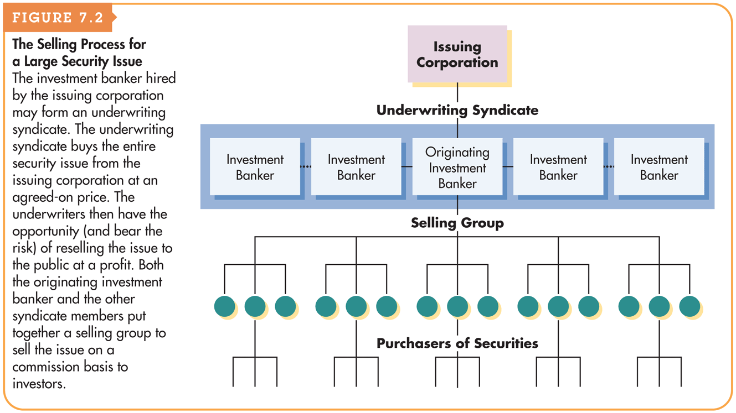
The Selling Process for a Large Security Issue (IPO)

Slide 11
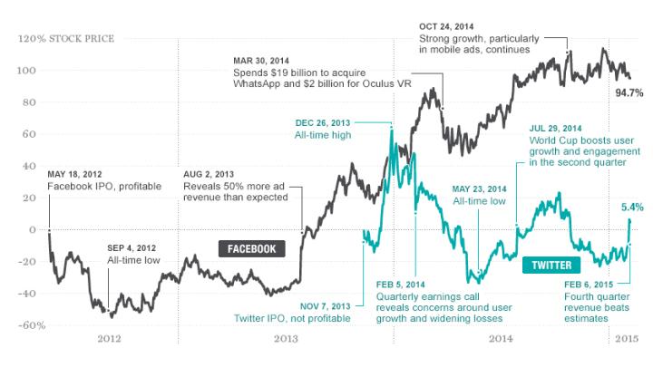
Facebook vs. Twitter – IPO and Performance

Slide 12
Physical Location Stock Exchanges vs. Electronic Dealer-Based Markets
Auction market vs. Dealer market (Exchanges vs. OTC)
NYSE vs. Nasdaq
Differences are narrowing

Slide 13
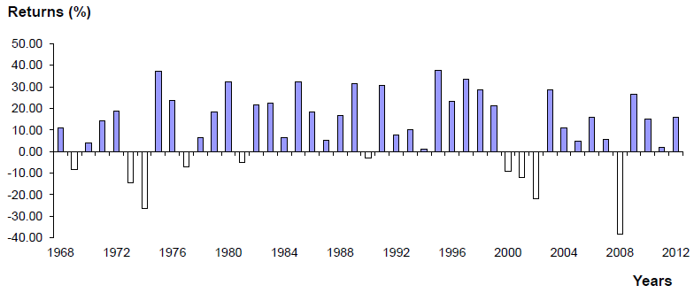
S&P 500 Index, Total Returns: Dividend Yield + Capital Gain or Loss, 1968-2012

Slide 14
Where can you find a stock quote, and what does one look like?
The Wall Street Journal or the local newspaper
Online sources
Yahoo!Finance
CNNMoney
MSN MoneyCentral
Etc.
Stock Quote for Snap, Inc (SNAP)

Slide 15
What is stock market efficiency?
Efficient market hypothesis
Securities are normally in equilibrium and are “fairly priced.”
Investors cannot “beat the market” except through good luck or better information.
Efficiency continuum:
Highly
Inefficient
Highly
Efficient
Small companies not followed by many analysts. Not much contact with investors.
Large companies followed by many analysts. Good communications with investors.

Slide 16
Implications of Market Efficiency
You decide:
You hear in the news that a medical research company received FDA approval for one of its products. If the market is highly efficient, can you expect to take advantage of this information by purchasing the stock?
A small investor has been reading about a “hot” IPO that is scheduled to go public later this week. She wants to buy as many shares as she can get her hands on, and is planning on buying a lot of shares the first day once the stock begins trading. Would you advise her to do this?

Slide 17
What are derivatives? How can they be used to reduce or increase risk?
Value is “derived” from the price of another security (e.g., mortgage backed securities).
Can be used to “hedge” or reduce risk.
Example: Corn farmer buys corn futures contract to sell
Speculators use to bet on the direction of future stock prices, interest rates, exchange rates, and commodity prices.
These transactions produce high returns if you guess right, but large losses if you guess wrong.
Here, derivatives can increase risk.

Slide 18
Assignment
MindTap HW 2 (Chapter 2) is due Friday, September 9th by 11:59 pm
Read WSJ Credit, Banking, Buying a Car, and Buying a Home for Thursday

