Slide 2
Current Events
Career Week – Oct 1 to Oct 5
Sign up for professional name tags and other perks!
https://nau.joinhandshake.com/career_fairs/5888/student_preview Target specific employers
Portfolio Review

Slide 3
Time Value of Money!
Chapter 5
Future Value
Present Value
Finding I and N
Annuities
Rates of Return
Amortization

Slide 4
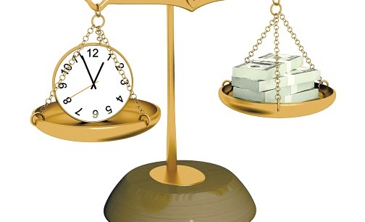
What is the time value of money?

Slide 5
Drawing Time Lines
$100 lump sum due in 2 years
0
I%
1
2
100
3-year $100 ordinary annuity
0
I%
1
2
3
100
100
100

Slide 6
Drawing Time Lines
Uneven cash flow stream
0
I%
1
2
3
-50
100
75
50

Slide 7
Future Value
Finding the FV of a cash flow or series of cash flows is called compounding
What does compounding mean?
FV can be solved with these methods
step-by-step/formulas
financial calculator
spreadsheets
0
1
2
3
4%
100
FV = ?

Slide 8
The Step-by-Step/Formula Method
What is the future value (FV) of $100 invested for 3 years at 4%?
After 1 year:
FV₁ = PV(1 + I) = $100(1.04) = $104.00
After 2 years:
FV₂ = PV(1 + I)² = $100(1.04)² = $108.16
After 3 years:
FV₃ = PV(1 + I)³ = $100(1.04)³ = $112.49
After N years (general case):
FV_{N} = PV(1 + I)^{N}

Slide 9
Solving for FV: Calculator and Excel Methods
Solves the FV equation
Requires 4 calculator inputs, solve for the fifth
Set to P/YR = 1 and END mode
Why is PV entered as a negative number?
Excel: =FV(rate,nper,pmt,pv,type)
INPUTS
3
4
-100
0
N
I/YR
PV
PMT
FV
OUTPUT
112.49

Slide 10
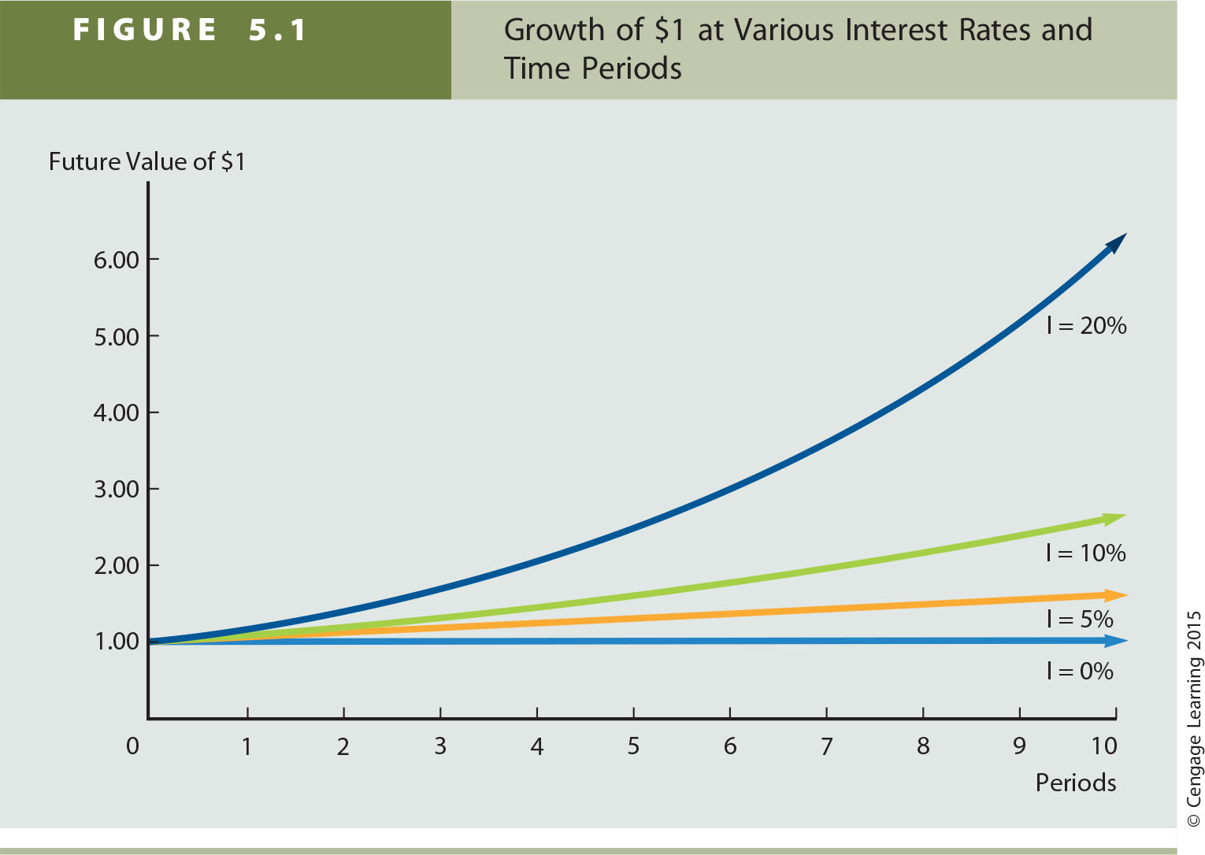

Slide 11
Present Value
What is the present value (PV) of $100 due in 3 years, if I/YR = 4%?
Finding the PV is called discounting (the reverse of compounding).
The PV shows future cash flows in today’s dollars (purchasing power).
If you were offered $80 today or $100 in three years, which would you choose if your investments could earn 4%?
0
1
2
3
4%
PV = ?
100

Slide 12
Solving for PV: The Formula Method
Solve the general FV equation for PV:
PV = FV_{N} /(1 + I)^{N}
PV = FV₃ /(1 + I)³
= $100/(1.04)³
= $88.90

Slide 13
Solving for PV: Calculator and Excel Methods
Solves the general FV equation for PV.
Exactly like solving for FV
we have different input information
solving for a different variable
Excel: =PV(rate,nper,pmt,fv,type)
INPUTS
3
4
0
100
N
I/YR
PV
PMT
FV
OUTPUT
-88.90

Slide 14
Solving for I: What annual interest rate would cause $100 to grow to $119.10 in 3 years?
Solves the FV equation for I/YR.
Hard to solve without a financial calculator or spreadsheet.
Excel: =RATE(nper,pmt,pv,fv,type,guess)
INPUTS
3
-100
0
119.10
N
I/YR
PV
PMT
FV
OUTPUT
6

Slide 15
Solving for N: If sales grow at 10% per year, how long before sales double?
Solves the FV equation for N
Hard to solve without a financial calculator or spreadsheet
Can approximate with the rule of 72!
EXCEL: =NPER(rate,pmt,pv,fv,type)
INPUTS
10
-1
0
2
N
I/YR
PV
PMT
FV
OUTPUT
7.3

Slide 16
What is the difference between an ordinary annuity and an annuity due?
Ordinary Annuity
0
1
2
3
I%
PMT
PMT
PMT
Annuity Due
0
1
2
3
I%
PMT
PMT
PMT

Slide 17
Solving for FV: 3-Year Ordinary Annuity of $100 at 4%
$100 payments occur at the end of each period, but there is no PV.
Excel: =FV(rate,nper,pmt,pv,type); type = 0.
INPUTS
3
4
0
-100
N
I/YR
PV
PMT
FV
OUTPUT
312.16

Slide 18
Solving for PV: 3-year Ordinary Annuity of $100 at 4%
$100 payments still occur at the end of each period, but now there is no FV.
Excel: =PV(rate,nper,pmt,fv,type); type = 0.
INPUTS
3
4
100
0
N
I/YR
PV
PMT
FV
OUTPUT
-277.51

Slide 19
Solving for FV: 3-Year Annuity Due of $100 at 4%
Now, $100 payments occur at the beginning of each period.
FVA_{due}= FVA_{ord}(1 + I) = $312.16(1.04) = $324.65
Alternatively, set calculator to “BEGIN” mode and solve for the FV of the annuity due:
Excel: =FV(rate,nper,pmt,pv,type); type = 1.
BEGIN
INPUTS
3
4
0
-100
N
I/YR
PV
PMT
FV
OUTPUT
324.65

Slide 20
Solving for PV: 3-Year Annuity Due of $100 at 4%
Again, $100 payments occur at the beginning of each period.
PVA_{due} = PVA_{ord}(1 + I) = $277.51(1.04) = $288.61
Alternatively, set calculator to “BEGIN” mode and solve for the PV of the annuity due:
Excel: =PV(rate,nper,pmt,fv,type); type = 1.
BEGIN
INPUTS
3
4
100
0
N
I/YR
PV
PMT
FV
OUTPUT
-288.61

Slide 21
What if it were a 10-year ordinary annuity? A 25-year annuity? A perpetuity?
10-year annuity
N = 10, I/YR = 4, PMT = -100, FV = 0; solve for PV = $811.09.
25-year annuity
N = 25, I/YR = 4, PMT = -100, FV = 0; solve for PV = $1,562.21.
Perpetuity
PV = PMT/I = $100/0.04 = $2,500.

Slide 22
Real-life example of TVM!
A 20-year-old student wants to save for her retirement. She plans to retire at age 60.
She will contribute her money to a brokerage account with an expected annual return of 8%, but will earn 4% in retirement.
Inflation is expected to average 2.5% per year.
How much money does she need annually to live on in retirement?
What will that amount be in future dollars (40 years from now-based on inflation increases)?
How long will she live, and how much in total will she need to save to receive this amount annually until she dies?
What does she need to save annually until age 60 to end up with this amount of savings?

Slide 23
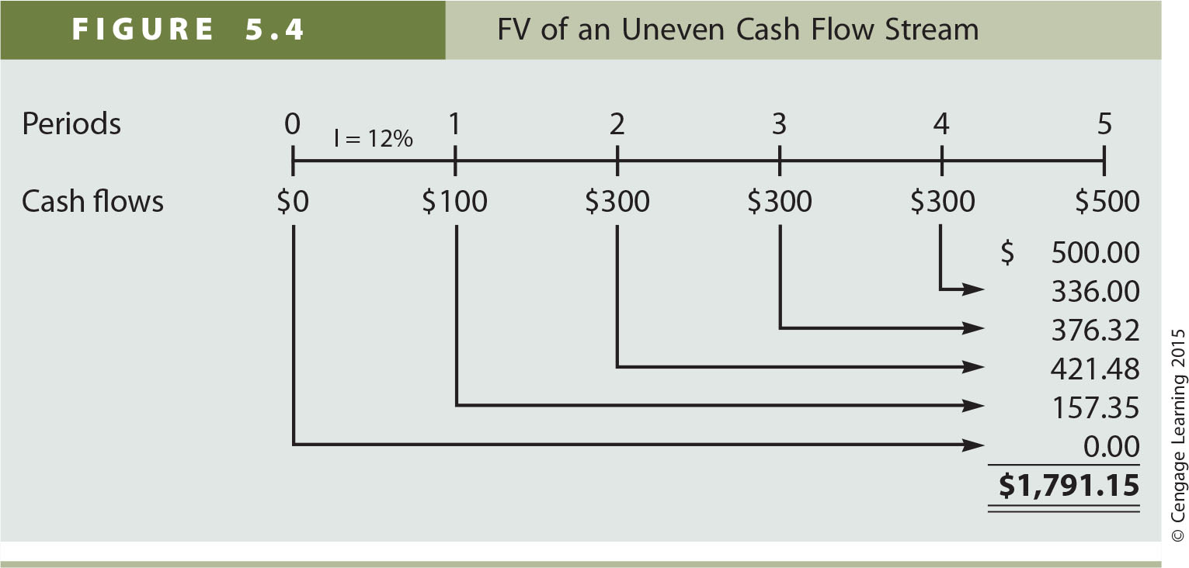

Slide 24
What is the PV of this uneven cash flow stream?
0
1
2
3
4
4%
100
300
300
-50
96.15
277.37
266.70
-42.74
597.48 = PV

Slide 25
Solving for PV: Uneven Cash Flow Stream
Input cash flows in the calculator’s “CF” register:
CF₀ = 0
C0₁ = 100, F0₁ = 1
C0₂ = 300, F0₂ = 1
C0₃ = 300, F0₃ = 1
C0₄ = -50, F0₄ = 1
Press NPV button
Enter I/YR = 4, arrow down to NPV = and Press CPT
NPV = $597.48. (Here NPV = PV)

Slide 26
What if the interest is compounded more often than annually?
Compounding more frequently than annually
Results in a higher effective interest rate
Earning interest on interest more frequently.
The nominal (stated) annual rate = contractual annual rate of interest charged by a lender or promised by a borrower.
The effective (true) annual rate (EAR) = annual rate of interest actually paid or earned.
effective rate > nominal rate when compounding > once per year

Slide 27
Compounding more frequently than annually
0
1
2
3
4%
100
112.49
Annually: FV₃ = $100(1.04)³ = $112.49
0
1
2
3
0
1
2
3
4
5
6
2%
100
112.62
Semiannually: FV₆ = $100(1.02)⁶ = $112.62

Slide 28
Personal Finance Example
You wish to find the effective annual rate associated with an 8% nominal (quoted) annual rate (r = 0.08) when interest is compounded (1) annually (n = 1); (2) semiannually (n = 2); and (3) quarterly (n = 4).
Do you know how frequently your banks/lenders/credit cards compound interest for your account?

Slide 29
What is the FV of $100 after 3 years at 10% with semiannual compounding? Quarterly compounding?

Slide 30
Loan Amortization
Amortization table uses:
home mortgages, auto loans, business loans, retirement plans, etc.
Financial calculators and spreadsheets are great for setting up amortization tables.
EXAMPLE: Construct an amortization schedule for a $100,000, 6% annual rate loan with 5 equal payments.

Slide 31
First: Find the Required Annual Payment
Remember that the FV = 0 because the balance is 0 when the last payment is received!
Excel: =PMT(.06,5,-100000,0,0)
INPUTS
5
6
-100,000
0
N
I/YR
PV
PMT
FV
OUTPUT
23,739.64

Slide 32
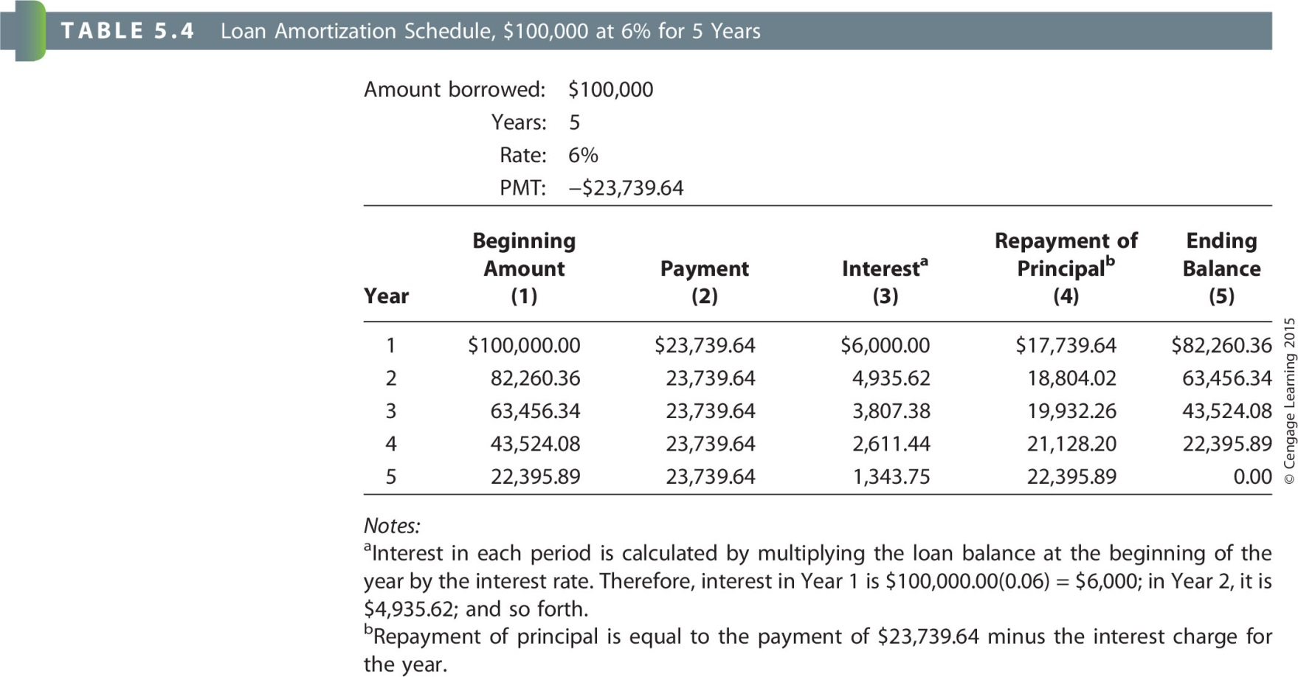

Slide 33
Assignment
Chp 5 MindTap HW due Sun, Oct. 7th by 11:59 pm
EAR = EFF = Effective Annual Rate (true rate paid or received)
Q5 - Solving for growth rates = solving for interest rates (I\Y)
Q7 – Last problem: find the annuity payment and then find the present value of the annuity
(if it says the first payment is today then it is an annuity due-beginning of period)
Q11 – Last problem: first find the daily rate and use for I/Y, then find the number of days the loan is outstanding and use for N, solve for FV
Q12 – 3rd problem: find the total paid for each loan by multiplying the payment amount by the number of payments. The difference in the total paid is the extra interest paid

