Slide 2
Current events
Portfolio Review
What is LIBOR and how does it affect you?
Today’s Interest Rates

Slide 3
Interest Rates
Chapter 6

Slide 4
Factors that Affect the Cost of Money (Interest Rates)
Production opportunities
Time preferences for consumption
Risk
Inflation
Supply and Demand (Equilibrium)

Slide 5
What is an Interest Rate?
The fee for borrowing money expressed as a % of a loan
The reward for lending money also expressed as a %
Real rate of interest
interest rate that would exist in the absence of inflation (deflation) and risk
Nominal rate of interest
interest rate adjusted for inflation (deflation) and risk

Slide 6
The Determinants of the Equilibrium Rate of Interest

Slide 8
Determinants of Interest Rates
Real rate (r*)
If inflation and risk did not exist
Inflation (IP)
Expectations about inflation
Risk Free Rate (R_{RF}) = r* + IP
Inflation and real rate combined
Default Risk (DRP)
Can the borrower meet their future obligations?
Liquidity & Marketability (LP)
How quickly can the investment be turned into cash (marketability) without loss (liquidity)?
Maturity Risk Premium (MRP) –
Expectations of future rates, economy, markets, etc. (interest rate risk)
r = Nominal Rate (sum of all rates and premiums)

Slide 9
Determinants of Interest Rates
r = r* + IP+ DRP + LP + MRP
What portion is the risk free rate?
What portion is the risk premium?
What portion makes up the short-term rates?
What premiums are applicable for long-term?
Which components make up long-term U.S. Treasury bond rates?
Which components make up long-term corporate bond rates?

Slide 10
Interest Rate Example Problem
You currently work for a bank and have the responsibility of pricing (determining interest rates) for small business loans. The following information is provided by your bank. Determine the 5 and 10 year loan rates for a customer with a high credit rating (good financial condition).
The real risk-free rate is r* = 2.5%
Inflation is expected to be 2.5% for the next 3 years and then 4% indefinitely
The default risk premium DRP = 1.30% for 5 years and 1.7% for 10 years (DRPs for high credit ratings)
The liquidity risk premium LP = .5%
The maturity risk premium for all loans is found with the formula MRP = (t − 1) × 0.1%, where t = number of years to maturity

Slide 11
The Structure of Interest Rates
Term structure: the relationship between interest rates (or yields) and maturities
A graph of the term structure is called the yield curve
The shape and position of the yield curve are not constant.
As interest rates changes, the yield curve shifts up and down and changes its shape and slope

Slide 12
Yield Curves for Treasury Securities at Three Different Points in Time

Slide 13
Factors That Influence Yield Curve Shape

Slide 14
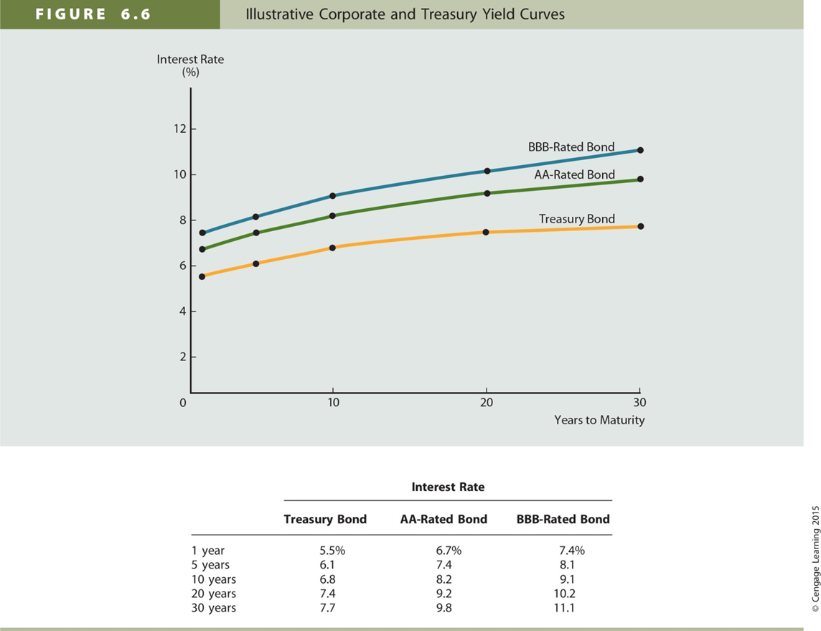
Corporate and Treasury Yield Curves

Slide 15
Other Factors That Influence Interest Rate Levels
Federal Reserve Policy – Money Supply
Open market operations
Federal deficits or surpluses
Increased demand for capital
International Factors (Foreign Trade Balance)
Borrow to cover trade deficits
Must pay rates competitive in global markets
Business Activity
Different reasons for borrowing short- and/or long-term

Slide 16
Interest Rate Levels and Stock Prices
The higher the rate of interest, the lower a firm’s profits
Interest rates affect the level of economic activity
Economic activity affects corporate profits

Slide 17
Assignment
Chapter 6 MindTap due Sunday, October 14th by 11:59 pm
Read Chapter 8 for Tuesday

