Slide 1
I do not regard a broker as a member of the human race.
Honore de Balzac

Slide 2
Review
Explain unsystematic (business) risk.
How is this total risk measured?
Explain systematic (market) risk.
How is market risk measured?
Which type of risk is relevant in a diversified portfolio?

Slide 3
CURRENT EVENTS
AB Inbev – second Largest bond sale in history ($46 billion)

Slide 4
Chapter 7
Bonds and their Valuation

Slide 5
Common Bonds
Government Bond
Corporate Bond
Mortgage Bond (different than mortgage backed securities)
A bond backed by fixed assets
Debenture
An unsecured bond
Subordinated Debenture
Last in line of creditors to get paid if firm liquidates!

Slide 6
Types of Corporate Bonds
Callable
Can be redeemed at the issuer’s option
Allows issuer to refund the bond issue if rates decline (helps the issuer, but hurts the investor).
Bond investors require higher yields on callable bonds.
In many cases, callable bonds include a deferred call provision and a declining call premium.
Sinking fund
Provision to pay off a loan over its life rather than all at maturity.
Similar to amortization on a term loan.
Reduces risk to investor, shortens average maturity.
But not good for investors if rates decline after issuance

Slide 7
Types of Corporate Bonds
Zero coupon bond
no coupon payments
pays face value at maturity
sell at deep discount
Convertible bonds
may be exchanged for shares of the firm’s stock
sells for a higher price than a comparable non-convertible bond
bondholders benefit if the market value of the company’s stock gets high enough

Slide 8
Corporate Bonds
Market for Corporate Bonds
Mainly purchased by Life insurance companies and pension funds
Transactions occur in very large dollar amounts
Less than 1% of all corporate bonds are traded on organized exchanges
The market is thin – low volume, few dealers
Less marketable than securities with large daily trading volumes
Debt market second to equity market, which are $12 trillion and $18.7 trillion respectively

Slide 9
Bond (Debt Capital) Features
A contract between borrower/lender
Bankruptcy/reorganization threat if contract is violated
Priority claim on assets, cash flow
Lower return potential than equity
Little/no voice in management

Slide 10
Bond Indentures
Indenture
Contract between bondholder and company
Covenants
Impose restrictions or extra duties on the firm
Protect bondholder stake in the firm
Examples:
Credit rating requirements
Limits on dividends
Limits on additional debt issues
Requirements to retire portions of debt

Slide 11
General Bond Terms
Par value or Face Value (Principal)
Typically $1,000
Liability to the firm
Coupon Rate – interest
Usually fixed rate
Expense to the firm
Coupon Payment
Annual coupon = coupon rate x par value
Example: 6% coupon
Maturity Date
Date the debt must be repaid

Slide 12
Risk to Bondholders
Default: failure to meet ANY terms of indenture
Price Risk
Fluctuations in interest rates
Leads to fluctuations in bond prices
Reinvestment rate risk
Loss of purchasing power (inflation)

Slide 13
Bond Ratings
Measure likelihood of default;
influenced by level of issuer’s cash flow
investor protection in the covenants
security or collateral provisions considered
Acts as a market signal
Lower rating➔Higher risk➔Higher coupon rate on new issues

Slide 14
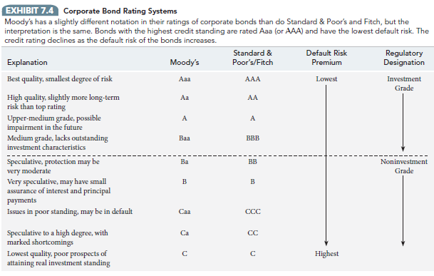
Corporate Bond Ratings

Slide 15
Federal Government Securities
Non-marketable federal government debt
Series EE (“patriot”) savings bonds
No secondary market
Sold at a discount
Tax on interest deferred until maturity
Marketable federal government debt
Treasury bills (90 days or less)
Treasury notes (up to 10 years)
Treasury bonds (up to 30 years)
Buy and sell in secondary market
Exempt from state and local income taxes

Slide 16
Municipal Bonds (State and Local Government Debt)
Issued by state and local governments
FUSD bond issues
Tax exemption
Municipal bond interest exempt from federal income taxation
Investors will accept lower interest rate

Slide 17
Bond Pricing
Price = sum of present value of future cash flows:
Interest payments
Principal repayment
Price= PVA(coupon payments)+ PV(principal)
Coupon payment is an ordinary annuity
Principal repayment is a single sum

Slide 18
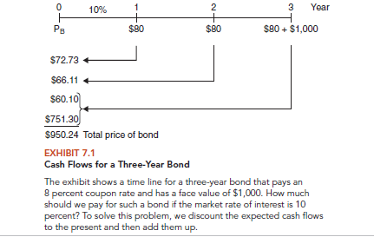
Cash Flows for a Three-Year Bond

Slide 19
Bond Pricing
Coupon is paid semi-annually typically
Must account for this in pricing bonds
Interest rate divided by 2 (i.e. 8%/2 = 4%)
# of yrs to maturity doubled (i.e. 3*2 = 6)
Coupon payment divided by 2 (i.e. $80/2 = $40)
Receive half of the coupon payment at every six months

Slide 20
Bond Pricing
Price (PV) of a $1,000 bond that has a 6% coupon and matures after 3 years; current rate (market rate) on comparable bonds is 6%
Unknown: PV
PMT = 30
FV = 1000
N = 6
I = 3
What is the current price of this bond in the secondary market (no calculation required)?

Slide 21
Same Bond at a Discount
Same as previous, but current rate (market rate) on comparable bonds is 10%
Unknown: PV
PMT = 30
FV = 1000
N = 6
I = 5

Slide 22
Same Bond at a Premium
Same as previous, but current rate on comparable bonds is 4%.
Unknown: PV
PMT = 30
FV = 1000
N = 6
I = 2

Slide 23
The Inverse Relationship
Inverse relationship between
Bond prices and
Interest rates
Interest rate (Price) risk
Higher interest rates cause bond prices to decline
Why?

Slide 24
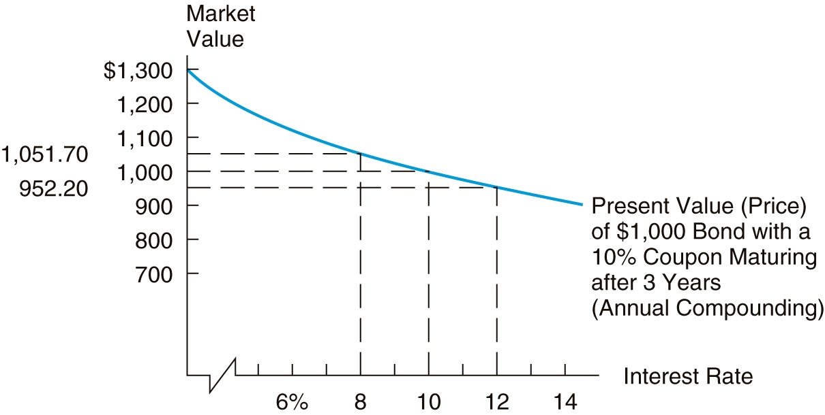
Relationship Between Interest Rates and a Bond’s Price

Slide 25
Yield to Maturity
The annual return if you buy the bond now and hold it to maturity
Changes daily as interest rates change
Current market rate
Unknown: I
PV = -$952
PMT = $50
FV = 1000
N = 6

Slide 26
Assignment
Chapter 7 MindTap homework due Sunday, October 21st
Read Chapter 9 for Tuesday, October 23rd
Stocks and their Valuation

