Slide 1
Budgeting

Slide 2
Spending plans (budgets)
What are they?
Why are they important?
How many of you have a plan or budget?

Slide 3
Knowledge is power
Helps to know how much you have to spend (income)
Expenses
Fixed
Variable
Are you spending wastefully or smartly?
The budget helps to track spending patterns
Spend discretionary income on what is most important to you
i.e. $5 lattes
Ladies 80’s night at the Green Room
Budgeting 101-Take control of your money! Or
http://clark.com/deals-money-saving-advice/16-ways-to-save-more-in-2016/

Slide 4
Important items
Include savings in your spending plans
Save for emergencies
Money market accounts pay higher interest
Save for specific high dollar items that you wish to purchase in the future
Prioritize what is most important to you
i.e. choose lunch with a friend over two lattes for the week
Live Within Your Means
Make a personal budget in 7 steps or
https://www.thebalance.com/how-to-make-a-budget-1289587

Slide 5
Personal Financial Planning Assignment
Read through given information
Categorize items:
Income
Expenses
Assets (at market value)
Liabilities (current outstanding balance)
Create an Amortization Schedule
First determine payment amount
Create schedule for term of loan (60 months)

Slide 6
Personal Financial Planning Assignment
Put these into the Cash Flow and Personal Balance Sheet worksheets
Determine net worth
Prepare a Spending Plan for yourself
Either monthly or per semester
Use the Cash Flow template or create your own

Slide 7
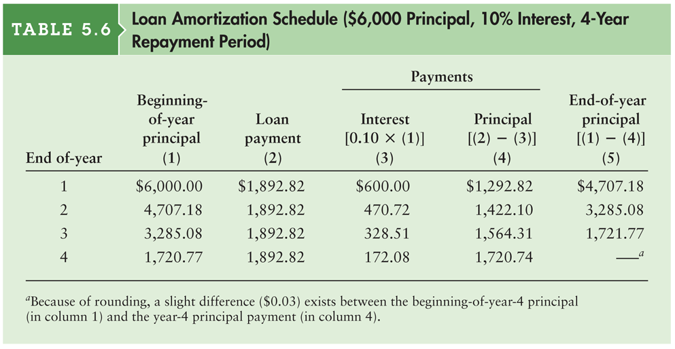
Loan Amortization Schedule ($6,000 Principal, 10% Interest, 4-Year Repayment Period)
Schedule of equal payments
Shows the allocation of each loan payment to interest and principal.

Slide 8
Creating Our Own Amortization Schedule
You are buying a car
The car costs $12,000 (used)
The nominal interest rate is 7.5%, compounded monthly
Your loan agreement is for three years
You will make monthly payments
Determine the payment amount
Create a loan amortization schedule

Slide 9
Assignment
Personal Financial Planning Excel Assignment due Thursday, November 8th
Turn in on BbLearn (WSJ folder)
Five pages max (Fit spreadsheets to one page each)
Analysis of case (can include as a text box in spreadsheet)
Cash Flows
Net Worth
Amortization Schedule
Personal Cash Flows

