Slide 1
CHAPTER
21
The Theory of
Consumer Choice
Notes:
This chapter covers topics considered advanced for the typical principles course: budget constraints, indifference curves, household optimization, and the income and substitution effects of price changes.
Most students find it more difficult than average.
The first half of the chapter develops the theory. The second half applies the theory to three consumer choice problems:
1) Giffen goods and positively-sloped demand curves
2) The labor–leisure choice
3) The effects of interest rates on household saving
The first half of this PowerPoint chapter uses a different example than the text, with different numerical values. (The applications in the second half are as in the textbook.)

Slide 2
Look for the answers to these questions:
How does the budget constraint represent the choices a consumer can afford?
How do indifference curves represent the consumer’s preferences?
What determines how a consumer divides her resources between two goods?
How does the theory of consumer choice explain decisions such as how much a consumer saves, or how much labor she supplies?

Slide 3
Introduction
People face tradeoffs.
Buying more of one good leaves less income to buy other goods
Working more hours means more income and more consumption, but less leisure time
Reducing saving allows more consumption today but reduces future consumption
This chapter explores how consumers make choices like these.

Slide 4
The Budget Constraint: What the Consumer Can Afford
Budget constraint:
The limit on the consumption bundles that a consumer can afford
Example:
Hurley divides his income between two goods: fish and mangos.
A “consumption bundle” is a particular combination of the goods, e.g., 40 fish & 300 mangos
Notes:
The two-good assumption greatly simplifies the analysis without altering the basic insights about consumer choice.
If your students remember the Production Possibilities Frontier, you might tell them that a budget constraint is, in essence, a “consumption possibilities frontier” for the consumer: it shows all combinations (bundles) of the two goods that the consumer can afford to buy.

Slide 5
Active Learning 1 The budget constraint
Hurley’s income: $1200
Prices: P_{F} = $4 per fish, P_{M} = $1 per mango
If Hurley spends all his income on fish, how many fish does he buy?
If Hurley spends all his income on mangos, how many mangos does he buy?
If Hurley buys 100 fish, how many mangos can he buy?
Plot each of the bundles from parts A – C on a graph that measures fish on the horizontal axis and mangos on the vertical; connect the dots.
Notes:
A very straightforward exercise.

Slide 6
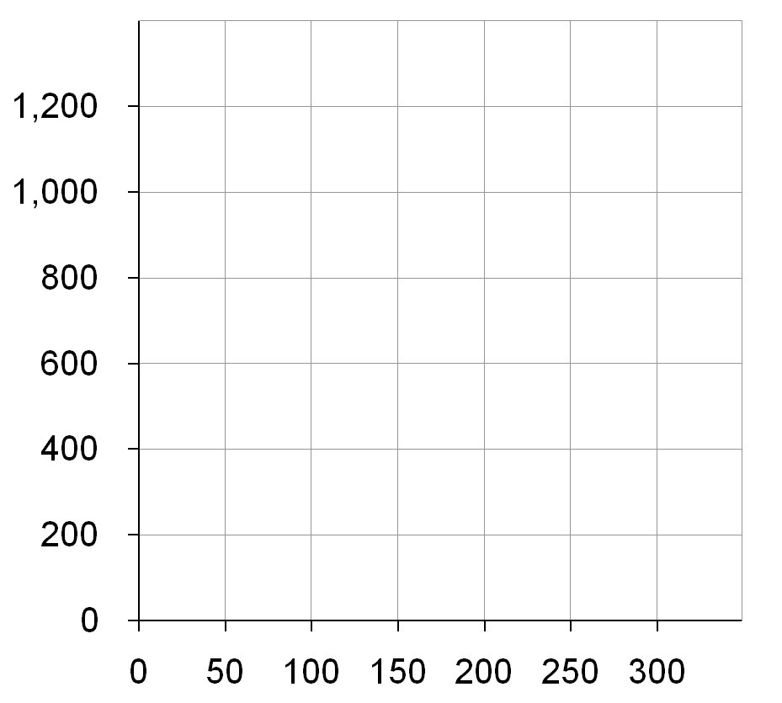
Active Learning 1 Answers
A. $1200/$4 = 300 fish
B. $1200/$1 = 1200 mangos
C. 100 fish cost $400, $800 left buys 800 mangos
D. Hurley’s budget constraint shows the bundles he can afford.
Quantity of Mangos
B
C
A
Quantity of Fish

Slide 7
Active Learning 1 The Slope of the Budget Constraint
Quantity of Mangos
The slope of the budget constraint equals the relative price of the good on the X axis.
From C to D,
“rise” = –200 mangos
“run” = +50 fish
Slope = – 4
Hurley must give up 4 mangos to get one fish.
C
D
Quantity of Fish

Slide 8
Active Learning 2 The budget constraint, continued
Initial problem:
Hurley’s income: $1200
Prices: P_{F} = $4 per fish, P_{M} = $1 per mango
Show what happens to Hurley’s budget constraint if:
His income falls to $800.
The price of mangos rises to P_{M} = $2 per mango
Notes:
Another straightforward problem that will not take much class time. Yet, students will learn these concepts better by figuring out for themselves how the budget line moves in response to income and price changes.

Slide 9
Active Learning 2 Answers, part A
Now, Hurley can buy
$800/$4 = 200 fish
or $800/$1 = 800 mangos
or any combination in between.
Quantity of Mangos
A fall in income shifts the budget constraint down.
Quantity of Fish

Slide 10
Active Learning 2 Answers, part B
Hurley can still buy 300 fish.
But now he can only buy $1200/$2 = 600 mangos.
Notice: slope is smaller, relative price of fish is now only 2 mangos
Quantity of Mangos
An increase in the price of one good pivots the budget constraint inward.
Quantity of Fish

Slide 11
Preferences: What the Consumer Wants
Indifference curve: shows consumption bundles that give the consumer the same level of satisfaction
A, B, and all other bundles on I₁ make Hurley equally happy: he is indifferent between them.
One of Hurley’s indifference curves
Quantity of Mangos
B
A
I₁
Quantity of Fish

Slide 12
Four Properties of Indifference Curves 1. Indifference curves are downward-sloping.
One of Hurley’s indifference curves
Quantity of Mangos
If the quantity of fish is reduced,
the quantity of mangos must be increased to keep Hurley equally happy.
B
A
I₁
Quantity of Fish

Slide 13
Four Properties of Indifference Curves 2. Higher indifference curves are preferred to lower ones.
A few of Hurley’s indifference curves
Quantity of Mangos
Hurley prefers every bundle on I₂ (like C) to every bundle on I₁ (like A).
He prefers every bundle on I₁ (like A) to every bundle on I₀ (like D).
C
D
A
I₂
I₁
I₀
Quantity of Fish

Slide 14
Four Properties of Indifference Curves 3. Indifference curves cannot cross.
Suppose they did.
Hurley should prefer B to C, since B has more of both goods.
Yet, Hurley is indifferent between B and C:
He likes C as much as A (both are on I₄).
He likes A as much as B (both are on I₁).
Hurley’s indifference curves
Quantity of Mangos
B
C
A
I₁
I₄
Quantity of Fish

Slide 15
Four Properties of Indifference Curves 4. Indifference curves are bowed inward.
Quantity of Mangos
Hurley is willing to give up more mangos for a fish if he has few fish (A) than if he has many (B).
A
6
1
B
2
1
I₁
Quantity of Fish
Notes:
Hurley has more fish at B than at A, so an extra fish would be less valuable at B than at A.

Slide 16
The Marginal Rate of Substitution
Marginal rate of substitution (MRS): the rate at which a consumer is willing to
trade one good for another.
Hurley’s MRS is the amount of mangos he would substitute for another fish.
MRS falls as you move down along an indifference curve.
MRS = slope of indifference curve
Quantity of Mangos
A
MRS =
6
1
B
MRS =
2
1
I₁
Quantity of Fish
Notes:
At A, Hurley has few fish, so an additional fish is very valuable to him.
At B, Hurley already has lots of fish, so an additional one is not as valuable to him.

Slide 17
One Extreme Case: Perfect Substitutes
Perfect substitutes: two goods with straight-line indifference curves, constant MRS
Example: nickels and dimes
Consumer is always willing to trade two nickels for one dime.
Notes:
17
It is hard to think of examples of perfect substitutes. (Even nickels and dimes are probably not perfect substitutes: I’d rather carry 10 dimes in my pocket than 20 nickels.)
But it’s easy to think of examples that are close substitutes, and therefore are likely to have indifference curves that are not very bowed:
1) Movies (at the movie theater) and videos at home. A consumer might be willing to trade two videos for one night at the movies.
2) Coke and Pepsi (for consumers who do not perceive much difference between them).
3) Vacations in Hawaii and vacations in the Bahamas.

Slide 18
Another Extreme Case: Perfect Complements
Perfect complements: two goods with right-angle indifference curves
Example: Left shoes, right shoes
{7 left shoes, 5 right shoes}
is just as good as
{5 left shoes, 5 right shoes}
Notes:
18
Again, It is hard to think of examples of perfect complements. But it’s easy to think of examples that are good though not perfect complements, and therefore are likely to have indifference curves that are very bowed:
1) Tickets to rock concerts and parking at the arena in which the concert takes place.
2) Hot dogs and hot dog buns.
3) Brewed Starbucks coffee and 20 spoons of sugar (If you don’t get this one, you probably haven’t tried brewed Starbucks coffee!).

Slide 19
Less Extreme Cases: Close Substitutes and Close Complements
Indifference curves for close substitutes are not very bowed
Quantity of hot dog buns
Indifference curves for close complements are very bowed
Quantity of Pepsi
Quantity of Coke
Quantity of hot dogs
Notes:
When the two goods are close but not perfect substitutes (like Coke and Pepsi), indifference curves are slightly bowed.
When the two goods are close but not perfect complements (like hot dogs and buns), indifference curves are very bowed, having a very sharp (but not quite 90-degree) angle.
Later in this PowerPoint chapter, an Active Learning exercise asks students to illustrate the substitution effect for these two cases. They will see that a relative price change causes a much bigger movement along an indifference curve when the goods are substitutes than when they are complements.

Slide 20
Optimization: What the Consumer Chooses
Quantity of Mangos
A is the optimum: the point on the budget constraint that touches the highest possible indifference curve.
Hurley prefers B to A, but he cannot afford B.
Hurley can afford C and D, but A is on a higher indifference curve.
The optimum is the bundle Hurley most prefers out of all the bundles he can afford.
1200
B
A
600
C
D
150
300
Quantity of Fish
Notes:
Simply put, optimization means buying the bundle that makes the consumer happiest, given his or her income.

Slide 21
Optimization: What the Consumer Chooses
Quantity of Mangos
Consumer optimization is another example of “thinking at the margin.”
At the optimum,
slope of the indifference curve equals slope of the budget constraint:
1200
MRS = P_{F} / P_{M}
A
600
marginal value of fish (in terms of mangos)
price of fish (in terms of mangos)
150
300
Quantity of Fish
Notes:
Consumer optimization is another example of “thinking at the margin.”
Remember that MRS = marginal value of the good on the X-axis (fish) in terms of the good on Y-axis (mangos).
If MRS > Pf/Pm, the value of another fish is greater than its cost, so Hurley can make himself happier by decreasing his mango purchases and using the proceeds to buy another fish.
If MRS < Pf/Pm, the value of another fish is less than its cost, so Hurley should move along his budget line to a bundle with less fish and more mangos to make himself happier.

Slide 22
Conclusion: Do People Really Think This Way?
People do not make spending decisions by writing down their budget constraints and indifference curves.
Yet, they try to make the choices that maximize their satisfaction given their limited resources.
The theory in this chapter is only intended as a metaphor for how consumers make decisions.
It explains consumer behavior fairly well in many situations and provides the basis for more advanced economic analysis.

Slide 23
Summary
A consumer’s budget constraint shows the possible combinations of different goods she can buy given her income and the prices of the goods.
The slope of the budget constraint equals the relative price of the goods.
An increase in income shifts the budget constraint outward.
A change in the price of one of the goods pivots the budget constraint.

Slide 24
Summary
A consumer’s indifference curves represent her preferences.
An indifference curve shows all the bundles that give the consumer a certain level of happiness.
The consumer prefers points on higher indifference curves to points on lower ones.
The slope of an indifference curve at any point is the marginal rate of substitution
MRS = rate at which the consumer is willing to trade one good for the other.

Slide 25
Summary
The consumer optimizes by choosing the point on her budget constraint that lies on the highest indifference curve.
At this point, the marginal rate of substitution equals the relative price of the two goods.
When the price of a good falls, the impact on the consumer’s choices can be broken down into two effects, an income effect and a substitution effect.

Slide 26
Summary
The income effect is the change in consumption that arises because a lower price makes the consumer better off.
Movement from a lower indifference curve to a higher one.
The substitution effect is the change that arises because a price change encourages greater consumption of the good that has become relatively cheaper.
Movement along an indifference curve.

Slide 27
Summary
The theory of consumer choice can be applied in many situations.
It can explain why demand curves can potentially slope upward, why higher wages could either increase or decrease labor supply, and why higher interest rates could either increase or decrease saving.

