Slide 1
Chapter 2 Thoughts
Finance 311
Tuesday, September 4, 2018

Slide 2
Capital Allocation
“Money” flows we would say in common language.
Private Equity or Investment – Direct Flow
Stocks and Bonds – Investment Banks (Underwriters)
Bank CDs, Savings accounts, etc. – Financial Intermediaries (Commercial Banks)

Slide 3
Types of Institutions: Investment Banks

Slide 4
Types of Institutions: Commercial Banks
https://studypoints.blogspot.com/2012/08/functions-of-commercial-bank-or-explain.html

Slide 5
Types of Institutions: Pension Funds

Slide 6
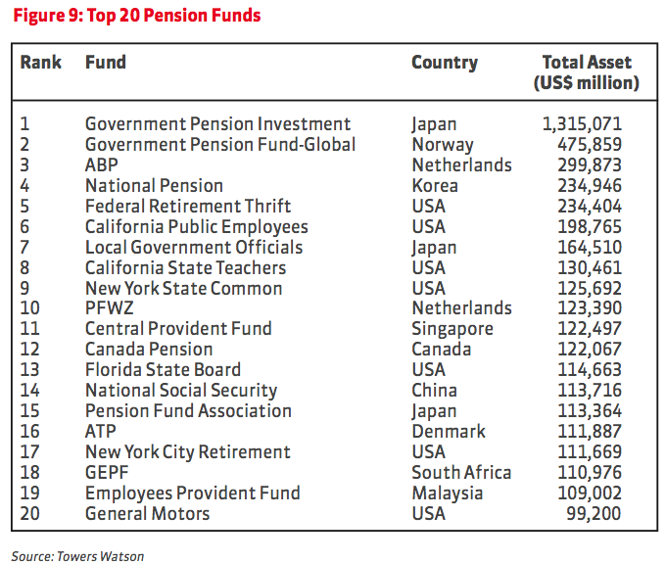
http://henrybutcherpenang.com/growing-retirement-savings-through-property.html 2010

Slide 7
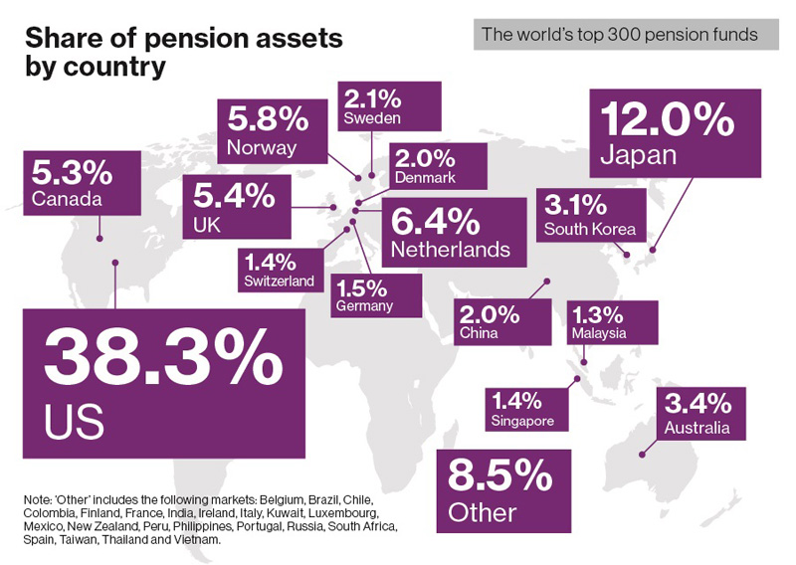
Year end 2015
https://www.willistowerswatson.com/en-SA/insights/2016/09/The-worlds-300-largest-pension-funds-year-ended-2015

Slide 8
Types of Institutions: Insurance Companies
In 2017
https://www.statista.com/chart/9212/leading-insurers-in-the-united-states/

Slide 9
Types of Markets: Spot and Futures
Spot – price & quantity are agreed on today and transaction takes place now
Future or Forward market – price and quantity are agreed upon now, exchange of funds happens now, but the transaction takes place in the future

Slide 10
Types of Secondary Markets
NYSE – the big one! (Dealers make the market)
NASDAQ – NOT a physical place (bid and asked prices)

Slide 13
NASDAQ

Slide 15
Money versus Capital Markets
Money market is up to one year to maturity: U.S. Treasury Bills, Repos, Commercial Paper
Capital Market is anything with over 1 year to maturity

Slide 16
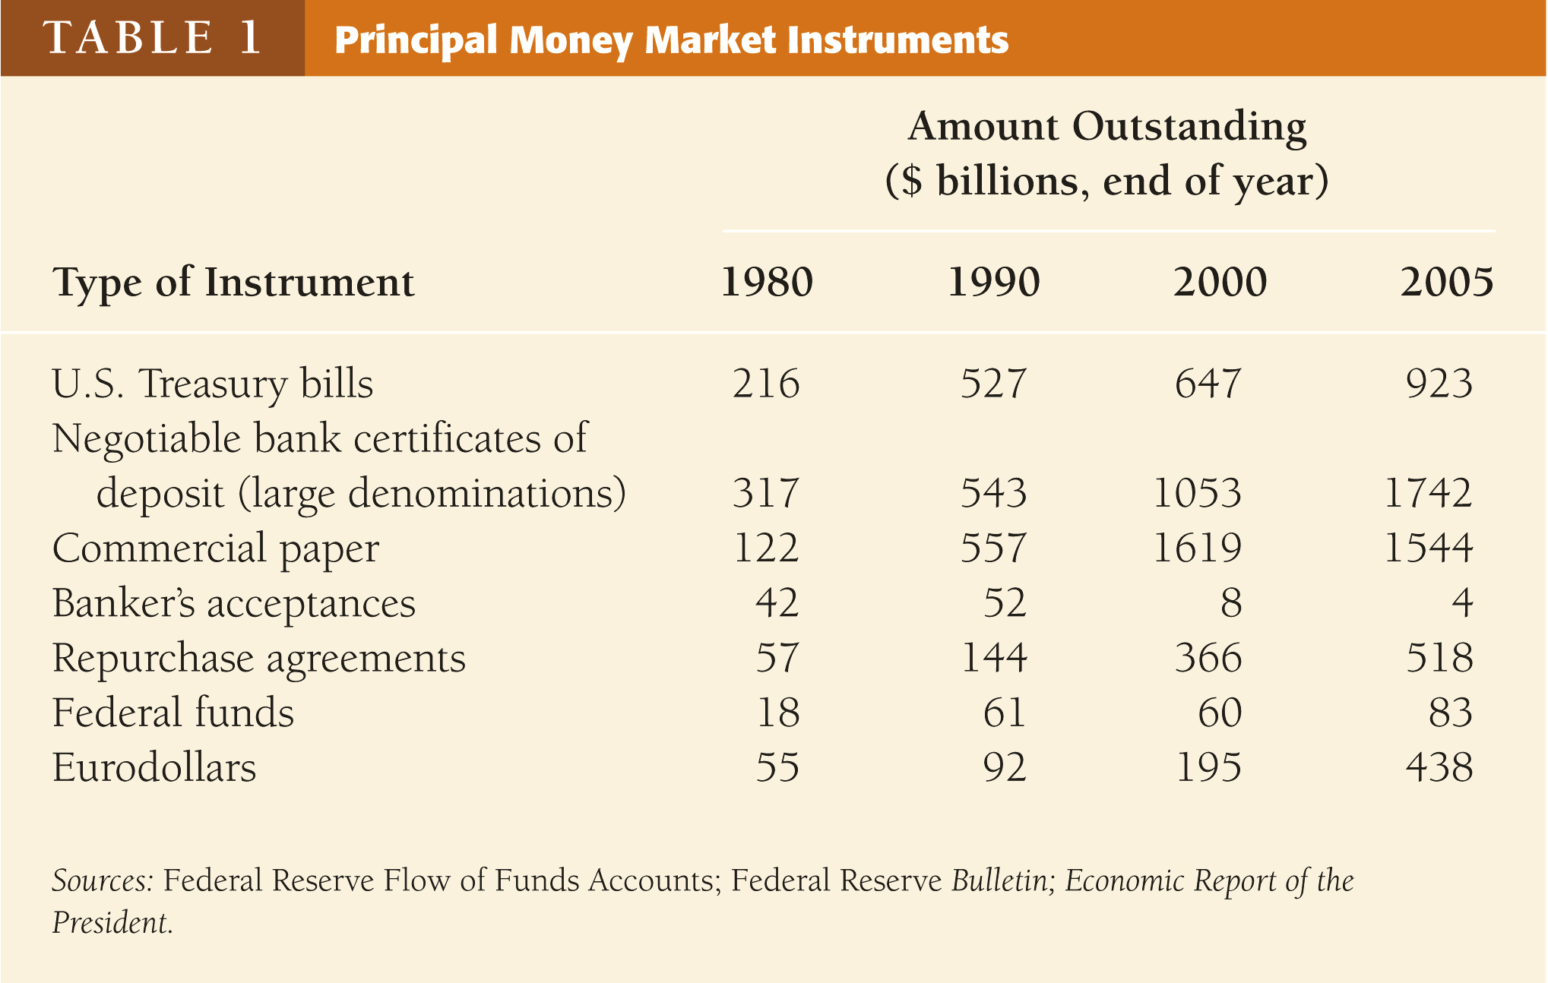

Slide 17
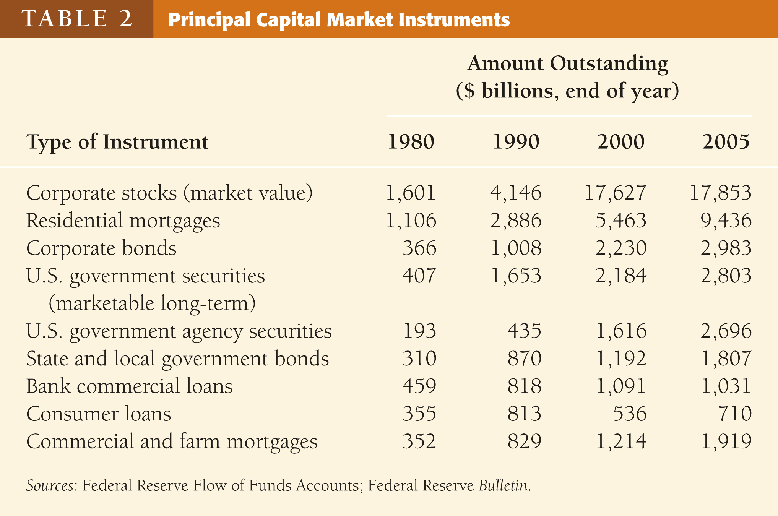

Slide 18
Financial Markets and Institutions

