Slide 1
Game Theory
Dr. Andrew L. H. Parkes
March 15, 2018
卜安吉

Slide 2
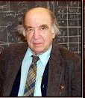
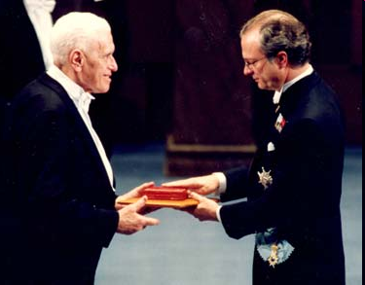
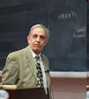
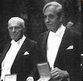
Nobel Memorial Prize in Economics
Eight game-theorists have won the Nobel Memorial Prize in Economic Sciences

Slide 3
John von Neuman
A brilliant mathematician who’s paper in 1928 was a significant milestone in creating the field of game theory.

Slide 4
John von Neuman
was a Hungarian-American mathematician and polymath who made major contributions to a vast number of fields.
Von Neumann founded the field of game theory as a mathematical discipline. Von Neumann proved his minimax theorem in 1928.

Slide 5
John Von Neuman
This theorem establishes that in zero-sum games with perfect information (i.e., in which players know at each time all moves that have taken place so far), there exists a pair of strategies for both players that allows each to minimize his maximum losses (hence the name minimax).

Slide 6
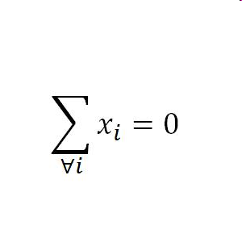
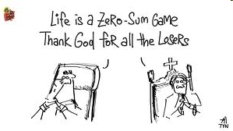
Zero Sum Games
Zero-sum games are those in which one person's gains exactly equal net losses of the other participant(s).

Slide 7
Perfect Information
Perfect information means that players know at each time all moves that have taken place so far.

Slide 8
A Nash Equilibrium
… is the solution to a game involving two or more players when each player takes into account the other players’ known strategies.
Jon Forbes Nash
A genius mathematician who created what has become known as the Nash Equilibrium.

Slide 9
A Nash Equilibrium
A Nash Equilibrium results when no player can improve their situation as long as others do not change their positions.
John Nash is the subject of the Hollywood movie A Beautiful Mind.
Russell Crowe plays his part …

Slide 10
Understanding Oligopoly
Some of the key issues in oligopoly can be understood by looking at the simplest case, a duopoly.
An oligopoly consisting of only two firms is a duopoly. Each firm is a duopolist.
With only two firms in the industry, each would realize that by producing more, it would drive down the market price. So each firm would, like a monopolist, realize that profits would be higher if it limited its production.

Slide 11
Understanding Oligopoly
One possibility is that the two companies will engage in collusion. Sellers engage in collusion when they cooperate to raise each others’ profits.
The strongest form of collusion is a cartel, an agreement by several producers to obey output restrictions in order to increase their joint profits.
They may also engage in non-cooperative behavior, ignoring the effects of their actions on each others’ profits.

Slide 12
Understanding Oligopoly
By acting as if they were a single monopolist, oligopolists can maximize their combined profits. So there is an incentive to form a cartel.
However, each firm has an incentive to cheat—to produce more than it is supposed to under the cartel agreement. So there are two principal outcomes: successful collusion or behaving non-cooperatively by cheating.
When firms ignore the effects of their actions on each others’ profits, they engage in non-cooperative behavior. It is likely to be easier to achieve informal collusion when firms in an industry face capacity constraints.

Slide 13
Competing in Prices vs. Competing in Quantities
Firms may decide to engage in quantity or price competition.
The basic insight of the quantity competition (or the Cournot model) is that when firms are restricted in how much they can produce, it is easier for them to avoid excessive competition and to “divvy up” the market, thereby pricing above marginal cost and earning profits.
It is easier for them to achieve an outcome that looks like collusion without a formal agreement.

Slide 14
Competing in Prices vs. Competing in Quantities
The logic behind the price competition (or the Bertrand model) is that when firms produce perfect substitutes and have sufficient capacity to satisfy demand when price is equal to marginal cost, then each firm will be compelled to engage in competition by undercutting its rival’s price until the price reaches marginal cost—that is, perfect competition.

Slide 15
The Prisoners’ Dilemma
When the decisions of two or more firms significantly affect each others’ profits, they are in a situation of interdependence.
The study of behavior in situations of interdependence is known as game theory.

Slide 16
The Prisoners’ Dilemma
The reward received by a player in a game—such as the profit earned by an oligopolist—is that player’s payoff.
A payoff matrix shows how the payoff to each of the participants in a two player game depends on the actions of both. Such a matrix helps us analyze interdependence.

Slide 17
A Payoff Matrix
Ajinomoto
Produce 30 million pounds
Produce 40 million pounds
Ajinomoto makes $180 million profit.
Ajinomoto makes $200 million profit.
Produce 30 million pounds
ADM makes $180 million profit
ADM makes $150 million profit
ADM
Ajinomoto makes $160 million profit.
Ajinomoto makes $150 million profit.
Produce 40 million pounds
ADM makes $200 million profit
ADM makes $160million profit
Notes:
Figure Caption: Figure 15-1: A Payoff Matrix
Two firms, ADM and Ajinomoto, must decide how much lysine to produce. The profits of the two firms are interdependent: each firm’s profit depends not only on its own decision but also on the other’s decision. Each row represents an action by ADM, each column one by Ajinomoto. Both firms will be better off if they both choose the lower output; but it is in each firm’s individual interest to choose the higher output.

Slide 18
The Prisoners’ Dilemma
Economists use game theory to study firms’ behavior when there is interdependence between their payoffs. The game can be represented with a payoff matrix. Depending on the payoffs, a player may or may not have a dominant strategy.
When each firm has an incentive to cheat, but both are worse off if both cheat, the situation is known as a prisoners’ dilemma.
The game based on two premises: (1) Each player has an incentive to choose an action that benefits itself at the other player’s expense. (2) When both players act in this way, both are worse off than if they had acted cooperatively.

Slide 19
The Prisoners’ Dilemma
Louise
Don’t confess
Confess
Louise gets 5-year sentence.
Louise gets 2-year sentence.
Don’t confess
Thelma gets 5-year sentence.
Thelma gets 20-year sentence.
Thelma
Louise gets 20-year sentence.
Louise gets 15-year sentence.
Confess
Thelma gets 2-year sentence.
Thelma gets 15-year sentence.
Notes:
Figure Caption: Figure 15-2: The Prisoners’ Dilemma
Each of two prisoners, held in separate cells, is offered a deal by the police—a light sentence if she confesses and implicates her accomplice but her accomplice does not do the same, a heavy sentence if she does not confess but her accomplice does, and so on. It is in the joint interest of both prisoners not to confess; it is in each one’s individual interest to confess.

Slide 20
The Prisoners’ Dilemma
An action is a dominant strategy when it is a player’s best action regardless of the action taken by the other player. Depending on the payoffs, a player may or may not have a dominant strategy.
A Nash equilibrium, also known as a non-cooperative equilibrium, is the result when each player in a game chooses the action that maximizes his or her payoff given the actions of other players, ignoring the effects of his or her action on the payoffs received by those other players.

Slide 21
Overcoming the Prisoners’ Dilemma
Repeated Interaction and Tacit Collusion
Players who don’t take their interdependence into account arrive at a Nash, or non-cooperative, equilibrium. But if a game is played repeatedly, players may engage in strategic behavior, sacrificing short-run profit to influence future behavior. In repeated prisoners’ dilemma games, tit-for-tat is often a good strategy, leading to successful tacit collusion.
Tit-for-tat involves playing cooperatively at first, then doing whatever the other player did in the previous period.
When firms limit production and raise prices in a way that raises each others’ profits, even though they have not made any formal agreement, they are engaged in tacit collusion.

Slide 22
How Repeated Interaction Can Support Collusion
Ajinomoto
Tit for tat
Always cheat
Ajinomoto makes $180 million profit each year.
Ajinomoto makes $200 million profit 1st year, $160 profit each later year.
Tit for tat
ADM makes $150 million profit 1st year, $160 million profit each later year.
ADM makes $180 million profit each year.
ADM
Ajinomoto makes $150 million profit 1st year, $160 million profit each later year.
Ajinomoto makes $160 million profit each year.
Always cheat
ADM makes $200 million profit 1st year, $160 million profit each later year.
ADM makes $160 million profit each year.
Notes:
Figure Caption: Figure 15-3: How Repeated Interaction Can Support Collusion
A strategy of “tit for tat” involves playing cooperatively at first, then following the other player’s move. This rewards good behavior and punishes bad behavior. If the other player cheats, playing “tit for tat” will lead to only a short-term loss in comparison to playing “always cheat.” But if the other player plays “tit for tat,” also playing “tit for tat” leads to a long-term gain. So a firm that expects other firms to play “tit for tat” may well choose to do the same, leading to successful tacit collusion.

