Slide 1
Macroeconomics 285 A few basic thoughts
Dr. Andrew L. H. Parkes
“A Macroeconomic Understanding for use in Business”

Slide 2
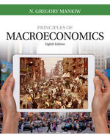
Syllabus and Our Course
The syllabus provides an outline of what we will do this semester:
See the outline for dates and chapters
This week I will talk about Chapters 1 and 2 as well as some other basic ideas.
The required textbook

Slide 3
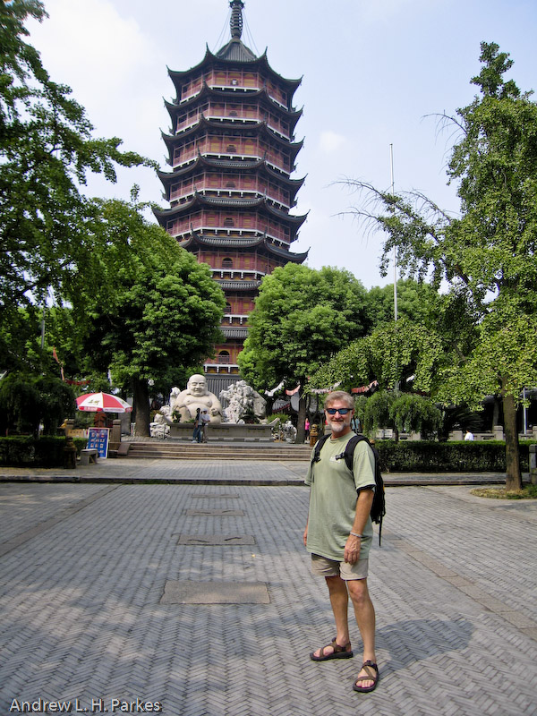
SEE Bb Learn and MY WEBSITE: andrewparkes.com
Visit Often and regularly
Kept ahead of class
Links and PowerPoint
Other information
andrew@andrewparkes.com
Info like this =>
Total Public Debt Outstanding
$ 9,139,880,193,861.94 – 11/29/2007
$ 13,788,289,275,079.99 – 11/24/2010
$ 19,941,807,383,847.05 – 1/12/2017
$19,845,100,367,124.09 – 8/24/2017

Slide 4
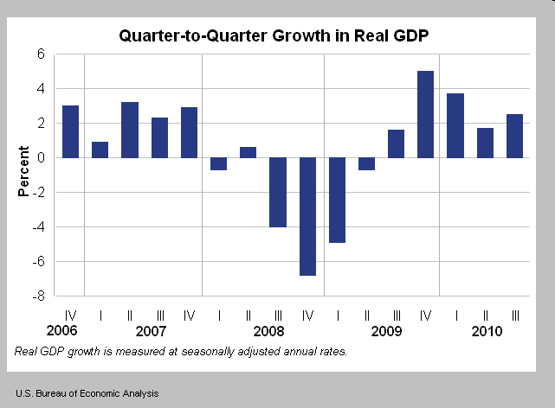
U. S. Real GDP 2006 - 2010
http://www.bea.gov/newsreleases/national/gdp/gdp_glance.htm
The Great Recession!

Slide 5
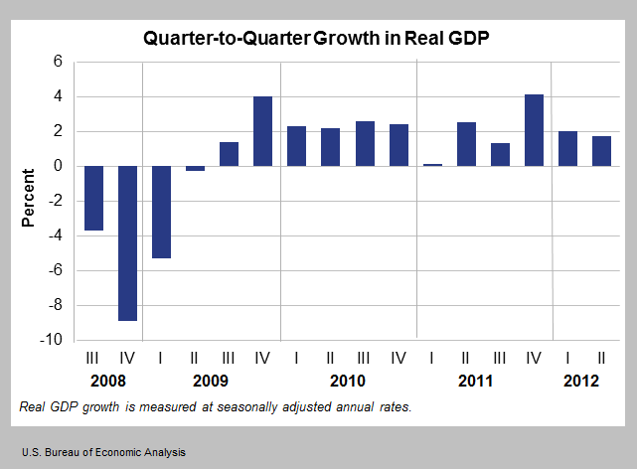
U. S. Real GDP 2008 - 2012
http://www.bea.gov/newsreleases/national/gdp/gdp_glance.htm
The Great Recession!

Slide 6
U. S. Real GDP 2012 - 2016
http://www.bea.gov/newsreleases/national/gdp/gdp_glance.htm
Macroeconomics Day 1

Slide 7
U. S. Real GDP 2013 - 2017
http://www.bea.gov/newsreleases/national/gdp/gdp_glance.htm
Macroeconomics Day 1

Slide 8
Consumer Price Index – All Items
https://fred.stlouisfed.org/graph/?s[1][id]=CPIAUCNS

Slide 9
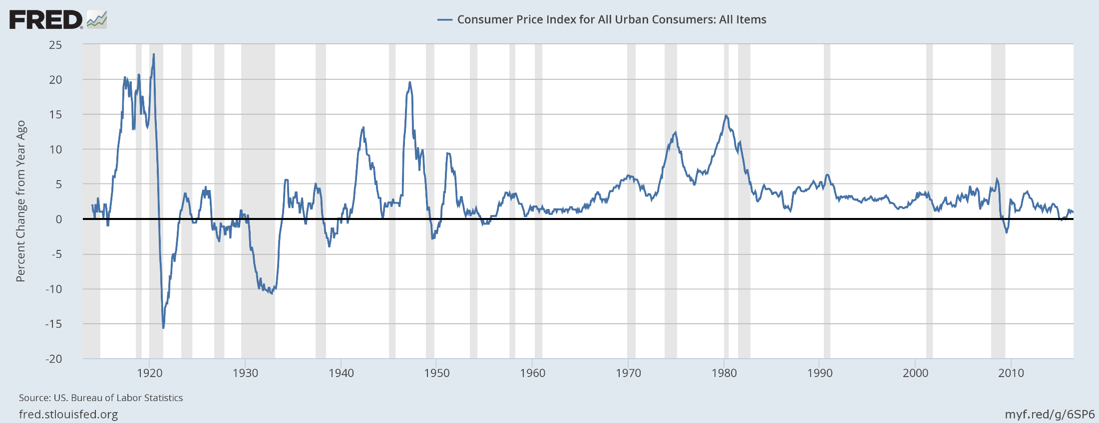
CPI percent change from a year ago – All Items
https://fred.stlouisfed.org/graph/?chart_type=line&s[1][id]=CPIAUCNS&s[1][transformation]=pc1

Slide 10
Just a few things we will learn about during this term

Slide 11
Entrepreneurs!
What makes an entrepreneur?
Being a risk taker
Specifically: A person that takes initiative by organizing a venture to gain from the benefit of an opportunity.

Slide 12
#1. Who is this? What company does he help run?

Slide 13
HINTS!

Slide 14
And Neuralink Corp.

Slide 15
2. Who was this?

Slide 16
What companies did he create?
Apple
NeXT
Pixar …
THEN the iPod, iPad, iPhone, etc.

Slide 17
3. Who is this?

Slide 18
What did she create?
In 1984, she took over daytime TV from Phil Donahue.
HARPO Productions
OWN
Multi-Billionaire

