Slide 1
10
Aggregate Supply

Slide 2
How do producers react when the economy's price level increases?
If the economy is already operating at full employment, how can it produce more?
What's your normal capacity for academic work, and when do you exceed that effort?
What valuable piece of information do employers and workers lack when they negotiate wages?
Why do employers and workers fail to agree on pay cuts that could save jobs?

Slide 3
Aggregate Supply in the Short Run
Aggregate supply, AS
Relationship between the price level
And output firms are willing and able to supply
Other things constant
Resource prices
State of technology and know-how
Rules of the game

Slide 4
Labor and Aggregate Supply
Labor
Most important resource
Account for about 70% of production costs
Supply of labor depends on
Size and abilities of adult population
Preferences for work versus leisure
Higher wage
More labor supplied

Slide 5
Labor and Aggregate Supply
Higher price level
The less the money wage purchases
The less attractive that wage to workers
Nominal wage
In dollars of the current year
Real wage
In dollars of constant purchasing power
Wage negotiation
Based on the expected price level

Slide 6
Potential Output
Potential output
Output level when there are no surprises about price level
Economy’s maximum sustainable output, given
Supply of resources
Technology and know-how
Rules of the game
Natural rate of output
Full-employment rate of output

Slide 7
Natural Rate of Unemployment
Natural rate of unemployment
Unemployment rate when the economy produces its potential output
No cyclical unemployment
Some frictional, structural and seasonal unemployment exists
Has ranged from 4% to 6%
Estimated at 5.0% to 5.2% in 2015

Slide 8
Actual Price Level Higher Than Expected
Short run in macroeconomics
Period during which some resource prices
Especially those for labor
Remain fixed by explicit or implicit agreements
Output in the short run
Can exceed the economy’s potential
Can fall short of that potential

Slide 9
Actual Price Level Higher Than Expected
Price level > expected
Higher profit per unit
Profit incentive in the short run to increase production
Economy’s output > potential
But the higher rate of output is not sustainable in the long run
Unemployment < natural rate

Slide 10
Actual Price Level Higher Than Expected
Why costs rise when output exceeds potential?
Additional pay for overtime
Extra pay to draw additional workers into the labor force
Prices of nonlabor resources increase
Equipment wears out faster
Increased per-unit production cost, but the price level rises faster

Slide 11
Actual Price Level Lower Than Expected
Price level < expected
Firms find production less profitable
Prices firms receive for their output are on average lower than they expected
But many of their production costs do not fall
Reduce quantity supplied
Economy’s output < potential
Unemployment > natural rate
Cyclical unemployment increases

Slide 12
Actual Price Level Lower Than Expected
Decreased per-unit production cost
Some workers are laid off, some work fewer hours
Equipment goes unused
Resource prices decline in markets where prices are flexible
Prices fall more than costs

Slide 13
Short-Run Aggregate Supply Curve
Short-run aggregate supply curve, SRAS
Shows a direct relationship between the actual price level and real GDP supplied in the short run
Other things constant, including the expected price level
Price level is as expected
Producers supply the economy’s potential output
Unemployment is at its natural rate

Slide 14
Exhibit 1
Short-Run Aggregate Supply Curve
Potential
output
The short-run aggregate supply curve is based on a given expected price level, in this case, 110. Point a shows that if the actual price level equals the expected price level of 110, firms supply potential output. If the actual price level exceeds 110, quantity supplied exceeds potential. If the actual price level is below 110, quantity supplied is less than potential. Output levels that fall short of the economy’s potential are shaded pink; output levels that exceed the economy’s potential are shaded blue.
Price
level
SRAS₁₁₀
120
110
a
100
0
17.0
Real GDP (trillions of dollars)

Slide 15
From the Short Run to the Long Run
Short-run equilibrium
Price level and real GDP when:
Aggregate demand curve intersects the short-run aggregate supply curve
Long run
Wage contracts and resource price agreements can be renegotiated
No surprises about the economy’s price level

Slide 16
From the Short Run to the Long Run
Expansionary gap
Amount by which actual output in the short run exceeds the economy’s potential output
The more that short run output exceeds the economy’s potential
The larger the expansionary gap
The greater the upward pressure on the price level

Slide 17
From the Short Run to the Long Run
Long run in macroeconomics
A period during which wage contracts and resource price agreements can be renegotiated
There are no surprises about the economy’s actual price level
Recessionary gap
Amount by which actual output in the short run falls short of the economy’s potential output

Slide 18
Closing an Expansionary Gap
AD greater than expected, short run:
Price level > expected
Output > potential
Unemployment < natural rate
Expansionary gap
Inflationary pressure

Slide 19
Exhibit 2
Long-Run Adjustment When the Price Level
Exceeds Expectations
If the expected price level is 110, the short-run aggregate supply curve is SRAS₁₁₀. If the actual price level turns out as expected, the quantity supplied is the potential output of $17.0 trillion.
But here the price level ends up higher than expected, and output exceeds potential, as shown by the short-run equilibrium at point b. The amount by which actual output exceeds the economy’s potential output is called the expansionary gap.
In the long run, price-level expectations and nominal wages will be revised upward. Costs will rise and the short-run aggregate supply curve will shift leftward to SRAS₁₂₀. Eventually, the economy will move to long-run equilibrium at point c, thus closing the expansionary gap.
Potential output
LRAS
Price
level
SRAS₁₂₀
SRAS₁₁₀
120
c
115
b
110
a
AD
0
17.0
17.2
Real GDP
(trillions
of dollars)
Expansionary
gap

Slide 20
Closing an Expansionary Gap
In the long run
Higher nominal payments
Higher production costs
SRAS shifts left
Cost-push inflation
Lower output
Long run equilibrium

Slide 21
Closing an Expansionary Gap
Long run equilibrium
Expected price level = actual price level
Quantity supplied in SR = potential output = Quantity supplied in LR
Quantity supplied = quantity demanded

Slide 22
Closing a Recessionary Gap
AD lower than expected, short run
Price level < expected
Output < potential
Unemployment > natural rate
Recessionary gap
Deflationary pressure

Slide 23
Exhibit 3
Long-Run Adjustment When the Price Level Is
Below Expectations
When the actual price level is below expectations, as indicated by the intersection of the aggregate demand curve AD” with the short-run aggregate supply curve SRAS₁₁₀, short-run equilibrium occurs at point d. Production below the economy’s potential opens a recessionary gap of $0.2 trillion.
If prices and wages are flexible enough in the long run, nominal wages will be renegotiated lower. As resource costs fall, the short-run aggregate supply curve eventually shifts rightward to SRAS₁₀₀ and the economy moves to long-run equilibrium at point e, with output increasing to the potential level of $17.0 trillion
Potential output
LRAS
Price
level
SRAS₁₁₀
SRAS₁₀₀
110
a
105
d
100
e
AD″
0
16.8
17.0
Real GDP
(trillions
of dollars)
Recessionary
gap

Slide 24
Closing a Recessionary Gap
In the long run
Lower nominal wages
Lower cost of production
SRAS shifts right
Deflation
Greater output
Long run equilibrium

Slide 25
Long-Run Aggregate Supply Curve
Long-run aggregate supply curve, LRAS
Vertical line at the economy’s potential output
Aggregate supply when
There are no surprises about the price level
All resource contracts can be renegotiated
If wages and prices are flexible enough
The economy produces its potential output in the long run

Slide 26
Tracing Potential Output
Long-run aggregate supply curve, LRAS, depends on
Supply of resources in economy
Level of technology and know-how
Production incentives
Long-run equilibrium
Output = LRAS = potential output
Price level: depends on AD curve

Slide 27
Exhibit 4
Long-Run Aggregate Supply Curve
Potential output
LRAS
In the long run, when the actual price level equals the expected price level, the economy produces its potential. In the long run, $17.0 trillion in real GDP is supplied regardless of the actual price level. As long as wages and prices are flexible enough, the economy’s potential GDP is consistent with any price level.
Thus, shifts of the aggregate demand curve, in the long run, do not affect potential output. The long-run aggregate supply curve, LRAS, is a vertical line at potential GDP.
Price
level
120
b
110
a
100
c
AD′
AD
AD″
0
17.0
Real GDP
(trillions of dollars)

Slide 28
Wage Flexibility and Employment
Expansionary gap
Creates a labor shortage
Higher nominal wage
Higher price level
Recessionary gap
Nominal wages = “sticky” downward
Slow to close the gap

Slide 29
U.S. Output Gaps and Wage Flexibility
Recessionary gap
Resulting from a coordination failure
Workers and employers fail to achieve an outcome that all would prefer
“Sticky” wages downward
Why not shorter contracts?
Negotiating contracts
Costly and time consuming

Slide 30
U.S. Output Gaps and Wage Flexibility
Negotiating long-term contracts
Reduced cost of negotiation
Reduce frequency of strikes and lockouts
When demand is slack, layoffs instead of cutting nominal wages
Employers: lower wages hurts morale and reduce productivity
The incentive to accept a lower wage is reduced by the prospect of unemployment benefits

Slide 31
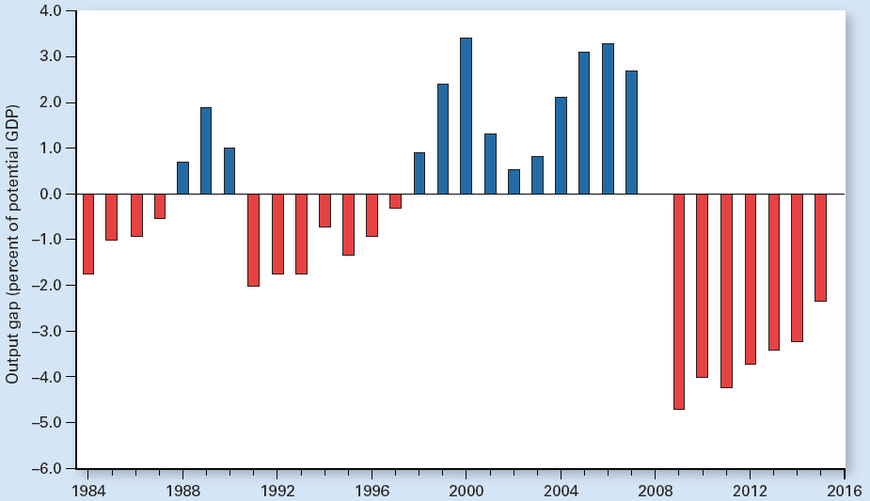
Exhibit 5
The U.S. Output Gap: Red Bars Show Actual Output Below
Potential Output and Blue Bars Show Actual Output
Exceeding
Potential
Output
The output gap each year equals actual GDP minus potential GDP as a percentage of potential GDP. When actual output exceeds potential output, the output gap is positive and the economy has an expansionary gap, as shown by the blue bars. When actual output falls short of potential output, the output gap is negative and the economy suffers a recessionary gap, as shown by the red bars. Note that the economy need not be in recession for actual output to fall below potential output.

Slide 32
U.S. Output Gaps and Wage Flexibility
The Great Recession
High unemployment rates
Yet 9 in 10 workers still had jobs
Congress extended unemployment
Some states added to that extension
New York: some unemployed workers were eligible for up to 99 weeks of benefits

Slide 33
Aggregate Supply Increases
Aggregate supply increases, LRAS
Increased quantity and quality of labor
Size, composition, or quality of the labor force
Preferences for labor versus leisure
Increased quantity and quality of other resources
Capital stock, land
Institutional changes
Clearer patent and copyright laws

Slide 34
Exhibit 6
Effect of a Gradual Increase in Resources on AS
LRAS
LRAS′
A gradual growth in the supply of resources increases the potential GDP—in this case, from $17.0 trillion to $17.5 trillion. The long-run aggregate supply curve shifts to the right.
Price level
0
17.0
Real GDP
(trillions of dollars)
17.5

Slide 35
Aggregate Supply Increases
Supply shocks
Unexpected events that affect AS
Sometimes only temporarily
Beneficial supply shocks: increase AS
Abundant harvests
Technological breakthroughs
Discoveries of natural resources
Sudden changes in economic system that promote more production
Higher output and lower price level

Slide 36
Exhibit 7
Effects of a Beneficial Supply Shock on AS
LRAS
LRAS′
A beneficial supply shock that has a lasting effect, such as a breakthrough in technology, permanently shifts both the short-run and the long-run aggregate supply curves to the right. A beneficial supply shock lowers the price level and increases output, as reflected by the change in equilibrium from point a to point b. A temporary beneficial supply shock shifts the aggregate supply curves only temporarily.
SRAS₁₁₀
Price
level
SRAS₁₀₅
110
a
105
b
AD
0
17.0
17.2
Real GDP
(trillions
of dollars)

Slide 37
Aggregate Supply Decreases
Adverse supply shocks
Unexpected events that reduce aggregate supply, sometimes only temporarily
A drought
Overthrow of government
Terrorist attacks
Stagflation
Lower output
Higher price level

Slide 38
Exhibit 8
Effects of an Adverse Supply Shock on AS
LRAS″
LRAS
Given the aggregate demand curve, an adverse supply shock, such as a drought, shifts the short-run and long-run aggregate supply curves to the left, increasing the price level and reducing real GDP, a movement called stagflation. This change is shown by the move in equilibrium from point a to point c. If the shock is just temporary, the shift of the aggregate supply curves will be temporary.
Price
level
SRAS₁₁₅
SRAS₁₁₀
115
c
110
a
AD
0
16.8
Real GDP
(trillions of dollars)
17.0

Slide 39
Hysteresis
Hysteresis
The theory that the natural rate of unemployment depends in part on the recent history of unemployment
A long period of high unemployment can increase the natural rate of unemployment
The longer the actual unemployment rate remains above what had been the natural rate, the more the natural rate itself increases

Slide 40
Hysteresis
Natural rate of unemployment has increased in Europe
Hysteresis
Generous unemployment benefits indefinitely, reducing the hardship of unemployment
Benefits are 60% to 80% of lost pay
Legislation: more difficult to layoff workers
Mandatory severance pay

