Slide 1
12
Federal Budgets and Public Policy

Slide 2
How big is the U.S. federal budget, and where does the money go?
Why is the federal budget process such a tangled web?
In what sense is the federal budgeting process at odds with discretionary fiscal policy?
How is a sluggish economy like an empty restaurant?
Why has the federal budget been in deficit most years?
What is the federal debt, and who owes it to whom?
Can a nation run deficits year after year and decade after decade?

Slide 3
The Federal Budget Process
Federal budget: About $4,000,000,000,000 a year
A plan for federal government outlays and revenues, for a specified period, usually a year
Federal outlays, 2016
Government purchases
Transfer payments (redistributed income)
Social Security and Medicare: 38% of outlays
Welfare: 14% of outlays

Slide 4
The Federal Budget Process
Federal outlays, 2016
52% redistributes income (Social Security, Medicare, welfare)
15% for national defense
7% interest on federal debt
26% for everything else (environment protection, education, prisons, and so on)

Slide 5
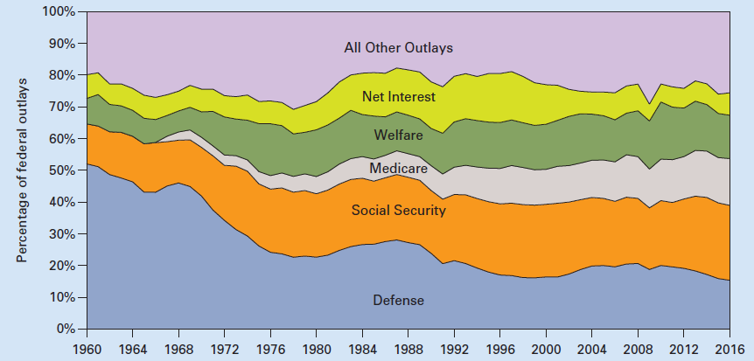
Exhibit 1
Defense’s Share of Federal Outlays Declined Since
1960 and Redistribution Increased

Slide 6
Presidential and Congressional Roles
The President
Budget proposal
Budget request from each agency
“The Budget of US government” to Congress
Council of Economic Advisers
“Economic Report of the President”
House and Senate
Budget committees: Budget resolution

Slide 7
Presidential and Congressional Roles
Budget resolution
Congressional agreement about
Total outlays
Spending by major category
Expected revenues
Guides spending and revenue decisions
By the many congressional committees and subcommittees

Slide 8
Presidential and Congressional Roles
Budget deficit: Outlays > Revenues
Stimulates AD in short-run
Increases the federal debt and reduces national saving
Long-run: hinders economic growth
Budget surplus: Revenues > Outlays
Dampens AD in short-run
Reduces the federal debt and boosts domestic saving
Long-run: promote economic growth

Slide 9
Problems
Problems with the federal budget process
Continuing resolutions instead of budget decisions
Spend at the rate of previous year’s budget
Lengthy budget process
Uncontrollable budget items
Entitlement programs
Overly detailed budget

Slide 10
Possible Budget Reforms
Biennial budget (two-year budget)
Congress now spends nearly all of the year working on the budget
The executive branch is always dealing with three budgets:
Administering an approved budget
Defending a proposed budget before congressional committees
Preparing the next budget for submission to Congress

Slide 11
Possible Budget Reforms
Simplify the budget document
Concentrate only on major groupings and eliminating line items
Drawback: agency heads may have priorities that from those of elected representatives
Plus: elected officials would be less able to insert favorite pork-barrel projects into the budget

Slide 12
Fiscal Impact of the Federal Budget
Rationale for deficits
Outlays that increase economy’s productivity
Budget philosophies and deficits
Annually balanced budget
Cyclically balanced budget
Functional finance

Slide 13
Fiscal Impact of the Federal Budget
Annually balanced budget
Prior to the Great Depression
Aimed at matching annual revenues with outlays, except during times of war
Spending increases during expansions and declines during recessions
Magnifies fluctuations in the business cycle

Slide 14
Fiscal Impact of the Federal Budget
Cyclically balanced budget
Budget deficits during recessions to be financed by budget surpluses during expansions
Dampens swings in the business cycle without increasing the federal debt

Slide 15
Fiscal Impact of the Federal Budget
Functional finance
Using fiscal policy to achieve the economy’s potential GDP, rather than balancing budgets either annually or over the business cycle
The federal budget has been in deficit in all but 14 years since 1929
Chronic deficits accumulate into a crippling federal debt

Slide 16
Federal Deficits Since the Birth of the Nation
1789-1929
Deficits: 33% of the time (war)
Since the onset of the Great Depression
Deficits: 84% of years
1980s relatively large deficits
Large tax cuts
Increase in defense spending

Slide 17
Federal Deficits Since the Birth of the Nation
1990s: improved economy
Decreasing deficits
By 1998: budget surplus
2001 recession
Tax cuts
Higher federal spending
Deficits
Weak recovery, war against terrorism
2003, deficit 3.5 % of GDP

Slide 18
Federal Deficits Since the Birth of the Nation
2004 – 2007: stronger economy, rising stock market
Deficit 1.2% of GDP
Global financial crisis and the Great Recession of 2007 – 2009
Reduced revenues and expanded outlays

Slide 19
Federal Deficits Since the Birth of the Nation
2009 – 2012 deficits
2009 deficit: $1.4 trillion (9.8% of GDP)
2010 – 2012 deficits topped $1.0 trillion each year
8.6% of GDP, 2010
8.4% of GDP, 2011
6.7% of GDP, 2012
About 36 cents of every dollar of federal spending had to be borrowed

Slide 20
Federal Deficits Since the Birth of the Nation
2013 – 2016 deficits
Added more than $2 trillion to the federal debt
4.1% of GDP, 2013
2.8% of GDP, 2014
3.2% of GDP, 2015
2.5% of GDP, 2016
2017 – 2024 projections
Projected to add another $4.4 trillion to federal debt during this period

Slide 21
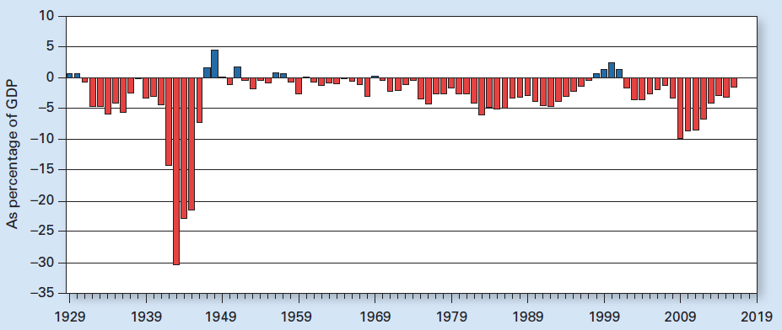
Exhibit 2
Federal Deficits and Surpluses Relative to GDP Since
the Great Depression

Slide 22
Why Deficits Persist
Decreasing tax revenues
Increasing government outlays
Federal officials
Not required to balance the budget
Elected officials: maximize political support
Big spending programs
Small taxes
Pork-barrel spending

Slide 23
Crowding Out and Crowding In
Increase budget deficits: increase spending without raising taxes
Reduces the supply of national saving, leading to higher interest rates
Crowd out private investment
Because of higher interest rates
Crowd in private investment
Because of optimistic business expectations

Slide 24
Crowding Out and Crowding In
Crowding out
Displacement of interest-sensitive private investment that occurs when higher government deficits drive up market interest rates
Crowding in
The potential for government spending to stimulate private investment in an otherwise dead economy

Slide 25
The Twin Deficits
Finance huge fiscal deficits
U.S. Treasury – sells IOUs
Higher interest rates
Greater demand for $
Dollar appreciation
U.S. trade deficit increase
Foreigners buy U.S. assets
Greater investment from abroad
Offset a decline in U.S. savings

Slide 26
The Short-Lived Budget Surplus
Tax increases
1990, George H. W. Bush imposed spending cuts, tax increases,
1993, Bill Clinton increased tax rate on higher income households,
Vigorous economic recovery during 1990s
Increased federal revenue
Additional $250 billion in tax revenue by 2000

Slide 27
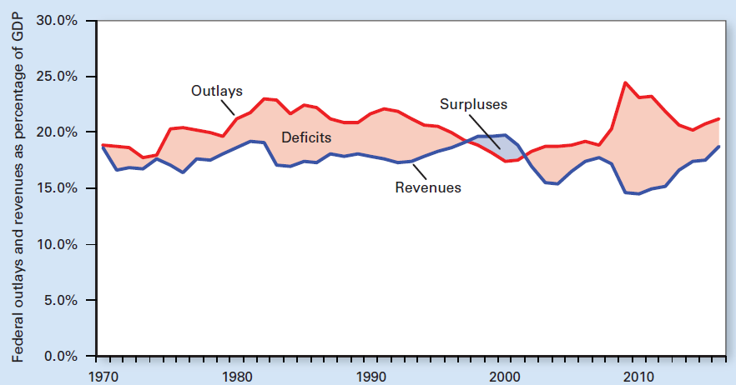
Exhibit 3
The Great Recession of 2007–2009 Cut Federal Revenues and
Increased Federal Outlays, Resulting in Huge Deficits

Slide 28
The Short-Lived Budget Surplus
Slower growth in federal outlays
1990-2000: Reduced U.S. military presence abroad
30% drop in defense spending
Little domestic spending growth
Interest rates decreased
Saving billions in interest charges on the national debt
Decrease in federal outlays

Slide 29
The Short-Lived Budget Surplus
A reversal of fortune in 2001
By 2000, federal budget surplus of $236 billion
From a deficit that had topped $290 billion in 1992
2001, unemployment increased
The stock market sank; Terrorist attacks
Cut taxes and increased federal spending
2002 Federal deficit returned

Slide 30
The Short-Lived Budget Surplus
Financial crisis of 2008 and the Great Recession of 2007–2009
Increased budget deficits because of
Lower federal revenues
Increased federal spending
Lower federal revenues
Falling employment, income, and profits
Discretionary tax cuts
Revenues dropped: 17.7% of GDP in 2007 to 14.6% in 2009

Slide 31
The Short-Lived Budget Surplus
Increased federal spending
Automatic stabilizers
Unemployment benefits and welfare payments increased federal outlays
Discretionary spending
Bailouts and the $831 billion stimulus plan
Federal outlays grew
From 18.8% of GDP in 2007 to 24.4% in 2009

Slide 32
The Short-Lived Budget Surplus
Federal deficit
$161 billion in 2007
$459 billion in 2008
$1.4 trillion in 2009
$1.0 trillion plus in 2010, 2011, 2012

Slide 33
The Short-Lived Budget Surplus
Sequestration, 2012-2021
Automatic cuts to certain categories of federal spending
Enacted in 2011 to reduce the growth of federal spending from 2012 to 2021
To slow spending growth by a total of $1.1 trillion
Exempt: Social Security, Medicaid, federal pensions, and veterans benefits

Slide 34
The Short-Lived Budget Surplus
Sequestration, 2012-2021
Cut $85 billion a year, 2.4% of the budget
Nondefense spending programs – cut by 6.5% a year, $294 billion over 10 years
Defense – cut by 9.0% a year, $454 billon total
Medicare – cut by 2.0%, or $170 billion total
Interest payments on the debt - cut by $170 billion total
Helped keep federal spending flat in 2012, 2013, and 2014

Slide 35
The Relative Size of the Public Sector
Federal, state, and local governments
Government outlays relative to GDP
U.S.
36% in 1997
38% in 2016
Average of 10 industrialized countries: 43%

Slide 36
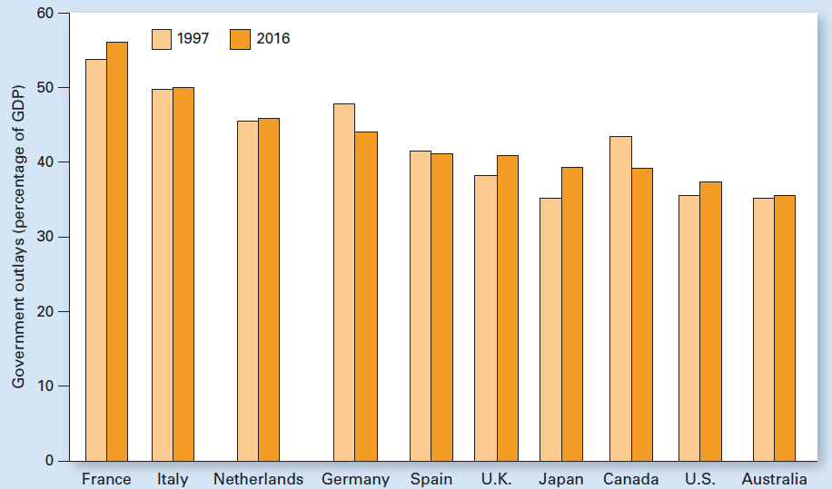
Exhibit 4
Government Outlays as a Percentage of GDP in 1997 and 2016
Government outlays relative to GDP increased in 7 of the 10 industrial economies between 1997 and 2016. The 10-country average increased slightly from 42 percent to 43 percent. In the United States, the percentage increased from 36 to 38.

Slide 37
The National Debt in Perspective
National debt (federal debt)
Net accumulation of federal budget deficits
National debt in perspective
Changes over time
U.S. government debt levels compared with those in other countries
Interest payments on the national debt
Who bears the burden of the national debt
What impact does the national debt have on the nation’s future

Slide 38
Measuring the National Debt
Gross debt, 2015: $18.6 trillion
US Treasury notes purchased by various federal agencies
Federal government owes this debt to itself
Debt held by the public, 2015: $13.5 trillion
US Treasury securities held by
Households; Firms; Banks (including the Fed)
Foreign entities
Measure debt over time
Relative to GDP

Slide 39
Measuring the National Debt
Debt relative to GDP
Ignores the fact that the federal government is on the hook to pay Social Security and Medicare benefits
The U.S. Congress exempts itself from including the cost of promised retirement benefits in the budget
As of 2015, the federal government should have $25 trillion set aside and earning interest to cover Social Security retirement benefits

Slide 40
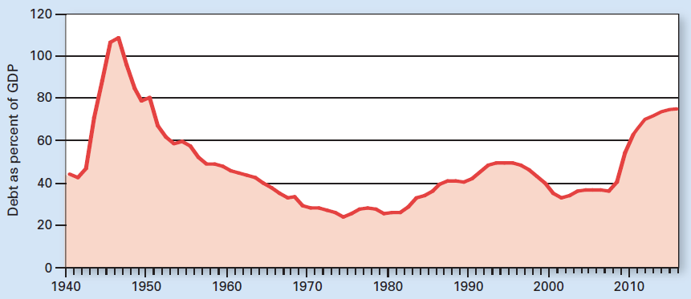
Exhibit 5
Federal Debt Held by the Public as Percent of GDP Spiked Because of the Great Recession
The huge cost of World War II rocketed federal debt from 44 percent of GDP in 1940 to over 100 percent by 1946. During the next few decades, GDP grew faster than federal debt so by 1980, federal debt had dropped to only 26 percent of GDP. But high deficits in recent years increased federal debt to 75 percent relative to GDP by 2016. That's double the percentage in 2007 and the highest since the early 1950s.

Slide 41
International Perspective on Public Debt
International perspective on public debt
Different economies, different fiscal structures
10 industrialized nations, average 72% relative to GDP, 2016
U.S.: 86%; Australia: 6%; Japan: 150%
Average among the 30 most advanced economies
Increased from 35% in 2000 to 72% in 2016

Slide 42
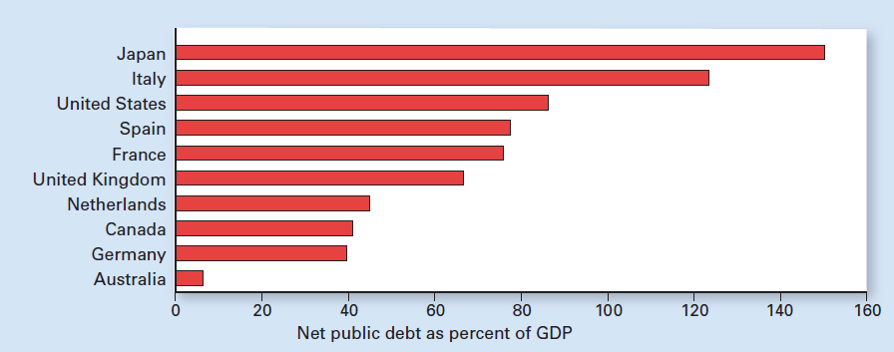
Exhibit 6
Relative to GDP, U.S. Net Public Debt Is Above Average for Major Economies in 2016

Slide 43
Interest Payments on the National Debt
Buyers of federal securities
Individuals, $25 U.S. savings bonds
Institutions, $1 million Treasury securities
Nearly half the national debt is refinanced every year
$13.5 trillion debt held by the public in 2015
A 1 percentage point increase in the nominal interest rate
Increases interest costs by $135 billion a year

Slide 44
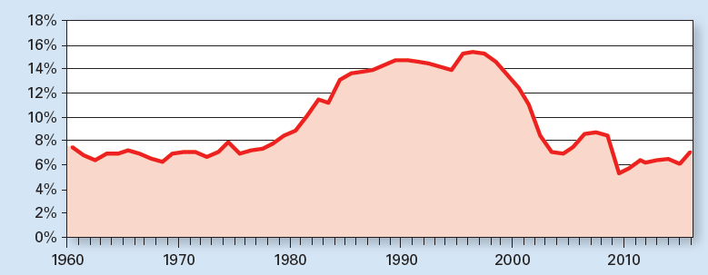
Exhibit 7
Interest Payments on Federal Debt Held by the Public as Percent of Federal Outlays Peaked in 1996
After remaining relatively constant during the 1960s and 1970s, interest payments as a share of federal outlays climbed during the 1980s and early 1990s because of growing deficits and higher interest rates. After peaking in 1996 at 15.4 percent of outlays, interest payments declined first because of budget surpluses and later because of record-low interest rates.

Slide 45
Are Persistent Deficits Sustainable?
How long can the country run a deficit?
As long as lenders are willing to finance that deficit at reasonable interest rates
Depends on the confidence that lenders have about getting repaid
U.S. government securities
Considered the safest in the world
Helped us finance our chronic deficits and rising debt

Slide 46
Are Persistent Deficits Sustainable?
Global financial crisis
Encouraged investors around the globe to buy U.S. securities
“Flight to quality”
Drove down the interest rate the U.S. government had to pay
Reducing the cost of servicing our debt

Slide 47
Are Persistent Deficits Sustainable?
Indebted countries
Greece, Ireland, Spain, and Portugal
Received rescue packages from international institutions
Yet they continued to struggle
One sign of possible problems in the U.S.
The downgrading of the nation’s credit risk
By the chief credit-rating agency in 2011

Slide 48
Are Persistent Deficits Sustainable?
Countries can continue to run deficits
As long as the cost of servicing the resulting debt remains manageable
As long as the economy is growing at least as fast as the debt service payments
Those deficits should be manageable
Trillion dollar deficits were not sustainable

Slide 49
The Debt Ceiling and Debt Default
Debt ceiling
A limit on the total amount of money the federal government can legally borrow
Congress
Set the first debt ceiling about a century ago
Raised it whenever necessary
More than 80 times in all

Slide 50
The Debt Ceiling and Debt Default
2011, sharply rising debt
From giant deficits for years to come
Early 2011, the gross debt ceiling stood at $14.3 trillion - reached in May 2011
The U.S. Treasury - able to buy time by suspending payments to some retirement funds
Government was borrowing about 40 cents of each dollar spent
Without additional borrowing the Treasury would run out of money

Slide 51
The Debt Ceiling and Debt Default
If the debt ceiling had not been raised
The U.S. government would have missed some debt-service payments and would be in default
Would have triggered a cascade of troubles
Sharply higher cost of borrowing
Inability to borrow

Slide 52
The Debt Ceiling and Debt Default
If the debt ceiling had not been raised
Default on ‘the securest investment in the world’
Catastrophic for world financial markets
Increase sharply
Federal cost of borrowing
Market interest rates (to reflect a riskier economy
Drying credit flows

Slide 53
The Debt Ceiling and Debt Default
If the debt ceiling had not been raised
Unemployment would jump
The Congress: the debt ceiling should be raised
Republicans: reduce future deficits by cutting spending
Democrats: tax increases, especially on high-income households

Slide 54
Who Bears the Burden of the Debt?
Deficit spending
Billing future taxpayers for current spending
We owe it to ourselves
Future generations
Service the debt
Receive the payments

Slide 55
Who Bears the Burden of the Debt?
Foreign ownership of debt
Increase burden of debt on future generations of Americans
Future debt service payments no longer remain in the country
Foreigners hold about half of all federal debt held by the public in 2015

Slide 56
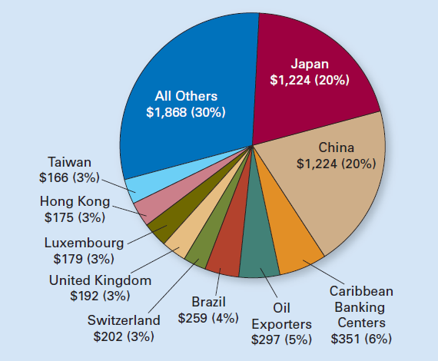
Exhibit 8
Largest Foreign Holders of U.S. Treasury Securities as of February 2015 (in billions and as percent of foreign holdings)

Slide 57
Crowding Out and Capital Formation
Government borrowing
Can drive up interest rates
Crowding out some private investment
Long-run effect of deficit spending
Depends on how the government spends the borrowed funds

Slide 58
Crowding Out and Capital Formation
If borrowed dollars are invested in public capital
Better highways and a more educated workforce
Enhance productivity in the long run

Slide 59
Crowding Out and Capital Formation
If borrowed dollars go toward current expenditures
More farm subsidies or higher retirement benefits
Less capital formation
Less capital in the future
Hurting labor productivity and our future standard of living

Slide 60
National Debt and Economic Growth
Impact of the national debt on economic growth
Major public debt episodes in the advanced economies around the world
Ratio of public debt to GDP exceeds 90% for at least five years in a row
Growth slowdown
At least one percentage point less growth annually
Can last a long time

Slide 61
National Debt and Economic Growth
Impact of the national debt
26 instances
20 lasted more than a decade
5 of the 6 shorter episodes were immediately after World Wars I and II
Average duration of the slowdown
23 years
Potentially huge cumulative shortfall in output

Slide 62
National Debt and Economic Growth
Impact of the national debt
Growth declines are significant
Even if debtor countries were able to secure continual access to capital markets at relatively low real interest rates
Government deficits of one generation
Can affect the standard of living of the next

Slide 63
National Debt and Economic Growth
Our current measure of the national debt
Does not capture all burdens passed on to future generations
More than double national debt
Unfunded liabilities of government retirement programs
Especially Medicare

Slide 64
Reforming Social Security and Medicare
Social Security
Federal redistribution program established during the Great Depression
Collects payroll taxes from current workers and their employers
To pay pensions to current retirees
Average $1,300 per month for each of the more than 48 million beneficiaries
More than half the income for two-thirds of retirees
Benefits increase each year to keep up with inflation as measured by the CPI

Slide 65
Reforming Social Security and Medicare
Medicare
Established in 1965 to provide short-term medical care for the elderly
In-kind transfer program
Funded in part by payroll taxes on current workers and their employers
Beneficiaries also pay premiums depending on their income

Slide 66
Reforming Social Security and Medicare
Medicare, in 2015
Helped pay medical expenses
For more than 40 million Americans age 65 and older
Plus about 8 million other people with disabilities
Costs: averaged about $11,400 per beneficiary
And are growing much faster than inflation

Slide 67
Reforming Social Security and Medicare
Social Security and Medicare
Credited with helping reduce poverty among the elderly
From about 35% in 1960 to under 10% most recently
A poverty rate below other age groups

Slide 68
Reforming Social Security and Medicare
The population
Americans are living longer
Fertility rates have declined
Health care costs are rising faster than inflation
76 million baby boomers
Huge impact on Medicare, a pay-as-you-go system

Slide 69
Reforming Social Security and Medicare
65-and-older population
Will nearly double by 2030: 72 million people
About 20% of the U.S. population
Pay-as-you-go Medicare system
42 workers per retiree, 1945
2.8 workers per retiree, today
2.1 workers per retiree, by 2030

Slide 70
Reforming Social Security and Medicare
Spending on Social Security and Medicare
Now: 8% relative to GDP and 38% of federal outlays
By 2030: 14% relative to GDP and over 50% of federal outlays
Huge sucking sound: the federal deficit arising mostly from Social Security and Medicare

Slide 71
Reforming Social Security and Medicare
Because of the 2007–2009 recession
Social Security tax receipts declined as people lost jobs
Outlays increased as some of those out of work decided to retire early
2010: Social Security payouts exceeded pay-ins for the first time in history
By $50 billion - that wasn’t supposed to happen until 2016
More pressure on the entire federal budget

Slide 72
Reforming Social Security and Medicare
Prior to 2010
Social Security pay-ins exceeded payouts
This surplus would accumulate over time
So there would be funds available when baby boomers started to retire
But Congress never saved any of the surplus
Instead they raked it off
Put IOUs in the Social Security Trust Fund
Then spent the surplus

Slide 73
Reforming Social Security and Medicare
Medicare costs
Growing an average of 7% per year
Some people put off surgeries such as hip replacements until they become eligible for Medicare
Payroll taxes that are supposed to pay for Medicare cover less than half the annual cost of the program

Slide 74
Reforming Social Security and Medicare
Possible reforms
Increasing taxes
Reducing benefits
Raising the eligibility age
Using a more accurate index to calculate the annual cost-of-living increase in benefits
Cutting benefits to wealthy retirees
Slowing the growth of Medicare costs

Slide 75
Reforming Social Security and Medicare
Social Security and Medicare
Helped reduce poverty among the elderly
Grow more costly
As the elderly population swells
As the flow of young people into the workforce slows
Social Security – created in 1930s
Life expectancy was 60 years
Now people live 20 years longer

Slide 76
Reforming Social Security and Medicare
President Obama and the Congress
Raised Medicare payroll taxes on high income households
But used that to fund health care reform more generally, not Medicare in particular
Most elected officials
Reluctant to address the problem of Social Security and Medicare
Because they fear upsetting senior voters, a powerful political bloc

Slide 77
Reforming Social Security and Medicare
During the next decade
Social Security cost – will grow by 77%
Medicare cost – will grow by 89%
Measure enacted in 2013
Cut the growth of Medicare spending by 2% per year
Reduce the growth in spending by $170 billion between 2014 and 2021
Healthcare reform has started to control the cost per Medicare beneficiary

