Slide 1
14
Banking and the Money Supply

Slide 2
How is the Fed both literally and figuratively a money machine?
How do banks create money?
Why are banks called First Trust or Security National rather than Benny’s Bank or Loans ‘R’ Us?
Why are we so interested in banks, anyway?
After all, isn’t banking a business like any other, such as dry cleaning, auto washing, or home remodeling?
Why not devote a chapter to the home-remodeling business?

Slide 3
Money Aggregates
Money aggregates
Measures of the economy’s money supply
Defined by the Fed
M1 = Narrow definition of money
Currency and coins held by nonbanking public
Checkable deposits
Traveler’s checks

Slide 4
Money Aggregates
Checkable deposits
Bank deposits that allow the account owner to write checks to third parties
Debit cards can also access these deposits and transmit them electronically
Currency = Fiat money
Federal Reserve notes
Coins

Slide 5
Money Aggregates
Federal Reserve notes
US Bureau of Engraving and Printing
Issued by and Liabilities of the 12 Federal Reserve banks
Half circulate abroad
Coins
Manufactured by the U.S. Mint
Sells them to the Fed at face value

Slide 6
Faking It
The Supernote = Counterfeit $100 note
Began circulating in 1990
Extremely high quality
Sequential numbers
Polymer security thread
Suspected origin: North Korea
Other counterfeit money
Using copy machines, printers, computers

Slide 7
Faking It
To help combat technological improvements in counterfeiting
Redesign every 7 to 15 years
Additional colors
3-D security images, a security thread, and a bell that shifts inside a copper colored inkwell

Slide 8
Faking It
Most popular counterfeit
Domestic: $20 note
International: $100 note
Colombia
World’s largest source of bogus American currency (because neighboring Ecuador uses U.S. dollars as its currency)

Slide 9
Money Aggregates
M2 = Broader definition of money, includes
M1
Savings deposits
Earn interest; no specific maturity date
Small-denomination time deposits
Certificates of deposits, CDs
Earn interest; specific maturity date
Money market mutual fund accounts
Restrictions

Slide 10
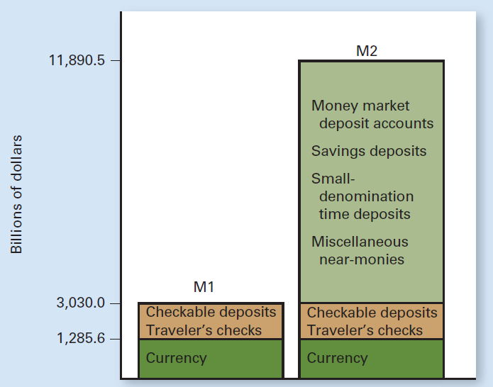
Exhibit 1
Two Measures of Money Supply (Week of May 4, 2015)

Slide 11
Money Aggregates
Credit cards
Loan from the card issuer
Repay later
Dispute a charge
Not part of money supply
Debit cards
Tap checking account
Part of M1

Slide 12
Money Aggregates
Paying for purchases
Debit cards – increasing
Checks – decreasing
Cash transactions – becoming less important
Credit cards – will continue to fund major purchases
Smartphones as debit cards
Online payments: Square, PayPal

Slide 13
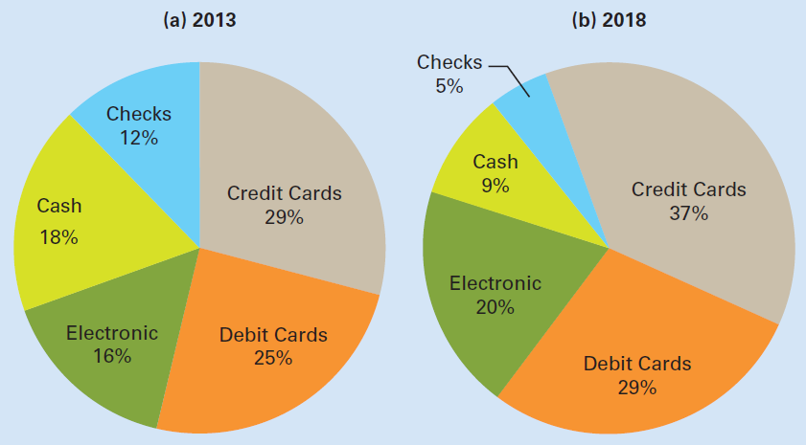
Exhibit 2
U.S. Consumer Payments as a Share of Spending: 2013 and 2018

Slide 14
Money Aggregates
Is Bitcoin Money?
Digital currency, initially purchased with traditional currencies
Can fund some transactions
Questionable safety
Wide fluctuation in value relative to traditional currencies
Behaves more like a speculative investment than a currency

Slide 15
Money Aggregates
Is Bitcoin Money?
Medium of exchange
Not good as a unit of account
Not good as store of value
Not so good as money
June 13, 2015: 14.3 million bitcoin in circulation throughout the world

Slide 16
How Banks Work
Banks earn profit
Attract deposits from savers
Lend to borrowers
Banks are financial intermediaries
Reduce transaction costs
Cope with asymmetric information
Reduce risk through diversification

Slide 17
How Banks Work
Asymmetric information
A situation in which one side of the market has more reliable information than the other side
Diversification
Develop a diversified portfolio of assets
Rather than lending funds to a single borrower
Reduce the risk to each individual saver

Slide 18
Starting a Bank
Home Bank – obtains a charter
Net worth = Owner’s equity
Balance sheet
Financial statement at a given point in time
Assets = Liabilities + Net worth
Asset
Anything of value that is owned
Liabilities
Anything owed to other people or institutions

Slide 19
Exhibit 3
Home Bank’s Initial Balance Sheet

Slide 20
Exhibit 4
Home Bank’s Balance Sheet after $1,000,000
Deposit into Checking Account

Slide 21
Reserve Accounts
Required reserve
Dollar amount that must be held in reserve
Required by Fed
Required reserve ratio
Percentage of checkable deposits (10%)
Must be held in reserve

Slide 22
Reserve Accounts
Reserves
Cash in bank’s vault
Deposits at the Fed
Excess reserves
Bank reserves exceeding required reserves
Can be used to make loans or to purchase interest-bearing assets

Slide 23
Liquidity Versus Profitability
Liquidity
Ease to convert assets into cash
Safety
Profitability
Hold more profitable assets
The objectives of liquidity and profitability are at odds

Slide 24
Liquidity Versus Profitability
Federal funds market
Day-to-day lending and borrowing
Among banks
Interbank market for reserves on account at the Fed
Interest rate: federal funds rate

Slide 25
Liquidity Versus Profitability
Federal funds rate
Interest rate charged in the federal funds market
Interest rate banks charge one another for overnight borrowing
The Fed’s target interest rate

Slide 26
How Banks Create Money
Creating money through excess reserves
Round one
Fed buys $1,000 US government bond; creates reserves
Money supply: +$1,000
Required reserves: +$100
Excess reserves: +$900

Slide 27
Exhibit 5
Changes in Home Bank’s Balance Sheet after the Fed
Buys a $1,000 Bond from Securities Dealer

Slide 28
How Banks Create Money
Creating money through excess reserves
Round two
$900 loan
Money supply: +$900
Required reserves: +$90
Excess reserves: +$810

Slide 29
Exhibit 6
Changes in Home Bank’s Balance Sheet after
Lending $900 to You

Slide 30
How Banks Create Money
Creating money through excess reserves
Round three
$810 loan
Money supply: +$810
Required reserves: +$81
Excess reserves: +$729

Slide 31
Exhibit 7
Changes in Merchants Trust’s Balance Sheet after
Lending $810 to English Major

Slide 32
How Banks Create Money
Creating money through excess reserves
Round four and beyond
Excess reserves: new loans
Required reserves: +10% of new checkable deposits
Excess reserve: maximum amount for loans
Money supply expansion

Slide 33
How Banks Create Money
A summary of rounds
Fed: $1,000 injection in fresh reserves
Increased excess reserves
Money supply increase: up to $10,000
Checkable deposits
Banking system
Eliminates excess reserves
Expand money supply

Slide 34
Exhibit 8
Summary of the Money Creation Resulting from the
Fed’s Purchase of $1,000 U.S. Government Bond

Slide 35
Reserve Requirements
Assumptions
No bank holds excess reserves
Borrowed funds don’t sit idle
People don’t want to hold more cash
Change in the money supply = Change in fresh reserves ˣ 1/r
Required reserve ratio = r
Simple money multiplier = 1/r

Slide 36
Reserve Requirements
Money multiplier
The multiple by which the money supply changes
As a result of a change in fresh reserves in the banking system
Simple money multiplier, 1/r
Reciprocal of the required reserve ratio
Maximum multiple of fresh reserves by which the money supply can increase

Slide 37
Reserve Requirements
Excess reserves
Fuel the deposit expansion process
A higher reserve requirement
Drains this fuel from the banking system
Reducing the amount of new money that can be created

Slide 38
Limitations of Money Expansion
Leakages from expansion
Smaller money multiplier
Cash – preferred to checking accounts
People hold cash
Fewer excess reserves

Slide 39
Contraction of the Money Supply
The Fed sells a $1,000 bond
Money supply: -$1,000
Required reserves: -$900
Recall loans
Money supply: -$900
Required reserves: -$810
Maximum effect
Decrease money supply = Original decrease in reserve requirements ˣ 1/r

Slide 40
The Fed’s Tools of Monetary Control
Open-market operations
Buy / sell US government bonds
The discount rate
Interest rate, the Fed
For loans made to banks
The required reserve ratio
Minimum fraction of reserves

Slide 41
Open-Market Operations
Increase money supply
The Fed buys US bonds: open-market purchase
Reduce money supply
The Fed sells US bonds: open-market sale
Tool of choice for the Fed
Influences bank reserves
Influences federal funds rate

Slide 42
The Discount Rate
Discount rate
The interest rate the Fed charges banks that borrow reserves
Banks borrow to satisfy reserve requirements
The Fed
Lender of last resort

Slide 43
The Discount Rate
Discount rates
Primary discount rate
Secondary discount rate
Signal to financial markets
Monetary policy
Emergency tool
Injecting liquidity

Slide 44
Reserve Requirements
Reserve requirements
Regulations regarding the minimum amount of reserves that banks must hold to back up deposits
Determine how much money the banking system can create with each dollar of fresh reserves
Changes in the reserve requirement
Disruptive to the banking system

Slide 45
Responding to Financial Crises
Regulation of financial markets
Prevents major disruptions and financial panics
Sufficient liquidity in the financial system
2007 and 2008
Discount rate dropped from 6.25% to 0.5%
Encouraged banks to borrow from the Fed

Slide 46
Responding to Financial Crises
To help banks improve - balance sheets
Interest paid on bank reserves held at the Fed
To keep mortgage rates low
Invested more than a $1 trillion in mortgage-backed securities
To prevent the insurance giant AIG from collapsing
Invested more than $90 billion in the company

Slide 47
The Fed is a Money Machine
Composition of assets (most earn interest)
Mortgage-backed securities (40%)
U.S. government securities (55%)
From open-market operations
Foreign currencies
Liabilities
Federal Reserve notes outstanding (30%)
U.S. currency
Reserves

Slide 48
The Fed is a Money Machine
The Fed is a money machine
Supplies Federal Reserve notes
Main assets: earns interest
Main liability: require no interest payment
Earns revenue from discount lending to banks and from other services it provides banks

Slide 49
The Fed is a Money Machine
The Fed’s payments
Its operating costs
A small amount of interest paid on bank reserves at the Fed
6% dividend to the member banks
Any remaining income: goes to the federal government (U.S. Treasury)
Fed paid the Treasury $97 billion in 2014

Slide 50
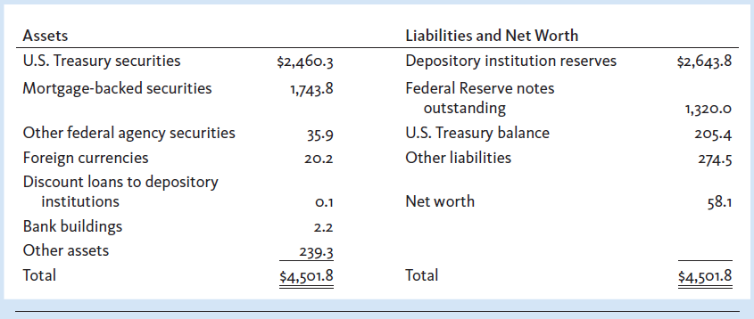
Exhibit 9
Federal Reserve Bank Balance Sheet as of May 13, 2015 (Billions)

