Slide 1
2
Economic Tools
and Economic Systems

Slide 2
Why are you reading this book right now rather than doing something else?
What is college costing you?
Why will you eventually major in one subject rather than continue to take courses in various subjects?
Why is fast food so fast?
Why is there no point crying over spilled milk?
Why does common ownership often lead to common neglect?

Slide 3
Choice and Opportunity Cost
Because of scarcity
Whenever you make a choice
You must pass up another opportunity
You must incur an opportunity cost
Opportunity cost
The value of the best alternative forgone when an item or activity is chosen
Opportunity lost
Monetary or non-monetary aspect

Slide 4
The Opportunity Cost of College
Value of the best alternative forgone
Forgone income (full-time job: $20,000)
Minus income earned as student (part-time work: $10,000)
Plus direct cost of college
Tuition, fees, books ($12,000)
$20,000 - $10,000 + $12,000 = $22,000
Not included: room, board, personal expenses

Slide 5
Opportunity Cost Is Subjective
Opportunity cost is subjective
‘The road not taken’
Calculating opportunity cost
Requires time and information
Time: the ultimate constraint
Even the rich face the problem of scarcity
Opportunity cost varies with circumstance
Depends on the alternative

Slide 6
Sunk Cost and Choice
Sunk cost
Has already been incurred
Cannot be recovered
Irrelevant for present and future economic decisions
Economic decision makers
Relevant: costs affected by the choice
Irrelevant: sunk costs

Slide 7
The Law of Comparative Advantage
Law of comparative advantage
The individual, firm, region, or country
With the lowest opportunity cost of producing a particular good
Should specialize in that good
Specialize
In the task that you do better
Specialization and exchange
Makes you better off

Slide 8
Absolute vs. Comparative Advantage
Absolute advantage
Ability to make something
Using fewer resources than other producers use
Comparative advantage
Ability to make something
At a lower opportunity cost than other producers face

Slide 9
The Law of Comparative Advantage
1 hour for typing papers and ironing shirts
You need half hour to type one paper and 10 minutes to iron a shirt
Your roommate needs one hour to type one paper and 12 minutes to iron a shirt
Absolute advantage
You, in both typing and ironing

Slide 10
The Law of Comparative Advantage
Comparative advantage
Your opportunity cost of typing a paper is 3 ironed shirts
Your roommate’s opportunity cost of typing a paper is 5 ironed shirts
You have comparative advantage in typing
Your roommate has comparative advantage in ironing

Slide 11
Specialization and Exchange
Barter
Direct exchange of one product for another without using money
Can be used in simple economies
Few goods, little specialization
Money
Facilitates exchange
Degree of specialization
Limited by the extent of the market

Slide 12
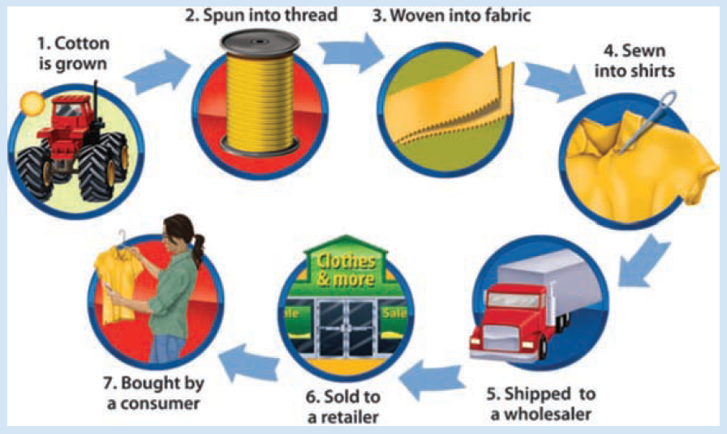
Exhibit 1
Specialization in the Production of Cotton Shirts

Slide 13
Division of Labor
Division of labor
Breaking down the production of a good into separate tasks
Increased productivity
Downside:
Repetitive
Tedious
Routine tasks – robots

Slide 14
Division of Labor
Specialization of labor
Takes advantage of individual preferences and natural abilities
Allows workers to develop more experience at a particular task
Reduces the need to shift between different tasks
Permits the introduction of labor-saving machinery

Slide 15
Economy’s Production Possibilities
PPF: production possibilities frontier
Assumptions of the PPF model
Output: consumer goods and capital goods
Production: 1 year
Resources are fixed (quantity, quality)
Technology and know-how are fixed
Rules of the game are fixed
Resources
Scarce for the economy

Slide 16
Economy’s Production Possibilities
PPF
A curve showing alternative combinations of goods
That can be produced when available resources are used efficiently
The boundary line between inefficient and unattainable combinations

Slide 17
Economy’s Production Possibilities
Resources are employed efficiently
When there is no change that could increase the production of one good
Without decreasing the production of the other good
Getting the most from available resources
Points on the PPF

Slide 18
Inefficient and Unattainable Production
Inefficient combinations
Do not employ resources efficiently
Points inside the PPF
Unattainable combinations
Cannot be achieved with the existing resources, technology, know-how, and rules of the game
Points outside the PPF

Slide 19
Exhibit 2
The Economy’s Production Possibilities Frontier
If the economy uses its available resources and its technology and know-how efficiently to produce consumer goods and capital goods, that economy is on its production possibilities frontier, AF. The PPF is bowed out to reflect the law of increasing opportunity cost; the economy must sacrifice more and more units of consumer goods to produce each additional increment of capital goods. Note that more consumer goods must be given up in moving from E to F than in moving from A to B, although in each case the gain in capital goods is 10 million units.
Points inside the PPF, such as I, represent inefficient use of resources.
Points outside the PPF, such as U, represent unattainable combinations.
50
A
48
B
43
C
U
34
D
Unattainable
30
Inefficient
Consumer goods (millions of units per year)
20
I
E
10
F
0
10
20
30
40
50
Capital goods (millions of units per year)

Slide 20
The Shape of the PPF
Movement down along PPF
Give up some consumer goods to get more capital goods
Law of increasing opportunity costs
To produce more of one good, a successively larger amount of the other good must be sacrificed
Slope of PPF
Opportunity cost of 1 unit of capital goods

Slide 21
What Can Shift the PPF?
Economic growth
An increase in the economy’s ability to produce goods and services
Outward shift of the economy’s PPF
Changes in resource availability
Outward shift of PPF – increase in:
Size, health of labor force
Skills of labor force
Availability of other resources

Slide 22
What Can Shift the PPF?
Increases in capital stock
More output; outward shift of PPF
3. Technological change and more know-how
Employs resources more efficiently
Outward shift of PPF
Improvements in the rules of the game
Formal and informal institutions
Economic growth
Outward shift of PPF

Slide 23
Exhibit 3 (a), (b)
Shifts of the Economy’s PPF
(a) Increase in available resources, better technology, more know-how, or improvement in the rules of the game
(b) Decrease in available resources
or greater uncertainty in the rules
of the game
A′
A
A
Consumer goods
Consumer goods
A″
F
F′
F″
F
Capital goods
Capital goods
When the resources available to an economy change, the PPF shifts. If more resources become available, if technology and know-how improve, or if the rules of the game create greater stability, the PPF shifts outward, as in panel (a), indicating that more output can be produced. A decrease in available resources or an upheaval in the rules causes the PPF to shift inward, as in panel (b).

Slide 24
Exhibit 3 (c), (d)
Shifts of the Economy’s PPF
(c) Change in resources, technology, know-how, or rules that benefits consumer goods
(d) Change in resources, technology, know-how, or rules that benefits capital goods
A′
A
A
Consumer goods
Consumer goods
F
F
F′
Capital goods
Capital goods
When the resources available to an economy change, the PPF shifts. Panel (c) shows a change affecting consumer goods. More consumer goods can now be produced at any given level of capital goods. Panel (d) shows a change affecting the production of capital goods.

Slide 25
What We Learn from the PPF?
Efficiency
The PPF describes efficient combinations of output
Given the economy’s resources, technology and know-how, and rules of the game
Scarcity
Given the resources, technology and know-how, and rules of the game
The economy can produce only so much output per period

Slide 26
What We Learn from the PPF?
Opportunity cost
The PPF slopes downward
More of one good means less of the other good
The law of increasing opportunity cost
The PPF’s bowed-out shape
Some resources are not perfectly adaptable to the production of each type of good

Slide 27
What We Learn from the PPF?
Economic growth
A shift outward of the PPF
Choice
Selecting a particular combination determines
Not only consumer goods and capital goods available this period
But also the capital stock available next period

Slide 28
Economic Systems
Three questions
What goods and services are to be produced?
How are they to be produced?
For whom are they to be produced?
Economic system
Set of mechanisms and institutions
That resolve the what, how, and for whom questions

Slide 29
Economic Systems
Criteria used to distinguish among economic systems
Who owns the resources
What decision-making process is used to allocate resources and products
What types of incentives guide economic decision makers
Range from
Pure capitalism to pure command system

Slide 30
Pure Capitalism
Pure capitalism
There is no government
Rules of the game:
Private ownership of resources
Market distribution of products
Market system
Private property rights
An owner’s right to use, rent, or sell resources or property

Slide 31
Pure Capitalism
Unrestricted markets
Buyers and sellers make their intentions known
Market prices
Guide resources to their most productive use
Channel goods and services to the consumers who value them the most
Answer the what, how, and for whom questions

Slide 32
Pure Capitalism
Adam Smith (1723–1790)
Market forces allocate resources as if by an “invisible hand”
Unseen force that harnesses the pursuit of self-interest
To direct resources where they earn the greatest reward
Each individual pursues self-interest
“Invisible hand” of market forces promotes general welfare

Slide 33
Pure Capitalism: Flaws
No central authority
To protect property rights
To enforce contracts
To ensure that the rules of the game are followed
People with no resources to sell
Could starve

Slide 34
Pure Capitalism: Flaws
Monopoly
Some producers may try to monopolize markets by eliminating the competition
Side effects for people not involved
Side effects can harm or benefit people not involved in the market transaction
No public goods
Because firms cannot prevent nonpayers from enjoying the benefits of public goods

Slide 35
Pure Capitalism: Flaws
Economic fluctuations
Alternating periods of expansions and recessions in the level of economic activity
Especially in employment and production

Slide 36
Pure Command System
Pure command system
Public ownership of resources
Centralized planning
Communism
Government planners
Central plans
Direct resources
Coordinate production
Answer the three questions

Slide 37
Pure Command System: Flaws
Resources
Are used inefficiently
Some are wasted
Each person has less incentive to employ them in their highest-valued use
Central plans
May reflect more the preferences of central planners (unelected dictators)

Slide 38
Pure Command System: Flaws
Government responsible for all production
Limited variety of products
Each individual
Has less personal freedom in making economic choices
No profit
Less incentive to develop better products
Less incentive to find more efficient ways to make existing products

Slide 39
Mixed and Transitional Economies
Increasing role of government
In capitalist economies
Increasing role of markets
In command economies
Government
Economic activity
Regulates the private sector

Slide 40
Economies Based on Custom or Religion
Caste systems in India
Restrict occupational choices
Islamic law
Charging interest is banned
Family relations
Play significant roles in organizing and coordinating economic activity
Tradition
Some occupations are dominated by women, others by men

