Slide 1
3
Economic Decision Makers

Slide 2
If we live in the age of specialization, then why haven’t specialists taken over all production?
For example, why do most of us still do our own laundry and perform dozens of other tasks for ourselves?
Why is the value of some products such as Facebook created mostly by users rather than by the suppliers?
If the “invisible hand” of competitive markets is so efficient, why does government get into the act?
And if specialization based on comparative advantage is such a good idea, why do most nations try to restrict imports?

Slide 3
The Household
Households: starring role in a market economy
Demand for goods and services
Determines what gets produced
Supply labor, capital, natural resources, and entrepreneurial ability
Produces that output
Make all kinds of choices
What to buy, how much to save, where to live, and where to work

Slide 4
The Evolution of the Household
Farm household
Self-sufficient
Better technology
Increased productivity
Growth in urban factories
Increased demand for factory labor
More specialized but less self-sufficient

Slide 5
The Evolution of the Household
Women in the labor force
1950: 15% of women with young children
Today: 70% of women with children under 18
Rise in two-earner households
Produce less for themselves and demand more from the market

Slide 6
Households Maximize Utility
Utility
Satisfaction received from consumption
Sense of well-being
Households attempt to maximize utility
Depends on each household’s subjective goals

Slide 7
Households as Resource Suppliers
Resource suppliers
Labor, capital, natural resources, and entrepreneurial ability
To satisfy their unlimited wants
Most important: labor
To earn income
2014, personal income
More than two-thirds comes from labor earnings

Slide 8
Households as Resource Suppliers
Sources of personal income, 2014
62% from wages and salaries
10% from transfer payments
9% proprietors’ income
Proprietors
People who work for themselves rather than for employers

Slide 9
Households as Resource Suppliers
Transfer payments for households with few resources that are valued in the market
Cash transfers are monetary payments
Welfare benefits, Social Security, unemployment compensation, disability benefits
In-kind transfers provide for specific goods and services
Food, health care, housing
Short-term public assistance

Slide 10
Households: Demanders of Goods and Services
Personal consumption
Largest spending of household personal income
Durable goods: expected to last 3 or more years
9% of personal income
Nondurable goods; 19% of personal income
Services; 55% of personal income

Slide 11
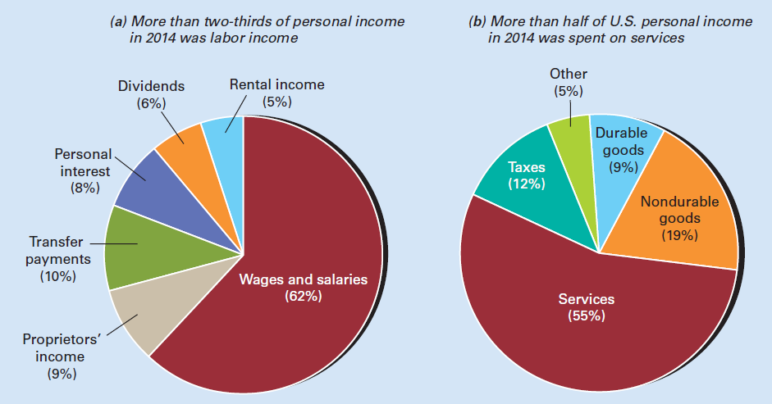
Exhibit 1
Where U.S. Personal Income Comes From and Where It Goes

Slide 12
The Firm
The efficiency arising from comparative advantage
Resulted in a greater specialization among resource suppliers
A firm is the natural result of comparative advantage and specialization
Reducing transaction costs

Slide 13
The Evolution of the Firm
Cottage industry system
An entrepreneur supplied raw materials to rural households
18th century
Entrepreneurs organize the stages of production under one factory roof
Technological developments
Increased the productivity of each worker
Helped shift employment from rural areas to urban factories

Slide 14
The Evolution of the Firm
Large, centrally powered factories
Efficient division of labor
Direct supervision of production
Reduce transportation costs
Bigger machines
Industrial Revolution
Large-scale factory production
Began in Great Britain around 1750
Spread to Europe, North America, Australia

Slide 15
The Evolution of the Firm
Firms
Economic units formed by profit-seeking entrepreneurs
Who combine labor, capital, and natural resources to produce goods and services
Assume that firms try to maximize profit
Profit, the entrepreneur’s reward
Equals sales revenue minus the cost of production

Slide 16
Types of Firms
Sole proprietorship
Single-owner firm
The owner
Has the right to all profits
Bears unlimited liability for the firm’s losses and debts
No partners or other investors
Most common type of business
Generate a tiny portion of all business sales

Slide 17
Types of Firms
Partnership
Two or more owners
Combine their funds and efforts
Share the profits or losses
Bear unlimited liability for the firm’s losses and debts
Least common form of business
10% of all firms
15% of all business sales

Slide 18
Types of Firms
Corporation
Legal entity owned by stockholders
Whose liability is limited to the value of their stock ownership
Survives if ownership changes hands
Voting board of directors
Corporate income is taxed twice
As corporate profits
As stockholder income (corporate dividends or realized capital gains)

Slide 19
Types of Firms
S corporation
Provides owners with limited liability
Profits are taxed only once
A income on each shareholder’s personal income tax return
No more than 100 stockholders
And no foreign stockholders
Corporation
19% of businesses
81% of all business sales

Slide 20
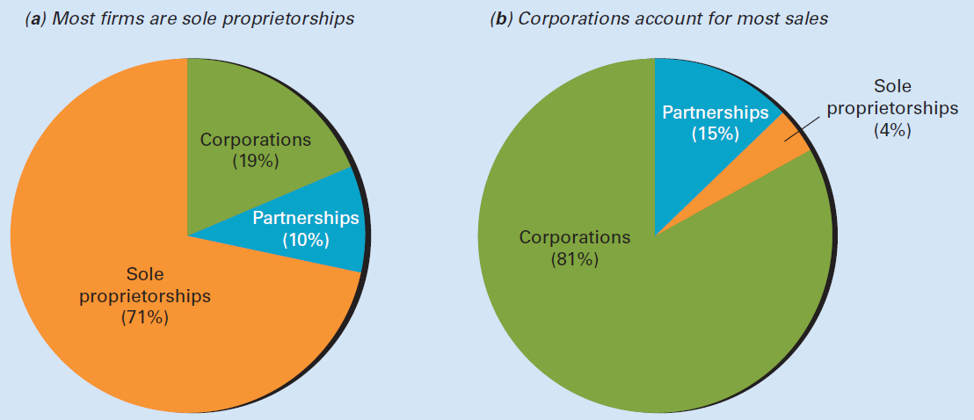
Exhibit 2
Percent Distribution by Type of Firm Based on Number of
Firms and Firm Sales

Slide 21
Types of Firms
Cooperatives, co-op
People who pool their resources to buy and sell more efficiently than they could individually
Consumer cooperatives
Retail business owned and operated by some or all of its customers
To reduce costs

Slide 22
Types of Firms
Producer cooperatives
Producers join forces to buy supplies and equipment and to market their output
To reduce costs and increase profits
Federal legislation allows farmers to cooperate without violating antitrust laws

Slide 23
Not-for-Profit Organizations
Not-for-profit organizations
Do not pursue profit as a goal
Engage in different activities
Charitable; Educational; Humanitarian
Cultural; Professional
Not included: government agencies
Any revenue exceeding cost is plowed back into the organization

Slide 24
Not-for-Profit Organizations
Not-for-profit organizations
Revenue
Voluntary contributions and service charges
E.g.: College tuition, hospital charges
Are usually exempt from taxes
1.6 million not-for-profit organizations in U.S.
Employ about 12 million workers

Slide 25
User-Generated Products
Computer programming: open source
Linux – operating system
Apache – web server software
Firefox – web browser
LibreOffice – office suite
Wikipedia – information website
Facebook – social networking
YouTube – videos
Twitter – social networking

Slide 26
User-Generated Products
Older user-generated products
Radio call-in shows
New technology has increased the opportunities for users
To create new products
To improve existing products

Slide 27
Why Does Household Production Still Exist?
A household performs a task
If its opportunity cost of performing the task is below the market price
People with a lower opportunity cost of time
Do more for themselves

Slide 28
Why Does Household Production Still Exist?
Reasons for household production
Few skills or special resources are required
Avoids taxes
Reduces transaction costs
Technological advances increase household productivity
Information revolution: technological change spawned by the microchip and the Internet
Enhanced the acquisition, analysis, and transmission of information

Slide 29
The Government
Role of government
To intervene in case of market failure
Market failure
Arises when the unregulated operation of markets yields socially undesirable results

Slide 30
The Role of Government
Establish and enforce rules of the game
Safeguard private property
Make sure that market participants abide by the rules of the game
Promote competition
Antitrust laws that prohibit
Collusion (agreement among firms to divide the market and fix the price)
Unfair business practices

Slide 31
The Role of Government
Regulate natural monopolies
To lower price and increase output
Monopoly
Sole supplier of a product with no close substitutes
Natural monopoly
One firm that can supply the entire market at a lower per-unit cost than could two or more firms

Slide 32
The Role of Government
Provide public goods
Funded with taxes
Private goods
Rival in consumption and exclusive
Public goods
Nonrival in consumption and nonexclusive
Once produced, are available for all to consume
Regardless of who pays and who doesn’t

Slide 33
The Role of Government
Deal with externalities
Use taxes, subsidies, and regulations
To discourage negative externalities
To encourage positive externalities
Externality
Cost or benefit that affects neither the buyer nor seller
Affects people not involved in the market transaction

Slide 34
The Role of Government
More equal distribution of income
Transfer payments
Fostering a healthy economy
Full employment
Price stability
Economic growth
Using fiscal and monetary policy

Slide 35
The Role of Government
Fiscal policy
Use of government purchases, transfer payments, taxes, and borrowing
To influence economy-wide variables (inflation, employment, economic growth)
Monetary policy
Regulation of the money supply
To influence economy-wide variables (inflation, employment, economic growth)

Slide 36
Government’s Structure and Objectives
National, or federal government
National security, economic stability, market competition
State government
Public higher education, prisons, highways, welfare
Local government
Primary and secondary education, police, fire protection

Slide 37
Government’s Structure and Objectives
Difficulty in defining government objectives
About 89,150 government jurisdictions
1 nation with 50 states
3,000 counties
36,000 cities and towns
12,900 school districts
37,200 special districts
Not a single decision maker
Vote maximization

Slide 38
Government’s Structure and Objectives
Voluntary exchange vs. coercion
Some government coercion
Enforced by the police
No market prices
Public output is usually offered at
Zero price
Or below the production cost

Slide 39
The Size and Growth of Government
Government outlays relative to GDP
1929: 10% of GDP
Mostly state and local
2016: 38% of GDP, mostly federal
Defense spending: decreased from half in 1960 to less than one-fifth today
Redistribution: increased to more than half of outlays
Social Security, Medicare, and welfare programs

Slide 40
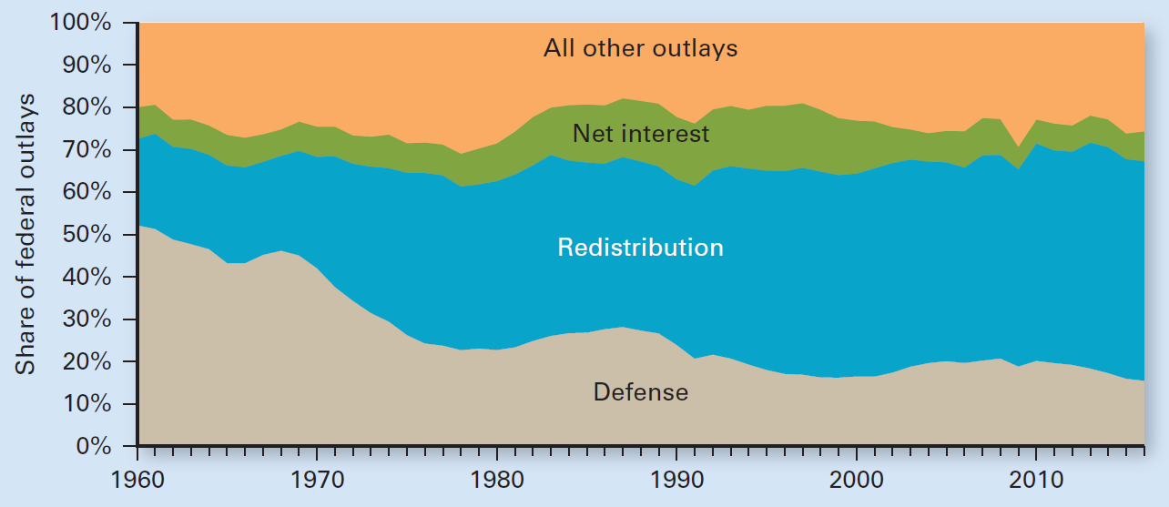
Exhibit 3
Redistribution Has Grown and Defense Has Declined
as Share of Federal Outlays: 1960-2016

Slide 41
Sources of Government Revenue
Taxes
Individual income tax (federal)
Income tax and sales tax (state)
Property tax (local)
Other sources
User charges: highway tolls, college tuition
Borrowing
Monopolize certain markets such as liquor and lotteries

Slide 42
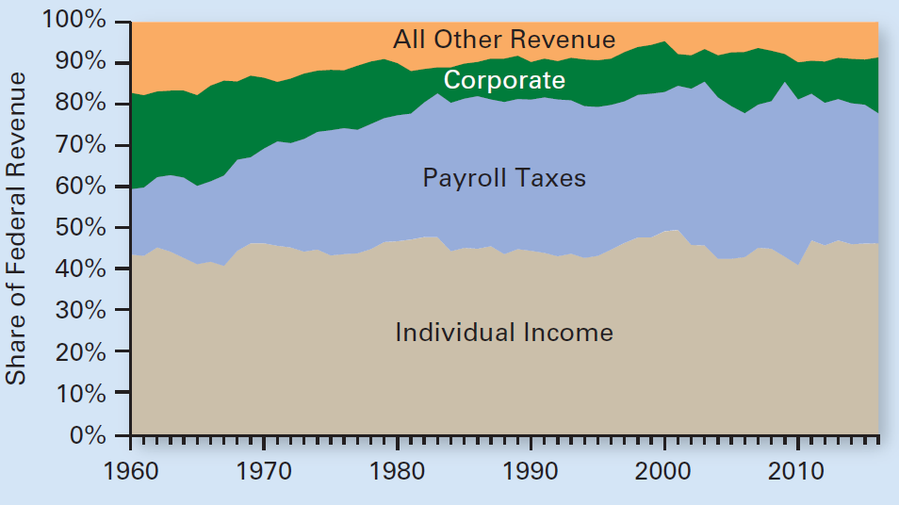
Exhibit 4
Payroll Taxes Have Grown and Corporate Taxes Have Declined as a Share of Federal Revenue: 1960-2016

Slide 43
Tax Principles and Tax Incidence
Ability-to-pay tax principle
Those with a greater ability to pay
Earning higher incomes
Owning more property
Should pay more taxes
Benefits-received tax principle
Those who get more benefits from the government program should pay more taxes

Slide 44
Tax Principles and Tax Incidence
Tax incidence
The distribution of tax burden among taxpayers
Who ultimately pays the tax
Evaluate tax incidence
Measure the tax as a percentage of income

Slide 45
Tax Principles and Tax Incidence
Proportional taxation (flat tax)
The tax as a percentage of income remains constant as income increases
The dollar amount of taxes increases proportionately as income increases
Marginal tax rate
Percentage of each additional dollar of income that goes to the tax
If high: reduces people’s incentive to work and invest

Slide 46
Tax Principles and Tax Incidence
Progressive taxation
Tax as a percentage of income increases as income increases
Increasing marginal tax rate
The U.S., progressive taxation
Seven marginal rates (personal income tax)
From 10 to 39.6% in 2015

Slide 47
Tax Principles and Tax Incidence
U.S. personal income tax (progressive)
High-income households pay most of the federal income tax collected
More than 40% of all U.S. households pay no federal income tax
The top 1 percent of tax filers, based on income
Paid 38% of all income taxes collected in 2012
Their average tax rate = 23.5%

Slide 48
Tax Principles and Tax Incidence
U.S. personal income tax (progressive)
The top 10 percent of tax filers
Paid 70% of all income taxes collected
Their average tax rate = 18.7%
The bottom 50 percent of tax filers
Paid only 2.8% of all income taxes collected
Their average tax rate = 3.0%

Slide 49
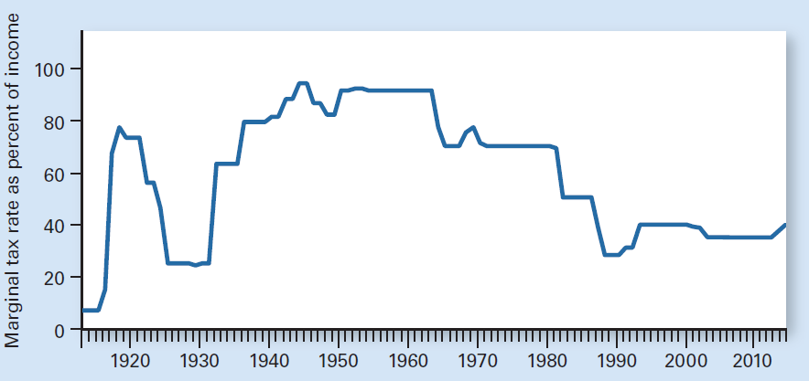
Exhibit 5
Top Marginal Rate on Federal Personal Income Tax
Since 1913

Slide 50
Tax Principles and Tax Incidence
Regressive taxation
Tax as a percentage of income decreases as income increases
Decreasing marginal tax rate
Most U.S. payroll taxes are regressive
Social Security taxes, 2015
Levied on the first $118,500 of worker’s pay
Employees and employers each pay 6.2% (self-employed pay the entire 12.4%)

Slide 51
The Rest of the World
The rest of the world
Foreign households, firms, and governments
Affects what U.S. households consume
Affects what U.S. firms produce
Affects U.S. prices, wages, and profits

Slide 52
International Trade
International trade
Occurs because of different opportunity costs of producing specific goods
The U.S. imports
Raw materials
Crude oil, bauxite, coffee beans
Finished goods
Cameras, computers, cut diamonds

Slide 53
International Trade
The U.S. exports
Sophisticated products
Computer software, aircraft, movies
Agricultural products
Wheat, corn, cotton
From 6% of GDP in 1970 to 14% today
Top 10 destinations:
Canada, Mexico, China, Japan, United Kingdom, Germany, Netherlands, South Korea, France, and Brazil

Slide 54
International Trade
Merchandise trade balance
Value of a country’s exported goods minus the value of its imported goods
Includes only goods, not services
For the last 25 years, the U.S.
Imported more goods than exported
Merchandise trade deficit
Must be offset by a surplus in one of the balance-of-payments accounts

Slide 55
International Trade
Balance of payments
Record of all economic transactions
Between residents of one country and residents of the rest of the world
During a given period

Slide 56
Exchange Rates
Foreign exchange
Foreign money needed to carry out international transactions
Exchange rates
Price of one currency in terms of another
Determined in foreign exchange markets
E.g.: 1 euro exchanges for $1.10

Slide 57
Trade Restrictions
Tariff
Tax on imports
Quota
Legal limit on the quantity of a particular product that can be imported or exported
Other trade restrictions

Slide 58
Trade Restrictions
Why do most countries restrict trade?
Restrictions benefit certain domestic producers that lobby governments for these benefits
Higher prices
Hurt domestic consumers
Interfere with the free flow of products across borders
Hurt the overall economy

