Slide 1
4
Demand, Supply, and Markets

Slide 2
Why do roses cost more on Valentine’s Day than during the rest of the year?
Why do TV ads cost more during the Super Bowl ($4.5 million for 30 seconds in 2015) than during Nick at Nite reruns?
Why do hotel room rates double in the host city during Super Bowl weekend?
Why do surgeons earn more than butchers?
Why do economics majors earn more than most other majors?

Slide 3
Demand
Demand
The quantity consumers are willing and able to buy at each price during a given time period, other things constant
Relation between price and quantity demanded
Willing and able
Specific period
Other things constant

Slide 4
Law of Demand
Law of demand
Quantity demanded varies inversely with price, other things constant
Higher price: lower quantity demanded
Consumer Demand
Not ‘consumer wants’
Not ‘consumer needs’

Slide 5
Law of Demand
Substitution effect of a price change
When the price of a good falls
That good becomes cheaper compared to other goods
Consumers tend to substitute that good for other goods
Caused by a change in the relative price
Relative price
Price of a good relative to the prices of other goods

Slide 6
Law of Demand
Income effect of a price change
A fall in the price of a good
Increases consumers’ real income
Consumers are more able to purchase goods
For a normal good, quantity demanded increases
The more important the item is as a share of your budget, the bigger the income effect

Slide 7
Law of Demand
Money income
Number of dollars a person receives per period
Real income
Measured in terms of what it can buy
Purchasing power
Changes when price changes

Slide 8
Demand Schedule and Demand Curve
Demand can be expressed as
A demand schedule
A demand curve
Demand schedule
Lists possible prices
Along with the quantity demanded at each price
Reflects the law of demand

Slide 9
Demand Schedule and Demand Curve
Demand curve
A curve showing the relation between the price of a good and the quantity consumers are willing and able to buy
Per period
Other things constant
Downward slope
Reflects the law of demand

Slide 10
Demand Schedule and Demand Curve
Demand
Entire relationship between price and quantity demanded
Quantity demanded
Amount of a good consumers are willing and able to buy
Per period
At a particular price
Reflected as a point on the demand curve

Slide 11
Exhibit 1
Market Demand Schedule and Market Demand Curve for Pizza
(a) Market demand schedule
(b) Market demand curve
 | Price per pizza | Quantity Demanded Per week (millions)
a b c d e | $15 12 9 6 3 | 8 14 20 26 32
$15
a
12
b
Price per pizza
c
9
6
d
3
e
The market demand curve D shows the quantity of pizza demanded, at various prices, by all consumers. Price and quantity demanded are inversely related other things constant, reflecting the law of demand.
D
0
8
14
20
26
32
Millions of pizzas per week

Slide 12
Demand Schedule and Demand Curve
Individual demand
Relation between the price of a good and the quantity purchased
By an individual consumer
During a given period, other things constant
Movement along the demand curve
Change in quantity demanded
Resulting from a change in the price of the good, other things constant

Slide 13
Demand Schedule and Demand Curve
Market demand
Relation between the price of a good and the quantity purchased
By all consumers in the market
During a given period
Other things constant
Sum of the individual demands in the market

Slide 14
What Shifts a Demand Curve?
Variables that can affect market demand
Money income of consumers
Prices of other goods
Consumer expectations
The number and/or composition of consumers in the market
Consumer tastes

Slide 15
Changes in Consumer Income
Increase in consumer income
Willing and able to buy more normal goods at each price
Increase in market demand
Demand curve shifts rightward
Normal good
Demand increases as income increases
Inferior good
Demand decreases as income increases

Slide 16
Exhibit 2
An Increase in the Market Demand for Pizza
An increase of the market demand for pizza is shown by a rightward shift of the curve, indicating that the quantity demanded increases at each price. For example, at a price of $12, quantity demanded increases from 14 million (point b) to 20 million (point f).
$15
b
12
f
Price per pizza
9
6
3
D′
D
0
8
14
20
26
32
Millions of pizzas per week

Slide 17
Changes in the Prices of Other Goods
Substitutes
An increase in the price of one good
Increases the demand for the other (rightward shift of the demand curve)
Complements - used in combination
An increase in the price of one
Decreases the demand for the other (leftward shift of the demand curve)

Slide 18
Changes in Consumer Expectations
Income expectations
Future income increase
Increases current demand (rightward shift)
Price expectations
Future price increase
Increases current demand (rightward shift)

Slide 19
Number or Composition of Consumers
Increase in number of consumers
Increases demand
Rightward shift of the demand curve
Composition of the population
Shift the demand
E.G.: a baby boom increases in the demand for car seats

Slide 20
Changes in Consumer Tastes
Tastes
Consumer preferences
Likes and dislikes in consumption
Assumed to remain constant along a given demand curve
Change in tastes
May shift the demand

Slide 21
Demand
Movement along the demand curve
Change in quantity demanded
Resulting from a change in the price of the good, other things constant
Shift of the demand curve
Movement of a demand curve right or left
Resulting from a change in one of the determinants of demand
Other than the price of the good

Slide 22
Supply
Supply
How much producers are willing and able to offer for sale per period at each price, other things constant
Relation between price and quantity supplied
Willing and able
Specific period
Other things constant

Slide 23
Law of Supply
Law of supply
Quantity supplied is directly related to its price, other things constant
Higher the price, greater the quantity supplied
Higher reward, profit
More willing to increase quantity supplied
Can afford to cover the marginal costs
Increasing opportunity cost
More able to increase quantity supplied

Slide 24
Supply Schedule and Supply Curve
Supply can be expressed as
A supply schedule
A supply curve
Supply schedule
Lists possible prices
Along with the quantity supplied at each price
Reflects the law of supply

Slide 25
Supply Schedule and Supply Curve
Supply curve
A curve showing the relation between price of a good and the quantity producers are willing and able to sell
Per period
Other things constant
Upward slope
Reflects the law of supply

Slide 26
Exhibit 3
The Market Supply Schedule and Market Supply Curve for Pizza
(a) Market supply schedule
(b) Market supply curve
Price per pizza | Quantity Supplied Per week (millions)
$15 12 9 6 3 | 28 24 20 16 12
S
$15
12
Price per pizza
9
6
3
The market supply curve S shows the quantities of pizza supplied, at various prices, by all pizza makers. Price and quantity supplied are directly related.
0
12
16
20
24
28
Millions of pizzas per week

Slide 27
Supply Schedule and Supply Curve
Supply
Entire relationship between price and quantity supplied
Quantity supplied
Amount offered for sale
Per period
At a particular price
A point on the supply curve

Slide 28
Supply Schedule and Supply Curve
Movement along the supply curve
Change in quantity supplied due to a change in price
Individual supply
Relation between the price of a good and the quantity an individual producer is willing and able to sell
Per period, other things constant
The supply of an individual producer

Slide 29
Supply Schedule and Supply Curve
Market supply
Relation between the price of a good and the quantity all producers are willing and able to sell
Per period
Other things constant
The sum of individual supplies of all producers in the market

Slide 30
What Shifts a Supply Curve?
Factors that can affect the market supply
State of technology and know-how
Prices of resources
Prices of other goods
Producer expectations
Number of producers in the market

Slide 31
State of Technology and Know-How
Better technology or better production process
Production costs decrease
Increase the quantity supplied at each price
Increase in the supply
Rightward shift of the supply curve

Slide 32
Exhibit 4
An Increase in the Market Supply of Pizza
S
An increase in the market supply of pizza is reflected by a rightward shift of the supply curve, from S to S’.
Quantity supplied increases at each price. For example, at a price of $12, the quantity supplied per week increases from 24 million pizzas (point g) to 28 million pizzas (point h).
S′
$15
g
12
h
Price per pizza
9
6
3
0
12
16
20
24
28
Millions of pizzas per week

Slide 33
Changes in the Prices of Resources
Prices of resources
Employed to make the good
Affect the cost of production and therefore the supply of the good
Decrease in the price of a resources
Production costs decrease
Increase in the supply
Rightward shift of the supply curve

Slide 34
Changes in the Prices of Other Goods
Resources
Have alternative uses
Other goods
Use some resources employed to produce the other good
Decrease in price of other goods
Increase in the supply of the other good
Rightward shift of the supply curve of the other good

Slide 35
Changes in Producer Expectations
Expected higher prices in the future
Can affect future profits
May increase the current supply
For easily stored goods
Reduce current supply (leftward shift)

Slide 36
Changes in the Number of Producers
Market supply
Amount supplied at each price
By all producers
Increase in the number of producers
Increase the supply
Rightward shift of the supply curve

Slide 37
Supply
Movement along the supply curve
Change in quantity supplied
Resulting from a change in the price of the good, other things constant
Shift of the supply curve
Movement of a supply curve left or right
Resulting from a change in one of the determinants of supply
Other than the price of the good

Slide 38
Demand and Supply Create a Market
Markets
Sort out differences between demanders and suppliers
Reduce transaction costs
Transaction costs
Costs of time and information required to carry out market exchange
Adam Smith
The “invisible hand”

Slide 39
Market Equilibrium
Surplus: excess quantity supplied
Amount by which quantity supplied exceeds quantity demanded
At a given price
Puts a downward pressure on price, which
Decreases quantity supplied
Increases quantity demanded

Slide 40
Market Equilibrium
Shortage: excess quantity demanded
Amount by which quantity demanded exceeds quantity supplied
At a given price
Puts an upward pressure on price, which
Increases quantity supplied
Decreases quantity demanded

Slide 41
Market Equilibrium
Equilibrium
Quantity demanded = Quantity supplied
Plans of buyers and sellers match
Equilibrium point
Equilibrium quantity
Equilibrium price
Market clears
No pressure on price to change
“X marks the spot”

Slide 42
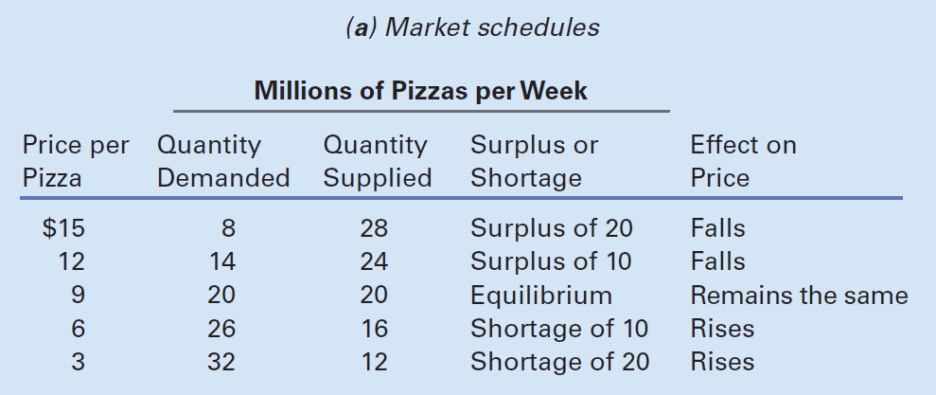
Exhibit 5 (a)
Equilibrium in the Pizza Market

Slide 43
Exhibit 5 (b)
Equilibrium in the Pizza Market
Market equilibrium occurs at the price where quantity demanded equals quantity supplied. This is shown at point c, where the price is $9 and the quantity is 20 million pizzas per week.
Above the equilibrium price, quantity supplied exceeds quantity demanded. This creates a surplus, which puts downward pressure on the price.
Below the equilibrium price, quantity demanded exceeds quantity supplied. The resulting shortage puts upward pressure on the price.
S
$15
Surplus
12
Price per pizza
c
9
6
3
Shortage
D
0
14
16
20
24
26
Millions of pizzas per week

Slide 44
Changes in Equilibrium Price and Quantity
Equilibrium
Occurs when the intentions of demanders and suppliers exactly match
Once a market reaches equilibrium
That price and quantity prevail
Until something happens to demand or supply
Changes in equilibrium price and quantity
Are due to a change in any non-price determinant of demand or supply

Slide 45
Shifts of the Demand Curve
Factors that can affect market demand
Money income of consumers
Prices of other goods
Consumer expectations
The number or composition of consumers in the market
Consumer tastes

Slide 46
Shifts of the Demand Curve
Increase the demand for pizza due to:
Increase in the money income of consumers
Increase in the price of a substitute, or a decrease in the price of a complement
Change in consumer expectations that causes people to demand more pizzas now
Growth in the number of pizza consumers
Change in consumer tastes

Slide 47
Shifts of the Demand Curve
The demand increases
Rightward shift of the demand curve
At the initial price: shortage
Puts upward pressure on p
Q_{D} decreases
Q_{S} increases
New equilibrium
Higher price and higher quantity

Slide 48
Exhibit 6
Effects of an Increase in Market Demand
An increase in demand is shown by a shift of the demand curve rightward from D to D’.
Quantity demanded exceeds quantity supplied at the original price of $9 per pizza; this shortage puts upward pressure on the price.
As the price rises, quantity supplied increases along supply curve S, and quantity demanded decreases along demand curve D’. When the new equilibrium price of $12 is reached at point g, quantity demanded once again equals quantity supplied.
S
Price per pizza
$12
g
c
9
D′
D
0
20
24
30
Millions of pizzas per week

Slide 49
Shifts of the Demand Curve
The demand decreases
Leftward shift of the demand curve
At the initial price: surplus
Puts downward pressure on p
Q_{D} increases
Q_{S} decreases
New equilibrium
Lower price and lower quantity

Slide 50
Shifts of the Supply Curve
Factors that can affect market supply
State of technology and know-how
Prices of resources
Prices of other goods
Producer expectations
Number of producers in the market

Slide 51
Shifts of the Supply Curve
Increase in the supply of pizza due to
Technological breakthrough in pizza ovens
Reduction in the price of a resource
Decline in the price of another good produced with these resources
Change in expectations that encourages pizza makers to expand production now
Increase in the number of pizzerias

Slide 52
Shifts of the Supply Curve
The supply increases
Rightward shift of the supply curve curve
At the initial price: surplus
Downward pressure on p
Q_{D} increases
Q_{S} decreases
New equilibrium
Lower price and higher quantity

Slide 53
Shifts of the Supply Curve
The supply decreases
Leftward shift of the supply curve curve
At the initial price: shortage
Upward pressure on p
Q_{D} decreases
Q_{S} increases
New equilibrium
Higher price and lower quantity

Slide 54
Exhibit 7
Effects of an Increase in Market Supply
An increase in supply is shown by a shift of the supply curve rightward, from S to S’.
Quantity supplied exceeds quantity demanded at the original price of $9 per pizza, putting downward pressure on the price.
As the price falls, quantity supplied decreases along supply curve S’, and quantity demanded increases along demand curve D.
The new equilibrium price of $6 is reached at point d, where quantity demanded once again equals quantity supplied.
S
c
S′
Price per pizza
$9
6
d
D
0
20
26
30
Millions of pizzas per week

Slide 55
Simultaneous Shifts of D and S Curves
Both S and D increase:
Q increases
If D shifts more: p increases
If S shifts more: p decreases
Both S and D decrease:
Q decreases
If D shifts more: p decreases
If S shifts more: p increases

Slide 56
Exhibit 8
Effects of an Increase in Both Demand and Supply
(a) Shift of demand dominates
(b) Shift of supply dominates
S
S
Price
S′
Price
S″
p’
b
a
a
p
D′
p
p’’
c
D″
D
D
Units per
period
Units per
period
0
Q
Q′
0
Q
Q′′
When both demand and supply increase, the equilibrium quantity also increases. The effect on price depends on which curve shifts more. In panel (a), the demand curve shifts more, so the price rises. In panel (b), the supply curve shifts more, so the price falls.

Slide 57
Simultaneous Shifts of D and S Curves
S increases and D decreases
p decreases
If D shifts more: Q decreases
If S shifts more: Q increases
S decreases and D increases
p increases
If D shifts more: Q increases
If S shifts more: Q decreases

Slide 58
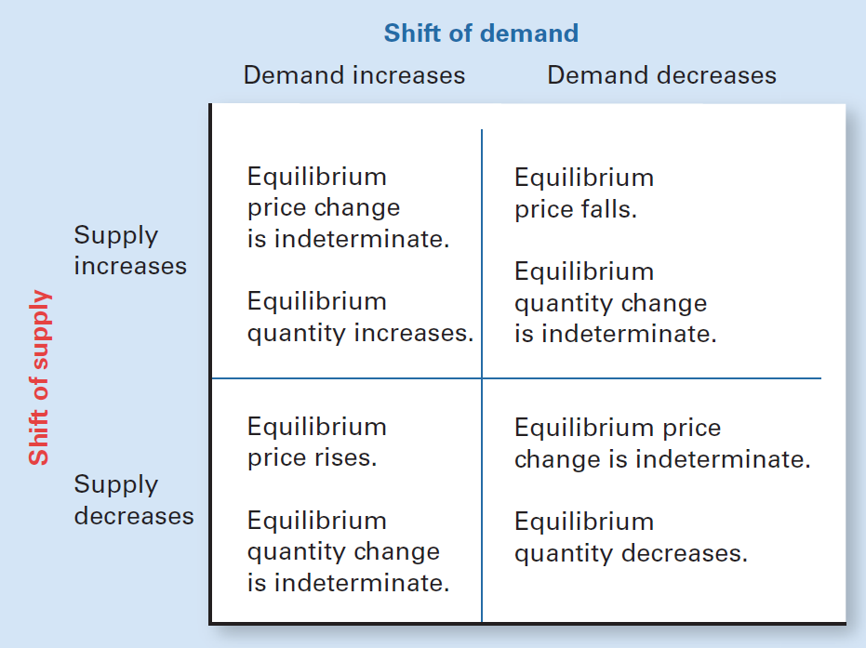
Exhibit 9
Effects of Shifts of Both Demand and Supply
When the demand and supply curves shift in the same direction, equilibrium quantity also shifts in that direction. The effect on equilibrium price depends on which curve shifts more.
If the curves shift in opposite directions, equilibrium price will move in the same direction as demand. The effect on equilibrium quantity depends on which curve shifts more.

Slide 59
Disequilibrium
Disequilibrium
Plans of buyers do not match those of sellers
Temporary mismatch between quantity supplied and quantity demanded
As the market seeks equilibrium
As a result of government intervention, it can last a while
Price floors
Price ceilings

Slide 60
Disequilibrium
Price floor
Minimum legal price below which a product cannot be sold
To have an impact, the price floor must be set above the equilibrium price
Creates a surplus
Distorts a market
Reduces economic welfare

Slide 61
Disequilibrium
Price Ceiling
Maximum legal price above which a product cannot be sold
To have an impact, the price ceiling must be set below the equilibrium price
Creates a shortage
Distorts a market
Reduces economic welfare

Slide 62
Exhibit 10
Effects of Price Floors and Price Ceilings
(a) Price floor for milk
(b) Price ceiling for rent
S
S
Surplus
$2.50
$1,000
Price per gallon
Monthly rental price
1.90
600
Shortage
D
D
0
14
19
24
0
40
50
60
Millions of gallons per month
Thousands of rental units per month
A price floor set above the equilibrium price results in a surplus, as shown in panel (a). A price floor set at or below the equilibrium price has no effect. A price ceiling set below the equilibrium price results in a shortage, as shown in panel (b). A price ceiling set at or above the equilibrium price has no effect.

Slide 63
Rent Ceilings in New York City
Rent ceilings
Nearly half of the 2.1 million rental apartments
Excess demand in the rent-controlled sector raised rents in the free-market sector
Sharp drop in new construction
Wastes valuable resources
Deteriorating quality of housing stock

Slide 64
Rent Ceilings in New York City
Tenants in low- and moderate-income areas
Get little or no benefit from rent control
Upscale Manhattan, three-bedroom apartment
$1,000 a month if rent controlled
$12,000 a month on the open market

Slide 65
Rent Ceilings in New York City
Who benefits from rent control?
More than 87,000 New York City households with incomes exceeding $100,000 a year
Landlords - incentive to oust a tenant
Pay $5,000 bounties to doormen who report tenants violating their lease
Hire private detectives to identify lease violators
Use professional “facilitators” to negotiate with tenants about moving out

