Slide 1
19
Introduction to Macroeconomics

Slide 2
What’s the big idea with macroeconomics?
Why is its focus the national economy?
How do we measure the economy’s performance over time?
Which has more impact on your standard of living, the economy’s short-term ups and downs or the long-term growth trend?
What’s the difference between demand-side economics and supply-side economics?
How has the economic role of government evolved during the last century?
How is learning about the macroeconomy like learning about the weather?

Slide 3
The National Economy
Economy
Structure of economic activity
In a community, a region, a country, a group of countries, or the world
Gross domestic product, GDP
Market value
Of all final goods and services
Produced in the U.S.
During a given period, usually a year

Slide 4
The National Economy
Gross world product
Market value
Of all final goods and services
Produced in the world
During a given period
Usually a year
About $105 trillion in 2014
The U.S. – 4.5% of world’s population, produces 17% of gross world product

Slide 5
The National Economy
Each country has its own:
Standard of living and currency
Culture and language
Communication and transportation system
System of government
“Rules of the game”
Laws, regulations, customs, manners, and ways of doing business

Slide 6
The National Economy
U.S. economy
One of the largest and most complex in world history
120 million households
More than 30 million for-profit businesses
89,150 government jurisdictions
The world’s economy
About 200 sovereign nations
Population ranges from 37,000 people (Liechtenstein) to 1.4 billion (China)

Slide 7
The National Economy
Money
Medium of exchange
Circulates throughout the economy, facilitating the exchange of resources and products among individual economic units
Circular flow
Money
Products
Resources

Slide 8
The National Economy
Flow variable
A measure of something per period of time
Stock variable
A measure of something at a point in time
Knowledge and performance
Understand essential relationships among key variables

Slide 9
The National Economy
Mercantilism
Incorrect theory
A nation’s economic objective
Accumulate precious metals in the public treasury
Prompted trade barriers to cut imports
Other countries retaliated
Reducing trade and the gains from specialization

Slide 10
Economic Fluctuations and Growth
Economic fluctuations
Rise and fall of economic activity
Business cycles
Expansion
Contraction
Expansion – the economy grows
Rising output, employment, income
Contraction – the economy declines
Falling output, employment, income

Slide 11
Economic Fluctuations and Growth
Depression
Severe and prolonged reduction in economic activity
Recession
Decline in economic activity
Lasting more than a few months
Inflation
Increase in the economy’s average price level

Slide 12
Economic Fluctuations and Growth
U.S. economic fluctuations
15 times more real output in 2014 than in 1929
Increased production stems from
Increase in quantity and quality of resources, especially labor and capital
Better technology and know-how
Improvements in rules of the game that facilitate production and exchange

Slide 13
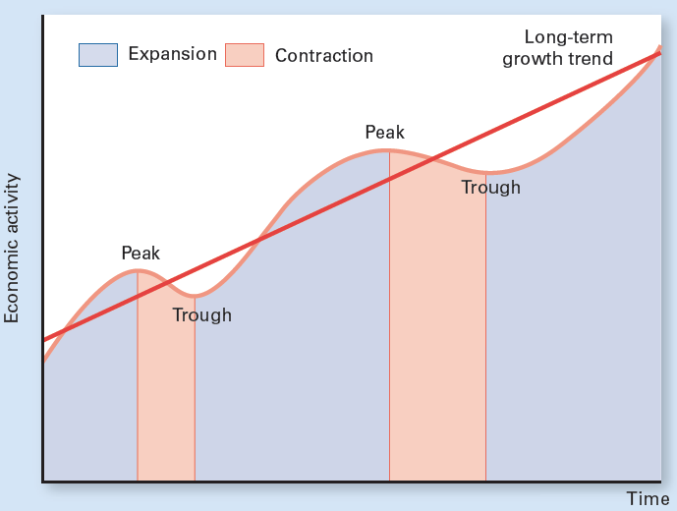
Exhibit 1
Hypothetical Business Cycles
Business cycles reflect movements of economic activity around a trend line that shows long-term growth. An expansion (shaded in blue) begins when the economy starts to grow and continues until the economy reaches a peak. After an expansion has peaked, a contraction (shaded in pink) begins and continues until the economy reaches a trough.

Slide 14
Economic Fluctuations and Growth
33 business cycle since 1854
Peak-to-trough-to-peak
Contraction
Between peak and trough
Longest - 5½ years (1873 to 1879)
Expansion
Between trough and peak
Longest - 10 years (March 1991 to March 2001)

Slide 15
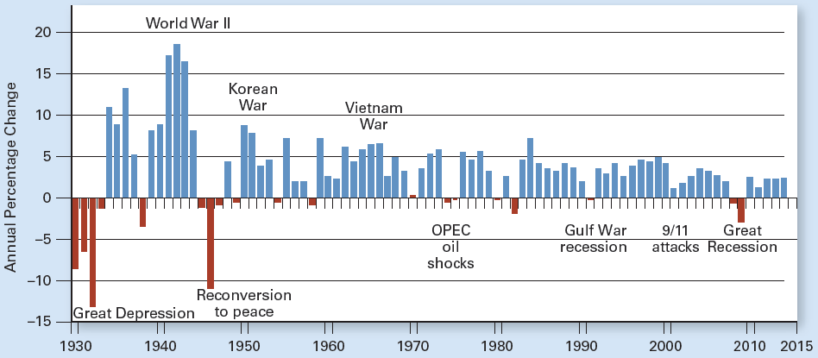
Exhibit 2
Annual Percentage Change in U.S. Real GDP Since 1929
Years of declining real GDP are shown as red bars and years of growth as blue bars. Note that the year-to-year swings in output became less pronounced after World War II.

Slide 16
The Global Economy
Fluctuations
Usually involve the entire nation
Major economies around the world often fluctuate together
Economies are related through international trade, finance, and migration
And ties grow stronger each year
A slump in another major economy can worsen a recession in the U.S. and vice versa

Slide 17
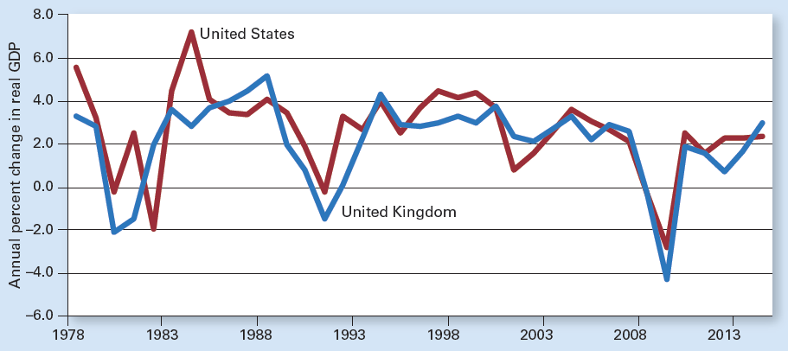
Exhibit 3
U.S. and U.K. Annual Growth Rates in Output Are Similar

Slide 18
Leading Economic Indicators
Leading economic indicators
Predict, or lead to, a recession or recovery
Consumer confidence, stock market prices, business investment, and big-ticket purchases
Coincident economic indicators
Reflect peaks and troughs in economic activity as they occur
Employment, personal income, and industrial production

Slide 19
Leading Economic Indicators
Lagging economic indicators
Follow, or trail, changes in overall economic activity
The interest rate
The unemployment rate
The average duration of unemployment

Slide 20
Aggregate Demand & Aggregate Supply
Aggregate output, Real GDP
Total amount of goods and services
Produced in economy
During a given period
Aggregate demand
Relationship between
Economy’s price level
Aggregate output demanded
Other things constant

Slide 21
Aggregate Demand & Aggregate Supply
Price level
Composite measure
Reflects the prices of all goods and services in the economy
Relative to prices in a base year
Index number
100 in the base year
Real GDP
GDP adjusted for price level changes

Slide 22
Aggregate Demand Curve
Aggregate demand
Sums demands of the four economic decision makers
Households
Firms
Governments
Rest of the world

Slide 23
Aggregate Demand Curve
Aggregate demand curve, AD
Inverse relationship between
Price level and real GDP demanded
Other things constant
Price levels in other countries
Exchange rates
Downward sloping

Slide 24
Exhibit 4
U. S. Aggregate Demand Curve
The quantity of aggregate output demanded is inversely related to the price level, other things constant. This inverse relationship is reflected by the aggregate demand curve AD.
150
100
Price level (2009 = 100)
50
AD
0
2
4
6
8
Real GDP
(trillions of 2009 dollars)
10
12
14
16

Slide 25
Exhibit 5
U.S. Aggregate Demand and Aggregate Supply in 2014
AS
The total output of the economy and its price level are determined at the intersection of the aggregate demand and aggregate supply curves. This point reflects real GDP and the price level for 2014, using 2009 as the base year.
150
108.3
Price level (2009 = 100)
50
AD
Real GDP
(trillions of 2009 dollars)
0
16.1

Slide 26
Aggregate Supply Curve
Aggregate supply curve, AS
Positive relationship between
Price level
Real GDP supplied
Other things constant
Resource prices
State of technology and know-how
Rules of the game
Upward sloping

Slide 27
Equilibrium Real GDP
AD curve intersects AS curve
Equilibrium price level
Equilibrium real GDP
Higher levels of real GDP
More goods and services become available in the economy
More people are employed

Slide 28
Brief History of the U.S. Economy
Before and during Great Depression
After Great Depression to early 1970s
The Age of Keynes
From early 1970s to early 1980s
Stagflation
From the early 1980s to 2007
Somewhat normal times
Great Recession of 2007–2009 and beyond

Slide 29
The Great Depression and Before
1873 – 1879: Longest contraction on record
80 railroads went bankrupt
Most of the nation’s steel mills shut down
1890s
Contractions about half the time
18% unemployment rate
1929: The Great Depression Began
October 1929 stock market crashed

Slide 30
The Great Depression and Before
1929 - 1933: Deepest economic contraction on record
Stock market crashed
Investment dropped
Consumer spending fell
Banks failed
Money supply dropped by 1/3
High tariffs – restricted trade

Slide 31
The Great Depression and Before
1929 - 1933: Deepest economic contraction on record
Big decline in AD
Real GDP dropped 27%
Price level dropped 26%
Unemployment rate reached 25%

Slide 32
Exhibit 6
The Decrease in U.S. Aggregate Demand From 1929 to 1933
AS
The Great Depression of the 1930s can be represented by a shift to the left of the aggregate demand curve, from AD₁₉₂₉ to AD₁₉₃₃. In the resulting depression, real GDP fell from $1,057 billion to $778 billion, and the price level dropped from 9.9 to 7.3, measured relative to a price level of 100 in the base year 2009.
9.9
Price level (2009 = 100)
7.3
AD₁₉₂₉
AD₁₉₃₃
0
778
Real GDP
(billions of 2009 dollars)
1,057

Slide 33
The Age of Keynes
After the Great Depression to early 1970s
1936 John Maynard Keynes
He wrote The General Theory of Employment, Interest, and Money
Argued that AD, especially investment, is inherently unstable
Government – increase AD
Expansionary fiscal policy
Increase government spending, cut taxes
Incur federal budget deficit if necessary

Slide 34
The Age of Keynes
Federal budget deficit
Amount by which federal government outlays exceed federal government revenues
In a particular period, usually a year
Increase in AD
Increase real GDP
Increase employment

Slide 35
The Age of Keynes
Demand-side economics
Macroeconomic policy that
Focuses on shifting the aggregate demand curve
To promote full employment and price stability

Slide 36
The Age of Keynes
WWII
Increased employment
Increased federal government spending
From 7% of GDP in 1940
To 46% of GDP in 1944
No significant increase in tax rates
Resulted in large federal deficits

Slide 37
The Age of Keynes
Employment Act of 1946
Federal government
Promote maximum employment, production, and purchasing power
President
Appoint a Council of Economic Advisers
1950s: Prosperity
Without added stimulus of fiscal policy

Slide 38
The Age of Keynes
1960s: Golden age Keynesian economics
Fiscal policy ‘ fine tune’
Low unemployment
Healthy growth
Modest inflation
Early 1970s
Recession
High inflation

Slide 39
Stagflation: 1973-1975 and 1979-1980
1970 Inflation rate: 5.3%
1971 Ceilings: prices, wages
1973 Crop failures
Soaring grain prices
OPEC cut oil supply
Increased oil prices

Slide 40
Stagflation: 1973-1975 and 1979-1980
1973 - 1975: Decrease in AS
Stagflation
Stagnation or contraction in output
Inflation in price level
Real GDP decreased
Unemployment increased to 8.5%
Price level increased 20%
1979 - 1980: Stagflation; decrease in AS
OPEC cutbacks

Slide 41
Exhibit 7
U.S. Stagflation From 1973 to 1975
AS₁₉₇₅
The stagflation of the mid-1970s can be represented as a leftward shift of the aggregate supply curve from AS₁₉₇₃ to AS₁₉₇₅. Aggregate output fell from $5.42 trillion in 1973 to $5.38 trillion in 1975, for a decline of about $40 billion (stagnation). The price level rose from 26.3 to 31.4, for an increase of 19 percent (inflation).
AS₁₉₇₃
31.4
26.3
Price level (2009 = 100)
AD
0
5.38
5.42
Real GDP
(trillions of 2009 dollars)

Slide 42
Somewhat Normal Times: 1980 to 2007
Combat stagflation
Increase AS - Supply-side economics
Lower price level
Increase output
Increase employment
Through lower taxes
1981: Recession
Unemployment rate 10%
Lower output

Slide 43
Somewhat Normal Times: 1980 to 2007
Economic growth for 10 years
Federal budget deficit
1990: higher taxes
1993: higher taxes
1995:
Slower growth in federal spending
Lower federal deficits
1998: Federal budget surplus

Slide 44
Somewhat Normal Times: 1980 to 2007
Longest expansion on record: 1991-2001
22 millions jobs added
Unemployment rate 4.2%
Modest inflation
2001: Recession (lasted only 8 months)
But slow and uneven recovery
Tax cuts and spending programs
Increased output
Federal budget deficit

Slide 45
Somewhat Normal Times: 1980 to 2007
Federal budget deficit
Exceeded $400 billion in 2004
2000-2007
Employment grew 7%
Real GDP grew 18%
Budget deficit = $161 billion by 2007
Between 1982 and 2007
Employment grew 47% and real GDP grew 128%

Slide 46
Somewhat Normal Times: 1980 to 2007
Supply-side economics
Macroeconomic policy
Focuses on a rightward shift of the aggregate supply curve
Through tax cuts or other changes to increase production incentives
Federal debt
Net accumulation of annual federal deficits

Slide 47
Great Recession of 2007–2009 & Beyond
Recession began with
Declining home prices
Rising foreclosures
More borrowers failed to make their mortgage payments
Fewer homes were getting built
Fewer jobs
First eight months of the recession
151,000 job losses a month

Slide 48
Great Recession of 2008–2009 & Beyond
Early 2008
Government: stimulate aggregate demand
$117 billion tax rebate
Disappointing results
Federal deficit: $459 billion

Slide 49
Great Recession of 2008–2009 & Beyond
September 2008: Full-scale global financial panic
Trigger: the collapse of Lehman Brothers
Credit dried up
Banks grew reluctant to lend
Businesses cut investments sharply
Consumers cut their spending
Sliding home prices, Mounting job losses
Collapsing stock market

Slide 50
Great Recession of 2008–2009 & Beyond
Policy makers – needed to
Shore up confidence in financial institutions
Open up the flow of credit
Stimulate consumer spending

Slide 51
Great Recession of 2008–2009 & Beyond
Programs
$700 billion Troubled Asset Relief Program (TARP)
Stabilizing financial institutions
American Recovery and Reinvestment Act (stimulus bill)
Increasing aggregate demand
Estimated cost $831 billion

Slide 52
Great Recession of 2008–2009 & Beyond
Federal deficit
Tripled from $459 in 2008
To $1.4 trillion in 2009
Average job losses Between October 2008 and October 2009
565,000 a month

Slide 53
Great Recession of 2008–2009 & Beyond
December 2007 – December 2009
Employment fell by 8.4 million
6.1% drop
Real GDP dropped 2 %
Price level – no change
By the third quarter of 2009
Real GDP was growing again
Unemployment rate – still high into 2012

Slide 54
U.S. Economic Growth Since 1929
1929 – 2014
Long-tern growth in output
Real GDP
$1.1 trillion in 1929 to $16.1 trillion in 2014
Average annual growth rate: 3.3% per year
Average inflation: 2.9% per year
Population: increased 162%
122 million in 1929
319 million in 2014

Slide 55
U.S. Economic Growth Since 1929
1929 – 2014
Employment – increased 211%
47 million in 1929 to 146 million in 2014
Higher education: Human capital
More physical capital
Better technology
Higher productivity
Standard of living – increased
Real GDP per capita

Slide 56
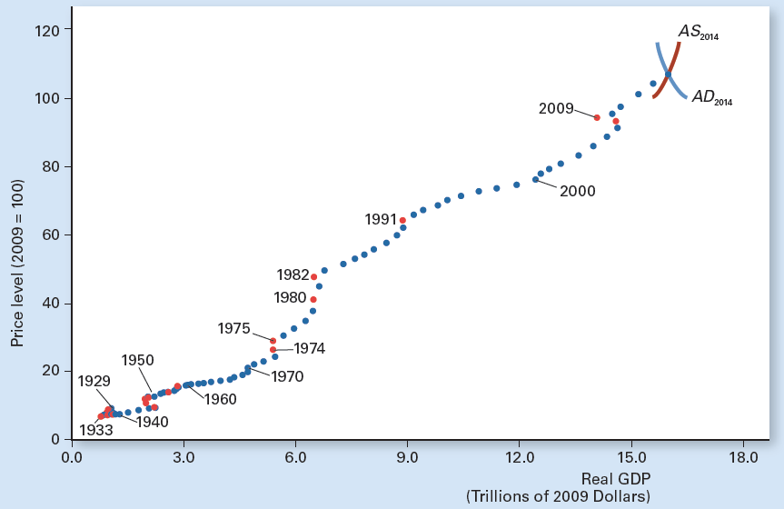
Exhibit 8
Tracking U.S. Real GDP and Price Level Since 1929
As you can see, both real GDP and the price level trended higher since 1929. Blue points indicate years of growing real GDP, and red points are years of declining real GDP. Real GDP in 2014 was 15 times greater than in 1929.

