Slide 1
7
Unemployment and Inflation

Slide 2
What’s so bad about unemployment?
Who among the following would be counted as unemployed: a college student who is not working, a bank teller displaced by an automatic teller machine, Jennifer Lawrence between movies, and baseball slugger Miguel Cabrera in the off-season?
What type of unemployment might be healthy for the economy?
Why is the unemployment rate for young adults much higher than for other age groups?
What’s so bad about inflation?
Why is anticipated inflation less of a problem than unanticipated inflation?

Slide 3
Unemployment: Its Measure and Sources
Unemployment
Personal costs
Loss of a steady paycheck
Loss of self-esteem
Loss of social connections to coworkers
Health costs
Cost on the economy
Fewer goods and services are being produced
Loss of the resource, labor

Slide 4
Measuring Unemployment
Civilian noninstitutional adult population
Adult population
All civilians 16 years of age and older
Except those in prison, in mental hospitals, or in homes for the aged
Not in the military
Labor force
People in the adult population that are working or looking for work
= Employed + Unemployed

Slide 5
Measuring Unemployment
Unemployed
Those who have no job but want one
And have looked for work at least once during the preceding four weeks
Unemployment rate
Percentage of unemployed in the labor force
Number unemployed divided by number in the labor force

Slide 6
Measuring Unemployment
Adult population: Employed + Not working
Employed
Working full time or part time
Not working
Unemployed (looking for work)
Not in the labor force (not unemployed)
Retired; Students; Don’t want to work; Unable to work (long-term illness or disability)
Discouraged workers: drop out of the labor force in frustration because they can’t find work

Slide 7
Measuring Unemployment
The official unemployment rate
May underestimate the true extent of unemployment in the economy because
Does not include discouraged workers
Counts all part-time workers as employed; one third of those working part-time would prefer to work full time

Slide 8
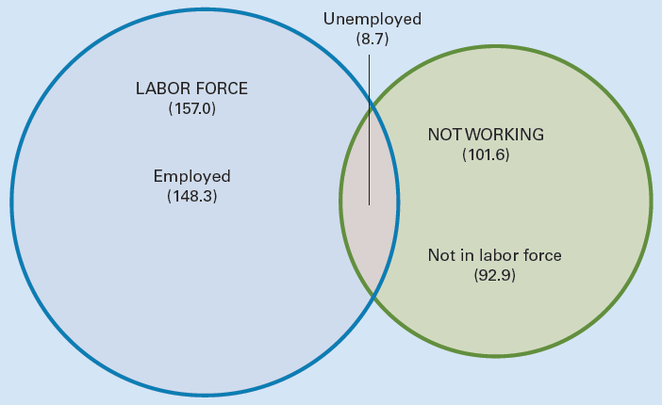
Exhibit 1
The Adult Population Sums the Employed, the Unemployed, and Those Not in the Labor Force: February 2015 (in millions)
The labor force, depicted by the left circle, consists of those employed plus those unemployed. Those not working, depicted by the right circle, consists of those not in the labor force and those unemployed. The adult population sums the employed, the unemployed, and those not in the labor force.

Slide 9
Labor Force Participation Rate
Labor force participation rate
Labor force as percentage of the adult population
Number in the labor force divided by adult population
On average, one out of three adults is not in the labor force

Slide 10
Labor Force Participation Rate
Labor force participation rate
60% in 1970 to 67% in 1990, then dropped
For women: 34% in 1950, to 57% today
Greater increase among younger women
For men: 86% in 1950, to 69% today
Higher among
White males (72%) than black males (67%)
Black females (62%) than white females (57%)
Those with a college degree (75%) than those lacking a high school diploma (45%)

Slide 11
Unemployment Over Time
Unemployment rates over time
Rise during contractions
Fall during expansions
The Great Depression, 1930s, 25%
From 2% in WWII to 10% of 1982
1980s to 2000: Overall downward trend
A high 10% in 1982 to a low 4% in 2000
Recession of 2001
6% by 2003; declined into 2007

Slide 12
Unemployment Over Time
Unemployment rates over time (continued)
Global financial crisis of 2008 and Great Recession: 10% by the end of 2009
5.5% by early 2015
Labor force participation rate
Dropped from 66.3% in February 2007
To 62.8% in February 2015

Slide 13
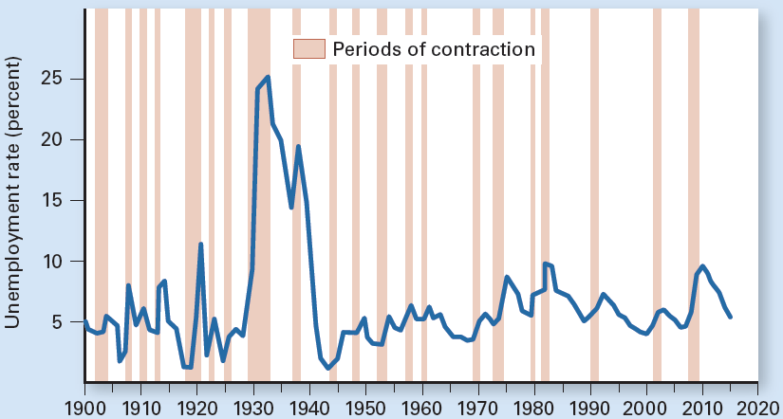
Exhibit 2
The U.S. Unemployment Rate Since 1900
Since 1900, the unemployment rate has fluctuated widely, rising during contractions and falling during expansions. During the Great Depression of the 1930s, the rate spiked to 25%.

Slide 14
Unemployment Over Time
1982 to 2000, unemployment rate, trend down from 10% in 1982 to 4% in 2000
Overall economy was on a roll
Brief recession in the early 1990s
Number employed increased by 37 million
Incredible job machine, the envy of the world
Fewer teenagers in the workforce
Teenagers have an unemployment rate about three times that of adults

Slide 15
Unemployment Over Time
2000 to 2015, unemployment rate
Mild recession in 2001
The Great Recession of 2007-2009
Unemployment rate topped 10%
5.5% by early 2015

Slide 16
Duration of Unemployment
February 2015, unemployment rate 5.5%
Average duration of unemployment: 32 weeks (down from 39 weeks in 2012)
But double the average of the previous three decades
28% were unemployed less than 5 weeks
26%, 5–14 weeks
15%, 15–26 weeks
31%, 27 weeks or longer

Slide 17
Duration of Unemployment
Long-term unemployed
Those out of work 27 weeks or longer
Are of special concern to policy makers
1.7% of the labor force in February 2015
Versus 0.8% in 2007, prior to the financial crisis and Great Recession
A long stretch of unemployment reduces the chances of finding a job

Slide 18
Unemployment Among Various Groups
Overall unemployment rate
Masks wide differences in the labor force based on education, race, gender, and age
Unemployment rate 5.5%, February 2015
Education
9.0% among workers 25 years of age or older with less than a high school diploma
1.9% among those with professional degree
6.0% for those with some college but no degree, the same as high school graduates

Slide 19
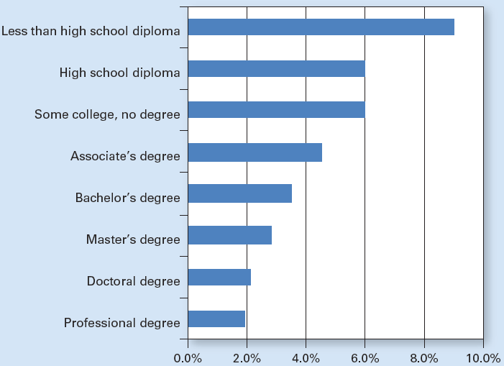
Exhibit 3
Unemployment Rates and Educational Attainment

Slide 20
Unemployment Among Various Groups
Unemployment rate 5.5%, February 2015
Race and ethnicity
4.7% among white workers
10.4% among African Americans
6.6% among those of Hispanic ethnicity
4.0% among Asian workers
Age and gender
5.2% among males 20 and older
4.9% among females 20 and older
17.1% among workers 16 to 19 years of age

Slide 21
Unemployment Among Various Groups
Teenagers have higher unemployment rate
Enter the labor force with little education or job experience
Take unskilled jobs
Are first laid off if the economy slows down (last hired, first fired)
Move in and out of the labor force more frequently as they juggle school demands
Often shop around more; quitting one job in search of a better one

Slide 22
Unemployment Among Various Groups
Black workers have higher unemployment rate
The black workforce is on average younger
Younger workers tend to have higher unemployment rates
A smaller than average percentage of black workers graduated from college
Tend to live in areas harder hit by recessions
Racial discrimination is a contributing factor

Slide 23
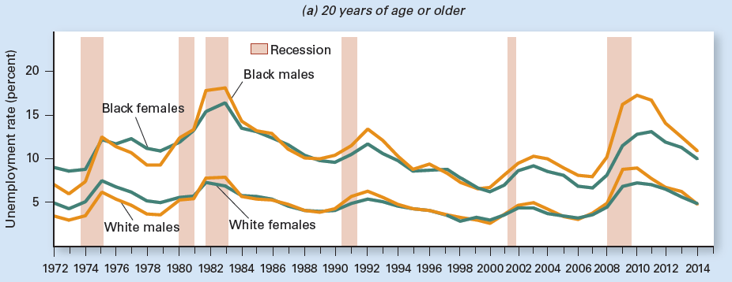
Exhibit 4 (a)
Unemployment Rates for Various Groups
Different groups face different unemployment rates. The unemployment rate is higher for black workers than for white workers and higher for teenagers than for those 20 and older.

Slide 24
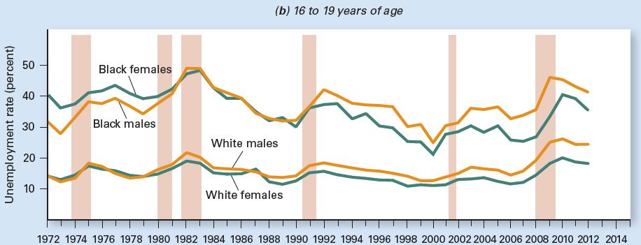
Exhibit 4 (b)
Unemployment Rates for Various Groups
Different groups face different unemployment rates. The unemployment rate is higher for black workers than for white workers and higher for teenagers than for those 20 and older.

Slide 25
Unemployment: Occupations and Regions
Unemployment rate varies by occupation
Professional and technical workers have lower unemployment rates than do blue-collar workers
Construction workers have high unemployment rates on average
Seasonal
Subject to wide swings over the business cycle

Slide 26
Unemployment: Occupations and Regions
Unemployment rate varies across region
Certain occupations dominate labor markets in certain regions
Varies even within a state
National unemployment rate
Masks differences across the country
Masks differences across an individual state

Slide 27
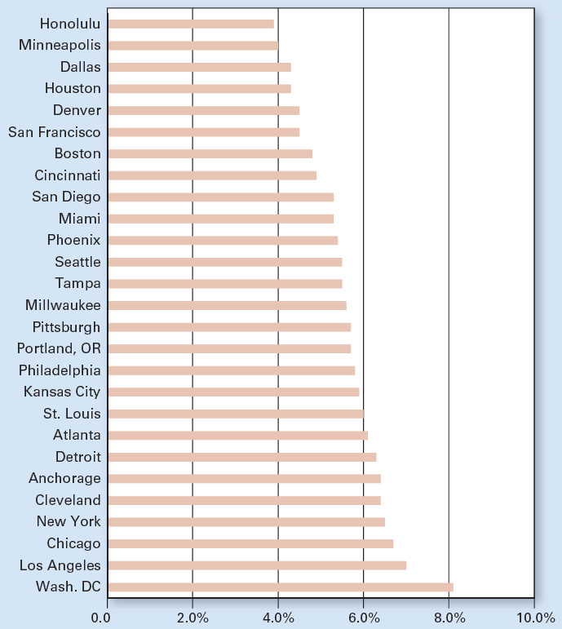
Exhibit 5
Unemployment Rates Differ Across U.S. Metropolitan
Areas

Slide 28
International Comparisons
Unemployment trends, last three decades
Before the Great Recession
Down in the U.S., up in Japan, and remained high in Europe
During the Great Recession of 2007–2009
Spiked in the U.S., even briefly exceeding the average in Europe
Relatively low in Japan
Recent years, the U.S. rate has dropped

Slide 29
International Comparisons
Unemployment trends, last three decades
US, average 6.4%
Europe, average 8.3%
Higher ratio of unemployment benefits to average pay
Unemployment benefits last longer
Government regulations: difficult to fire workers
Japan, average 3.5%
Job security for life

Slide 30
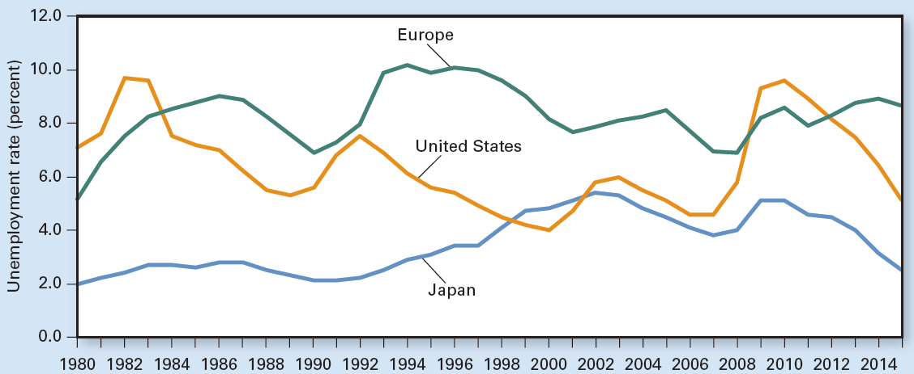
Exhibit 6
Unemployment Rates Increased After the Global Financial Crisis of 2008

Slide 31
Sources of Unemployment
Those unemployed in February 2015
52% lost their previous job
8% quit
12% entered the labor market for the first time
28% reentered the labor market
Overall, 48% were unemployed either because they quit jobs or because they were just joining or rejoining the labor force

Slide 32
Sources of Unemployment
Four sources of unemployment
Frictional, seasonal, structural, and cyclical
Frictional unemployment
Bring together employers and job seekers
Doesn’t last long
Provides better match of workers and jobs
Seasonal unemployment
Seasonal changes in labor demand

Slide 33
Sources of Unemployment
Structural unemployment
Mismatch of skills or geographic location
Occurs because changes in tastes, technology, taxes, and competition
Reduce the demand for certain skills
Increase the demand for other skills
Cyclical unemployment
Fluctuates with the business cycle
Increases during recessions
Decreases during expansions

Slide 34
Other Unemployment Issues
Other unemployment issues
Full employment
Unemployment compensation
Problems with official unemployment figures

Slide 35
The Meaning of Full Employment
Full employment
Employment level when there is no cyclical unemployment
Some unemployment still exists
Frictional, structural, seasonal
4%-6% unemployment rate

Slide 36
Unemployment Compensation
Unemployment benefits
Cash transfers to those who lose their jobs and actively seek employment
Replace about half of take-home pay
Between $235 - $700 per week
Criteria: lost job and looking for work
Time limit: 6 months
Longer during recessions
Up to two years following the Great Recession

Slide 37
Unemployment Compensation
Unemployment benefits
May reduce the incentive to find work
Possibility of fraud
Better match: job skills - job requirements
Do not qualify for unemployment benefits
Those entering or reentering the labor force
Those who quit their last job
Those fired for just cause
Such as excessive absenteeism or theft

Slide 38
Problems, Official Unemployment Figures
Marginally attached to the labor force
Discouraged workers
Dropped out of labor force in frustration
Sidetracked workers
Wanted a job but did not look for work in the prior four weeks
Faced transportation problems, family problems, or other personal issues
Not counted as unemployed – understates unemployment

Slide 39
Problems, Official Unemployment Figures
Underemployed workers
Works only part-time even though they want to work full-time
Work but are overqualified for the job
Counted as employed – understates unemployment

Slide 40
Problems, Official Unemployment Figures
People who do not really want a job but look for one
Just to qualify for unemployment insurance benefits or welfare
Counted as unemployed - overstates actual unemployment
People who would prefer to work part time
But can find only full-time jobs

Slide 41
Problems, Official Unemployment Figures
People forced to work overtime and weekends
Would prefer to work less
People in the underground economy
Not admitting they have jobs because they are breaking the law or could not collect unemployment or welfare benefits
But on balance official unemployment figures
Tend to understate unemployment

Slide 42
Inflation: Its Measure and Sources
Inflation
Sustained increase in economy’s average price level
Annual inflation rate
Percentage increase in the average price level from one year to the next

Slide 43
Inflation: Its Measure and Sources
Hyperinflation
Extremely high inflation
Deflation
Sustained decrease in price level
Disinflation
Reduction in the rate of inflation

Slide 44
Hyperinflation in Zimbabwe
Zimbabwean dollar, ZD
Was once worth about 1.59 U.S. dollars
Collapse of the economy, early 2000s
Government tried paying its bills by printing huge amounts of money
Hyperinflation
Price level at the end of 2008 was 50 million times higher than at the beginning of 2008

Slide 45
Hyperinflation in Zimbabwe
Collapse of the economy, early 2000s
ZD was cheapening by the hour
Workers – paid daily - immediately spent their pay before prices climbed more
Wild inflation
Everyone had trouble keeping up with prices
Different price increases among sellers of the same product
Buyers – had to shop around more

Slide 46
Hyperinflation in Zimbabwe
Government
Printing money at an astounding rate
It took mountains of cash to buy anything
Central bank
Issued currency in ever higher denominations: $100 trillion dollar note
Issued an entirely new series of notes
1 new ZD = 1,000,000,000,000 old ZD
Facilitated transactions but fed inflation

Slide 47
Hyperinflation in Zimbabwe
Trade
Stable currencies: U.S. dollar, South African rand
Barter
Other problems
Real GDP plunged 75% between 2006 and 2009
Unemployment rate reached 90%

Slide 48
Hyperinflation in Zimbabwe
Since mid-2009
All transactions carried out in foreign currencies
Local currency (a $100 trillion note = few U.S. pennies) disappeared
Multiple currency system
The U.S. dollar is preferred
Inflation: single-digit annual growth rate since 2009

Slide 49
Two Sources of Inflation
Demand-pull inflation
Increase in the aggregate demand, AD
Increased government spending
Social programs
Cost-push inflation
Decrease in the aggregate supply, AS
Increase cost of production
Push up the price level
Stagflation

Slide 50
Exhibit 7
Inflation Caused by Shifts of AD and AS Curves
Demand-pull inflation: inflation caused by an increase of aggregate demand
(b) Cost-push inflation: inflation caused by a decrease of aggregate supply
Price
level
AS
Price
level
AS′
AS
P′
P′
P
AD′
P
AD
AD
0
Aggregate output
0
Aggregate output
Panel (a) illustrates demand-pull inflation. An outward shift of the aggregate demand to AD′ “pulls” the price level up from P to P′.
Panel (b) shows cost-push inflation. A decrease of aggregate supply to AS′ “pushes” the price level up from P to P′.

Slide 51
A Historical Look
Price level, US, since 1913
Steady increase
Inflation or deflation, US, since 1913
Before 1950s
High inflation – war related
Followed by deflation
Since 1950s
Inflation: averaged 3.5% per year

Slide 52
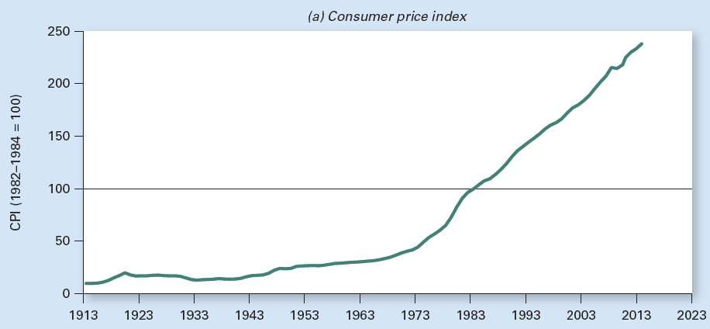
Exhibit 8 (a)
Consumer Price Index Since 1913
Panel (a) shows that, despite fluctuations, the price level, as measured by the consumer price index, was lower in 1940 than in 1920. The price level began rising in the 1940s.

Slide 53
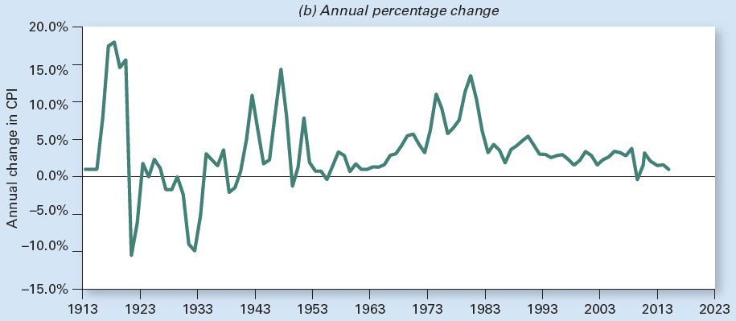
Exhibit 8 (b)
Consumer Price Index Since 1913
Panel (b) shows the annual rate of change in the price level.

Slide 54
Inflation Across Metropolitan Areas
Inflation rates differ across regions
Mostly because of differences in housing prices
Which rise or fall more in some places than in others
Annual inflation from 2010 to 2014 averaged
A low of 1.7% in Philadelphia
A high of 2.8% in Denver

Slide 55
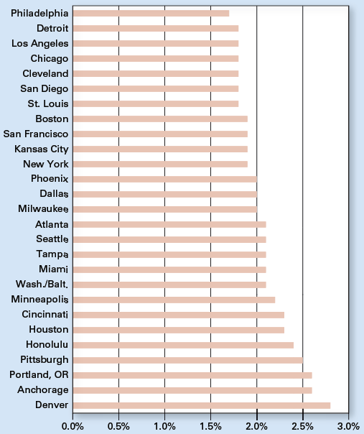
Exhibit 9
Average Annual Inflation from 2010 to 2014 Differed Across
U.S. Metropolitan Areas

Slide 56
International Comparisons of Inflation
Annual inflation
Based on the GDP price index
For the past three decades
In the United States, Japan, and Europe (average of four major nations: France, Germany, Italy, and the United Kingdom)
Similar trend

Slide 57
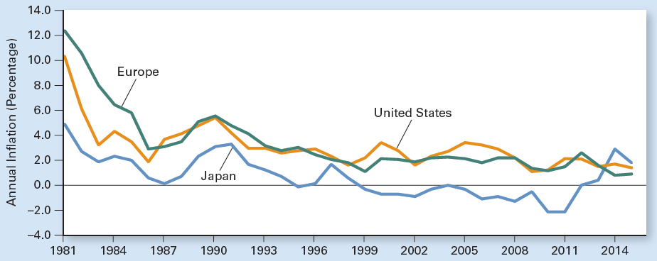
Exhibit 10
Inflation Rates in Major Economies Have Trended Lower Over the Past Three Decades

Slide 58
Effects of Inflation
Effects of inflation on the economy
Unanticipated inflation creates more problems than anticipated inflation
Transaction costs of variable inflation
Inflation obscures relative price changes
Real interest rates
Unpopular inflation

Slide 59
Anticipated vs. Unanticipated Inflation
Anticipated inflation
Expected inflation
If inflation > expected
Sellers lose
Buyers gain
If inflation < expected
Sellers gain
Buyers lose

Slide 60
Transaction Costs of Variable Inflation
During long periods of price stability
People correctly believe they can predict future prices
Can plan accordingly
If inflation changes unexpectedly
The future is cloudier
Planning gets harder
Market transactions become more complicated and more risky

Slide 61
Obscures Relative Price Changes
Inflation
Obscures relative price changes
Even with no inflation
Some prices would increase and some would decrease
Reflecting normal activity in particular markets
Relative prices change
Exchange rate among goods changes
Because the prices of various goods change by different amounts

Slide 62
Inflation and Interest Rates
Interest
Dollar amount paid by borrowers to lenders
Interest rate
Interest per year
As a percentage of the amount loaned

Slide 63
Inflation and Interest Rates
Supply of loanable funds
Amount of money people are willing to lend
Upward sloping
Demand for loanable funds
Amount of funds demanded by households, firms, and governments
Downward sloping

Slide 64
Inflation and Interest Rates
Interest rate
Inversely related with the quantity of loanable funds demanded
Downward-sloping demand curve
Directly related with the quantity of loanable funds supplied
Upward-sloping supply curve

Slide 65
Exhibit 11
The Market for Loanable Funds
S
Nominal interest rate
i
D
0
Loanable funds per period
The upward-sloping supply curve, S, shows that more loanable funds are supplied at higher interest rates. The downward-sloping demand curve, D, shows that the quantity of loanable funds demanded is greater at lower interest rates. The two curves intersect to determine the market interest rate, i.

Slide 66
Inflation and Interest Rates
Nominal interest rate
Interest rate expressed in dollars of current value
Not adjusted for inflation
Specified on the loan agreement
Real interest rate
Interest rate expressed in dollars of constant purchasing power
=Nominal interest rate – Inflation rate

Slide 67
Why is Inflation so Unpopular?
Pay higher prices
Inflation = Penalty
Receive higher receipts
Higher income; ‘well-deserved’ reward
Fixed nominal income
Unadjusted for inflation
Social Security
Adjusted for inflation (COLA)

