Slide 1
9
Aggregate Demand

Slide 2
When driving through a neighborhood new to you, how can you guess the income of the residents?
What’s one of the most predictable and useful relationships in macroeconomics?
Why are consumer confidence and business confidence in the economy so important?
How is spending linked to income?
Why did Americans spend less and save more after the financial crisis of 2008?

Slide 3
Consumption
Consumption depends on income
Positive and stable relationship between consumption and income
Both for the household and for the economy as a whole
Decisions in the circular-flow model
How much households spent, C
How much they saved, S

Slide 4
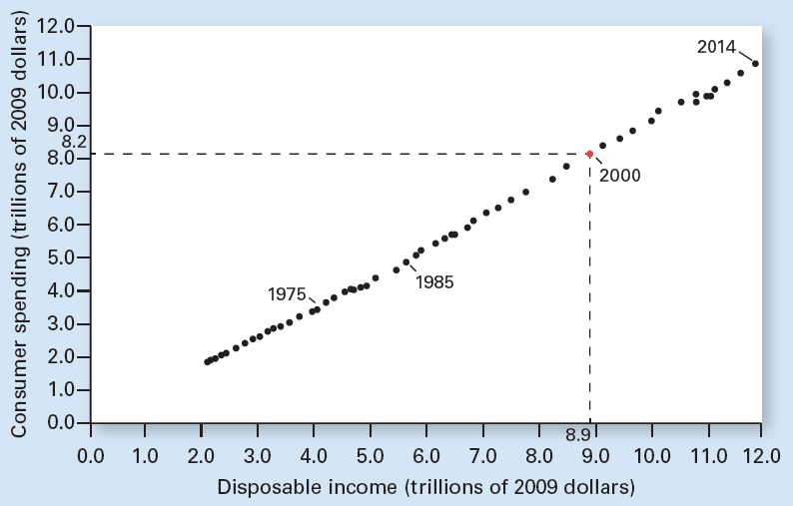
Exhibit 1
U.S. Consumption and Disposable Income Since 1959
Consumption is on the vertical axis and disposable income on the horizontal axis. Notice that each axis measures trillions of 2009 dollars. For example, in 2000, identified by the red point, disposable income was $8.9 trillion and consumption $8.2 trillion. There is a clear and direct relationship over time between disposable income and consumption. As disposable income increases, so does consumption.

Slide 5
The Consumption Function
Consumption, C
Depends on disposable income, DI
Consumption function
The relationship in the economy between consumption and income, other things constant
C – dependent variable
DI – independent variable
Positive slope

Slide 6
Exhibit 2
The Consumption Function
C
11
10
9
8
7
Real consumption (trillions of dollars)
6
5
4
3
2
1
0
1
2
3
4
5
6
7
8
9
10
11
12
13
14
Real disposable income (trillions of dollars)
The consumption function, C, shows the relationship between consumption and disposable income, other things constant.

Slide 7
Marginal Propensities
Marginal propensity to consume, MPC
Fraction of additional income that is spent on consumption
Change in consumption / change in income
Marginal propensity to save, MPS
Fraction of additional income that is saved
Change in saving / change in income
MPC + MPS = 1

Slide 8
MPC Is the Slope of the C Function
Consumption function
Relationship between consumption and income, other things constant
Slope of a straight line
The vertical distance between any two points
Divided by the horizontal distance between those same two points

Slide 9
MPC Is the Slope of the C Function
∆C
Change in consumption (vertical distance)
∆DI
Change in disposable income (horizontal distance)
MPC = ∆C / ∆DI
The slope of consumption function

Slide 10
Exhibit 3
The Marginal Propensity to Consume and the
Consumption Function
C
b
Real consumption
(trillions of dollars)
a
∆C=0.4
MPC = ∆C/∆DI
= 0.4/0.5
= 4/5
∆DI=0.5
0
Real disposable income (trillions of dollars)
The slope of the consumption function equals the marginal propensity to consume. For the straight-line consumption function, the slope is the same at all levels of income and is given by the change in consumption divided by the change in disposable income that causes it. Thus, the marginal propensity to consume equals ∆C/∆DI, or 0.4/0.5 = 4/5.

Slide 11
Nonincome Determinants of C
Net wealth
Value of assets minus liabilities
Decrease in net wealth
Spend less
C decreases
C function shifts down
Save more

Slide 12
Exhibit 4
Shifts of the Consumption Function
C″
C
C′
Real consumption
Real disposable income
A downward shift of the consumption function, such as from C to C′, can be caused by a decrease in net wealth, an increase in the price level, an unfavorable change in consumer expectations, or an increase in the interest rate.
An upward shift, such as from C to C″, can be caused by an increase in net wealth, a decrease in the price level, a favorable change in expectations, or a decrease in the interest rate.

Slide 13
Nonincome Determinants of C
Changes in price level
Changes in real value of cash and bank accounts
Increase in price level
Decreased purchasing power
Decrease C, downward shift of C function
Increased saving

Slide 14
Nonincome Determinants of C
Interest rate
Reward for saving
Cost for borrowing
Higher interest rates
Save more
Borrow less
Spend less: decrease C

Slide 15
Nonincome Determinants of C
Consumer expectations
Future income increase
Increase C now
Future price level increase
Increase C now
Future interest rate increase
Increase C now

Slide 16
The Life-Cycle Model
Life-cycle model of consumption and saving
Young people borrow
Middle agers pay off debt and save
And older people draw down their savings
On average, net savings over a lifetime is usually little or nothing

Slide 17
The Life-Cycle Model
Problems with this model
The elderly do not seem to draw down their assets as much as the theory predicts
Some want to leave bequests to children
Particularly concerned about covering unpredictable expenses: divorce, health problems, and living much longer than average
NFL players should save during their peak earning years
Instead what we see is a high bankruptcy rate among former players

Slide 18
Other Spending Components
Consumption, C
The most important spending component
Investment, I
Government purchases, G
Net exports, NX

Slide 19
Investment
Gross private domestic investment, I
Spending on new physical capital
Spending on new housing
Net increases to inventories
Firms buy new capital goods
Only if they expect this investment to yield a higher return
Than other possible uses of their funds

Slide 20
Investment
Investment demand curve
Inverse relationship
Quantity of investment demanded
Market interest rate
Other things constant
Business expectations
Optimistic expectations
Investment demand increases

Slide 21
Exhibit 5
Investment Demand Curve for the Economy
The investment demand curve for the economy sums the investment demanded by each firm at each interest rate. At lower interest rates, other things constant, more investment projects become profitable for individual firms, so total investment in the economy increases.
10
8
Nominal interest rate (percent)
6
D_{I}
0
0.9
1.0
1.1
Investment
(trillions of dollars)

Slide 22
Investment and Income
Investment
Depends more on interest rates and on business expectations
Than on the prevailing income level in the economy
The investment decision
Is forward looking
Based more on expected profit than on current income in the economy
Assumption: I is unrelated to income

Slide 23
Investment Varies More than Consumption
Consumption
Averaged 68% of GDP during the most recent decade, largest spending component
Investment
Averaged 16% of GDP
But fluctuates more than consumption and GDP
Accounts for almost all year-to-year GDP fluctuations

Slide 24
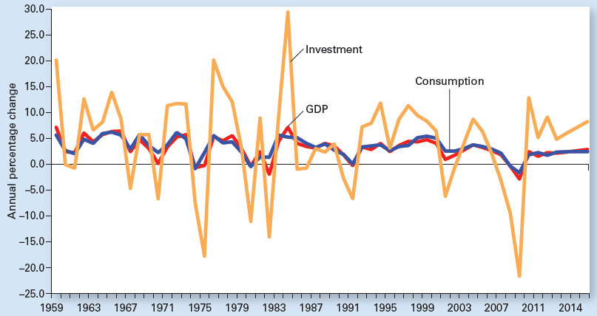
Exhibit 6
Annual Percentage Change in U.S. Real GDP, Consumption, and Investment
Investment varies much more year-to-year than consumption does and accounts for nearly all the variability in real GDP. This is why economic forecasters pay special attention to the business outlook and investment plans.

Slide 25
Government Purchases
Government purchases, G
Government purchases of goods and services
Averaged 20% of GDP during most recent decade (this excludes transfer payments)
Most by state and local governments
Spending decisions do not depend directly on income in the economy
Assumption: G is independent of income

Slide 26
Government Purchases
Government outlays
Government purchases, G
Transfer payments
Transfer payments
Outright grants from government to households
Vary inversely with income
Social Security, welfare benefits, and unemployment insurance

Slide 27
Government Purchases
Government outlays
Funded with taxes
Taxes
Vary directly with income
Taxes minus transfers = net taxes, or NT
Assumed to be independent of income
NT affects aggregate spending indirectly
By changing disposable income
Which in turn changes consumption

Slide 28
Net Exports
The U.S.
About one-twentieth of the world’s population
About one-eighth of the world’s imports
And one-ninth of the world’s exports
Imports
Affected by income
When incomes rise, Americans spend more on all normal goods, including imports

Slide 29
Net Exports
Exports
Depend on the income of foreigners, not on U.S. income
Net exports = Exports – Imports = X – M
Tend to decline as U.S. incomes increase
Assumption: independent of income
If M > X: Net exports < 0
If X > M: Net exports > 0
If X = M: Net exports = 0

Slide 30
Aggregate Expenditure and Income
A dollar spent (expenditure)
Translates directly into a dollar earned (income)
Aggregate expenditure components, AE = C + I + G + (X – M)
Varies with income: C
Assumed to be independent of income: I, G, (X – M)

Slide 31
Aggregate Expenditure and Income
Aggregate expenditure line, AE
A relationship tracing, for a given price level, spending at each level of income, or real GDP
The total of C + I + G + (X – M) at each level of income, or real GDP
Slope of AE line = MPC
Because only C varies with income

Slide 32
Aggregate Expenditure and Income
Income – Expenditure model
Relationship that shows how much people plan to spend at each income level
For a give price level
Identifies where the amount people plan to spend equals the amount produced in the economy

Slide 33
Aggregate Expenditure and Income
Income – Expenditure model
AE line, given price level
45-degree line
Spending = real GDP
Real GDP demanded (aggregate output demanded)
AE = real GDP

Slide 34
Exhibit 7
Deriving the Real GDP Demanded for a Given Price Level
18.0
d
Real GDP demanded for a given price level is found where aggregate expenditure equals aggregate output—that is, where spending equals the amount produced, or real GDP. This occurs at point e, where the aggregate expenditure line intersects the 45-degree line.
C+I+G+(X-M)
17.8
c
e
17.0
Aggregate expenditure (trillions of dollars)
b
16.2
16.0
a
45°
0
16.0
17.0
Real GDP
(trillions of dollars)
18.0

Slide 35
Aggregate Expenditure and Income
If spending > real GDP
Inventory reductions
Increase production, employment, income, and spending
If real GDP > spending
Unsold goods: unplanned inventory buildups
Decrease production, employment, income, spending

Slide 36
The Simple Spending Multiplier
Initial increased spending: AE line shifts upward
Round one, Spending > Output
Unplanned reduction in inventories
Expand production
Increased income
Round two
Increased spending and saving
Increased output,
Increased income

Slide 37
The Simple Spending Multiplier
Results of Increased Spending (continued)
Round three and beyond
Increased spending and saving
Increased output
Increased income
… as long as spending exceeds output

Slide 38
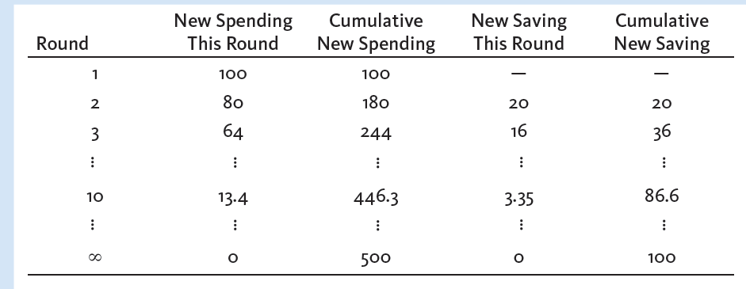
Exhibit 8
Tracking the Rounds of Spending Following a
$100 Billion Increase in Investment (billions of dollars)

Slide 39
The Simple Spending Multiplier
The larger the MPC
The larger the simple spending multiplier
Simple spending multiplier
Ratio of a change in real GDP demanded
To the initial change in spending that brought it about
Assuming only consumption varies with income

Slide 40
The Aggregate Demand Curve
For each price level
There is a unique AE line
Yields a unique real GDP demanded
Changing the price level
Different real GDP demanded in the income-expenditure model
Can derive the aggregate demand curve

Slide 41
The Aggregate Demand Curve
Higher price level
Decreased C
Higher interest rate
Decreased I
Decreased (X - M)
Reduced aggregate spending
AE line shifts down
Decrease real GDP demanded

Slide 42
The Aggregate Demand Curve
Lower price level
Increase: C, I, (X - M)
Increased aggregate spending
AE line shifts up
Increase real GDP demanded
Aggregate demand curve
Various price levels
Quantities of real GDP demanded

Slide 43
Exhibit 9
Changing the Price Level to Find the Aggregate Demand Curve
(a)
AE″(P=100)
At the initial price level of 110, the aggregate expenditure line is AE, which identifies real GDP demanded of $17.0 trillion. This combination of a price level of 110 and a real GDP demanded of $17.0 trillion determines one combination (point e) on the aggregate demand curve in panel (b).
At the higher price level of 120, the aggregate expenditure line shifts down to AE’, and real GDP demanded falls to $16.5 trillion. This price–quantity combination is identified as point e’ in panel (b).
At the lower price level of 100, the aggregate expenditure line shifts up to AE”, which increases real GDP demanded. This combination is plotted as point e” in panel (b).
Connecting points e, e’, and e” in panel (b) yields the downward-sloping aggregate demand curve AD, which shows the inverse relation between the price level and real GDP demanded.
e″
AE (P=110)
AE′ (P=120)
Aggregate expenditure
(trillions of dollars)
e
e′
45°
(b)
0
16.5
17.0
17.5
Real GDP
(trillions of dollars)
120
e′
110
e
Price level
100
e″
AD
0
16.5
17.0
17.5
Real GDP (trillions of dollars)

Slide 44
The Aggregate Demand Curve
A given price level
AE line – relationship between
Spending plans and income (real GDP)
Change in price level
Shifts AE line
Changes real GDP demanded
Movement along AD curve
A given price level
For changes in spending: shift AD curve

Slide 45
Exhibit 10
A Shift of the AE Line That Shifts the AD Curve
(a) Investment increase shifts up the aggregate expenditure line
A shift of the aggregate expenditure line at a given price level shifts the aggregate demand curve. In panel (a), an increase in investment of $0.1 trillion, with the price level constant at 110, causes the aggregate expenditure line to increase from C+I+G+(X-M) to C+I′+G+(X-M). As a result, real GDP demanded increases from $14.0 trillion to $14.5 trillion.
(b) Investment increase shifts aggregate demand rightward
In panel (b), the aggregate demand curve has shifted from AD out to AD′. At the prevailing price level of 110, real GDP demanded has increased by $0.5 trillion.
e′
C+I′+G+(X-M)
C+I+G+(X-M)
0.1
Aggregate expenditure
(trillions of dollars)
e
45°
0
Real GDP
(trillions of dollars)
17.0
17.5
e
110
e′
Price level
AD
AD′
0
17.0
17.5
Real GDP (trillions of dollars)

