Slide 1
CHAPTER
21
The Monetary System
Notes:
Students consider this chapter very interesting, and most of it is quite straightforward. It contains one analytically challenging topic: the process of money creation in the banking system. A good idea might be to proceed somewhat quickly through most of the chapter, spending more time on money creation in the banking system, t-accounts, and the money multiplier.

Slide 2
Look for the answers to these questions:
What assets are considered “money”? What are the functions of money? The types of money?
What is the Federal Reserve?
What role do banks play in the monetary system? How do banks “create money”?
How does the Federal Reserve control the money supply?

Slide 3
What Money Is and Why It’s Important
Without money
Trade would require barter: the exchange of one good or service for another.
Requires a double coincidence of wants: unlikely occurrence that two people each have a good the other wants.
Waste of resources: people spend time searching for others to trade with
Using money
Solves those problems
Notes:
“Double coincidence of wants” simply means that two people have to want each other’s stuff.
Students find the following example amusing:
I’m an economics professor, but I’m a consumer, too. Suppose I want to go out for a beer. Under a barter system, I would have to search for a bartender that was willing to give me a beer in exchange for a lecture on economics. As you might imagine, I would have to spend a LOT of time searching. (On the plus side, this would prevent me from becoming an alcoholic.)
But thanks to money, I can go directly to my favorite pub and get a cold beer; the bartender doesn’t have to want to hear my lecture, he only has to want my money.

Slide 4
The 3 Functions of Money
Medium of exchange
Item that buyers give to sellers when they want to purchase goods and services
Unit of account
Yardstick people use to post prices and record debts
Store of value
Item that people can use to transfer purchasing power from the present to the future
Notes:
Money is a medium of exchange. That just means you use money to buy stuff.
Money is a unit of account. The price or monetary value of virtually everything is measured in the same units—dollars (in the U.S., or substitute your country’s currency if you’re located outside the U.S.). Imagine how hard it would be to plan your budget or comparison shop if sellers each used their own system of measuring prices.
Money is a store of value. Money holds its value over time, so you don’t have to spend it immediately upon receiving it.

Slide 5
The 2 Kinds of Money
Commodity money:
Takes the form of a commodity with intrinsic value
Examples: gold coins, cigarettes in POW camps
Fiat money:
Money without intrinsic value, used as money because of government decree
Example: the U.S. dollar
Notes:
Intrinsic value means the commodity would have value even if it weren’t being used as money.
In the film “The Shawshank Redemption,” prisoners use cigarettes as money.
Fiat money is worthless—except as money. Yet, people are happy to accept your dollars (or euros or yen or whatever) because they know they will be able to spend the currency.

Slide 6
The Money Supply
The money supply (or money stock):
Quantity of money available in the economy
Currency:
Paper bills and coins in the hands of the (non-bank) public
Demand deposits:
Balances in bank accounts that depositors can access on demand by writing a check
Notes:
What assets should be considered part of the money supply? Two candidates: Currency and Demand deposits.
The definition of currency in the textbook does not include “(non-bank)”. I added it to avoid confusion later, when students are asked to think about what happens to the money supply when a consumer decides to deposit a $50 bill into his or her checking account.

Slide 7
The Money Supply
M1 = $3.2 trillion (May 2016)
Currency, demand deposits, traveler’s checks, and other checkable deposits.
M2 =$12.7 trillion (May 2016)
Everything in M1 plus savings deposits, small time deposits, money market mutual funds, and a few minor categories.
The distinction between M1 and M2 will often not matter when we talk about “the money supply” in this course.
Notes:
Source: Federal Reserve, Board of Governors, Statistical Release H.6.
The latest H.6 release can be found at:
http://www.federalreserve.gov/releases/h6/Current/

Slide 8
Central Banks & Monetary Policy
Central bank:
Institution that oversees the banking system and regulates the money supply
Monetary policy:
Setting of the money supply by policymakers in the central bank
Federal Reserve (Fed):
The central bank of the U.S.

Slide 9
The Structure of the Fed
The Federal Reserve System consists of:
Board of Governors
(7 members), located in Washington, DC
12 regional Fed banks
Located around the U.S.
Federal Open Market Committee (FOMC),
includes the Board of Governors and presidents of some of the regional Fed banks.
The FOMC decides monetary policy.
Notes:
In subsequent chapters (including the chapter immediately following this one), students will learn that the Federal Reserve’s monetary policy can have huge effects on many macroeconomic variables, like inflation, interest rates, unemployment, and even stock price indexes and exchange rates.

Slide 10
Bank Reserves
In a fractional reserve banking system
Banks keep a fraction of deposits as reserves and use the rest to make loans.
The Fed establishes reserve requirements
Regulations on the minimum amount of reserves that banks must hold against deposits.
Banks may hold more than this minimum
The reserve ratio, R
=fraction of deposits that banks hold as reserves
=total reserves as a percentage of total deposits
Notes:
Segue from last slide:
The Fed controls the money supply and regulates banks. Banks clearly play an important role in the money supply because bank deposits are part of the money supply (recall that M1 includes checking account deposits, and M2 also includes savings account deposits).
In the interests of parsimony, I have combined the definitions of “fractional reserve banking system” and “reserves,” as shown in the first bullet point. I believe it is sufficient to convey the meaning of both terms.

Slide 11
Bank T-Account
T-account: a simplified accounting statement that shows a bank’s assets & liabilities.
Banks’ liabilities include deposits,
Assets include loans & reserves.
Notice that R = $10/$100 = 10%.
FIRST NATIONAL BANK
Assets | Liabilities
Reserves $ 10 Loans $ 90 | Deposits $100

Slide 12
Banks and the Money Supply: An Example
Suppose $100 of currency is in circulation.
To determine banks’ impact on money supply, we calculate the money supply in 3 different cases:
No banking system
100% reserve banking system (banks hold 100% of deposits as reserves, make no loans)
Fractional reserve banking system

Slide 13
Banks and the Money Supply: An Example
Case 1: No banking system
Public holds the $100 as currency.
Money supply = $100.

Slide 14
Banks and the Money Supply: An Example
Case 2: 100% reserve banking system
Public deposits the $100 at First National Bank (FNB).
FNB holds 100% of deposit as reserves:
Money supply = currency + deposits = $0 + $100 = $100
In a 100% reserve banking system, banks do not affect size of money supply.
FIRST NATIONAL BANK
Assets | Liabilities
Reserves $100 Loans $ 0 | Deposits $100

Slide 15
Banks and the Money Supply: An Example
Case 3: Fractional reserve banking system
Suppose R = 10%. FNB loans all but 10% of the deposit:
FIRST NATIONAL BANK
Assets | Liabilities
Reserves $100 Loans $ 0 | Deposits $100
FIRST NATIONAL BANK
Assets | Liabilities
Reserves $10 Loans $90 | Deposits $100
Depositors have $100 in deposits, borrowers have $90 in currency.
Money supply = C + D = $90 + $100 = $190 (!!!)
Notes:
The notion that banks create money by making loans is a new and perhaps awkward idea for students. The following slide may help.

Slide 16
Banks and the Money Supply: An Example
Case 3: Fractional reserve banking system
How did the money supply suddenly grow?
When banks make loans, they create money.
The borrower gets
$90 in currency—an asset counted in the money supply
$90 in new debt—a liability that does not have an offsetting effect on the money supply
A fractional reserve banking system creates money, but not wealth.
Notes:
Students more easily accept the idea that banks create money when they see that banks do not create wealth.

Slide 17
Banks and the Money Supply: An Example
Case 3: Fractional reserve banking system
Borrower deposits the $90 at Second National Bank.
Initially,
SNB’s T-account
looks like this:
SECOND NATIONAL BANK
Assets | Liabilities
Reserves $90 Loans $ 0 | Deposits $90
SECOND NATIONAL BANK
Assets | Liabilities
Reserves $ 9 Loans $81 | Deposits $90
If R = 10% for SNB, it will loan all but 10% of the deposit.

Slide 18
Banks and the Money Supply: An Example
Case 3: Fractional reserve banking system
SNB’s borrower deposits the $81 at Third National Bank.
Initially,
TNB’s T-account
looks like this:
THIRD NATIONAL BANK
Assets | Liabilities
Reserves $81 Loans $ 0 | Deposits $81
THIRD NATIONAL BANK
Assets | Liabilities
Reserves $ 8.10 Loans $72.90 | Deposits $81
If R = 10% for TNB, it will loan all but 10% of the deposit.

Slide 19
Banks and the Money Supply: An Example
Case 3: Fractional reserve banking system
The process continues, and money is created with each new loan.
Original deposit = $100.00
FNB lending = $ 90.00
SNB lending = $ 81.00
TNB lending = $ 72.90
… …
Total money supply = $1,000.00
In this example, $100 of reserves generates $1,000 of money.

Slide 20
The Money Multiplier
Money multiplier = 1/R
Amount of money the banking system generates with each dollar of reserves
In our example, R = 10%
Money multiplier = 1/R = 10
$100 of reserves creates $1,000 of money

Slide 21
Active Learning 1 Banks and the money supply
While cleaning your apartment, you look under the sofa cushion and find a $50 bill (and a half-eaten taco). You deposit the bill in your checking account.
The Fed’s reserve requirement is 20% of deposits.
What is the maximum amount that the money supply could increase?
What is the minimum amount that the money supply could increase?

Slide 22
Active Learning 1 Answers
You deposit $50 in your checking account.
What is the maximum amount that the money supply could increase?
If banks hold no excess reserves, then money multiplier = 1/R = 1/0.2 = 5
The maximum possible increase in deposits is 5 x $50 = $250
But money supply also includes currency, which falls by $50.
Hence, max increase in money supply = $200.

Slide 23
Active Learning 1 Answers
You deposit $50 in your checking account.
What is the maximum amount that the money supply could increase?
Answer = $200.
What is the minimum amount that the money supply could increase?
Answer: $0
If your bank makes no loans from your deposit, currency falls by $50, deposits increase by $50, money supply does not change.

Slide 24
A More Realistic Balance Sheet
Assets:
Besides reserves and loans, banks also hold securities.
Liabilities:
Besides deposits, banks also obtain funds from issuing debt and equity.
Bank capital:
The resources a bank obtains by issuing equity to its owners
Also: bank assets minus bank liabilities
Notes:
This and the next few slides correspond to the section “Bank Capital, Leverage, and the Financial Crisis of 2008–2009.”

Slide 25
A More Realistic Balance Sheet
Capital requirement:
A government regulation that specifies a minimum amount of capital,
Intended to ensure banks will be able to pay off depositors and debts
Leverage:
The use of borrowed funds to supplement existing funds for investment purposes

Slide 26
A More Realistic Balance Sheet
Leverage ratio: ratio of assets to bank capital
In this example, the leverage ratio = $1000/$50 = 20
Interpretation: for every $20 in assets, $ 1 is from the bank’s owners, $19 is financed with borrowed money.
MORE REALISTIC NATIONAL BANK
Assets | Liabilities
Reserves $ 200 Loans $ 700 Securities $ 100 | Deposits $ 800 Debt $ 150 Capital $ 50

Slide 27
Leverage Amplifies Profits and Losses
In our example, suppose bank assets appreciate by 5%, from $1000 to $1050.
This increases bank capital from $50 to $100, doubling owners’ equity.
Instead, if bank assets decrease by 5%,
Bank capital falls from $50 to $0.
If bank assets decrease more than 5%,
Bank capital is negative and bank is insolvent.

Slide 28
Leverage and the Financial Crisis
Financial crisis of 2008–2009
Banks suffered losses on mortgage loans and mortgage-backed securities due to widespread defaults.
Many banks became insolvent:
In the U.S., 27 banks failed during 2000–2007,
166 during 2008–2009.
Many other banks found themselves with too little capital, responded by reducing lending, causing a credit crunch.

Slide 29
The Government’s Response
To ease the credit crunch
The Federal Reserve and U.S. Treasury injected hundreds of billions of dollars’ worth of capital into the banking system.
This unusual policy temporarily made U.S. taxpayers part-owners of many banks.
The policy succeeded in recapitalizing the banking system and helped restore lending to normal levels in 2009.

Slide 30
The Fed’s Tools of Monetary Control
Earlier, we learned
money supply = money multiplier × bank reserves
The Fed can change the money supply by
Changing bank reserves or
Changing the money multiplier

Slide 31
How the Fed Influences Reserves
Open-Market Operations (OMOs):
The purchase and sale of U.S. government bonds by the Fed.
To increase bank reserves and the money supply:
The Fed buys a government bond from a bank
Pays by depositing new reserves in that bank’s reserve account.
With more reserves, the bank can make more loans, increasing the money supply
Notes:
To decrease bank reserves and the money supply, the Fed sells government bonds.

Slide 32
How the Fed Influences Reserves
The Fed makes loans to banks, increasing their reserves
Traditional method: adjusting the discount rate (interest rate on loans the Fed makes to banks) to influence the amount of reserves banks borrow
New method: Term Auction Facility (the Fed chooses the quantity of reserves it will loan, then banks bid against each other for these loans.)
The more banks borrow,
The more reserves they have for funding new loans and increasing the money supply.

Slide 33
How the Fed Influences the Reserve Ratio
The Fed sets reserve requirements:
Regulations on the minimum amount of reserves banks must hold against deposits.
Reducing reserve requirements would lower the reserve ratio and increase the money multiplier.
Since 10/2008, the Fed has paid interest on reserves banks keep in accounts at the Fed.
Raising this interest rate would increase the reserve ratio and lower the money multiplier.
Notes:
Recall: reserve ratio = reserves/deposits, which inversely affects the money multiplier.

Slide 34
Problems Controlling the Money Supply
The Fed does not control:
The amount of money that households choose to hold as deposits in banks
The amount that bankers choose to lend
Yet, the Fed can compensate for household and bank behavior to retain fairly precise control over the money supply
Notes:
If households hold more of their money as currency, banks have fewer reserves, make fewer loans, and money supply falls.
If banks hold more reserves than required, they make fewer loans, and money supply falls.

Slide 35
Bank Runs and the Money Supply
A run on banks:
When people suspect their banks are in trouble, they may “run” to the bank to withdraw their funds, holding more currency and less deposits.
Under fractional-reserve banking
Banks don’t have enough reserves to pay off ALL depositors, hence banks may have to close.
Also, banks may make fewer loans and hold more reserves to satisfy depositors.
These events increase R,
Reverse the process of money creation, cause money supply to fall.

Slide 36
Bank Runs and the Money Supply
During 1929–1933
A wave of bank runs and bank closings caused money supply to fall 28%.
Many economists believe this contributed to the severity of the Great Depression.
Since then, federal deposit insurance
Helped prevent bank runs in the U.S.
2007, bank run in the U.K.
Northern Rock bank - was eventually taken over by the British government.

Slide 37
The Federal Funds Rate
The federal funds rate
Interest rate at which banks make overnight loans to one another
Lender – has excess reserves
Borrower – needs reserves
A change in federal funds rate
Cause changes in other rates and have a big impact on the economy.
Notes:
On any given day, banks with insufficient reserves can borrow from banks with excess reserves. The interest rate on these loans is the federal funds rate.
The FOMC uses OMOs to target the fed funds rate.

Slide 38
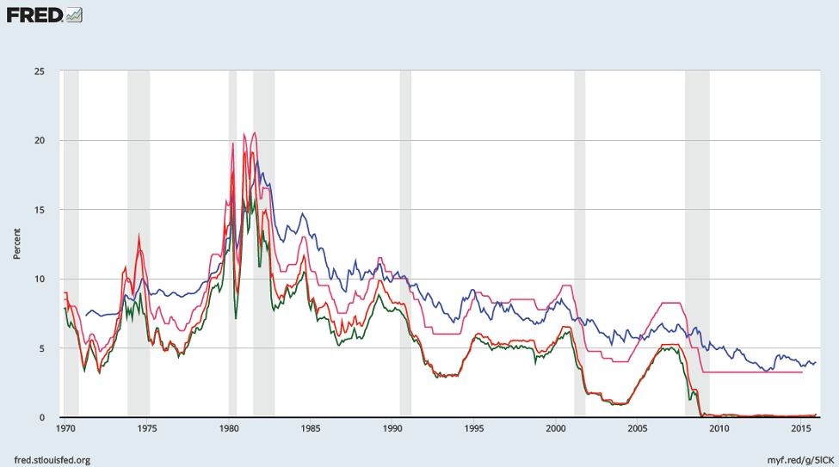
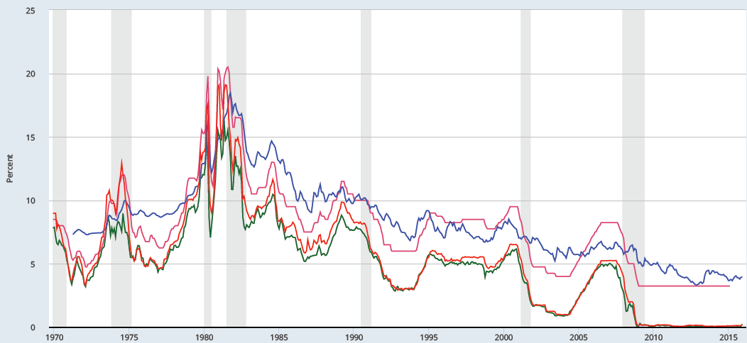
The Fed Funds rate and other rates, 1970–2016
Fed. Funds
Mortgage
Prime
3 Month T-bill
Notes:
The prime rate (the rate banks charge on loans to their best customers; IRSTPI01USM156N) and the 3-month Treasury Bill rate (TB3MS) are very highly correlated with the Fed Funds rate.
The mortgage rate shown is the 30-year fixed rate (MORTGAGE30US). It is less correlated with the Federal Funds rate (DFF), but this is to be expected: Fed Funds are overnight loans between banks, while mortgages are 30-year loans to consumers.
source: FRED database
http://research.stlouisfed.org/fred2/
Image permalink: https://fred.stlouisfed.org/graph/fredgraph.png?g=5lC5

Slide 39
Monetary Policy and the Fed Funds Rate
0
Federal funds rate
The Federal Funds market
r_{f}
To raise fed funds rate, Fed sells government bonds (OMO).
This removes reserves from the banking system, reduces supply of federal funds,
causes r_{f} to rise.
S₂
S₁
1.75%
1.50%
D₁
F
F₂
F₁
Quantity of federal funds
Notes:
39
This graph is not in the textbook, so it is not supported with material in the study guide or test bank. Therefore, you may wish to omit this slide from your presentation. But I hope you will consider keeping it. It uses a simple supply-demand diagram to illustrate something described verbally in the text: how the Federal Reserve targets the federal funds rate.
The demand for federal funds comes from banks that find themselves with insufficient reserves, perhaps because they made too many loans or had higher-than-expected withdrawals.
The supply of federal funds comes from banks that find themselves with more reserves than they want, perhaps because they had lower-than-expected withdrawals or because few customers took out loans.
The federal funds rate adjusts to balance the supply of and demand for federal funds.
The Federal Reserve can use OMOs to target the fed funds rate. Whenever the rate starts to fall below the Fed’s target, the Fed sells government bonds in the open market in order to pull reserves out of the banking system, which raises the rate as shown in this diagram. If the rate rises above the Fed’s target, the Fed buys govt bonds in the open market, injecting reserves into the banking system, and pushing the rate down.
For the Fed, OMOs are quick, easy, and effective, so the Fed can keep the fed funds rate very close to the target.

Slide 40
Summary
Money serves three functions: medium of exchange, unit of account, and store of value.
There are two types of money: commodity money has intrinsic value; fiat money does not.
The U.S. uses fiat money, which includes currency and various types of bank deposits.

Slide 41
Summary
In a fractional reserve banking system, banks create money when they make loans.
Bank reserves have a multiplier effect on the money supply.
Because banks are highly leveraged, a small change in the value of a bank’s assets causes a large change in bank capital.
To protect depositors from bank insolvency, regulators impose minimum capital requirements.

Slide 42
Summary
The Federal Reserve is the central bank of the U.S. The Fed is responsible for regulating the monetary system.
The Fed controls the money supply mainly through open-market operations.
Purchasing government bonds increases the money supply, selling government bonds decreases it.
In recent years, the Fed has set monetary policy by choosing a target for the federal funds rate.

