Slide 1
Chapter 1
An Introduction
to International
Trade

Slide 2
Topics to be Covered
Characteristics of National Economies
The Direction of International Trade
What Goods Do Countries Trade?

Slide 3
Examples of International Trade Questions
What impact will the global financial crisis have on world trade?
Has the recent growth of world trade and capital flows exacerbated the impact of the financial crisis?
Does reliance on international trade lead to a loss of jobs for Americans?
Can American firms compete against firms in low-wage countries?
Is the large U.S. trade deficit harmful?
What is the appropriate value of the dollar?

Slide 4
Branches of International Economics
Trade (international microeconomics)
  Why do nations engage in international trade?
  What goods and services do nations trade?
  How does international trade affect national income, welfare, and jobs?
  How do trade barriers affect national welfare?
  How are countries affected by international movements of labor and capital?

Slide 5
Branches of International Economics (cont.)
Finance (international macroeconomics)
  What is the balance of payments?
  What is an exchange rate and what factors determine the exchange rate?
  What is the relationship between exchange rates, prices, and interest rates?
  How are countries affected by foreign direct investment and lending?
  How effective are domestic policies given the global economy?

Slide 6
Characteristics of National Economies
Over 190 countries in the world today
Population
Land area
Gross National Product (GNP)—value of final goods and services produced by domestic factors of production.
Gross Domestic Product (GDP)—value of final products produced within a country.
Per capita GNP (GDP)

Slide 7
International Trade
Exports—goods and services produced by economic agents in one country and sold to other countries.
Imports—goods and services consumed in a country but which have been purchased from other countries.

Slide 8
Index of Openness
Index of Openness—a measure of how much a country participates in international trade; defined as the ratio of a country’s exports to its GDP (or GNP).
Open Economy—a country with a high value of the index of openness.
Closed Economy—a country with a relatively low index of openness.

Slide 9
Index of Openness (cont.)
Refer to Table 1.1
Most countries became more open from 1980 to 2007.
Singapore is the most open economy while the U.S. is relatively closed.
Smaller economies (ex., Singapore) tend to be more open since they are not able to produce all the types of goods that people want to consume.

Slide 10
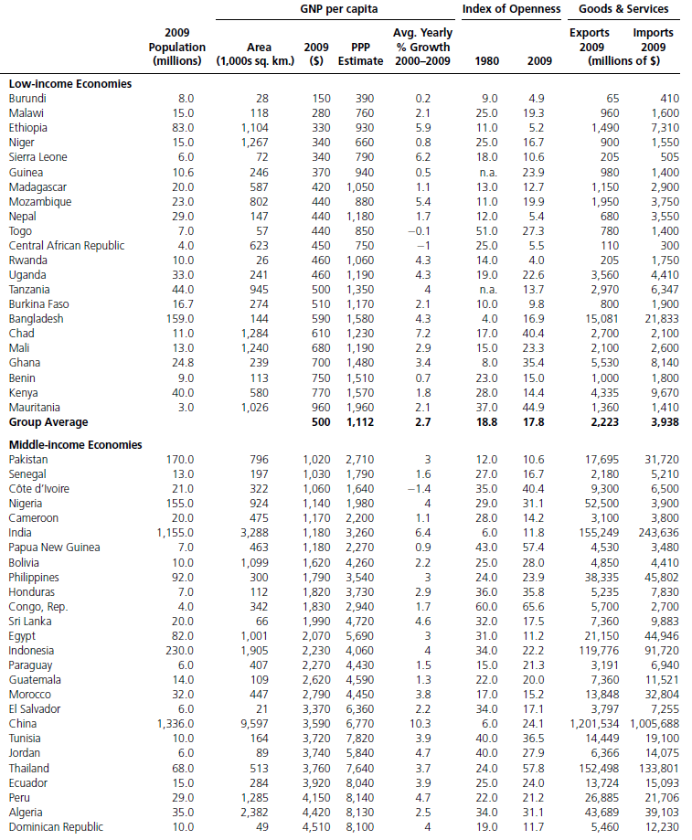
TABLE 1.1 Basic Characteristics of Selected Countries

Slide 11

TABLE 1.1 Basic Characteristics of Selected Countries (cont.)

Slide 12
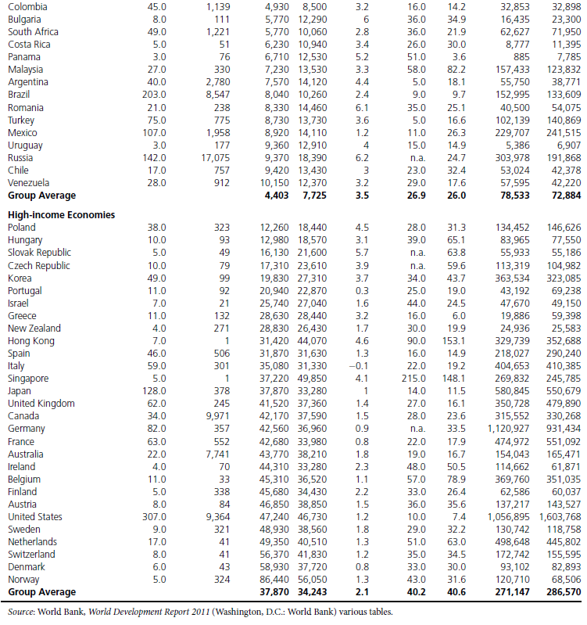
TABLE 1.1 Basic Characteristics of Selected Countries (cont.)

Slide 13
TABLE 1.1 Basic Characteristics of Selected Countries (cont.)

Slide 14
Developing Country vs. Developed Country
Developing (poor) countries vs. developed (rich) countries – classified by per capita GNP
The poorest countries tend to be located in Africa and Asia. See Table 1.1.
The richest countries are industrialized countries of Western Europe, North America, and the Pacific Rim.
International differences in standards of living are not so extreme when comparing real per capita GNP with its purchasing power parity (PPP) value.

Slide 15
Causes of Declining Standard of
Living
Financial crisis which causes financial institutions to reduce lending to households and firms.
War.
Declining prices of key products such as coffee, copper, and sugar.
A stagnant economy with rapid population growth.

Slide 16
Causes of Differences in Economic Growth of Countries
Quantity and quality of resource endowments, particularly human capital
Investment in plant and equipment
Political and socioeconomic environment that is stable and conducive to competition

Slide 17
Characteristics of World Trade
Value and growth of world merchandise trade
Largest exporters and importers
Geographic patterns or direction of world trade
Commodity composition – What goods do countries trade?

Slide 18
Growth of World Trade
Refer to Figure 1.1
What has caused the explosion of world trade?
  Reduction in trade barriers such as tariffs and quotas
  Advances in transportation, communication and technology
  Proliferation of trade agreements

Slide 19
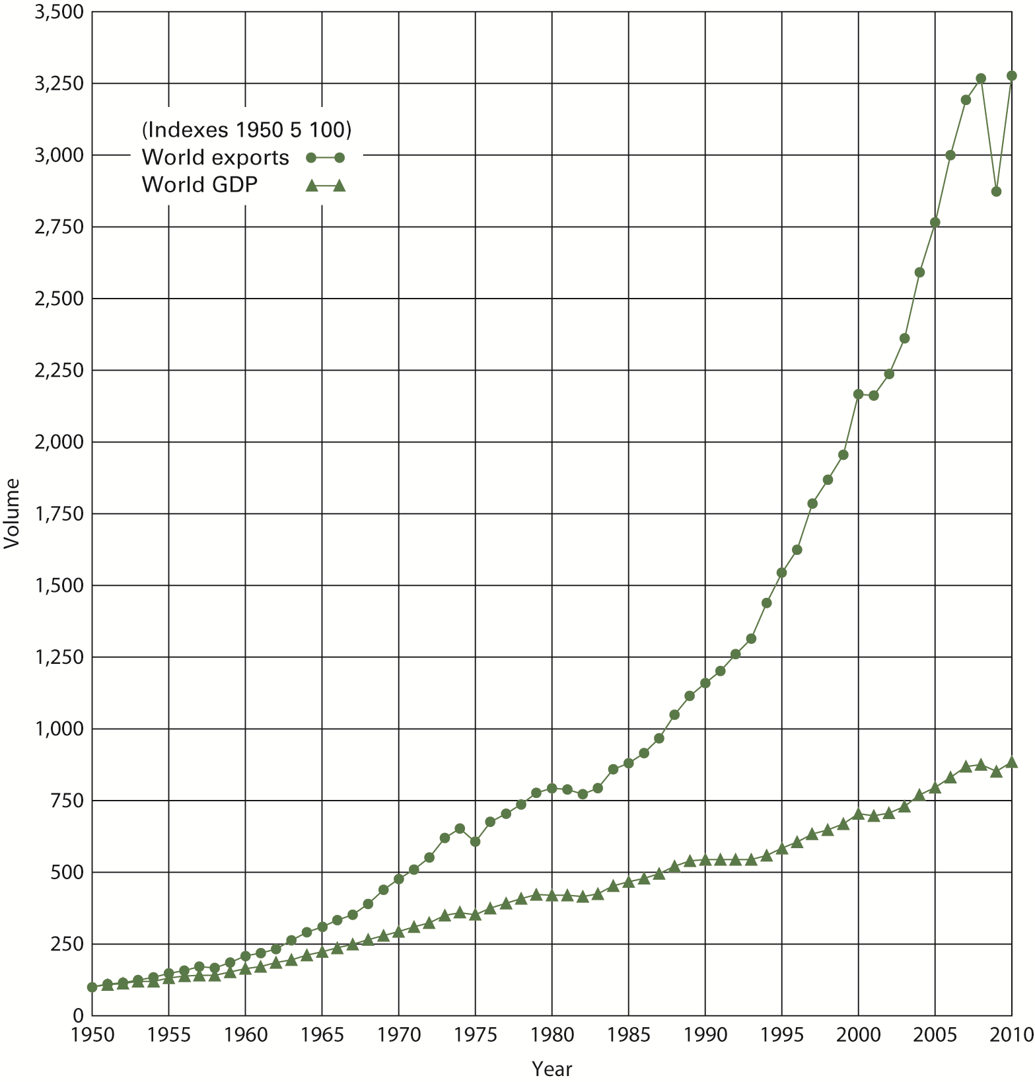
FIGURE 1.1 World Exports and
Output in Real Terms: 1950-2010

Slide 20
Causes of Great Trade Collapse of 2009
Refer to Figure 1.1
What has caused the explosion of world trade?
  Declines in orders for goods which normally are held as inventory
  Decrease in trade credit
  Growth of vertical networks of production across countries

Slide 21
Trade Deficit vs. Surplus
A country has a trade deficit (surplus) if its imports (exports) exceed its exports (imports).

Slide 22
World’s Leading Exporter
China is now the leading exporting country.
Its world export share grew from nearly zero in 1980 to 10 percent today.
China’s success is partly due to vertical network of production chains across countries, mainly in Asia.

Slide 23
Geographic Trade Patterns
Developed countries account for the bulk of world trade (largest exporters and importers). See Figure 1.2.
Asia’s export share has risen while that of Latin America and Africa has fallen.
Developed countries trade primarily with each other.
Developing countries rely on developed countries for their export markets.
Countries trade mainly with neighbors.

Slide 24
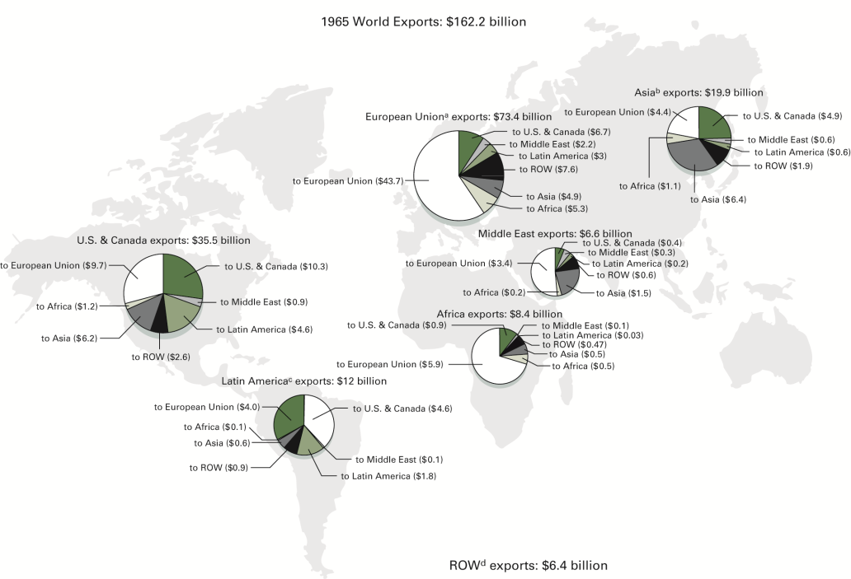
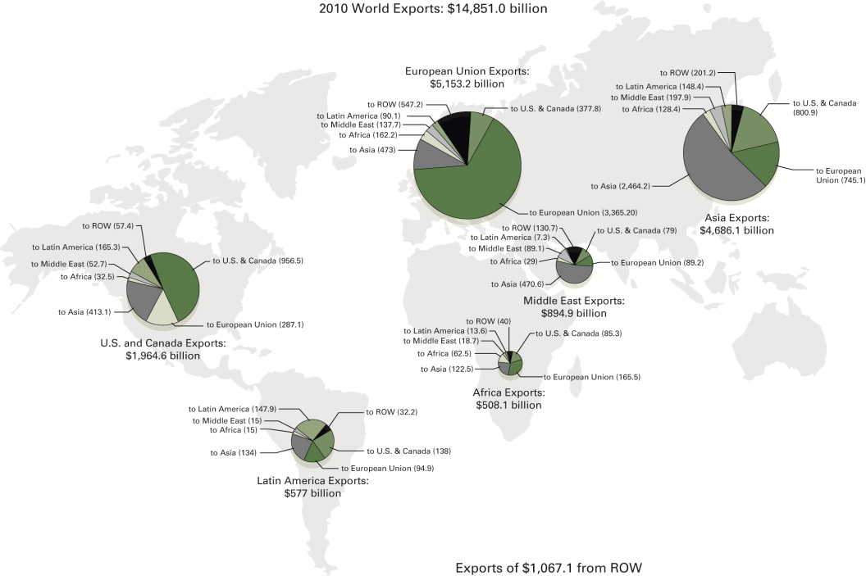
FIGURE 1.2 Geographic Pattern of
Merchandise Trade: 1965 and 2010

Slide 25
Major Trading Partners
Refer to Table 1.2
The U.S. is the major trading partner for many countries.
Distance is important – countries tend to trade primarily with their neighbors.

Slide 26
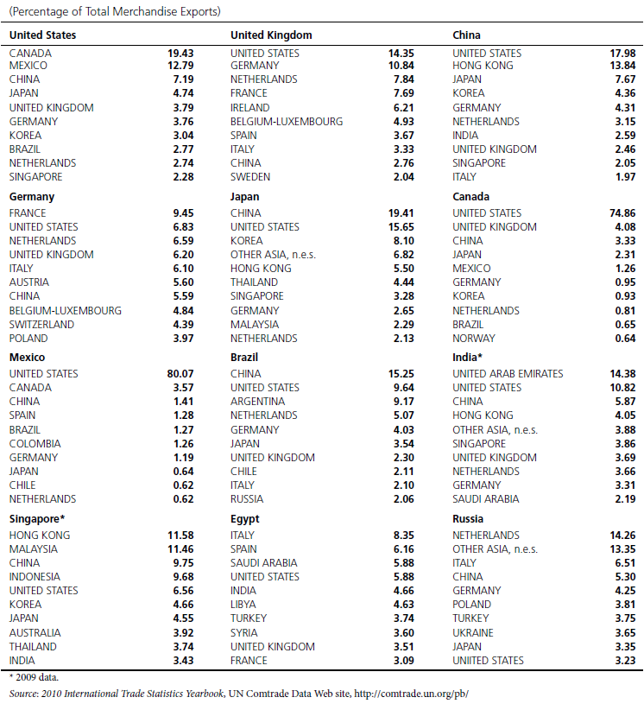
TABLE 1.2 Top Ten Trading Partners of Selected Countries, 2010

Slide 27
TABLE 1.2 Top Ten Trading Partners of Selected Countries, 2010 (cont.)

Slide 28
Commodity Composition: What Goods Do Countries Trade?
The top three most traded products in world markets (see Table 1.3):
  Petroleum
  Office machines, computers, and parts
  Automobiles
Increased role of global production (or outsourcing)

Slide 29
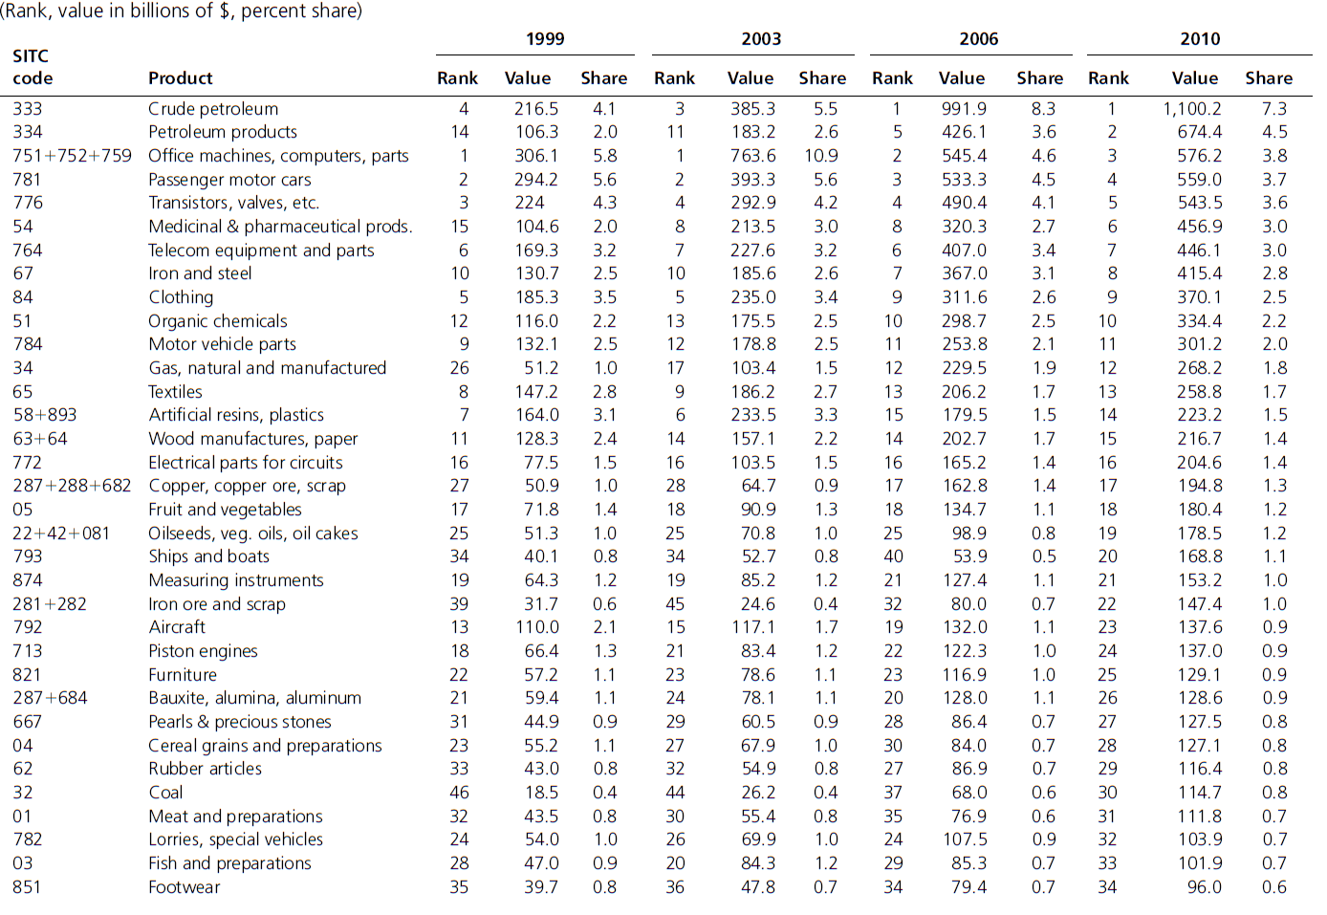
TABLE 1.3 World Trade in Major
Products: 1999, 2003, 2006, 2010

Slide 30
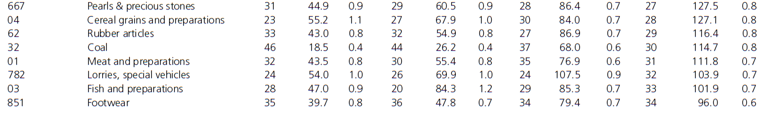
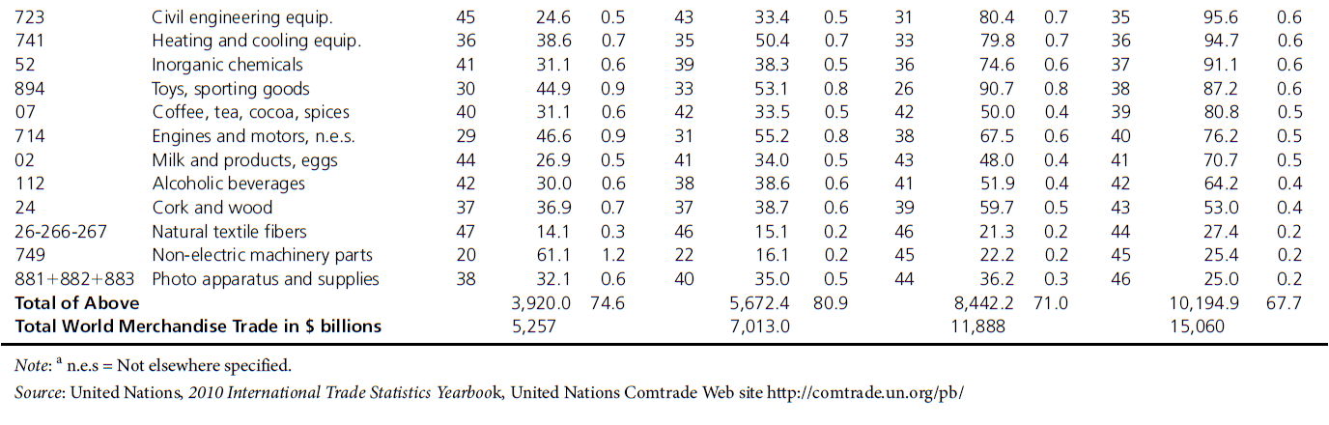
TABLE 1.3 World Trade in Major
Products: 1999, 2003, 2006, 2010
(cont.)

Slide 31
World Trade in Services
$3.5 trillion in 2010 (or 25% of international trade)
U.S. is the largest exporter and importer of services
Most traded services: transportation, travel, other services (banking, medicine, consulting, insurance, and education)

Slide 32
Characteristics of U.S. Trade
U.S. is the largest participant and a trading partner of many countries.
Top trading partners of the U.S. – primarily its neighbors, Canada and Mexico (Refer to Table 1.2, ONLY U.S. DATA)
Major U.S. exports and imports – primarily exports and imports machines and transport equipment (Refer to Tables 1.4 and 1.5, ONLY U.S. DATA)

Slide 33
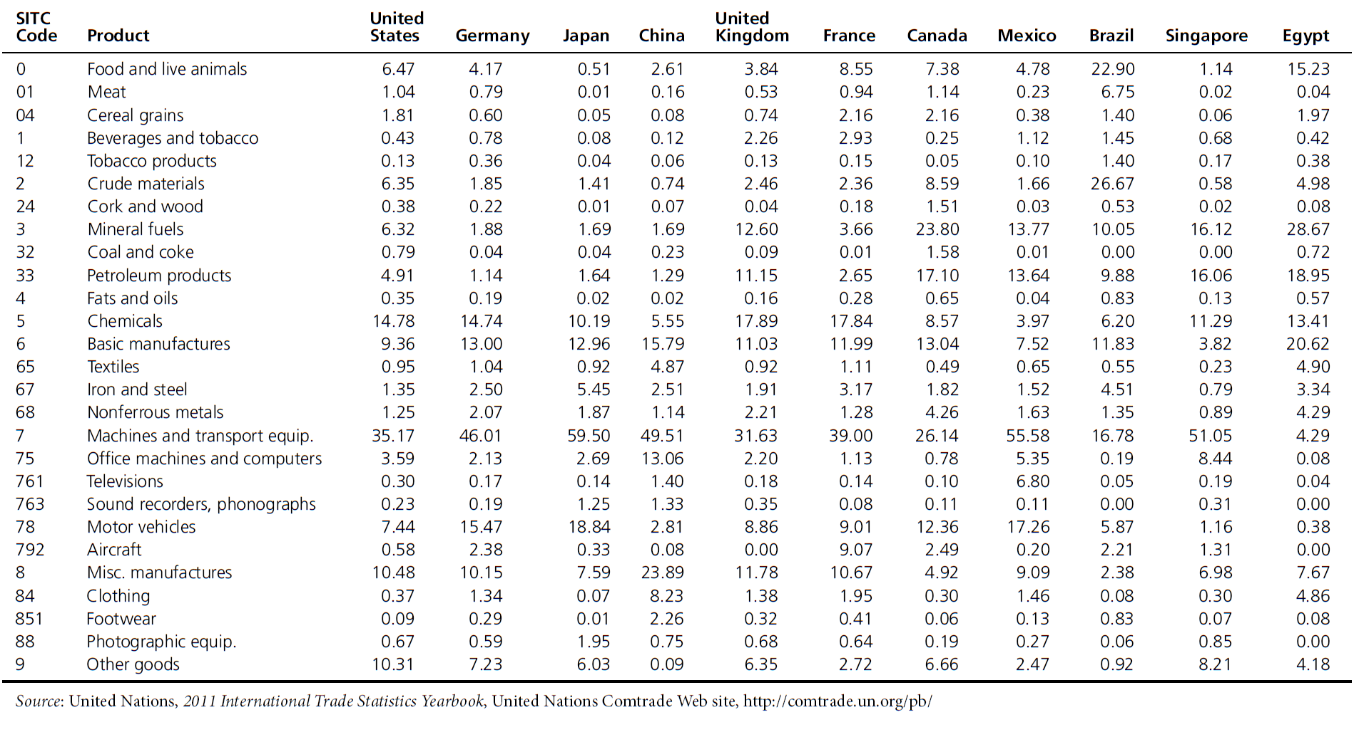
TABLE 1.4 Broad Categories of
Exports of Selected Countries, 2010

Slide 34
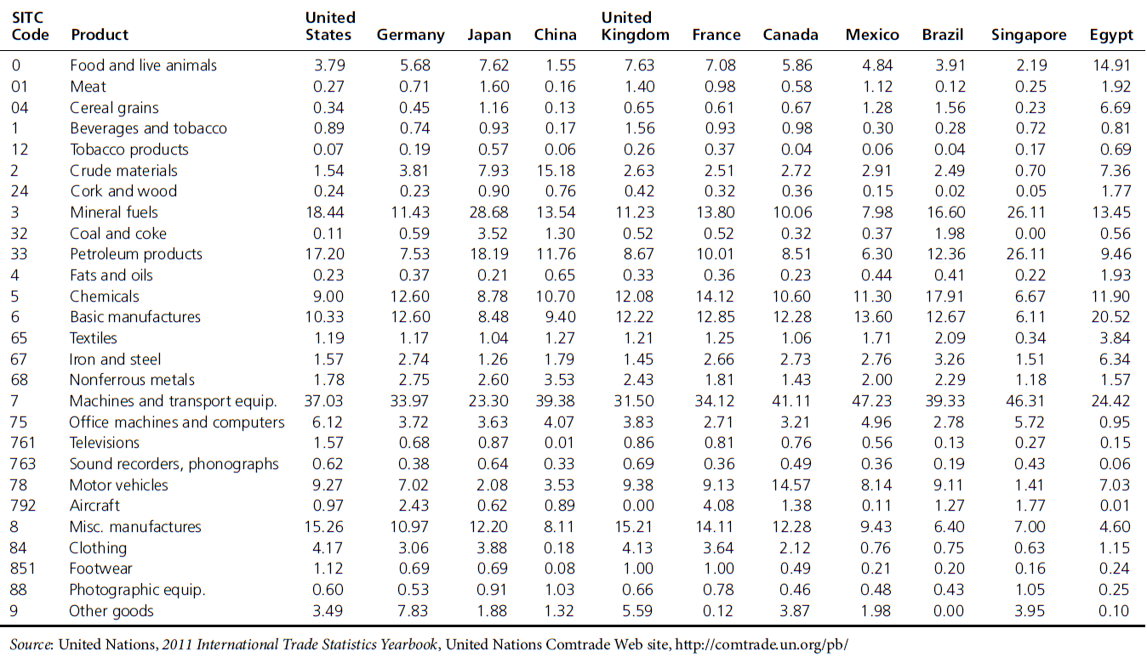
TABLE 1.5 Broad Categories of
Imports of Selected Countries, 2010
(cont.)

Slide 35
U.S. vs. Japan Trade Patterns
Refer to Tables 1.4 and 1.5
U.S. exports a wide variety of products (manufactured goods, raw materials, food).
Japan exports manufactured goods in exchange for food, raw materials, and fuel.
Reason: availability of resources – Japan is a small country with limited natural resources.

