Slide 1
Chapter 6
Tariffs

Slide 2
Topics to be Covered
The Gains from Free Trade
Tariffs: An Introduction
Tariffs: An Economic Analysis
The Gains from Free Trade: One More Time
The Welfare Cost of Tariffs
Tariffs: Some Extensions

Slide 3
Commercial Policy
Actions taken by a government to influence the country’s volume and composition of trade
Types of Commercial Policy
  Tariff
  Quota
  Subsidy
  Nontariff Barriers

Slide 4
Tariff
A tax imposed by government on either imports or exports

Slide 5
Quota
A government-imposed limit on the value or quantity of an import or export good

Slide 6
Subsidy
A government payment to a domestic industry to encourage exports or discourage imports

Slide 7
Nontariff Barriers
A wide range of government policies other than tariffs designed to affect the volume or composition of a country’s international trade
These NTBs include:
  Health and safety standards
  Government procurement policy

Slide 8
Gains from Free Trade
Economic Gains—increase in standard of living and economic growth that result from a country’s engaging in free international trade
  Static Gains
  Dynamic Gains
Political Gains—increases in well-being that accrue to a country because expanded trade and economic interdependency help reduce international hostility

Slide 9
Static Gains from Free Trade
Consumption gains – shown by a movement to a higher community indifference curve
Production gains – result from allocation of resources to the country’s comparative advantage industries
Refer to Figure 6.1

Slide 10
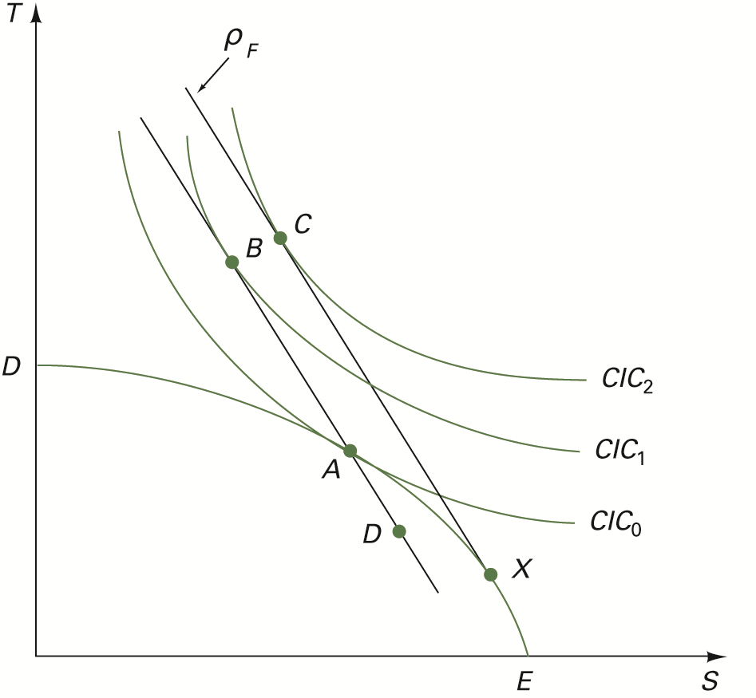
FIGURE 6.1 The Gains from Free Trade

Slide 11
Dynamic Gains from Free Trade
Increases in economic well-being that accrue to a country because trade expands the country’s productive resources or raises resource productivity

Slide 12
Relationship Between International Trade and Economic Growth
International trade enhances economic growth through imports of capital goods.
International trade enhances international diffusion of technology.
International trade is pro-competition.
International trade expands market size if economies of scale exist.
International trade can enlarge the pool of savings necessary for investment spending.

Slide 13
U.S. Tariff Schedule
Column 1 General Rates of Duty (Refer to Table 6.1)
  Most Favored Nation (MFN) Status —a country confers MFN status upon another by agreeing not to charge tariffs on that country’s goods which are no higher than those it imposes on the goods of any other country.

Slide 14
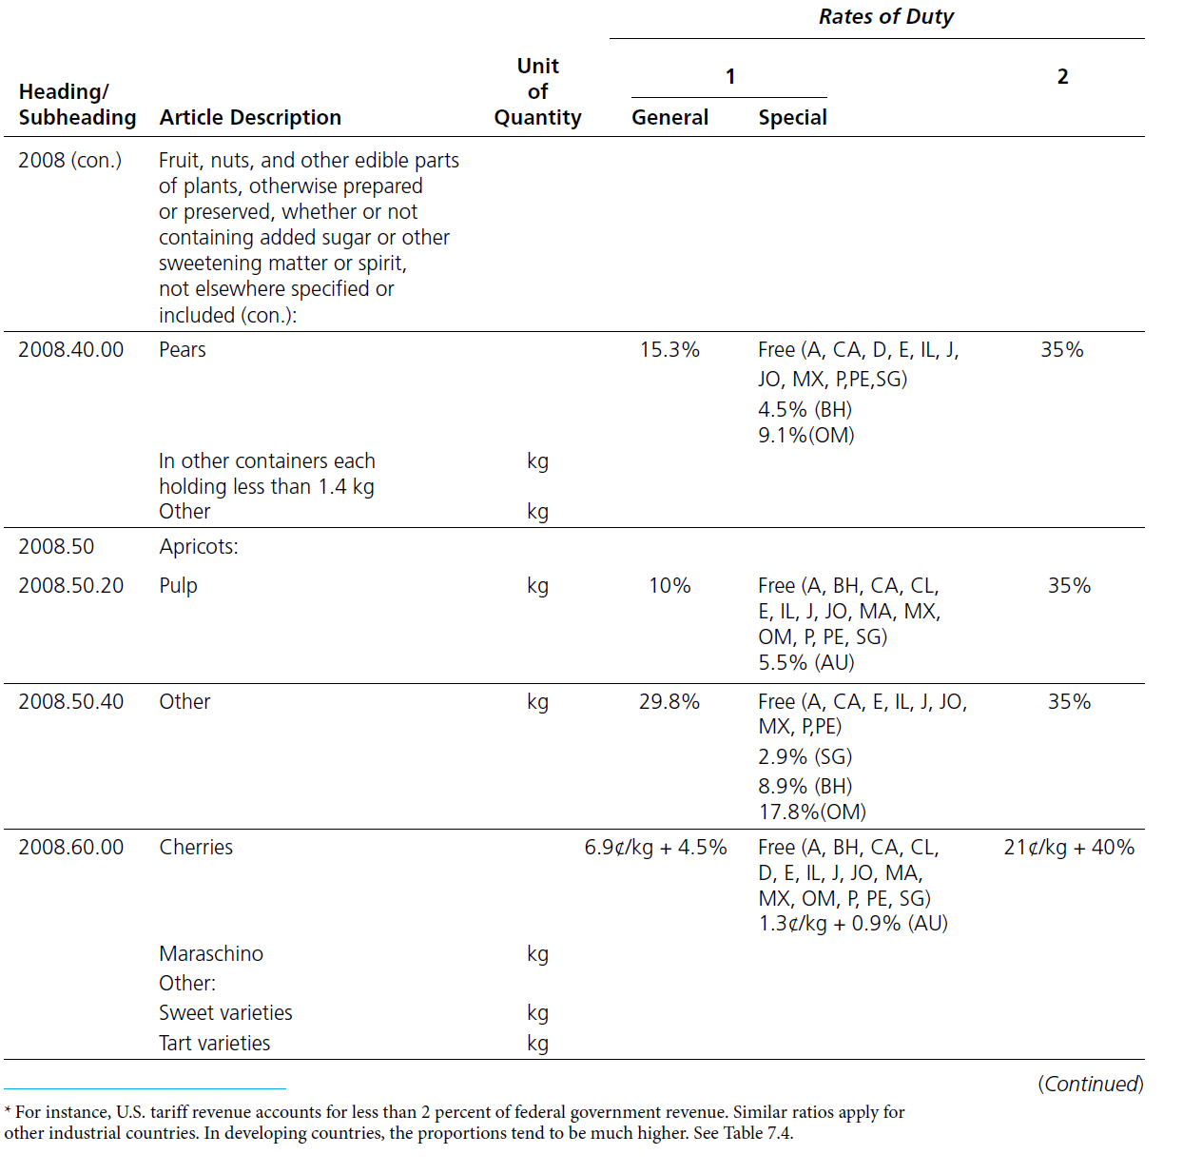
TABLE 6.1 Sample Page from the
Harmonized Tariff Schedule of the
United States (2012) (cont.)

Slide 15
TABLE 6.1 Sample Page from the
Harmonized Tariff Schedule of the
United States (2012) (cont.)

Slide 16
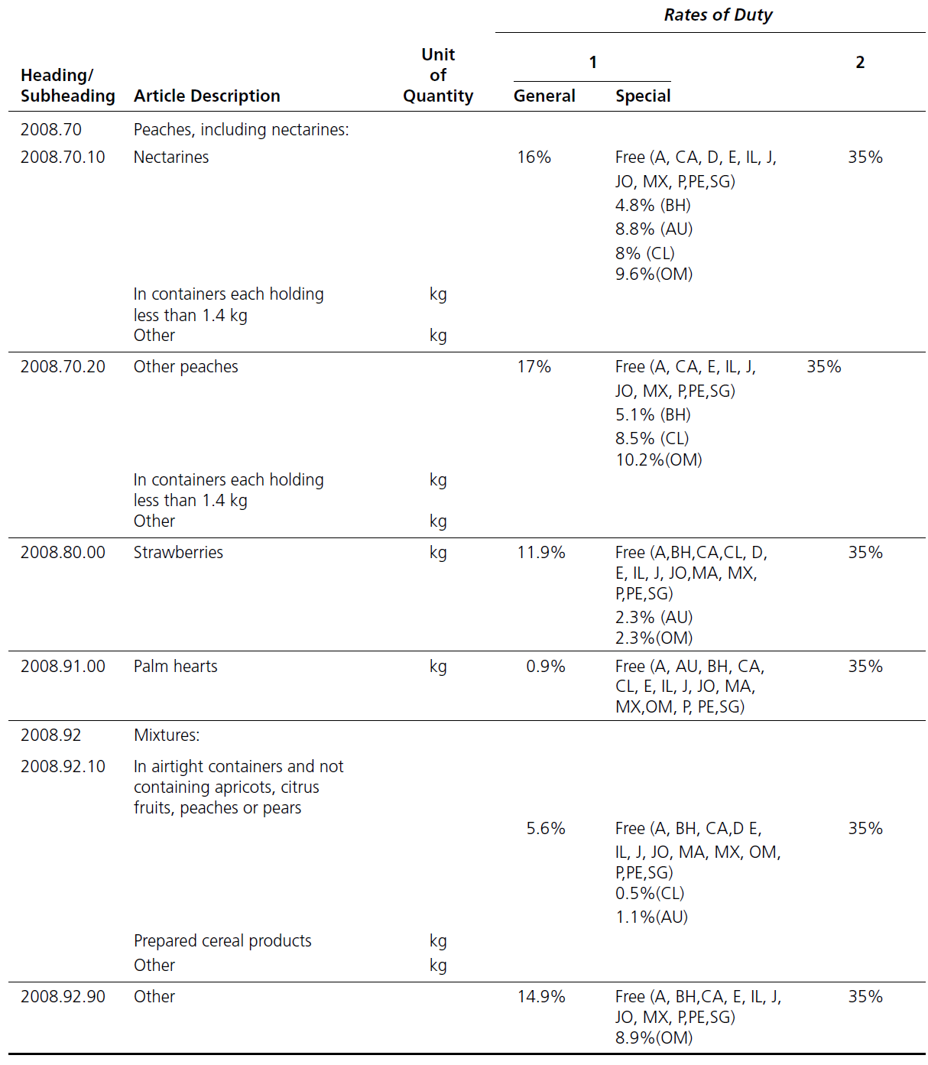
TABLE 6.1 Sample Page from the
Harmonized Tariff Schedule of the
United States (2012) (cont.)

Slide 17
TABLE 6.1 Sample Page from the
Harmonized Tariff Schedule of the
United States (2012) (cont.)

Slide 18
TABLE 6.1 Sample Page from the
Harmonized Tariff Schedule of the
United States (2012) (cont.)

Slide 19
TABLE 6.1 Sample Page from the
Harmonized Tariff Schedule of the
United States (2012) (cont.)

Slide 20
U.S. Tariff Schedule (cont.)
Column 1 Special Rates of Duty—
tariffs applied to goods from many developing countries or from countries with special trade agreements with the U.S. including:
  Generalized System of Preferences (GSP)—a system in which developed countries charge preferential lower tariffs on goods from certain developing countries.

Slide 21
U.S. Tariff Schedule (cont.)
Column 2 Rates of Duty—tariffs applied to goods from countries (Cuba and North Korea) without U.S.-granted MFN status; these rates are substantially higher than MFN rates.

Slide 22
Types of Tariffs
Ad Valorem tariff— a tax equal to a certain percentage of the good’s selling price.
      The most common ad valorem taxes are property taxes levied on real estate (US). GST (CA) & VAT (UK)
Specific tariff— a tax equal to a fixed amount of money per unit sold.
  A per unit tax, or specific tax, is a tax that is defined as a fixed amount for each unit of a good or service sold, such as cents per kilogram. It is thus proportional to the particular quantity of a product sold, regardless of its price.
Compound tariff—a tax with both ad valorem and specific components.

Slide 23
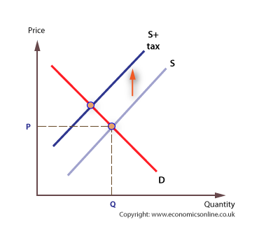
Tools for Analyzing Tariff Effects
A specific tax paid by the supplier

Slide 24
Tools for Analyzing Tariff Effects
Consumer Surplus
Producer Surplus

Slide 25
Consumer Surplus
The difference between the amount consumers are willing to pay to purchase a given quantity of a good and the amount they have to pay to purchase the good.
See Figure 6.2.

Slide 26
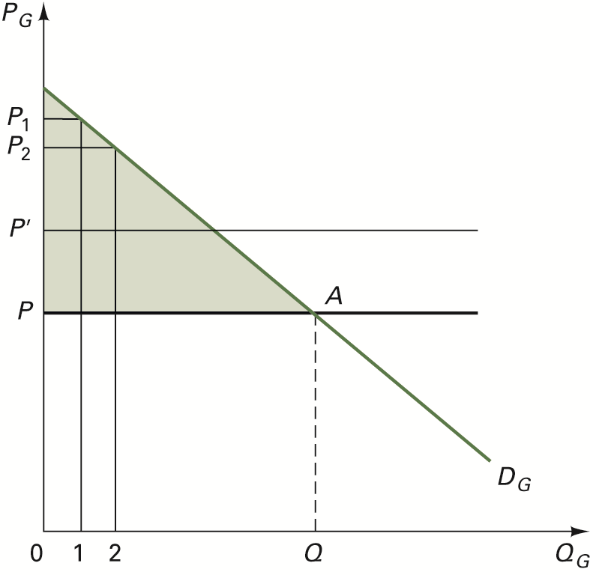
FIGURE 6.2 Consumer Surplus

Slide 27
Producer Surplus
The difference between the price paid in the market for a good and the minimum price required by the industry to produce and market the good.
See Figure 6.3.

Slide 28
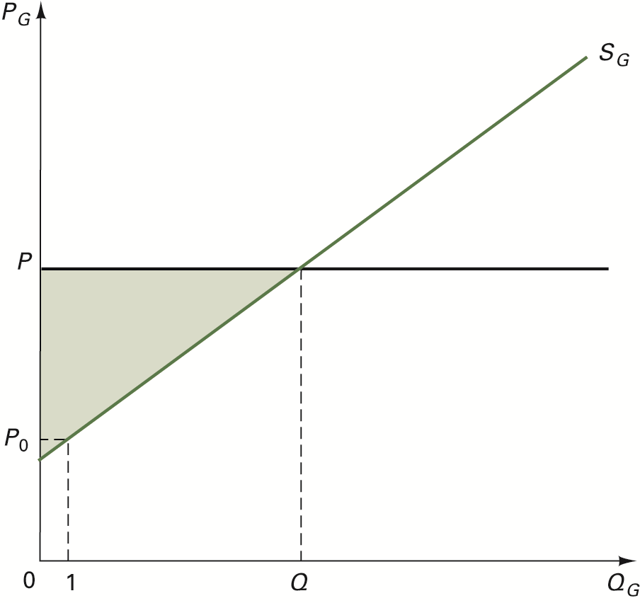
FIGURE 6.3 Producer Surplus

Slide 29
Gains from Free Trade for a Small Country
Imports Side
Exports Side

Slide 30
Effects of Free Trade on the Imports Side
Refer to Figure 6.4 Gains (imports side)
Price effect
Consumption effect
Production effect
Imports effect
Consumer surplus effect
Producer surplus effect

Slide 31
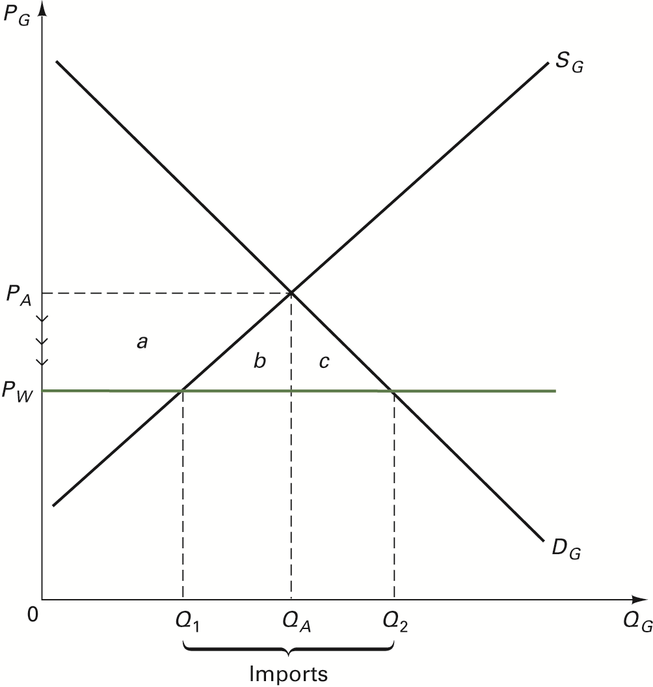
FIGURE 6.4 The Gains from Free Trade (Imports Side)

Slide 32
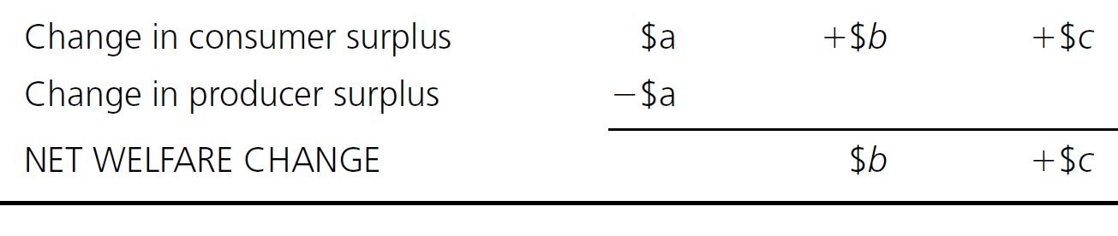
Trade Effects on Imports Side (cont.)
TABLE 6.2 Summary of the Welfare Effects in the Import
Market of a Move to Free Trade
Net welfare effect

Slide 33
Effects of Free Trade on Exports Side
Refer to Figure 6.5 Gains (Exports Side)
Price effect
Consumption effect
Production effect
Exports effect
Consumer surplus effect
Producer surplus effect

Slide 34
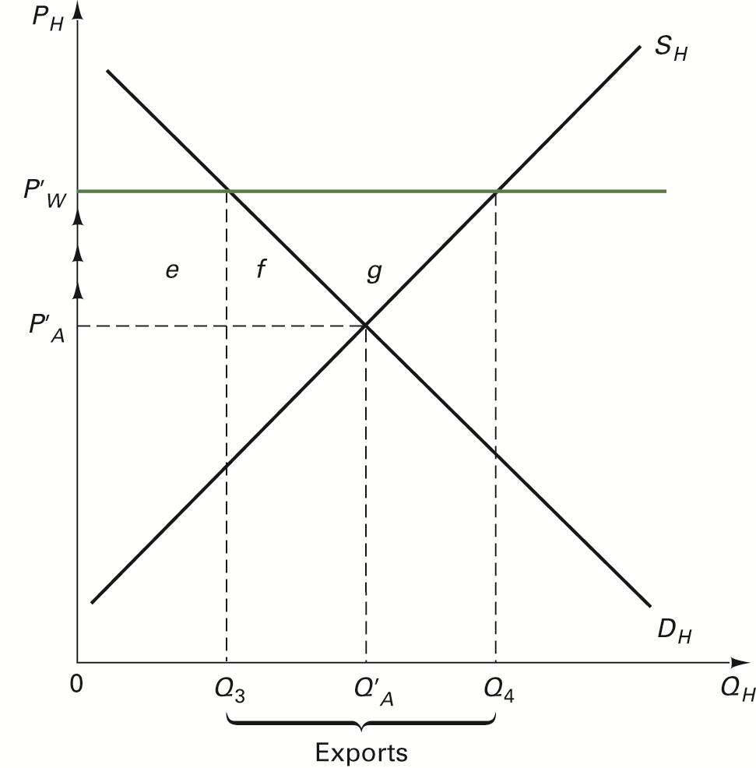
FIGURE 6.5 The Gains from Free Trade (Exports Side)

Slide 35
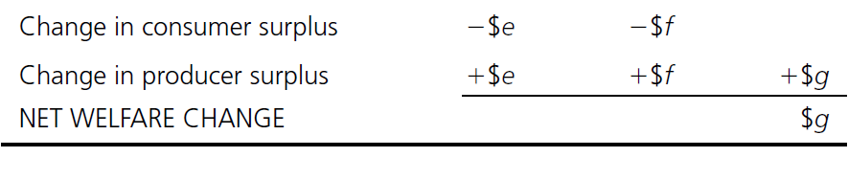
Trade Effects on Exports Side (cont.)
TABLE 6.3 Summary of the Welfare Effects in the Export
Market of a Move to Free Trade
Net welfare effect

Slide 36
Effects of a Tariff Imposed by a Small Country
Refer to Figure 6.6 Effect of Import Tariff
Price effect
Consumption effect
Production (or protective) effect
Imports effect
Government revenue effect
Consumer surplus effect
Producer surplus effect

Slide 37
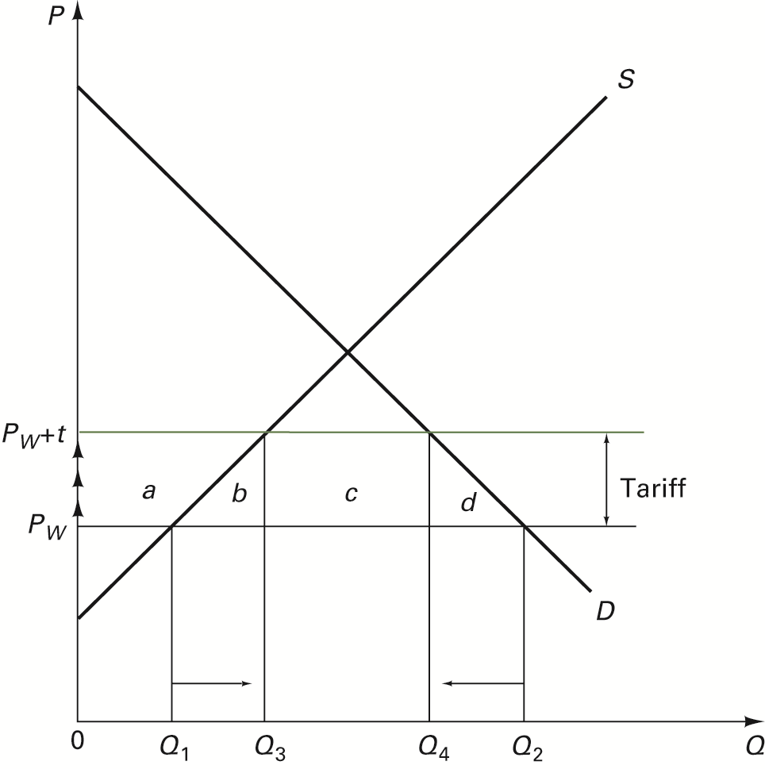
FIGURE 6.6 The Effect of an Import Tariff

Slide 38
Welfare Cost of Tariff Imposed by a Small Country
Deadweight cost—value of wasted resources devoted to expanded domestic production and expenditures devoted to less-desired substitutes brought about by a tariff

Slide 39
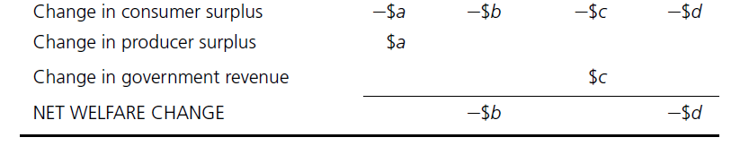
TABLE 6.4 Welfare Cost of a Tariff Imposed by a Small Country

Slide 40
Two Deadweight Costs of the Tariff
Refer to Figure 6.7 Deadweight Cost of Tariff
Production deadweight cost—refers to the protective effect of the tariff which allows domestic firms to increase production above free trade levels (area b).
Consumer deadweight cost—the value of lost consumer satisfaction due to a shift in consumption to less-desired substitutes brought on by the higher price (area d).
Total deadweight cost = ½ x tariff x reduction in imports
Consider Global Insights 6.1 for estimates of the welfare costs of tariffs on U.S. industries

Slide 41
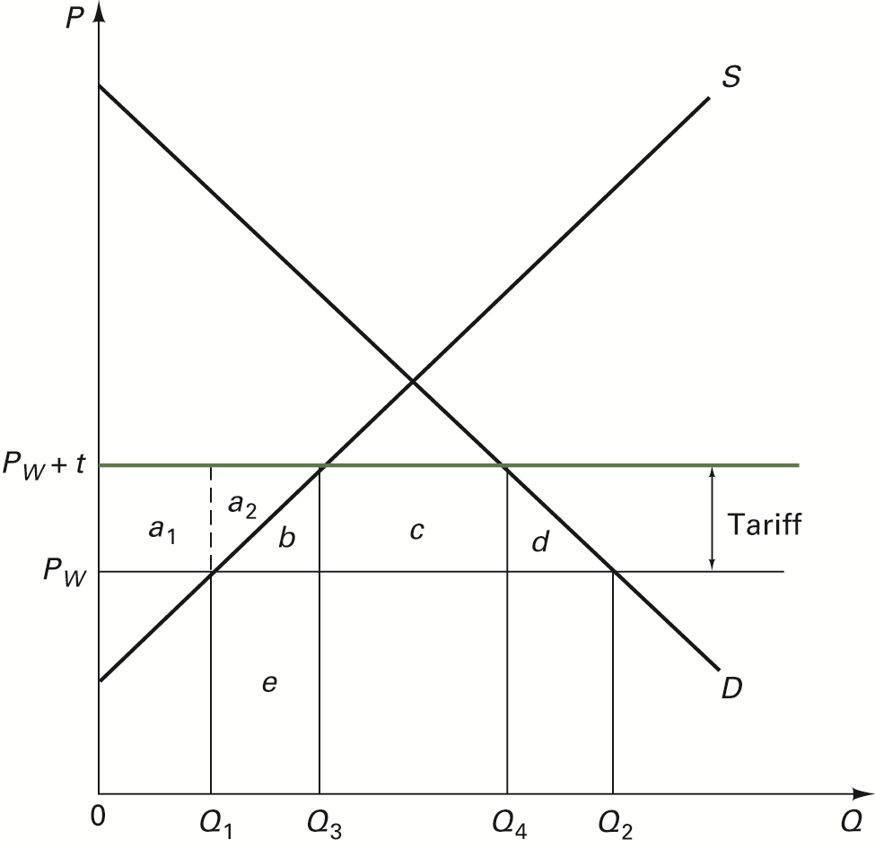
FIGURE 6.7 Deadweight Cost of the Tariff

Slide 42
Export Tariff
Consider Figure 6.8
Small country A imposes an export tariff of z dollars per bushel on its corn exports.
Effects of the export tariff:
domestic price falls
domestic production falls
domestic consumption rises
exports fall

Slide 43
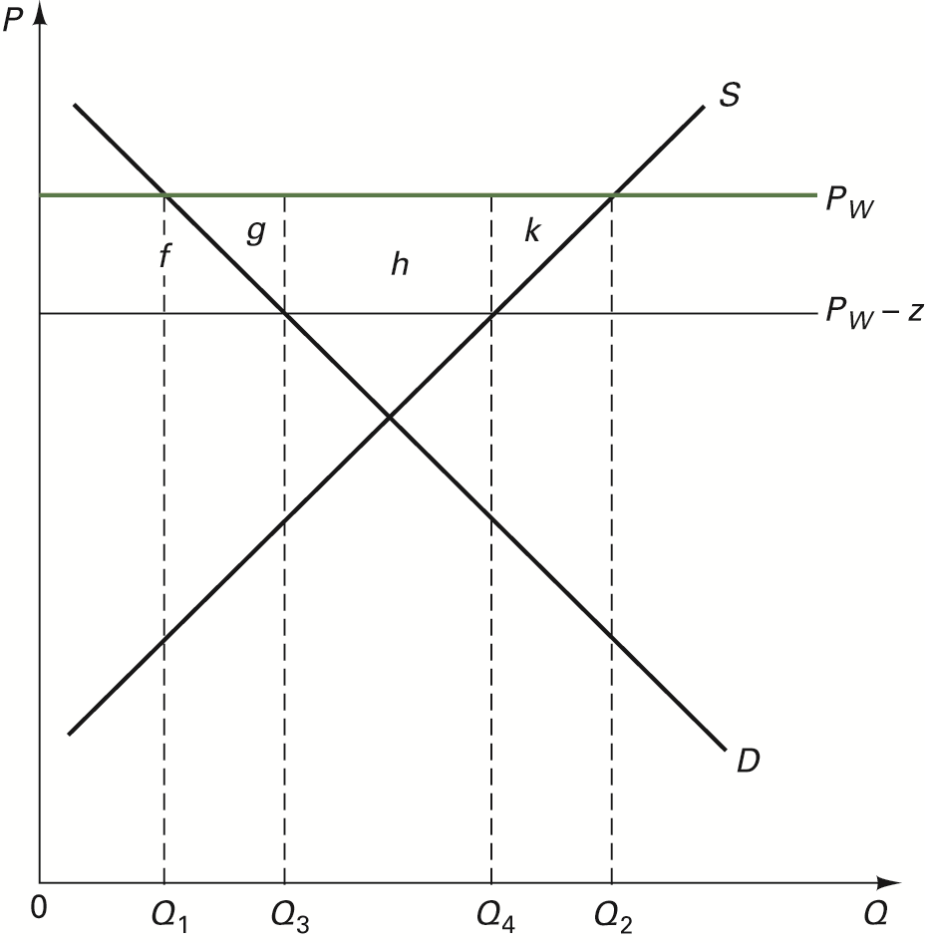
FIGURE 6.8 The Effect of an Export Tariff

Slide 44
Other Effects of an Export Tariff
See Table 6.5
Producer surplus falls by area (f+g+h+k)
Consumer surplus rises by area f
Government revenue rises by area h
Deadweight costs equal area (g+k)
See Global Insights 6.2 for examples

Slide 45
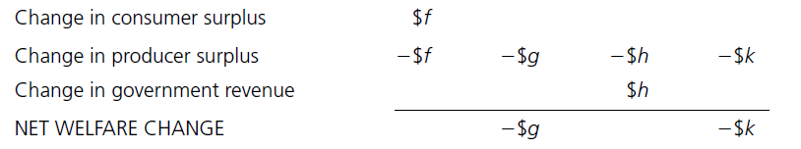
TABLE 6.5 Welfare Cost of an Export Tariff Imposed by a Small Country

Slide 46
Free Trade with a Large Country
Assume country A is a large country (with market power) importing from country B
Equilibrium world price—the price at which the quantity that consumers in A want to import is equal to the quantity producers in B want to export.
Refer to Figure 6.9 International Free Trade Equilibrium

Slide 47
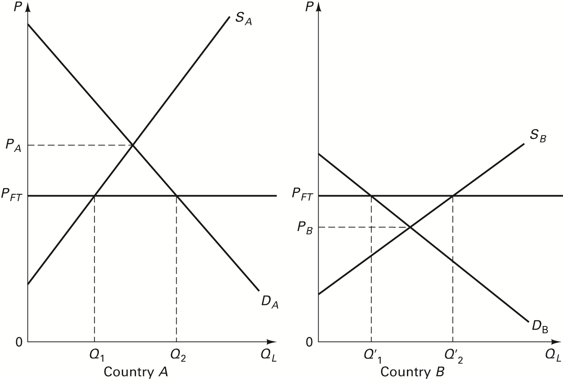
FIGURE 6.9 International Free-Trade Equilibrium

Slide 48
Effects of a Tariff Imposed by a Large Country
Refer to Figure 6.10 Tariff for Large Country
Price effect
Consumption effect
Production (or protective) effect
Imports effect
Government revenue effect
Consumer surplus effect
Producer surplus effect

Slide 49
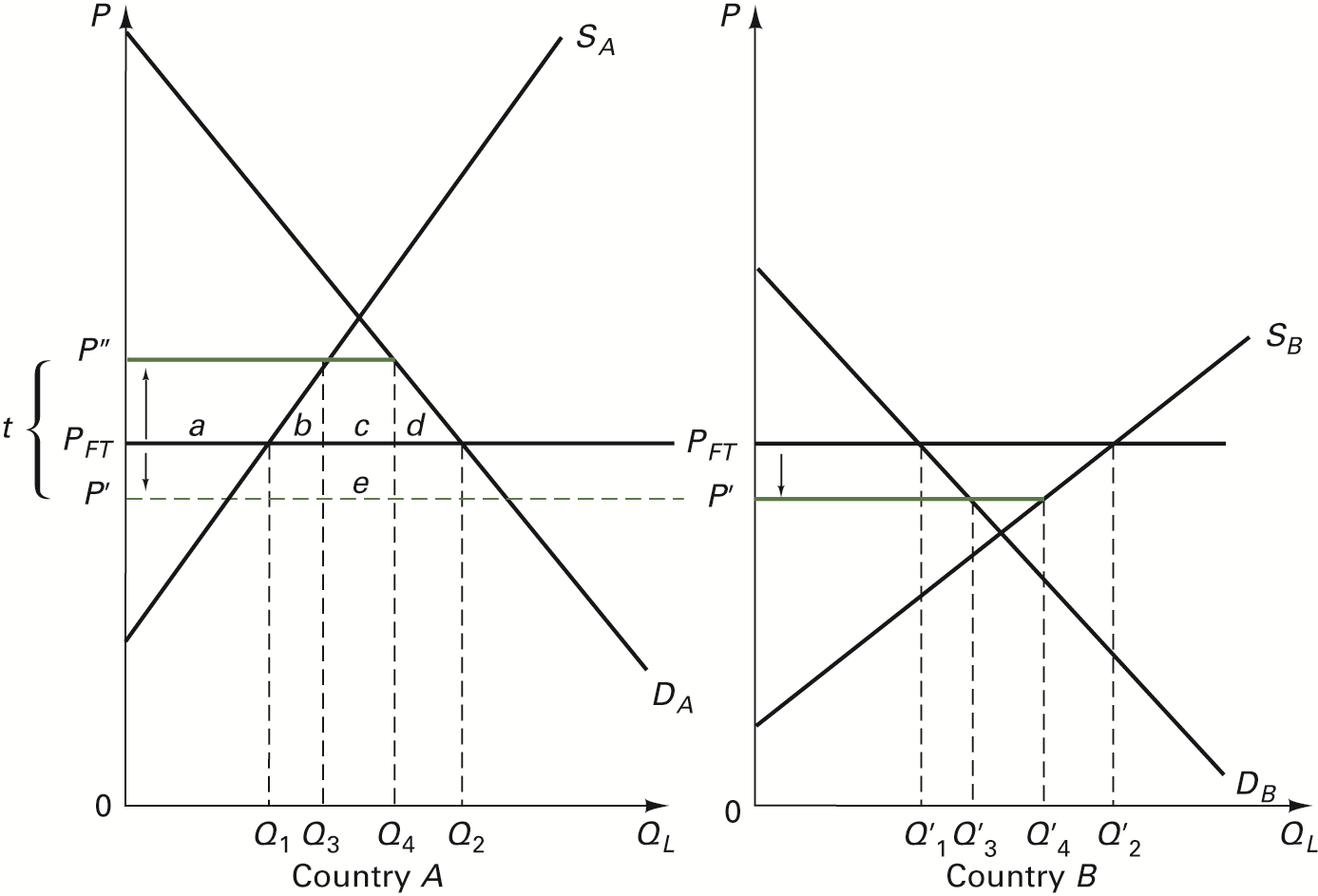
FIGURE 6.10 Illustration of a Tariff for a Large Country

Slide 50
Welfare Effects of a Tariff on a Large Country
Because of its market power, the large country is able to shift part of the burden of the tariff onto the exporting country.
The greater the tariff burden or revenue paid by foreign exporters compared to the large country’s deadweight costs, the greater the welfare increase in the large country (Refer to Table 6.6)

Slide 51
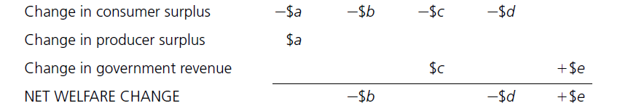
TABLE 6.6 Welfare Cost of a Tariff Imposed by a Large Country

Slide 52
Optimal Tariff
The size of a tariff that raises the welfare of a tariff-imposing country by the greatest amount relative to free-trade welfare levels.

Slide 53
Under What Conditions will a
Tariff Raise a Country’s Welfare?
The country must have market power, i.e., it is an important participant in the world market.
A country’s imposition of a tariff does not lead to retaliation by trading partners.

Slide 54
Trade (or Tariff) War
A general reduction in world trade brought about by retaliation and increases in trade barriers around the world.

Slide 55
Effects of the Smoot-Hawley Tariff Act of 1930
Refer to Global Insights 6.3
The Tariff Act resulted in average tariff levels rising to almost 60% and covered more than 12,000 products.
Other countries retaliated by raising their tariff levels.
World trade and U.S. exports dropped (see Figure 6.11).

Slide 56
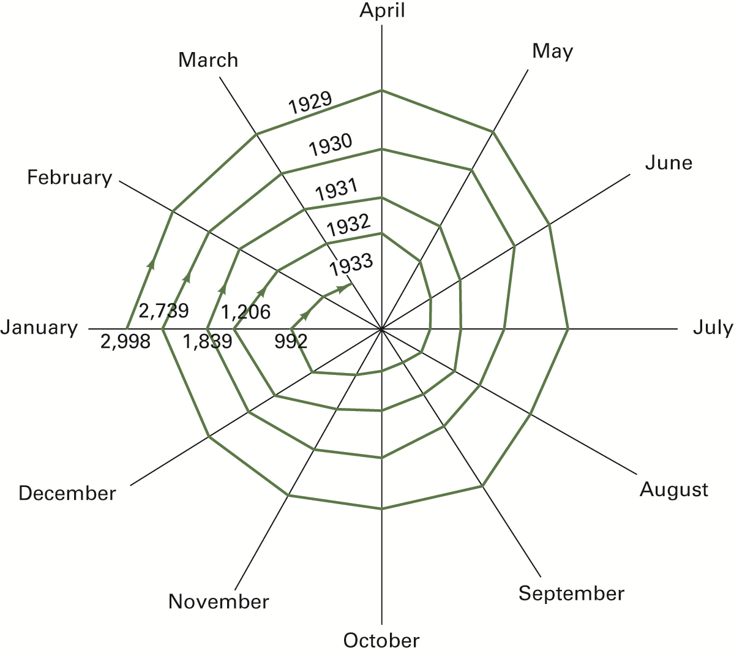
FIGURE 6.11 The Contracting Spiral of World Trade, January 1929 to March 1933 (total imports of 75 countries in millions of U.S. dollars)

Slide 57
How High are Tariffs?
Refer to Table 6.7 MFN Applied Tariff Rates
Tariffs for individual products may be different than the average rates shown.
The tariffs differ by product (tariffs on agricultural goods exceed those of manufactured goods).
Tariffs on manufactured final goods are higher than those on intermediate goods (tariff escalation by stages of processing).
Tariffs are generally lower for high-income countries.

Slide 58
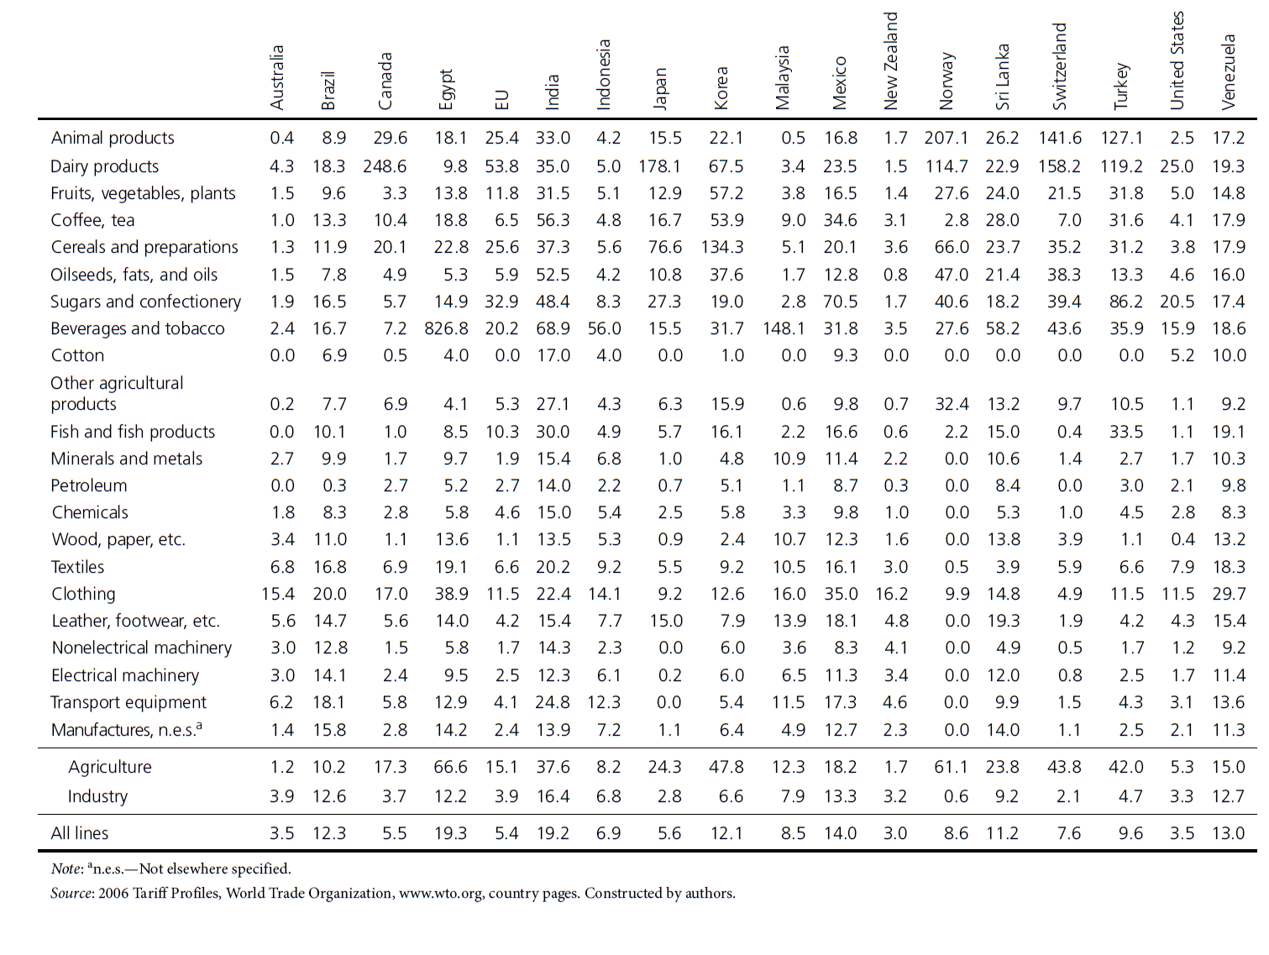
TABLE 6.7 2006 Simple Average MFN
Applied Tariff Rates for Selected Countries by Product Groups

Slide 59
TABLE 6.7 2006 Simple Average MFN
Applied Tariff Rates for Selected Countries by Product Groups (cont.)

Slide 60
TABLE 6.7 2006 Simple Average MFN
Applied Tariff Rates for Selected Countries by Product Groups (cont.)

