Slide 1
Chapter 7
Nontariff Barriers and Arguments
for Protection

Slide 2
Topics to be Covered
Quotas
The Welfare Effects of Quotas
The Equivalence or Non-equivalence of Tariffs and Quotas
Other Nontariff Barriers
Arguments for Protection

Slide 3
Types of Nontariff Trade Barriers (NTBs)
Quota
Voluntary Export Restraint (VER)
Other NTBs
  Customs Valuation Practices
  Government Procurement Policies
  Health and Safety Standards
  Intellectual Property Rights
  Export Subsidy

Slide 4
Quota
A government imposed limit on the quantity or value of a good traded between countries
Example: U.S. imposed an import quota of no more than 1.25 million tons of sugar from 1993 to 1994
Quotas have similar effects as tariffs

Slide 5
Types of Quotas
Embargo—complete ban on import of a certain good.
Tariff Rate Quota (TRQ)—allows a certain quantity of a good into a country at low or zero tariff rate, but applies higher tariff to quantities exceeding the quota.
Voluntary Export Restraint (VER)—an indirect quota resulting from an exporting country “voluntarily” limiting its exports.

Slide 6
Unallocated Global Quota
With this quota scheme, no specific countries are identified, only the quantity or value of the imported product.
Relatively uncommon because:
  Ports of entry are clogged or overburdened
  Trade friction may result from loss of market
  Government may want to obtain quota profits

Slide 7
Quota License
A license which gives the bearer the right to import into a country a specific amount of a good during a specific time period
Licenses may be sold or given away.
The recipients of the licenses may be domestic or foreign.

Slide 8
Welfare Effects of a Quota (Consider Figure 7.1)
Domestic price effect
Import effect
Consumption effect
Production or Protection effect
Redistribution effect
Consumer surplus effect
Producer surplus effect
Deadweight costs
QUOTA RENT

Slide 9
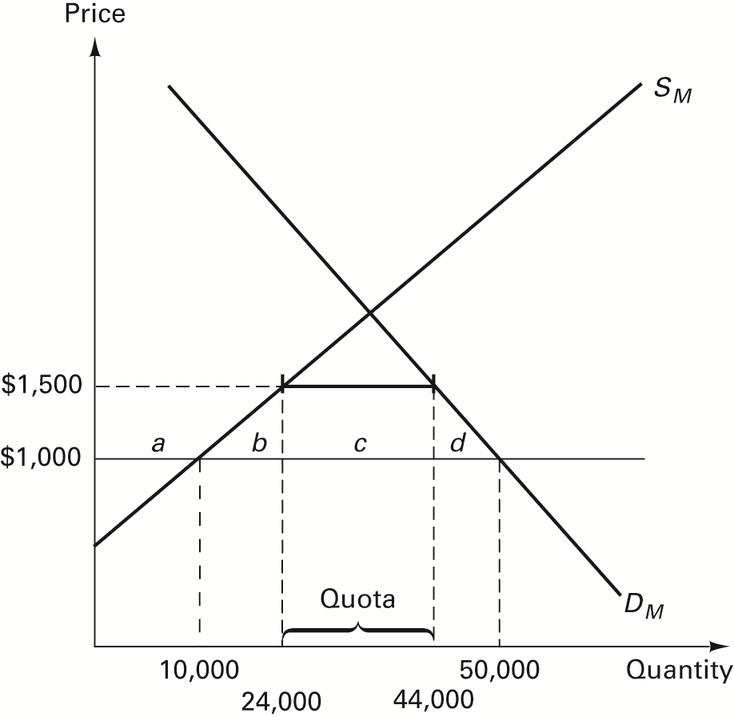
FIGURE 7.1 Welfare Effects of a Quota

Slide 10
Quota Rent
Profit that accrues to whoever has the right to bring imports into the country and sell these goods in the protected market

Slide 11
Who Gets the Quota Rent?
Government
Domestic producers or importers
Foreign producers

Slide 12
Government Auctions Licenses
When the government sells or auctions quota licenses, the welfare effects are identical to those of a tariff which raises the product price by the same amount
(refer to Table 7.1).
Studies estimate that the U.S. government loses between $3.7 billion to $6.8 billion yearly by not holding auctions.

Slide 13
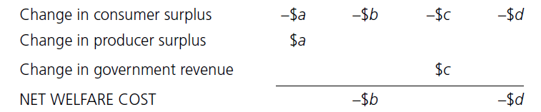
TABLE 7.1 Welfare Effects of a Quota Auctions Licenses

Slide 14
Domestic Firms Get Licenses
When government gives the quota licenses to domestic producers or importers, the latter group effectively gets the quota rent.
Profits to domestic firms rise by $(a+c) while government revenue is unaffected (Refer to Figure 7.1).

Slide 15
Government Gives Licenses to Foreigners
Voluntary Export Restraint (VER)—an agreement where the foreign government restricts the exports of its industries to the importing country.
Foreign producers get the quota rent.

Slide 16
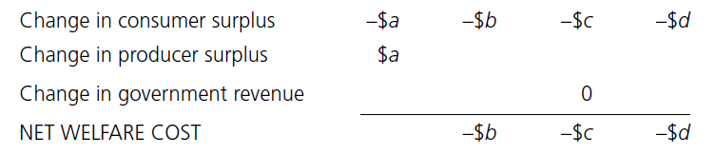
What are the Welfare Effects of a VER?
TABLE 7.2 Welfare Effects of a Voluntary Export Restraint

Slide 17
Equivalence or Nonequivalence of Tariffs and Quotas
They are similar in their effects on prices, output, and imports.
Tariff revenue goes to government, while quota rent depends on who gets the license.
With tariff, the domestic monopolist can only charge the world price plus tariff; with quota, the monopolist can charge higher price and produce less.

Slide 18
Equivalence or Nonequivalence of Tariffs and Quotas (cont.)
With a tariff, an increase in demand will be met by a rise in imports; with a quota, no new imports are allowed in.
Quotas are more difficult to administer because of the problem of how to give away licenses and the likelihood of graft and corruption.

Slide 19
Other Nontariff Barriers
Customs valuation practices
Government procurement policies
Technical barriers to trade
Health and safety standards
Intellectual property
Export subsidy

Slide 20
Customs Valuation Practices
Countries wanting to raise government revenue may instruct customs officials to raise estimates of the value of imports via:
freight and insurance cost
fees for processing paper work
assembly charges
other taxes
WTO Article VII requires the use of a transactions basis (invoices) to value imports.

Slide 21
Government Procurement Policies
“Buy American” policy—requires U.S. government agencies to purchase American products unless the domestic price is more than 12% higher than the foreign price.
Effect: This policy raises the cost to government of providing public services, thus redistributing income from taxpayers to domestic producers.
Despite being a member of the WTO Agreement on Government Procurement, the U.S. has passed bills (ex., American Recovery and Reinvestment Act) which contain “Buy American” provisions.

Slide 22
Technical Barriers to Trade
Technical regulations or standards may be imposed to protect the environment, insure consumer safety, promote national security, and guarantee product quality.
WTO requires that such standards do not create unnecessary and discriminatory barriers to trade.

Slide 23
Health and Safety Standards
These government standards help protect the health and safety of citizens.
Examples: EU ban on U.S. beef containing growth hormones; Japanese ban on U.S. beef due to mad cow disease.
Such standards also serve as an effective mechanism for protecting domestic firms from foreign competition.

Slide 24
Intellectual Property Rights
Intellectual property—the innovative or creative ideas of inventors, artists, or authors.
Laws which protect intellectual property include:
  Patent
  Copyright
  Trademark

Slide 25
Problems with Intellectual Property Rights Protection
Varying degrees of law enforcement in different countries
Growing trade in counterfeit goods

Slide 26
Export Subsidy
A direct or indirect payment by a country’s government to one or more of its export industries.
Forms of export subsidies include:
  Tax rebates
  Subsidized loans to foreign purchasers
  Insurance guarantees
  Funding for research & development
  Guarantees against losses
  Direct grants

Slide 27
Effects of Export Subsidy
Subsidy leads to a greater output of exportables than would otherwise occur.
Resources are drawn away from import-competing sectors.
Internal prices of exportables rise.
Consumers lose as they pay more taxes to finance the export subsidy.

Slide 28
Countervailing Duty
A tariff imposed by an importing country designed to offset the export subsidy and resulting low prices charged by exporters.

Slide 29
Arguments for Protection
Valid arguments
Invalid arguments

Slide 30
Invalid Arguments
Patriotism
Employment
Fallacy of composition
Fair play for domestic industry
Preservation of the home market

Slide 31
Valid Arguments
Government revenue
Income redistribution
Non-economic goals (national defense)
Infant industry
Domestic distortions
Environmental protection
Strategic trade policies

Slide 32
Government Revenue Argument
Reasons for using tariffs as revenue-generators:
foreigners may pay the tariff
tariffs are easy to collect
Refer to Table 7.3
Tariffs are an important source of revenue in developing countries.

Slide 33
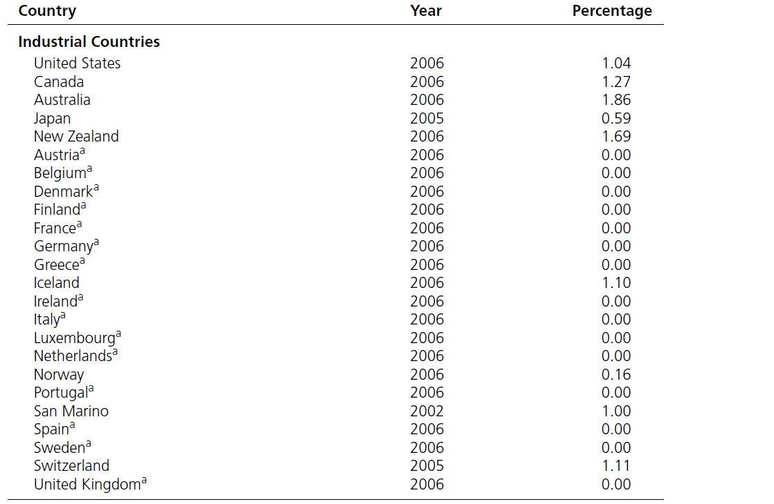
TABLE 7.3 Tariff and Trade Taxes as a Percentage of Government Revenue

Slide 34
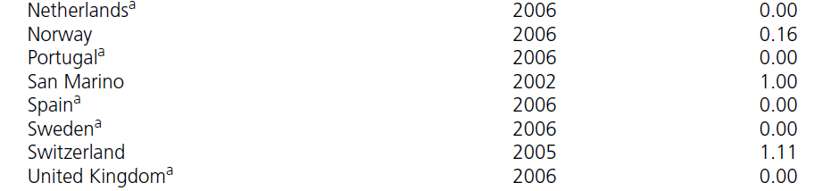
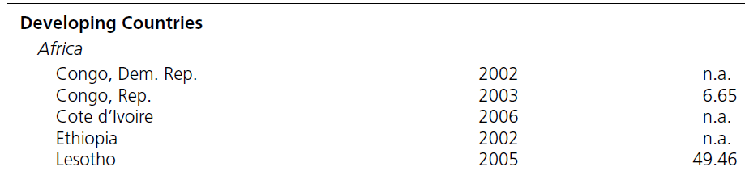
TABLE 7.3 Tariff and Trade Taxes as a Percentage of Government Revenue (cont.)

Slide 35
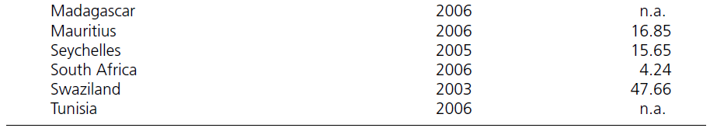
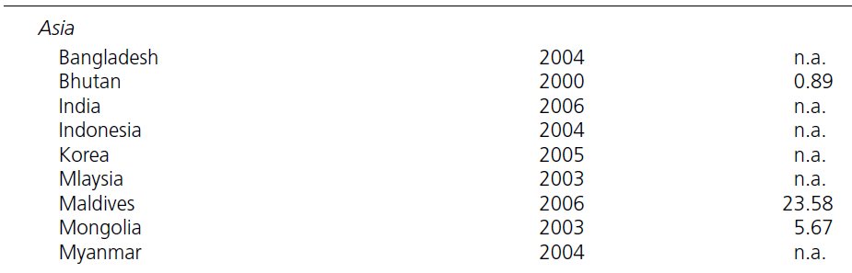
TABLE 7.3 Tariff and Trade Taxes as a Percentage of Government Revenue (cont.)

Slide 36
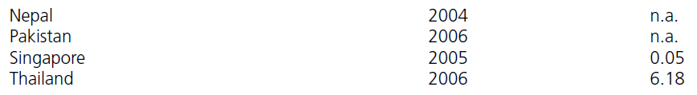
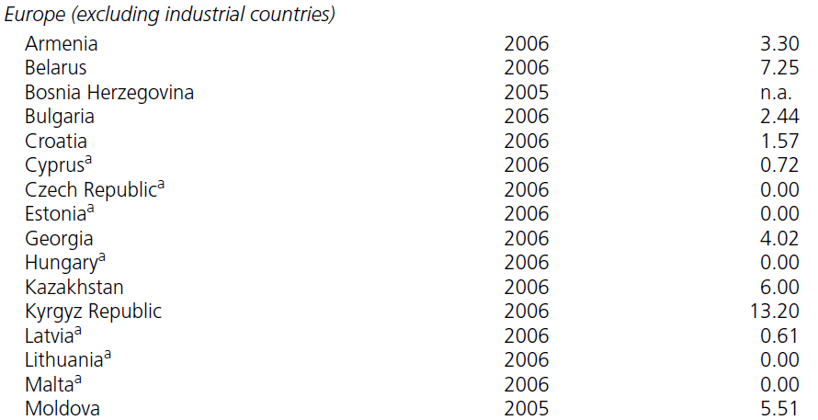
TABLE 7.3 Tariff and Trade Taxes as a Percentage of Government Revenue (cont.)

Slide 37
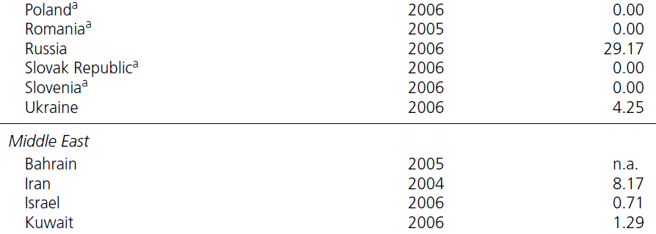
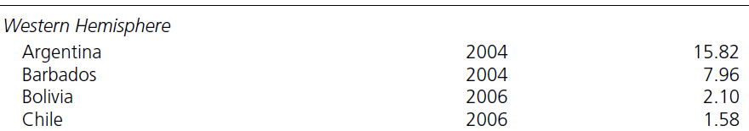
TABLE 7.3 Tariff and Trade Taxes as a Percentage of Government Revenue (cont.)

Slide 38
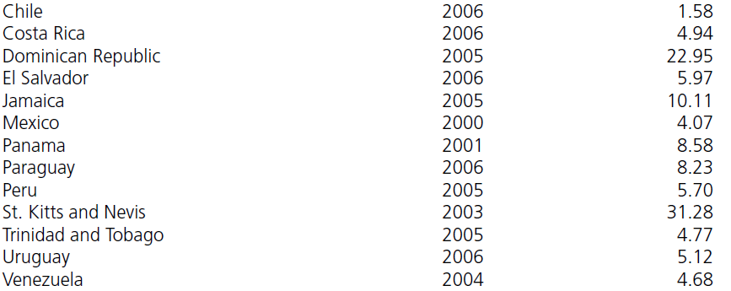
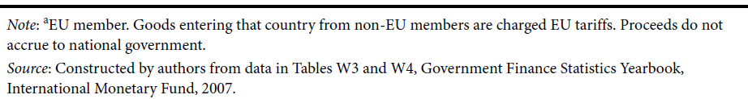
TABLE 7.3 Tariff and Trade Taxes as a Percentage of Government Revenue (cont.)

Slide 39
Income Redistribution Argument
Trade policy can be used to redistribute income from one sector of society to another:
from consumers to producers
from one industry to another
from the rich to the poor

Slide 40
Problems with National Defense Argument
This argument is over-used.
Defense needs may be better served by allowing or expanding imports rather than restricting them.
A better policy for meeting defense needs is through a domestic production subsidy with free trade.

Slide 41
Effects of a Domestic Production Subsidy
Shifts the domestic supply down by the amount of the subsidy.
Domestic producers gain.
Taxpayers pay for the subsidy.
Cost to society is a production deadweight cost.
With the subsidy and free trade, goods sell at the world price, so there is no consumption deadweight cost (as compared to a tariff). See Figure 7.2.

Slide 42
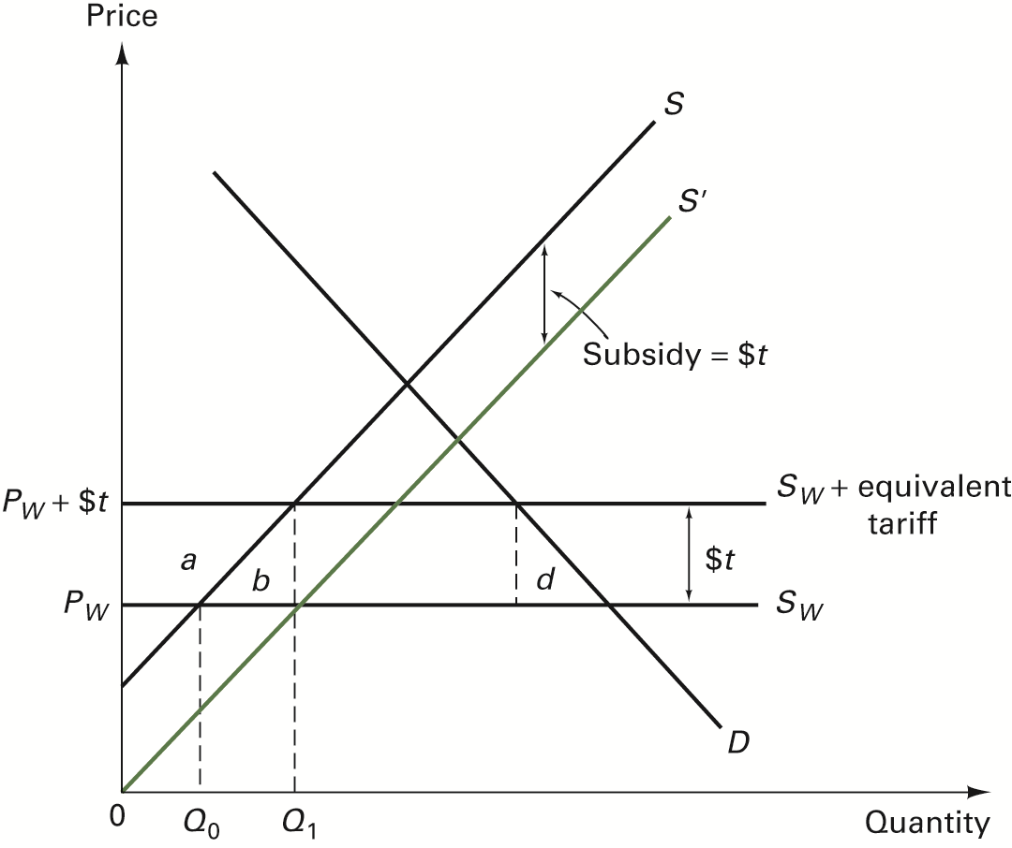
FIGURE 7.2 Welfare Effects of a Domestic Production Subsidy

Slide 43
Infant Industry Argument
Argument that new industries may need temporary protection until they have mastered the production and marketing techniques necessary to be competitive in the world market

Slide 44
Problems with the Infant Industry Argument
The argument presumes that the protected industry will grow up and mature.
It assumes that the government is capable of picking winners than the private sector is.

Slide 45
Domestic Distortions
Take, for example, an agricultural price support program (Refer to Figure 7.3).
Effects of price support:
  Guaranteed higher price (above equilibrium)
  Excess supply of the product
With free trade:
  Importers buy the good at lower world price and sell at the higher support price.
  Cost of the farm program increase.
  A second distortionary policy, i.e., protection, becomes necessary.

Slide 46
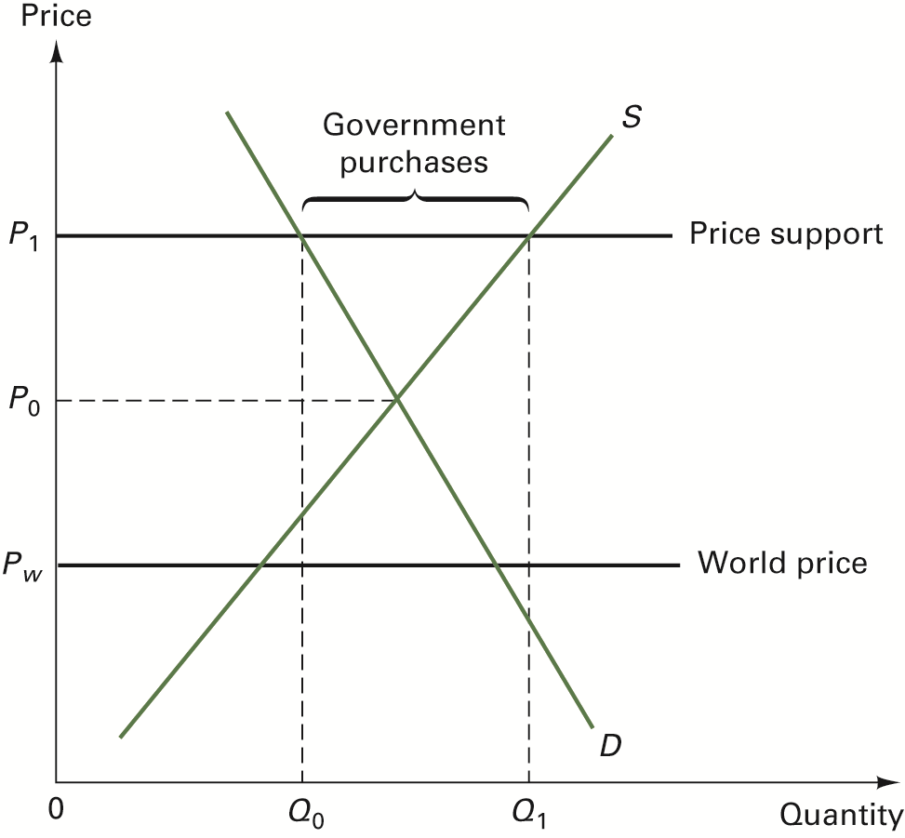
FIGURE 7.3 Price Supports and Tariffs

Slide 47
Pollution Havens Hypothesis
This argues that developing or poor countries with lax environmental standards will attract foreign firms that want to escape environmental standards in their home countries.
Discuss Global Insights 7.1

Slide 48
Strategic Trade Policy
The strategic use of trade policy (e.g., tariff or quota) to increase domestic welfare
Consider two examples:
  Brazil and IBM (foreign monopoly); see Figure 7.4.
  Strategic game by two monopolies, Airbus and Boeing; see Table 7.4.

Slide 49
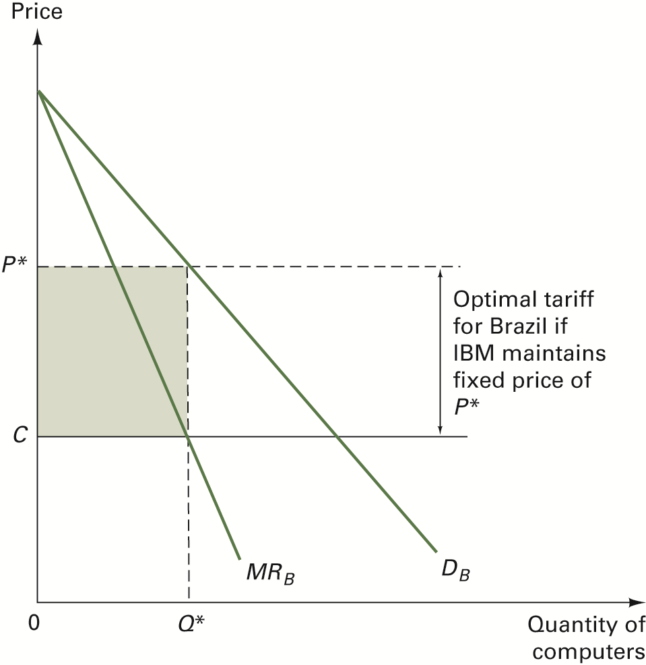
FIGURE 7.4 Trade Policy and Foreign Monopoly

Slide 50
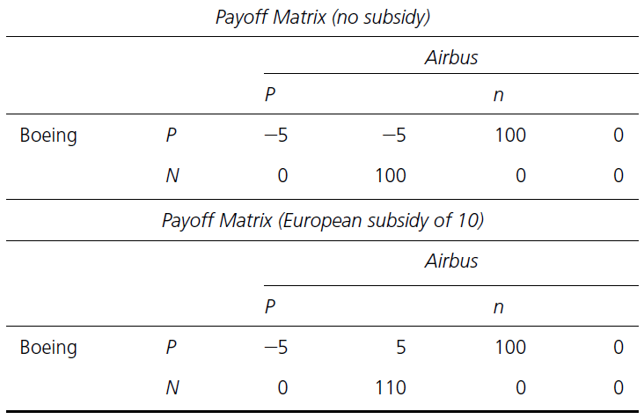
TABLE 7.4 The Effects of a Hypothetical Strategic Trade Policy

Slide 51
Limitations of Strategic Trade Policy
Types of situations where strategic trade policy should be applied are very specialized and depend on assumptions of firm behavior.
Even if firm behavior is known, other assumptions may still be violated.
Gains from strategic policy may depend on the reaction of foreign governments.
Strategic policy may be a “second-best” policy.

