Slide 1
Chapter 8
Commercial Policy: History and Practice

Slide 2
Topics to be Covered
History of U.S. Commercial Policy
The Uruguay Round and the Creation of the WTO
The Doha Round
The Conduct of U.S. Commercial Policy

Slide 3
History of U.S. Commercial Policy
The U.S. Constitution grants Congress the right to regulate commerce with foreign nations, including the right to impose import (not export) tariffs.
Refer to Figure 8.1 (cyclical movements in U.S. tariffs)
The first tariff act was passed in 1789; the 5% import tariff was aimed at generating revenue for the federal government.
The War of 1812 between the U.S. and England led to: (1) cutoff of trade with Europe; (2) higher tariffs to fund the war; (3) greater production by U.S. manufacturers.

Slide 4
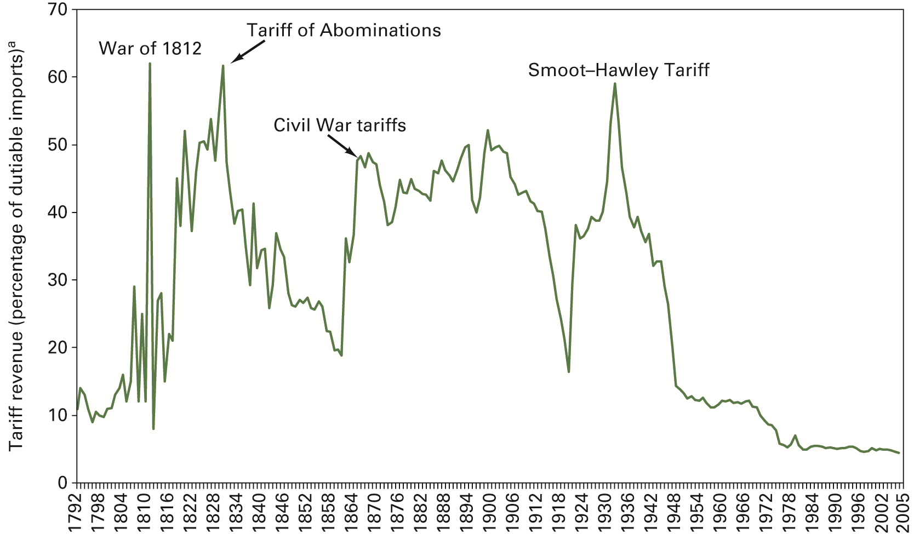
FIGURE 8.1 U.S. Tariffs, 1792–2005

Slide 5
History (cont.)
Tariff of Abominations (1828) raised the average tariff rate to almost 60%.
Compromise Tariff Act (1833) reduced tariffs to a uniform level of 20% by 1842; lasted only two months before tariffs were raised again
Starting in 1861, Congress raised tariffs to finance the Civil War effort.
Tariffs fell in 1913 and remained low during World War I.

Slide 6
History (cont.)
Fordney-McCumber Tariff of 1922 restored tariffs to pre-war levels.
The last general tariff bill passed by Congress was the Smooth-Hawley Tariff (1930).
This Act was a classic example of logrolling or the trading of votes by legislators to secure approval on issues of interest to each one.
It resulted in the highest tariffs since the Tariff of Abominations and reduced the volume of world trade by two-thirds.

Slide 7
Congress Cedes Trade Authority to the President
In the Reciprocal Trade Agreements Act (1934), Congress gave the president the authority to negotiate mutual tariff reductions with trading partners.
Unconditional Most Favored Nation Status—the basic principle of nondiscrimination underlying U.S. tariff negotiations with other countries.

Slide 8
General Agreement on Tariffs and Trade (GATT)
After WWII, the GATT was one of several international organizations created to deal with problems facing the countries of the world.
GATT’s objectives were:
To establish the rules of conduct of international commerce
To provide a forum for multilateral talks aimed at lowering trade protection around the world; see Table 8.1 for results of trade talks.

Slide 9
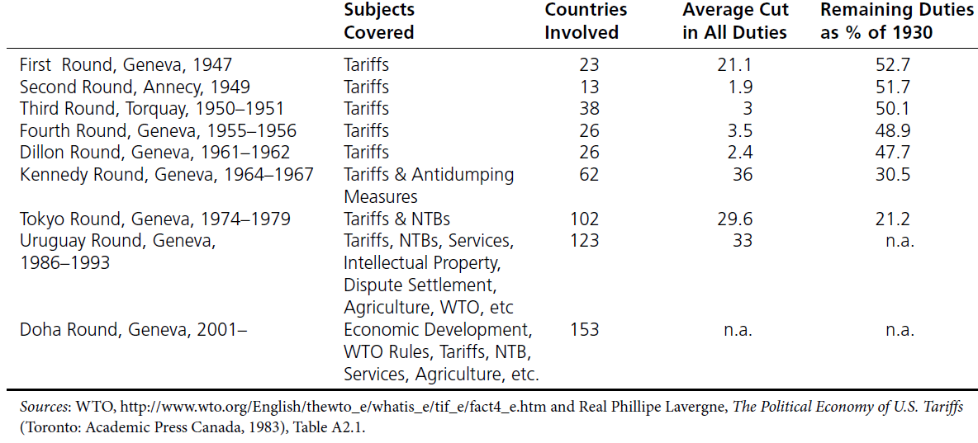
GATT Rounds of Talks
TABLE 8.1 U.S. Tariff Reduction under the GATT and WTO

Slide 10
Key Principles of GATT
Trade barriers should be lowered in general and quotas eliminated in particular.
Trade barriers should be applied on a nondiscriminatory (MFN) basis.
Once made, tariff concessions can not be rescinded, nor can new barriers be erected to replace tariffs that had been lowered.
Trade disputes should be settled by consultation. See Global Insights 8.1.

Slide 11
The Uruguay Round
Negotiations began in 1986 and concluded in 1993.
The Round focused on contentious issues such as non-tariff barriers, intellectual property rights, trade in services, and agriculture.
Its greatest achievement was the creation of a new international institution, the World Trade Organization (WTO).

Slide 12
World Trade Organization
WTO replaced GATT.
As of early 2012, WTO has 157 member countries accounting for more than 98% of world trade.
Another 26 countries are applying for membership.
The WTO dispute settlements system is stronger and more effective than the previous GATT. See Trade Case Study 1.

Slide 13
WTO and the Environment
WTO rules block a country’s use of trade measures as environmental policy
Montreal Protocol – multilateral agreement to ban trade of products that deplete the ozone layer
Kyoto Protocol – to reduce emissions of greenhouse gases to levels below 1990 levels

Slide 14
The Doha Round
Talks were held in Doha, Qatar in November 2001.
Focus of the talks was on the links between economic growth and trade liberalization.
Talks collapsed in July 2008.
The main point of contention is trade in agriculture with major industrialized nations such as the U.S., EU and Japan maintaining production subsidies and import barriers.

Slide 15
Dumping
Selling a product in a foreign country at a price lower than the price charged by the same firm in its home market or at a price below costs of production.
How would the U.S. be affected by dumping? (Refer to Figure 8.2)
Effect on U.S. consumers
Effect on U.S. producers
Net welfare effect

Slide 16
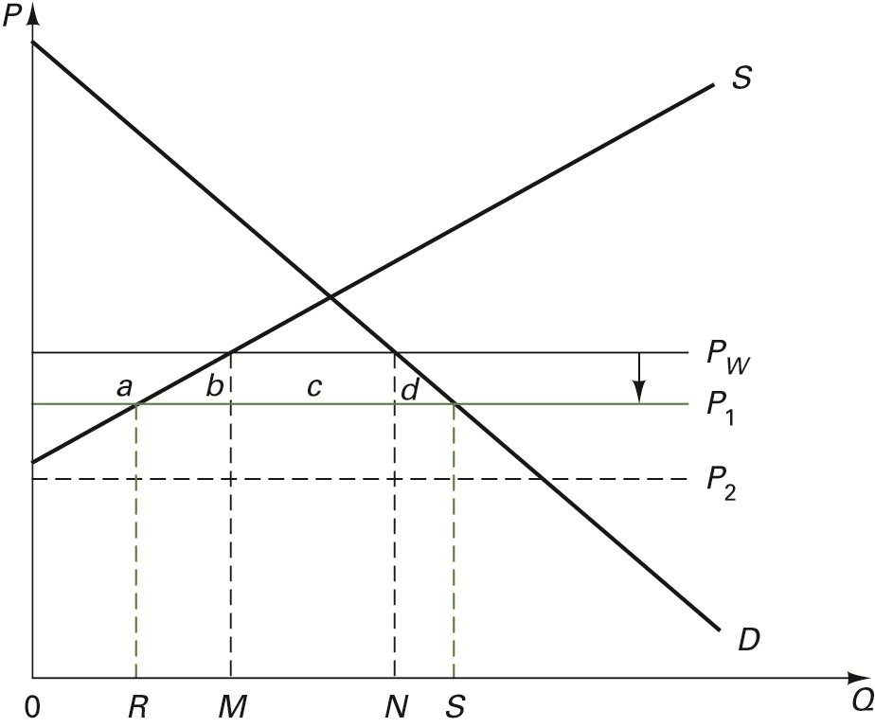
FIGURE 8.2 Dumping

Slide 17
Predatory Dumping
Dumping aimed at driving foreign competitors out of the market so that the market can be monopolized (refer to Figure 8.2).

Slide 18
Under What Situations Can Dumping Occur?
Foreign producers have market power in both domestic and foreign markets so that they can practice international price discrimination.
International price discrimination refers to selling the same product in two different countries at two different prices. See Figure 8.3.

Slide 19
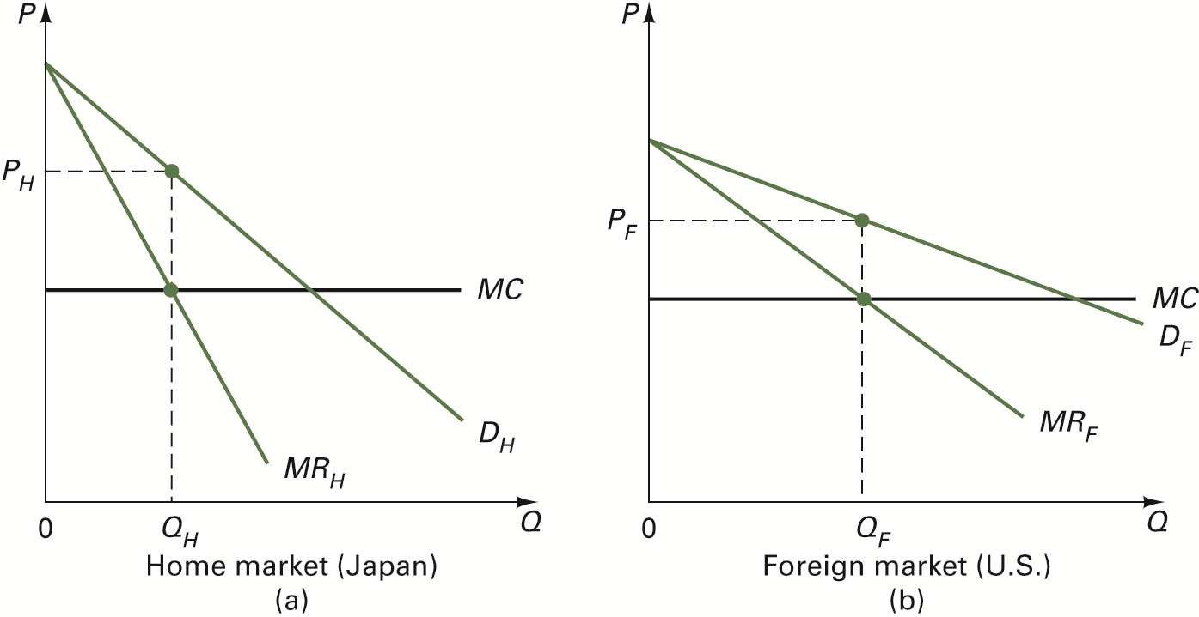
FIGURE 8.3 International Price Discrimination

Slide 20
Dumping Situations (cont.)
Dumping could occur if a foreign firm receives a production or export subsidy from its government.

Slide 21
Antidumping Law
If a U.S. industry can show injury from dumping, it can have a special tariff imposed on the dumped imports called the dumping margin.
The dumping margin is the difference between the market price of a product and its fair market value.

Slide 22
Injury Test
Injury Test—an investigation to determine whether unfair foreign trade practices have caused or threatens to cause harm to a domestic industry.
Complaint is simultaneously filed with:
Department of Commerce (DOC) which investigates whether dumping actually occurred
International Trade Commission (ITC) which investigates the question of injury

Slide 23
U.S. Antidumping Cases
Refer to Table 8.2
1,173 cases were initiated from 1980 to 2008.
Antidumping duties involve a wide range of products.
Many cases were filed against countries such as China, Japan, Korea, Germany, and Taiwan.
On average, antidumping duties are 10 to 20 times higher than MFN and are effective in reducing foreign competition.
Prusa (2001) stated that U.S. antidumping duties caused the value of imports to fall by 30-50%.

Slide 24
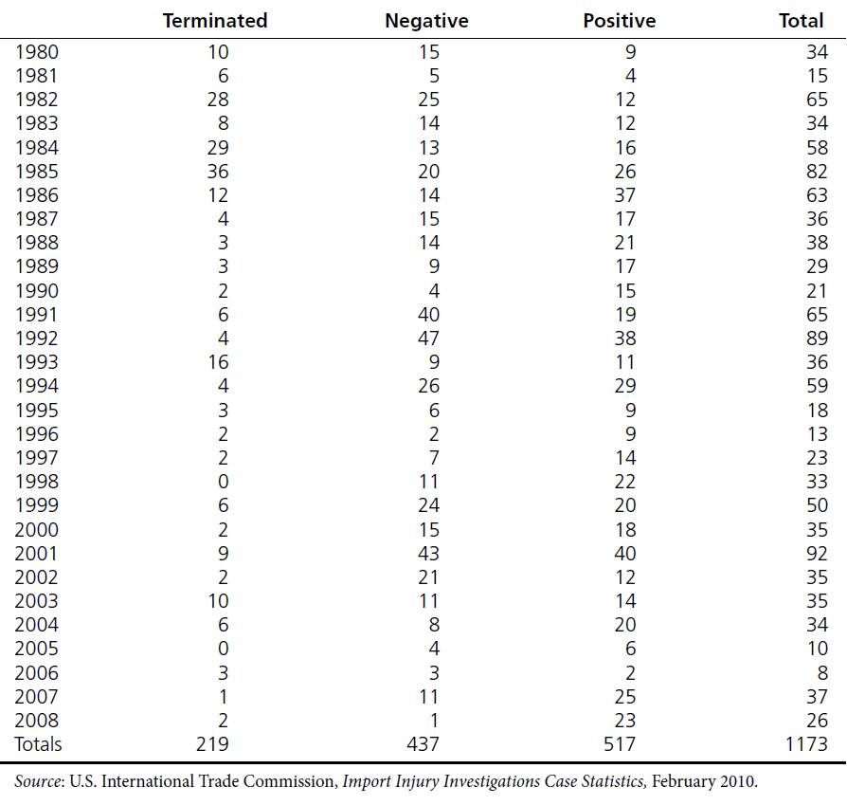
TABLE 8.2 U.S. Antidumping Cases: 1980–2008

Slide 25
TABLE 8.2 U.S. Antidumping Cases: 1980–2008 (cont.)

Slide 26
Countervailing Duty Law
Countervailing Duty—a tariff designed to raise the price of an imported product to its fair market value.
U.S. law uses countervailing duties to offset production or export subsidies as well as upstream subsidies which lower the cost of inputs for producing a good.
The WTO also administers a subsidies agreement with countervailing measures.

Slide 27
Unfair Foreign Practices: Section 301
Section 301 of the 1974 Trade Act requires the U.S. government to negotiate elimination of foreign unfair trade practices and to retaliate against offending countries if negotiations fail.
Section 301 cases are administered by the office of the U.S. Trade Representative.
For the 1975–2002 period, there were 121 cases with half resolved successfully and 13 led to U.S. retaliation. Since 2002, the U.S. has taken its complaints to the WTO.
See Trade Policy Case Study 2 for example.

Slide 28
Section 301 (cont.)
No new Section 301 cases filed from 2002 to 2010.
In 2010, the U.S. filed a Section 301 case against China for excluding U.S. firms from selling “green” products in China.

Slide 29
The Escape Clause: Section 201
Escape Clause—a measure in U.S. trade law that allows for temporary protection of domestic industry against fairly traded foreign imports.
Two reasons: (1) It provides more time for reallocation of domestic resources; (2) By increasing profits, it encourages domestic firms to reinvest in their industry.
Industry files petition with the ITC.
The clause has been used rarely.

Slide 30
Trade Adjustment Assistance
Payments made by the government to help resources retrain or retool after they have been displaced by foreign competition.
This aid was used extensively in the late 1970s as an alternative to trade protection.

Slide 31
Other Measures
Section 337—restricts unfair methods of competition such as patent or copyright infringement.
Section 406—provides relief from market disruption by imports from non-market economies.
Section 421 – U.S. industries can get temporary protection from threat of Chinese imports. See Trade Policy Case Study 3.

Slide 32
Safeguards Protection
A general name for protective measures similar to the escape clause that are used by foreign countries.

Slide 33
Global Antidumping Cases
Refer to Table 8.3
3,922 antidumping cases were initiated worldwide from 1995 to 2011.
Major users of antidumping laws are developed countries such as the U.S., Australia, Canada, and the EU.
Countries targeted in antidumping cases, in rank order, are China, the EU, Korea, U.S., and Taiwan.

Slide 34
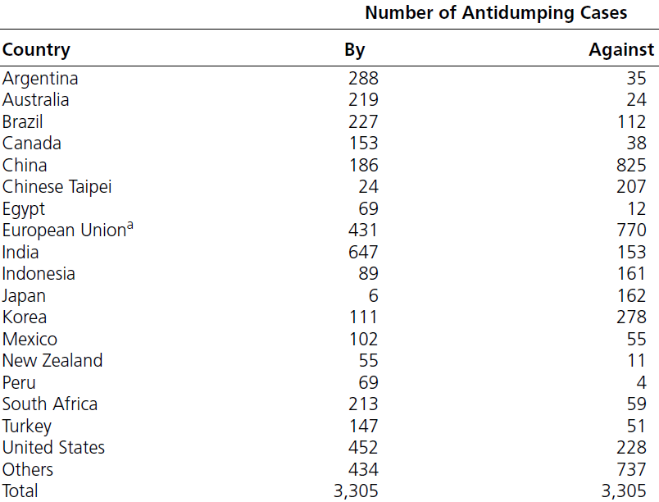
TABLE 8.3 Antidumping Cases Initiated Worldwide, January 1995-June 2011

Slide 35
TABLE 8.3 Antidumping Cases Initiated Worldwide, January 1995-June 2011 (cont.)

