Slide 1
Chapter 9
Preferential Trade Arrangements

Slide 2
Topics to be Covered
Preferential Trading Arrangements: Economic Analysis
North American Free Trade Agreement
Other U.S. Free Trade Area Agreements
European Union
Regionalism versus Multilateralism

Slide 3
Preferential Trade Arrangement
Agreement where countries join together to form a trade bloc with special relationships among the members
Types of trade arrangements
Effects of trade arrangements

Slide 4
Types of Trade Arrangements
Free-trade Area (FTA)—members agree to eliminate trade barriers among themselves, but maintain individual barriers against non-members (ex., NAFTA).
Customs Union (CU)—members remove trade barriers among themselves and form common barriers among non-members (ex., EU).

Slide 5
Other Types
Common Market—a customs union that has freedom of movement for all factors of production within the area defined by the member states.
Economic Union—a common market plus unification and harmonization of all economic policies and institutions.

Slide 6
European Union
Formed in 1957 as CU among six countries (France, West Germany, Italy, and Benelux nations).
Has added the following members since:
UK, Ireland, & Denmark (1973)
Greece (1981)
Spain & Portugal (1986)
Austria, Finland, & Sweden (1995)
Cyprus, Czech Republic, Estonia, Hungary, Latvia, Lithuania, Malta, Poland, Slovakia & Slovenia (2004)
Bulgaria and Romania (2007)

Slide 7
European Union (cont.)
EU population is over 450 million people.
EU countries as a group are largest exporter and importer in the world.
EU was first called European Common Market, then the European Community (1958), and now the European Union (1993).
Theoretically, EU is a sort of united states of Europe.

Slide 8
North American Free Trade Agreement
NAFTA consists of the U.S., Canada, and Mexico
Went into effect in January 1, 1994
Was an expansion of an existing US–Canada FTA to include Mexico
Also includes agreements on environmental, labor, and intellectual property rights issues

Slide 9
Economic Analysis of Preferential Trade Arrangements
Assume there are three countries (A, B, and C) in the world
A is the world’s high-cost producer of beer; A is a small country
C is the world’s low-cost producer of beer

Slide 10
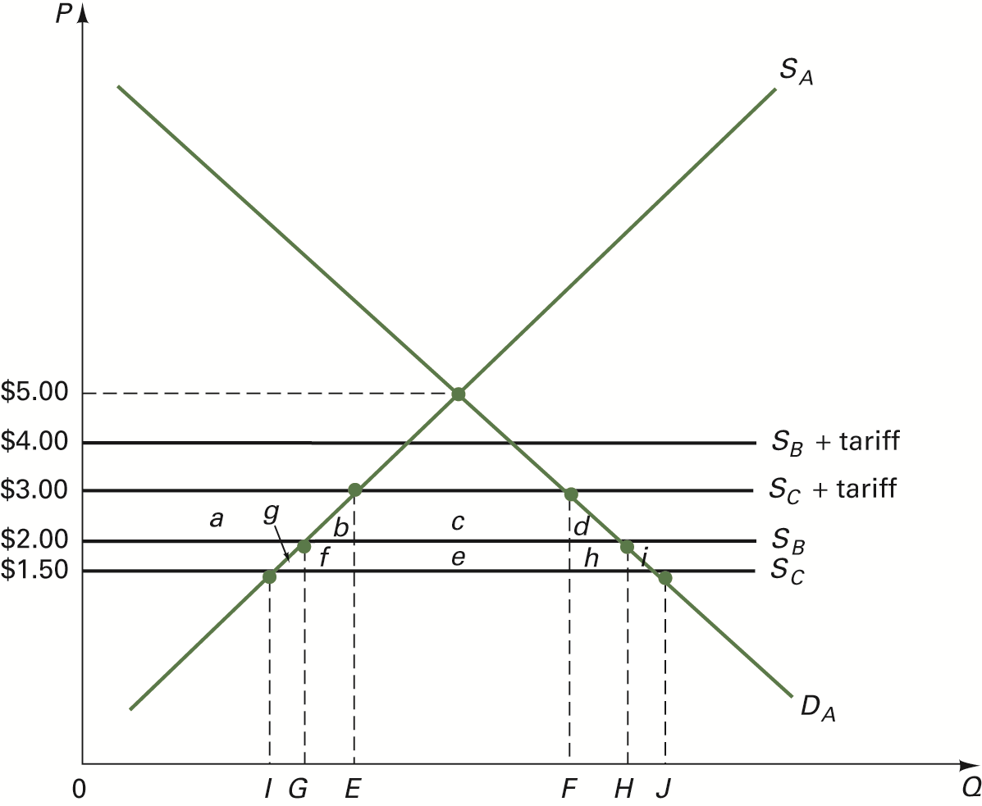
FIGURE 9.1 Regional Trade Liberalization

Slide 11
Free Trade Effects
A imports beer from C
Consumer surplus
Producer surplus

Slide 12
Tariff Effects
A protects its producers with 100% ad valorem tariff
A continues to import beer only from C
Price effect
Import effect
Government revenue effect
Other effects

Slide 13
Effects of FTA between A and B
Trade Diversion—a shift in the pattern of trade from low-cost world producers to higher-cost FTA members; welfare-reducing effect.
Trade Creation—an expansion in world trade resulting from formation of an FTA; welfare-increasing effect.

Slide 14
Welfare Effects of FTA between Countries A and B
TABLE 9.1 The Welfare Effects on Country A of an FTA between Countries A and B

Slide 15
FTA Welfare Effects on A
Price falls
Consumer surplus rises
Producer surplus falls
Government revenue falls
Net welfare impact of $(b + d) – $e
Trade creation gain (b + d)
Trade diversion loss (e)

Slide 16
FTA Effects on B and C
Country B gains due to new export market in A
Country C loses because its producers have lost its market in A

Slide 17
What Happens If A Forms FTA With C?
Pure trade creation as A’s imports from C return to free trade levels
Zero trade diversion since, both before and after FTA, country A trades only with C
A’s welfare gains are $(b + f + g + d + h + i)
C gains due to rise in exports
B neither gains nor loses (trade unaffected)

Slide 18
Why Would A Form FTA With B Instead of With C?
Dynamic gains resulting from economies of scale
Political reasons

Slide 19
NAFTA
NAFTA came into effect in January 1994
In 2008, NAFTA accomplished virtual free trade
NAFTA ranks second behind the EU as the largest preferential trading agreement
For more details, see Global Insights 9.1.

Slide 20
Why is NAFTA Controversial?
Standards of living (i.e., GDP per capita) are different among the three countries.
Lower wages in Mexico may lead to a loss in U.S. manufacturing jobs.
See Table 9.2 for comparative data.

Slide 21
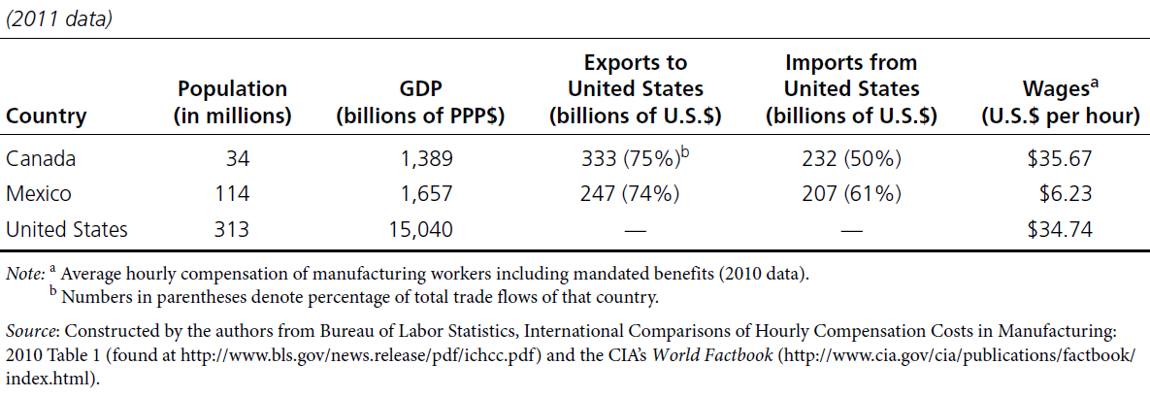
TABLE 9.2 Economic Characteristics of NAFTA Countries

Slide 22
What Accounts for Mexico’s Low Productivity Levels?
Largely untrained Mexican workers
Small scale of manufacturing operations
Poor infrastructure
Shortage of qualified managers
Limited capital goods
Unreliable legal system

Slide 23
Effects of NAFTA on U.S. Economy
After 20 years, very little impact.
U.S. trade with Canada and Mexico has grown, but so has U.S. trade with other countries.
Trade created by NAFTA has been offset by lost tariff revenues and by the diversion of imports from low-cost producers (Romalis, 2007).

Slide 24
Other U.S. Free Trade Agreements
U.S.-Israel FTA (1985)
U.S.-Jordan FTA (2000)
U.S.-Chile FTA (2004)
U.S.-Singapore FTA (2004)
U.S.-Australia FTA (2005)
U.S.-Morocco FTA (2006)
U.S.-Bahrain FTA (2006)
U.S.-Central American-Dominican Republic FTA (2006)

Slide 25
Other U.S. FTAs (cont.)
U.S. FTA with Columbia, Panama, and Korea (2011)
Trans-Pacific Partnership

Slide 26
European Union
EU is world’s largest custom union
27 current member countries with various candidate nations (Turkey, Croatia, Iceland, Macedonia, Montenegro)
EU is the world’s largest preferential trade area
Most of EU trade is member-to-member trade
Ultimate goal: to become “united states of Europe”

Slide 27
In Pursuit of EU’s Ultimate Goal
Single European Act (1986)—act passed by EU to remove various non-tariff trade barriers by the end of 1992.
Economic and Monetary Union (EMU)—adoption in 1999 of a common currency called the euro, used by 17 of the 27 member nations.
Other agreements involve a new social charter, common foreign and defense policies, and worker rights.

Slide 28
The EU Government
Headquarters in Brussels, Belgium
Four institutions:
European Commission
Council of the EU
European Court of Justice
European Parliament

Slide 29
European Commission
One of two executive offices of the EU government
Its primary task is to draft and enforce EU laws
It represents the EU in international trade negotiations
It consists of 27 members, one from each country, and is headed by a president and six vice-presidents

Slide 30
Council of the EU
Second executive office of the EU government
Each EU country has one representative, usually its foreign minister
It has power to decide about European Commission proposals and to issue directives and regulations to member states

Slide 31
European Court of Justice
Chief judiciary body of the EU
Decides on the legality of European Commission or Council of the EU actions with respect to EU treaties

Slide 32
European Parliament
Legislative branch of the EU government
Chief representative of the people in the process of setting EU policies
Consists of 754 members, each elected for 5-year terms
Number of representatives is based on population and size of economy:
Germany (99)
France (74), Italy (73), and UK (72 each)
Spain (54) and Poland (51)

Slide 33
European Parliament (cont.)
Administrative seat is in Luxembourg and in Strasbourg, France
Has limited powers:
Can scrutinize but not initiate legislation
Can make suggestions regarding European Commission proposals
Can amend some EU budget expenditures
Can amend council actions regarding Single European Act
Has veto power over applications of candidate countries

Slide 34
The Single Market Initiative
Single European Act (1986) – the goal was to achieve a single market by 1992 by removing border checkpoints for intra-EU trade, harmonizing technical standards, and deregulating various economic activities.
In 2011, the European commission adopted the Single Market Act for further EU integration.

Slide 35
Regionalism vs. Multilateralism
Regionalism—where countries lower trade barriers only for a small group of partner or neighboring countries and discriminate against the rest of the world (refer to Global Insights 9.2).
Multilateralism—non-discriminatory basis of the World Trade Organization.

Slide 36
Arguments Against Regionalism
Bhagwati views the formation of regional trade arrangements (RTAs) as undermining the WTO
Regionalism is harmful because it encourages trade diversion

Slide 37
Arguments Favoring Regionalism
Krugman argues that trade diversion from FTAs is low because trading blocs are “natural” trading areas
Due to proximity and similarity of cultures and standards of living, regional trade agreements stimulate trade that would have occurred even in the absence of an agreement

