Slide 1
Chapter 15
Exchange Rates in the Long Run

Slide 2
Topics to be Covered
An Introduction to Purchasing Power Parity
Uses of Purchasing Power Parity
Tests of Purchasing Power Parity
The Monetary Approach to Exchange Rates

Slide 3
Purchasing Power Parity
Purchasing Power Parity (PPP)— the relationship between the prices of goods and services and exchange rates; the PPP provides a theory of the long-run equilibrium value of the exchange rate.

Slide 4
Short-run vs. Long-run Behavior
Short-run movements in a variable (e.g., the exchange rate) refer to monthly or quarterly changes in the variable.
Long-run refer to trend changes over several decades.
See Figure 15.1 for plot of a trend line.

Slide 5
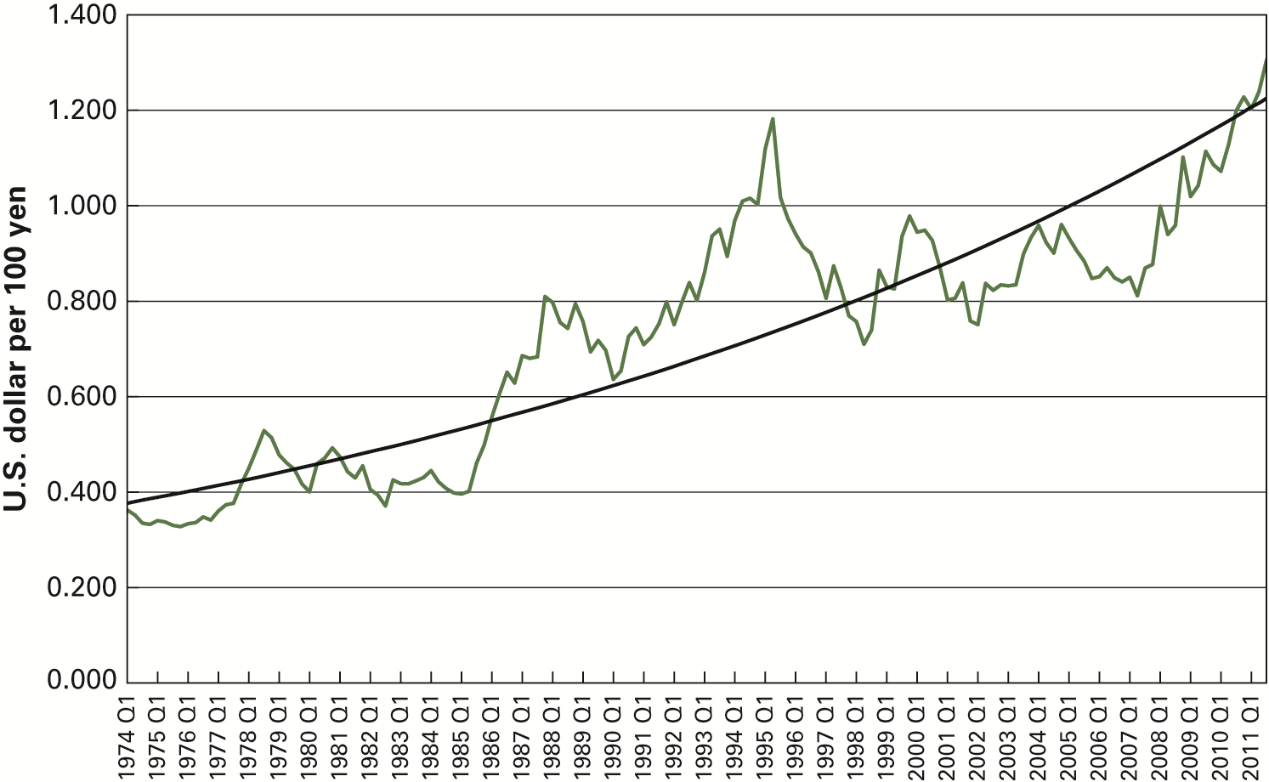
FIGURE 15.1 Japanese Exchange Rate

Slide 6
Purchasing Power Parity (PPP)
The idea of PPP began with early work by Swedish economist, Gustav Cassel.
PPP refers to the concept that the same basket of goods should cost the same when prices are measured in the same currency regardless of where it is located.

Slide 7
PPP Exchange Rate
Suppose that P is the price of a bundle of goods in the U.S., and P^{F} is the price of an identical bundle of goods in a foreign country. If the two bundles are to have the same price, then the following must hold:
(insert Equation 15.1 here)
E_{PPP} is the PPP exchange rate which equalizes the prices of bundles of domestic and foreign goods.

Slide 8
The Theory of PPP
The PPP theory states that the actual exchange rate should converge toward the PPP exchange rate.
In other words, E_{PPP} is the long-run equilibrium value for the exchange rate E.

Slide 9
Absolute PPP
If PPP holds, then the Absolute Purchasing Power Parity relation is:
(insert Equation 15.2 here)
where P is the domestic price index, P^{F} the foreign price index, and E is the actual spot exchange rate (domestic currency units per unit of the foreign currency).

Slide 10
Absolute PPP (cont.)
Absolute PPP indicates that the exchange rate between two currencies is equal to the ratio of the two countries’ price levels.
The problems in testing absolute PPP is that price levels are not observable and the bundles of goods are not identical.
National price indexes such as Consumer Price Index are reported but these may not be comparable in terms of product coverage and base year used.

Slide 11
Law of One Price
States that the same good sells for the same price in foreign and domestic markets.

Slide 12
Problems with Law of One Price
The more homogeneous goods are, the more the law of one price is expected to hold.
There are obstacles to equalization of product prices across countries, including differentiated products and costly information.

Slide 13
Relative Purchasing Power Parity
Relative PPP is said to hold if:
(insert Equation 15.3 here)
where a caret (^) over a variable indicates percentage change. Relative PPP states that the percentage change in the exchange rate is equal to the percentage change in the domestic price level minus the percentage change in the foreign price level.

Slide 14
Relative PPP (cont.)
Relative PPP states that there will be a long-run tendency for the local currency to fall in value (i.e., E rises) if inflation is higher in the home country than in the foreign country.

Slide 15
Evidence of Relative PPP
Refer to Figure 15.2
The exchange rate is more volatile than the inflation differential.
PPP is a weak predictor of exchange rate movements.

Slide 16
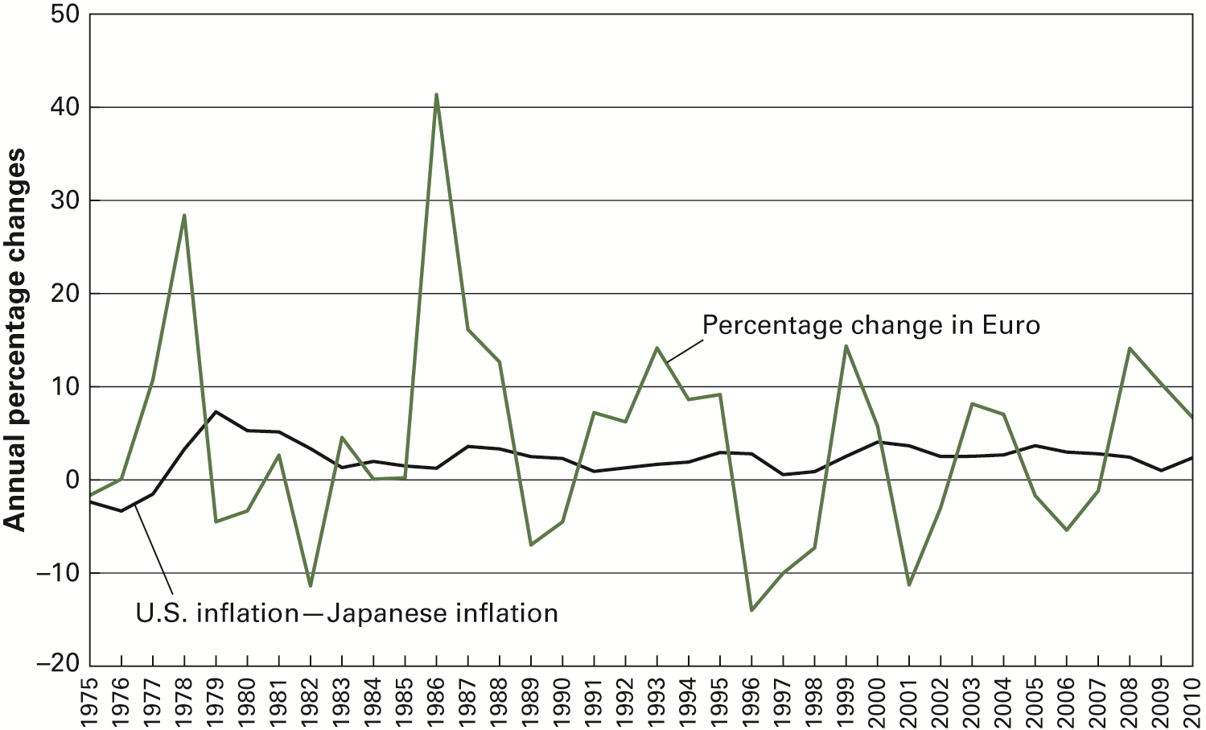
FIGURE 15.2 U.S.-Japan Purchasing Power Parity

Slide 17
Uses of PPP
PPP served as a guide for the resetting of fixed exchange rates at the end of World War I.
PPP helps compare economic performance data across countries.
PPP serves as a measure of the “disequilibrium” of a given exchange rate.

Slide 18
Undervalued vs. Overvalued Currency
Given: 1 = E_{PPP}/E but only if PPP holds
If 1 > E_{PPP}/E, then the foreign currency is overvalued and the domestic currency is undervalued.
If 1 < E_{PPP}/E, then the foreign currency is undervalued and domestic currency is overvalued.
See Global Insights 15.1

Slide 19
Tests of PPP
Evidence from studies is mixed.
Studies using data covering more than a century provide strongest support for PPP.
Ways of testing PPP examine:
- consumer price indexes
- real exchange rate behavior

Slide 20
Using Price Indexes to Test PPP
A country’s consumer price index (CPI) is calculated by:
(insert Equation 15.4 here)
or
(insert Equation 15.5 here)
where P_{t} is price level at time t and P₀ is the
price level in the base year. Similarly, the
foreign CPI is given by:
(insert Equation 15.6 here)

Slide 21
Using CPI to Test PPP (cont.)
Dividing the domestic CPI by the foreign CPI yields:
(insert Equation 15.7 here)
Cross-multiplying terms in Eq. (15.7) gives an empirical measure of the PPP exchange rate:
(insert Equation 15.8 here)
To test PPP, one looks at the correlation between movements in actual exchange rate, E, and E_{PPP}.
Studies show that PPP holds better for open economies.

Slide 22
Real Exchange Rate
Real Exchange Rate – the nominal exchange rate adjusted by the ratio of the foreign price level to the domestic price level.

Slide 23
Using Real Exchange Rate to Test PPP
The real exchange rate is measured as:
(insert Equation 15.9 here)
Converting to percentage changes:
(insert Equation 15.10 here)
If PPP holds for a country, then its real exchange rate should not change.

Slide 24
Summary of PPP Findings
The theory of PPP rarely holds.
PPP is less likely to hold for the exchange rate between any two developed countries.
PPP holds when one of the two countries is experiencing high inflation rates.
PPP holds better the less volatile the country’s nominal exchange rate.
PPP holds well in the long run.

Slide 25
Monetary Approach to Exchange Rates (MAER)
The MAER is a theory of long-run exchange rate behavior developed by University of Chicago economists in the 1970s.
Main assumptions:
PPP holds.
Economic agents have stable demands for money.
Price level in each country adjusts to clear the money market.

Slide 26
MAER (cont.)
The basic assumptions are represented as:
(insert Equation 15.2)
(insert Equation 15.11)
(insert Equation 15.12)
where M and M^{F} are the money supplies and L and L^{F} are the demands for real money balances in the two countries.

Slide 27
MAER (cont.)
Rewriting Equations 15.11 and 15.12 to solve for the domestic and foreign price levels:
(insert Equation 15.13 here)
(insert Equation 15.14)
Combining Equations 15.2, 15.13, and 15.14 yields:
(insert Equation 15.15)
Converting Equation 15.15 to percentage rates of change yields:
(insert Equation 15.16)

Slide 28
MAER (cont.)
Demand for real money balances in the two countries directly depends on real income:
(insert Equation 15.17)
(insert Equation 15.18)
where Y (Y^{F}) is home (foreign) income and
k is a constant indicating how much money
demand changes with a change in income.

Slide 29
MAER Equation
Substituting Equations 15.17 and 15.18 into Equation 15.16 gives the fundamental equation of the MAER:
(insert Equation 15.19 here)

Slide 30
Predictions of the MAER
A rise in the growth rate of domestic money creation will cause the exchange rate to rise.
A rise in the growth rate of foreign money creation will cause the exchange rate to fall.
A rise in domestic output will cause a decrease in the exchange rate.
A rise in foreign output will cause an increase in the exchange rate.

Slide 31
Studies of the MAER
The findings from studies are mixed.
Early empirical studies found support.
Meese and Rogoff found that the MAER does not work well in forecasting future values of the exchange rate.
There is consensus that the MAER is useful in analyzing long-run behavior of exchange rates.

