Slide 1
Chapter 16
Theories of the Current Account

Slide 2
Topics to be Covered
The Elasticities Approach to the Current Account
Elasticities and J Curves
The Evidence from Devaluations
The Absorption Approach
The Intertemporal Model

Slide 3
Balance of Payments (BOP) Table
Consider the BOP transactions:
Goods trade
Services trade
Income flows
Unilateral transfers
Capital account
Financial account
International reserves
Above the line shows transactions for calculating the Current Account Balance (CAB)
Below the line shows how the CAB is financed.

Slide 4
Theories of Current Account Balance
Elasticities Approach and Absorption Approach
Monetary Approach to the Balance of Payments

Slide 5
Elasticities Approach
Model of current account determination that focuses on the role of the exchange rate in affecting trade flows.

Slide 6
Absorption Approach
Model of current account determination that points out situations where exchange rate adjustment may not be sufficient to correct an imbalance.

Slide 7
Intertemporal Model
Model of current account determination that focuses on international flows of financial assets and liabilities.

Slide 8
The Elasticities Approach to the Current Account
Basic question:
If a country has a current account deficit, under what conditions would a devaluation of the local currency lead to a rise in the current account balance?

Slide 9
Elasticities Approach (cont.)
Beginning assumptions of the model:
No international flows of income and transfers.
Demand and supply of imports and exports depend only on their prices.

Slide 10
The Elasticities Approach (cont.)
The elasticities approach examines how changing relative prices of domestic goods and foreign goods resulting from a change in the exchange rate will affect the balance of trade of a country.
For example, a rise in the value of the Japanese yen (or $ depreciation) should cause the U.S. demand for imports of Japanese-made goods to fall.
How much quantity demanded changes in response to the relative price change is determined by the elasticity of demand for imports.

Slide 11
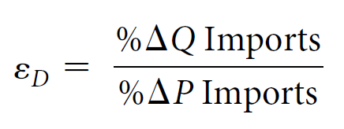
Price Elasticity of Demand for Imports
The price elasticity of demand for imports measures the responsiveness of quantity demanded of imports to a change in the price of these goods.
The coefficient of elasticity of demand is equal to the percentage change in quantity demanded divided by the percentage change in price, that is:

Slide 12
Elasticity of Demand (cont.)
If the % change in quantity demanded exceeds (is less than) the % change in price, then demand is said to be elastic (inelastic).
With an elastic (inelastic) demand, total revenue (or price times quantity) will move in the opposite (same) direction as the price change.
If U.S. $ depreciates relative to yen, the $ price of Japanese import will rise. With an elastic U.S. demand for imports, the quantity changes by a greater percentage amount than the price, so that U.S. spending on Japanese imports will fall.

Slide 13
Marshall-Lerner Condition
This states that a sufficient condition for a country’s current account to improve following a depreciation of its currency is that the sum of the domestic and foreign elasticities of demand for imports be greater than one.

Slide 14
Factors Which Affect the Size of the Import Elasticity of Demand
The more substitutes available for the imported goods, the larger the elasticity value.
If imported good is a necessity, the elasticity will be smaller.
Over the long run (given more time for adjustment), the elasticity will be larger.

Slide 15
The J Curve Effect
The J curve refers to the time pattern of the current account balance following currency devaluation. The pattern traces out a path similar to the letter J, that is, after the devaluation, the current account balance deteriorates for a while (due to inelastic import demands) before improving.
Refer to Figure 16.1

Slide 16
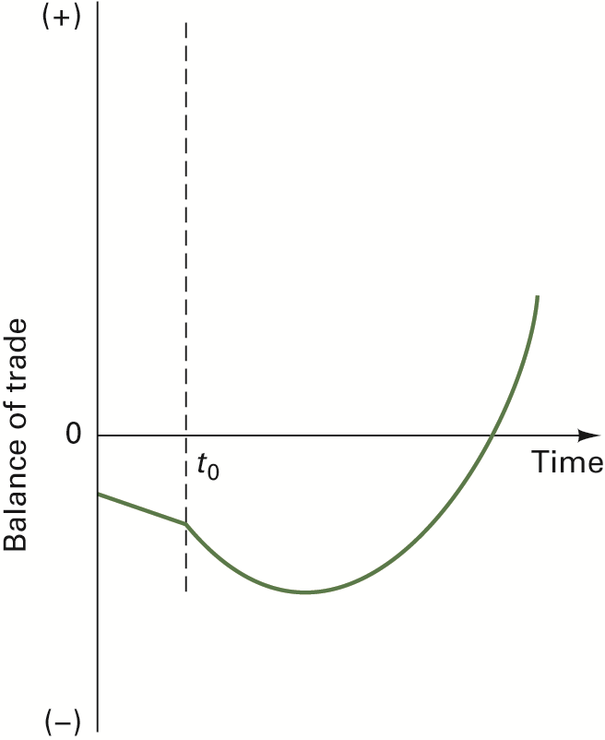
Figure 16.1 The J Curve

Slide 17
Causes of the J Curve Effect
The Currency Contract Period
The Pass-Through Effect

Slide 18
Currency Contract Period
Currency Contract Period—refers to the time period immediately following a devaluation when contracts signed prior to the devaluation are settled.
See Figure 16.2

Slide 19
Figure 16.2 The Currency-Contract Period

Slide 20
Currency Contract Period and Trade Balance Effects
The effects of fixed contracts on the balance of trade depend on the currency in which the contract is denominated.
Refer to Table 16.1 for possible cases
Based on Table 16.1, foreign currency-denominated imports is a necessary condition for the U.S. trade balance to exhibit the J curve effect.

Slide 21
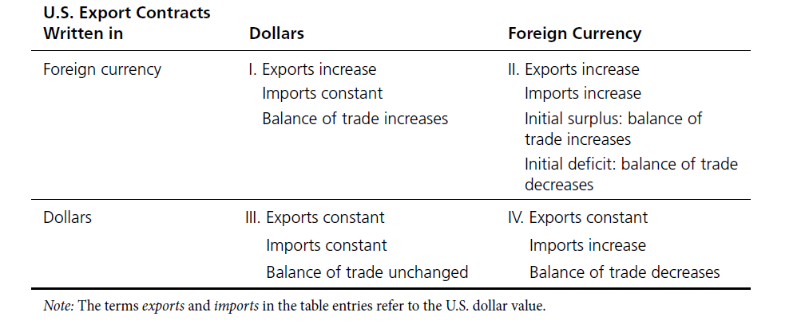
TABLE 16.1 U.S. Trade Balance Effects During the Currency-Contract Period Following a Devaluation of the Dollar

Slide 22
Pass-through Analysis
Pass-through analysis—examines the ability of goods prices to adjust in the short run. After devaluation, it is expected that import prices rise in the devaluing country and that prices of its exports fall.
Studies show that exchange rate pass-through is often incomplete, i.e., prices of traded goods do not change by the amount of change in the exchange rate.

Slide 23
Evidence from Devaluations
Effects of devaluation differ across countries and time.
One reason is that producers in different countries (e.g., Japan and Germany) adjust their profit margins on exports to offset the effect of exchange rate changes. This behavior is called pricing to market (see Global Insights 16.1).

Slide 24
Evidence (cont.)
Studies show that in countries where the capital-labor ratio is low, devaluations tend to result in export expansion and economic growth.
Evidence from studies also indicate that the adjustment of goods prices to changes in exchange rates takes a long time (as much as three years).

Slide 25
Reasons for Declining Pass-through Effect in Developed Countries
The share of imports accounted for by products with prices sensitive to exchange rate changes has been falling.
Foreign exporters have been practicing “pricing-to-market” behavior.
Although China’s market share has increased, the limited flexibility of China’s exchange rate relative to the dollar has reduced pass-through.

Slide 26
The Absorption Approach
The absorption approach extends the elasticities model by examining how domestic spending must change relative to domestic output in order for devaluation to be successful in improving the current account balance.

Slide 27
Absorption Approach (cont.)
Given the national output (Y) identity,
where C is consumption, I investment, G government spending, EX exports, and IM imports, define absorption A as:
A = C + I + G

Slide 28
Absorption Approach (cont.)
Thus,
If total output exceeds absorption, then the country will export its surplus and the current account will be in surplus.

Slide 29
Absorption Approach (cont.)
Suppose the country devalues its currency, then there are two possibilities:
With unemployed resources, devaluation will increase the current account and output without inflation.
With full employment, devaluation will raise the current account and lead to inflation as domestic prices are bid up.

Slide 30
The Intertemporal Model
This model focuses on international flows of assets needed to finance imbalances between national saving and investment.
It is intertemporal because saving and investment decisions involve the passage of time.

Slide 31
Intertemporal Model (cont.)
National Saving (NS) – amount that a country saves out of current income,
NS = Y – C - G
NS consists of private household saving and government saving,
NS_{priv} = Y – TX – C and NS_{govt} = TX - G
Given the GNP identity,
NS = Y – C – G = I + CAB

Slide 32
Intertemporal Model (cont.)
In each time period, individuals make plans regarding consumption (C^{d}) and investment (I^{d}).
Product market equilibrium is achieved when planned spending equals production:
Y = C^{d} + I^{d} + G + CAB
or CAB = NS^{d} – I^{d}
If desired national saving exceeds planned investment, then there will be a current account balance surplus.

Slide 33
Small Open Economy
An economy so small that it has effect on the world real interest rate.

Slide 34
Real Interest Rate
The nominal interest rate minus the expected rate of inflation.

Slide 35
Predictions of the Intertemporal Model
If the world interest rate is higher than the rate which would equalize national saving and investment, then the small country will have a current account surplus. See Figure 16.3.
If the world interest rate is lower, then the country will have a current account deficit. See Figure 16.4.

Slide 36
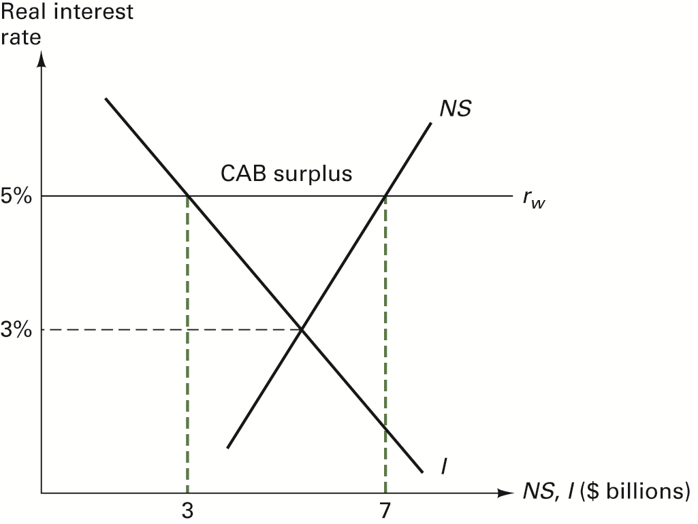
Figure 16.3 Determination of a Current Account Surplus

Slide 37
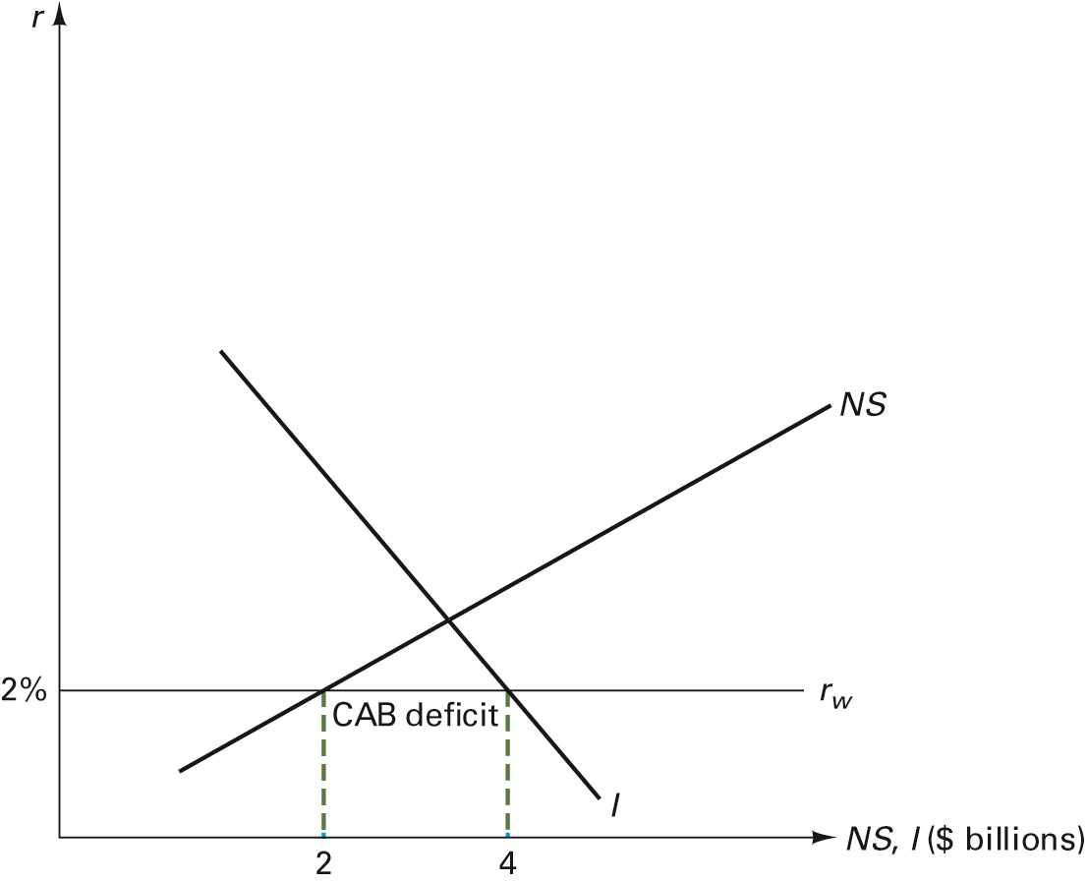
Figure 16.4 Determination of a Current Account Deficit

Slide 38
Large Open Economy Case
A large open economy is big enough that changes in assets it wants to borrow or lend can affect the world real interest rate.
Given two large open economies, there will be only one interest rate so that the amount of assets one country wants to borrow equals the amount the other country is willing to lend. See Figure 16.5.

Slide 39
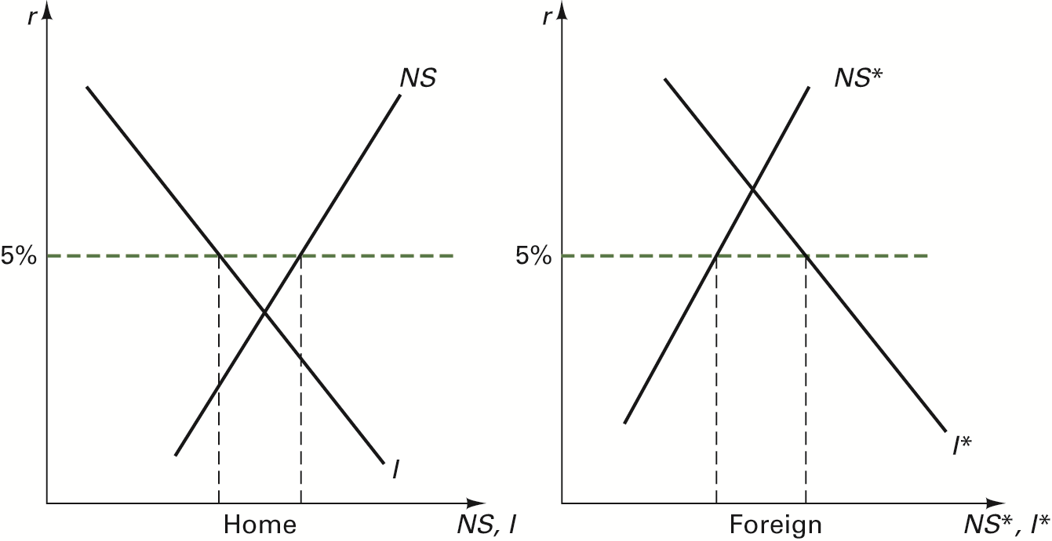
Figure 16.5 U.S. Saving and Investment Patterns

Slide 40
A Look at U.S. Data
Refer to Figure 16.6.
Since U.S. investment has been larger than U.S. saving over the period, the U.S. current account balance has been in deficit.
CAB deficit has been partly due to declines in national saving caused by a fall in asset prices (ex., housing).

Slide 41
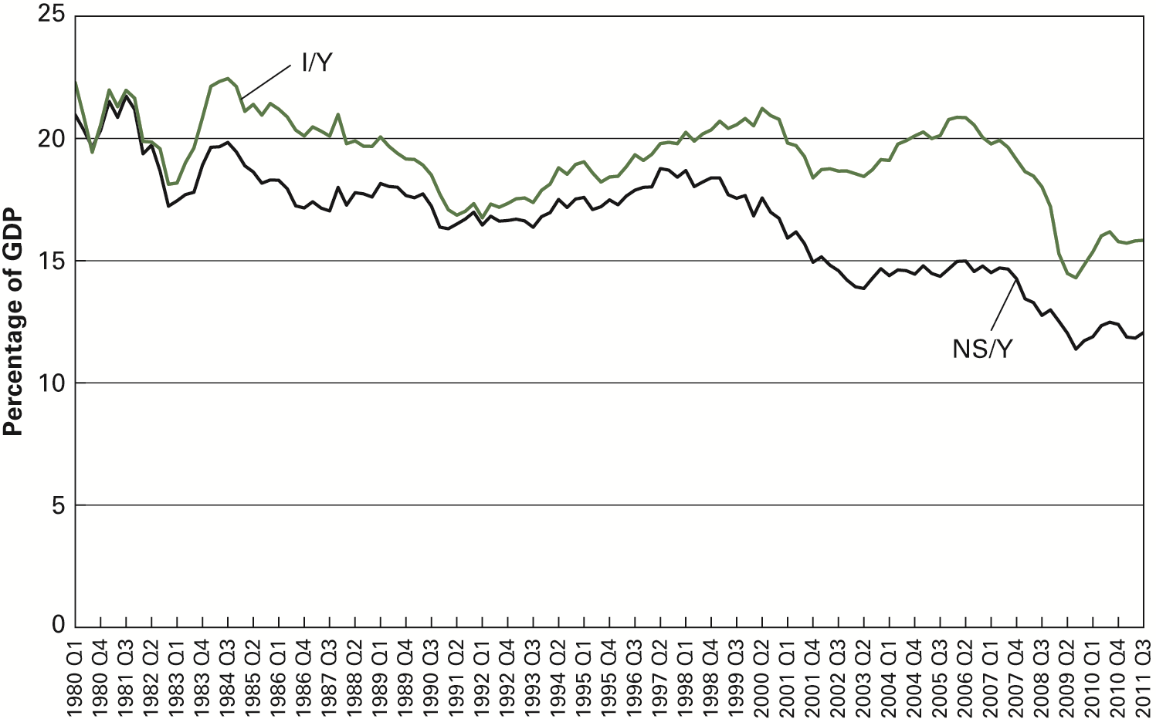
Figure 16.6 U.S. Saving and Investment Patterns

